Slide 1




Refining NO_{x} Emissions using Satellite Observations
Inverse Modeling through DART–CHIMERE Data Assimilation of S5P/TROPOMI NO₂ Retrievals
25.06.2026 | CHIMERE Workshop
Giorgia De Moliner, Gaëlle Dufour, Gaël Descombes, Alessandro D'Ausilio, Adriana Coman, Guillaume Siour, Arineh Cholakian, Giovanni Lonati

Slide 2
Motivations & context
01

Slide 3
Why is refining emission fluxes needed?
Bottom-Up Inventories
Top-Down Advantage
Ensemble-Based Inverse Modeling
Mapping of Sources
Activity Data
Emission Factors
Significant inter-product variability
Emission inventory uncertainties propagate into air quality simulations, degrading their skills
Since the availability of satellites measuring NO₂ in the atmosphere, methods aligning a-priori inventories with observations have been developed (Streets et al., 2013)
Satellite-based top-down emissions provide a NRT constraint to detect unreported sources, capture rapid activity shifts, and address systematic biases in a-priori inventories
We tested the skill of the Ensemble Adjustment Kalman Filter (EAKF) CHIMERE-DART to perform Inverse Modeling for NOx, following Hsu et al. (2024), Savas et al. (2023) and Miyazaki et al. (2017)
CHIMERE-DART was developed within the EU’s project CAMEO (Descombes et al. (2026))
Annual Emissions Fluxes (CAMS-REG-ANT v6.1)
Land Use Map
Spatial Proxies
Vertical Distributions
Temporal Allocation
Chemical Speciation
emiSURF v2023
Hourly Emissions Fluxes
Notes:
Flux-Divergence
Plume Fitting
Mass Balance

Slide 4
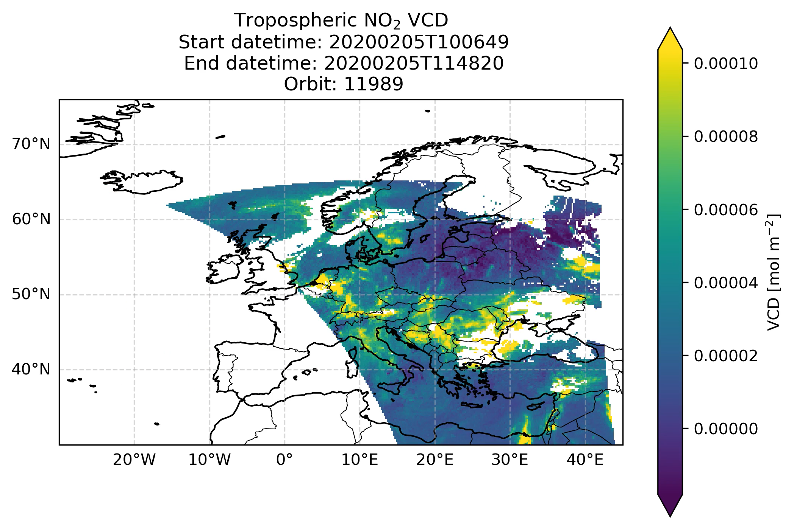

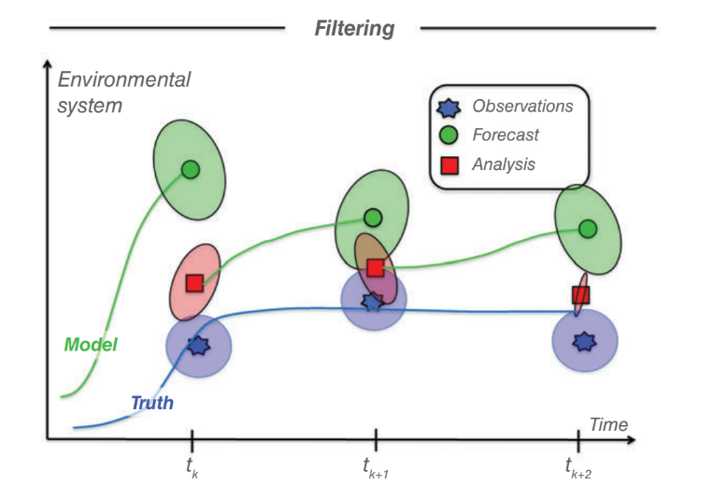
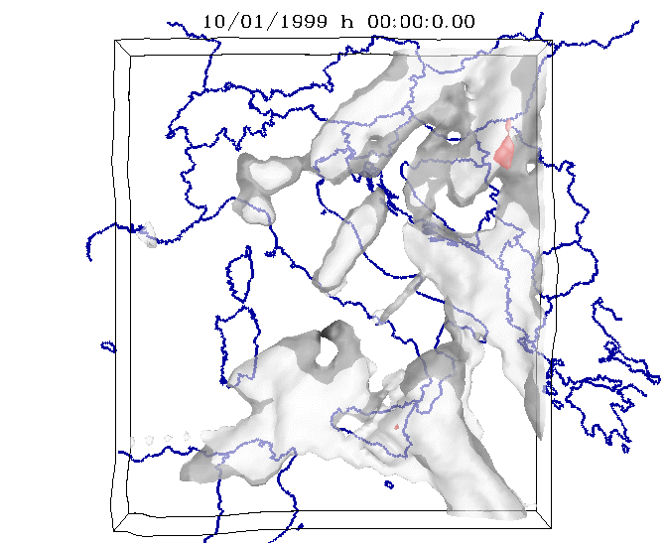
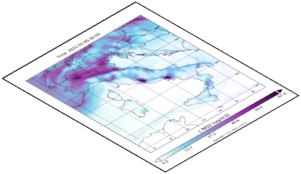
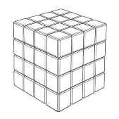

Data Assimilation
produce chemically/dynamically consistent integrated dataset
Knowledge of uncertenties
Mismatches between modelled and observed variables
Fast reactions and short lifetime of some species
The advantage of Ensemble Kalman filter (EnKF) is its easy implementa on for complicated systems; i.e., without development of adjoint code for CTMs.
Ensemble Adjustment Kalman filter (EAKF)
It is the process of optimally estimating the state of a dynamical system by combing observational data with an a priori estimate of the state
Key goal: constraining simulations with real-world observations
(J. L. Anderson, 2001, 2009)
Observations
Z
2
1
0
N
Y
X
(Figure: A. Carrassi et al., 2018)
$$\left\{0,…,N\right\}$$
Chemical Transport Model
(CTM)
Notes:
The advantage of Ensemble Kalman filter (EnKF) is its easy implementation for complicated systems; i.e., without development of adjoint code for CTMs.
At its core, DA relies on the Bayes’ theorem, which provides the principle for updating the prior distribution. A practical way to solve the Bayesian estimation problem is given by the Kalman filter (KF). In this approach, the model is integrated forward in time and, whenever observations become available, they are used to update the prior before the integration continues. This sequential filtering process ensures that observations and model simulations are consistently combined to produce the best possible estimate of the true state of the atmosphere.
The following is a general description of the Kalman filter, as in Houtekamer and Mitchell, 2005 []. A prior estimate of the variable state xf(t), also called the background, valid at time t is updated with the information of the new observations yo to get a new estimate of the variable state xa(t), the analysis, as in Eq. (1). To this end, a Kalman gain matrix K is used to weight the observations and the background, according to their associated errors, represented by the observation error covariance matrix R and the background error covariance matrix Pf, respectively. The formulation of the Kalman gain is given in Eq. (2). In KFs, the background errors covariances are dynamically updated at each cycle, accounting for flow-dependency. The forward operator H performs the mapping of the estimates from the model space to the observation space, through a spatio-temporal interpolation and the use of averaging kernels. It computes model estimates as they would have been seen by the satellite, enabling a comparison between the model and the observations. Lastly, a forecast model M integrates the analysis xa(t) to the next variable state prior estimate xf(t+1) as in Eq. (3).
The KF analysis xa t is the best (minimum error variance) linear unbiased estimate of the state at time t, given xb t and all observations up to time t (y0,y1,…,yt).
In large systems, computing and storing the background errors covariances is impractical due to memory and computational constraints, as it would require running the model as many times as the dimension of state space. To overcome this, the ensemble Kalman filter (EnKF) [] and other ensemble-based methods were proposed. They all use Monte Carlo methods to reduce the problem dimension and to estimate the error covariances of the background error. In particular, EnKFs approximate Pf from an ensemble of model realizations, each having differently perturbated inputs.
Unlike variational approaches (3D-VAR (Kalnay, 2002), 4D-VAR (Courtier et al., 1994)), the EnKF method avoids the need for adjoint models and instead represents forecast uncertainty through an ensemble of simulations (Houtekamer & Zhang, 2016). Each member of the ensemble evolves independently under model dynamics with stochastic perturbations that represent model errors. The ensemble statistics provide a flow-dependent approximation of the forecast error covariance, allowing the analysis to converge toward the optimal Kalman solution as the ensemble size increases (Mitchell et al., 2002).

Slide 5
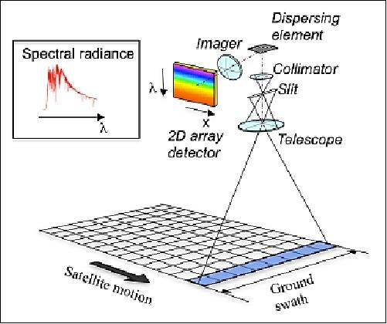
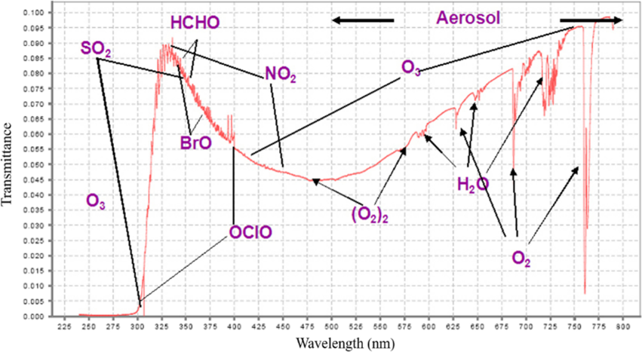
EU’s space missions targeting atmospheric composition
Satellite | Instrument | Mission objectives | Spatial Resolution | Launch (operational) / EOL | Orbit | Provider | Reference
Sentinel-5P | TROPOMI (UV-VIS-NIR-SWIR) | O3, CO, HCHO, NO2, SO2, CH4, tot Aerosols and Clouds | 3.5 x 5 km | 2017 (2018) / ≥ 2027 | LEO, sun-synchronous, 1 day revisit time | ESA | https://space.oscar.wmo.int/instruments/view/tropomi https://sentiwiki.copernicus.eu/web/s5p-mission https://stcorp.github.io/harp/doc/html/ingestions/index.html#sentinel-5p-products
Metop-SG-A1 | Sentinel-5(A) (UV-VIS-NIR-SWIR) | O3, CO, CO2, H2O, HCHO, NO2, SO2, CH4, OCHCHO, BrO | 7 km | 2025 (2026) / 2034 | LEO, sun-synchronous, 1 day revisit time | EUMETSAT, ESA | https://user.eumetsat.int/resources/user-guides/metop-sg-sentinel-5-uvns-l1b-data-guide https://www.esa.int/Applications/Observing_the_Earth/Copernicus/Sentinel-5/Sentinel-5_debuts_images_of_atmospheric_gases
Meteosat-TG-S1 | Sentinel-4 (UV-VIS-NIR) | BrO, HCHO, NO2, O3, SO2, Aerosols and Clouds | 8 km | 2025 (2026) / 2036 | GEO, Europe, 1 hour revisit time | ESA, EUMETSAT | https://space.oscar.wmo.int/instruments/view/sentinel_4 https://www.eumetsat.int/first-copernicus-sentinel-4-images-showcase-europes-hourly-air-pollution-watch
Metop-(A)/B/C | GOME-2 (UV-VIS-NIR) | BrO, CHOCHO, H2O, HCHO, NO2, O2, O3, O4, OClO, SO2 and aerosol | 80 x 40 km | 2007 / 2033 | LEO, sun-synchronous, 1.5/3 days revisit time | ESA, EUMETSAT | https://space.oscar.wmo.int/instruments/view/gome_2 https://doi.org/10.5194/essd-15-1831-2023
WMO OSCAR tool
https://space.oscar.wmo.int/gapanalyses?variable=105
Others: CO2M (0.8 km); TANGO (0.3/0.2 km)
Notes:
TEMPO, GEMS, OMI (nasa), Satellite NOAA-2, ISS-SAGE, OMS on Feng-Yun satellites
(more on GHGs: EMI and AIUS on GaoFen, TANSAT-2)
MetopSG-A1: has also IASI-NG and 3MI

Slide 6
Methodology
02

Slide 7
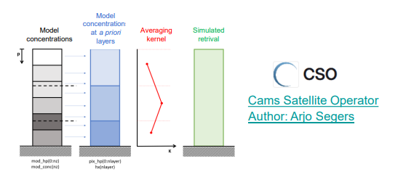
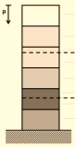
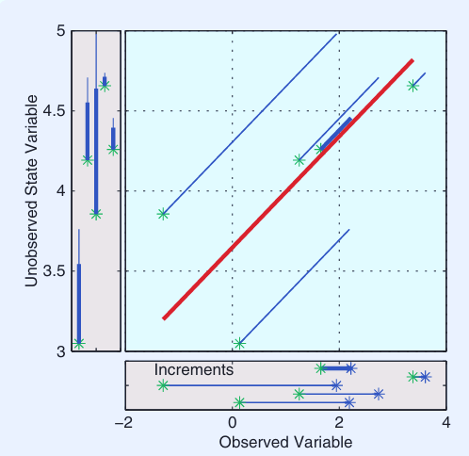





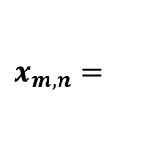


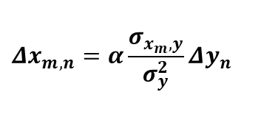

Workflow CHIMERE-DART
Fed through the ratio: $E_{analysis}^{t+1}=\frac{E_{analysis}^{t}}{E_{prior}^{t}}∙E_{prior}^{t+1}$
Model space
DART
Observation
$$x_{prior,n}$$
NO₂ Conc
$$y_{prior,n}$$
NO₂ VCD
$$x_{analysis,n}$$
Updated NO₂ Conc
Annual Emissions Fluxes (CAMS-REG-ANT v6.1)
Hourly Emissions Fluxes
Ensemble CHIMERE runs
CTM-simulated observation
Refined
Hourly Emissions Fluxes
emiSURF v2023
METEO (ECMWF)
BCs (CAMS)
Analysis
Refined NO₂ ICs
Forward Operator
EAKF
Observation space
Perturbations
$$x_{prior,n}$$
NO₂ & NO Emi Fluxes
$$x_{analysis,n}$$
Updated NO₂ & NO Emi Fluxes
$$Δx$$
Forward Operator H
$${Δx}_{m,n}=α\frac{σ_{x_{m},y}}{σ_{y}^{2}}Δy_{n}$$
$$x_{m,n}=$$
NO₂ Conc
NO₂ & NO Emi Fluxes
State vector augmentation
$$Δy$$
(Anderson, J. 2009)
Notes:
observation operator that maps from the model state vector to the expected value of observations.
In (25), Dxm, n is the increment for ensemble member n of state vector component m, while sxm, y is the prior sample covariance of state vector component m and y. The term sxm, y/sp 2 in (25) is the form that the Kalman gain takes in the sequential EAKF. Figure 2 illustrates this part of the sequential EAKF algorithm.
The sample variance sp 2 of the prior estimate of the expected ‘observed’ model variables (observation) are computed

Slide 8

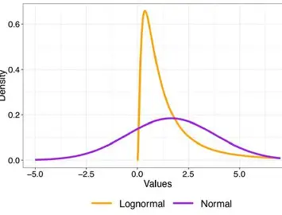
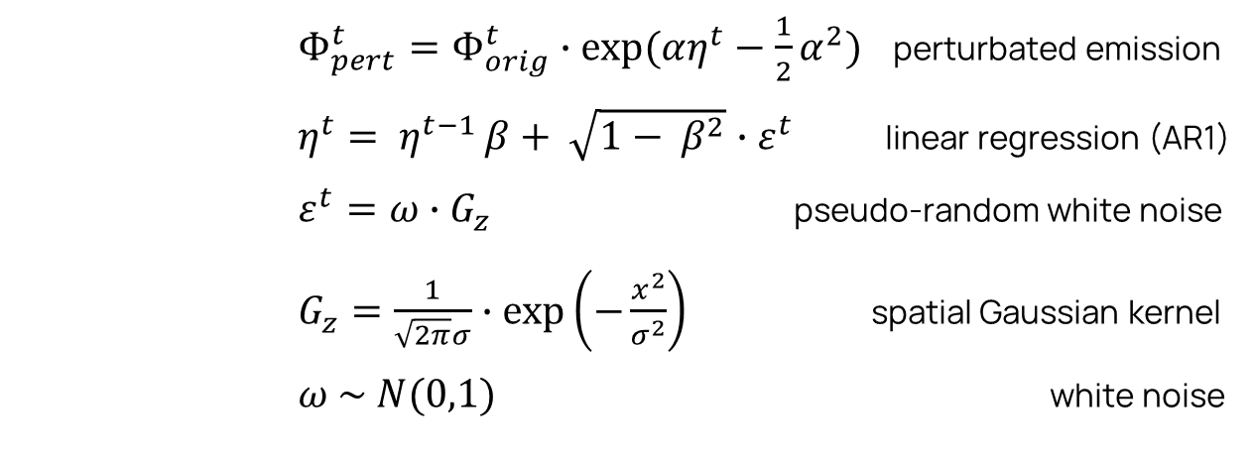
LogNormal perturbations
The ensemble of prior emissions is generated by applying a spatially and temporally correlated noise to the given prior emission field, following previous studies as Coman et al. (2012), Barre et al.(2015), Gaubert et al. (2020), Deng et al. (2022).
α = magnitute of lognormal perturbations
β = index of temporal persistence
σ =spatial smoothing (as grid points)
= original emission flux
x = distance from center grid
→ Perturbations drive model error estimation
        $Φ_{pert}^{t}=Φ_{orig}^{t}∙exp⁡(αη^{t}−\frac{1}{2}α^{2})$ perturbated emission
        $η^{t}= η^{t−1 }β+ \sqrt{1− β^{2}}∙ε^{t}$ linear regression (AR1)
        $ε^{t}=ω{∙G}_{z}$ pseudo-random white noise
        $G_{z}=\frac{1}{\sqrt{2π}σ}∙\exp\left(−\frac{x^{2}}{σ^{2}}\right)$ spatial Gaussian kernel
        $ω \sim N(0,1)$ white noise

Slide 9
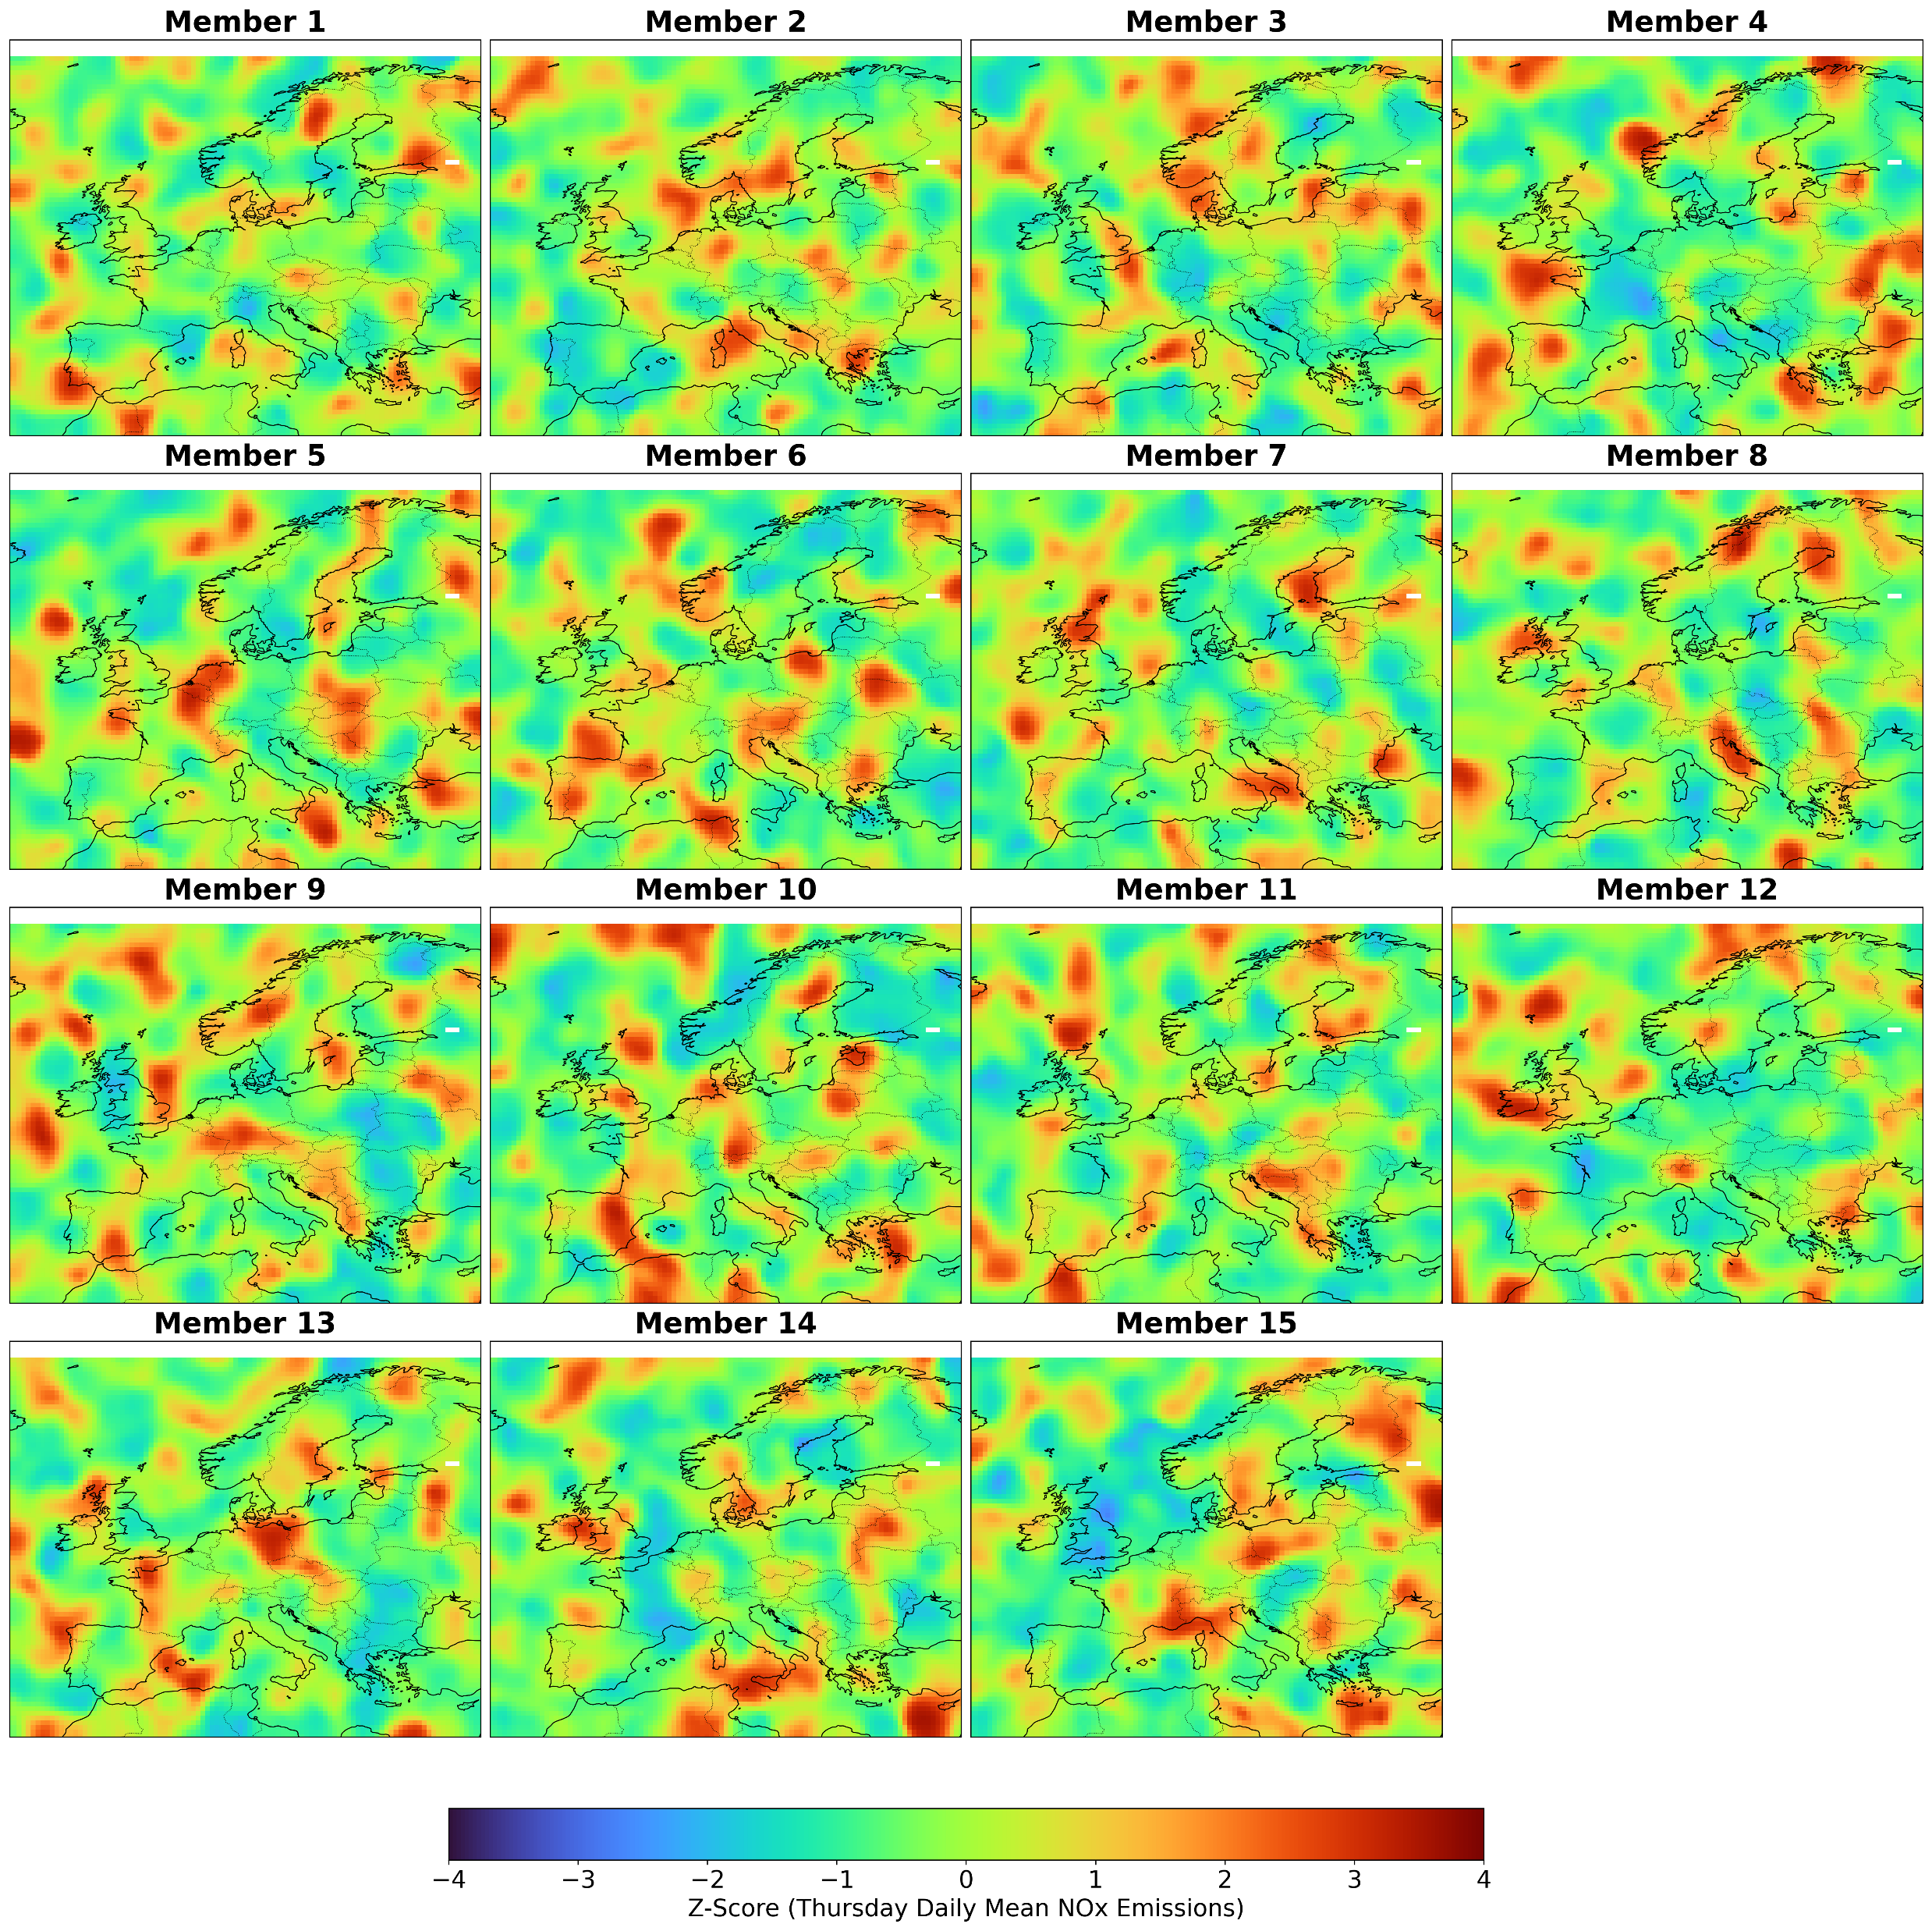
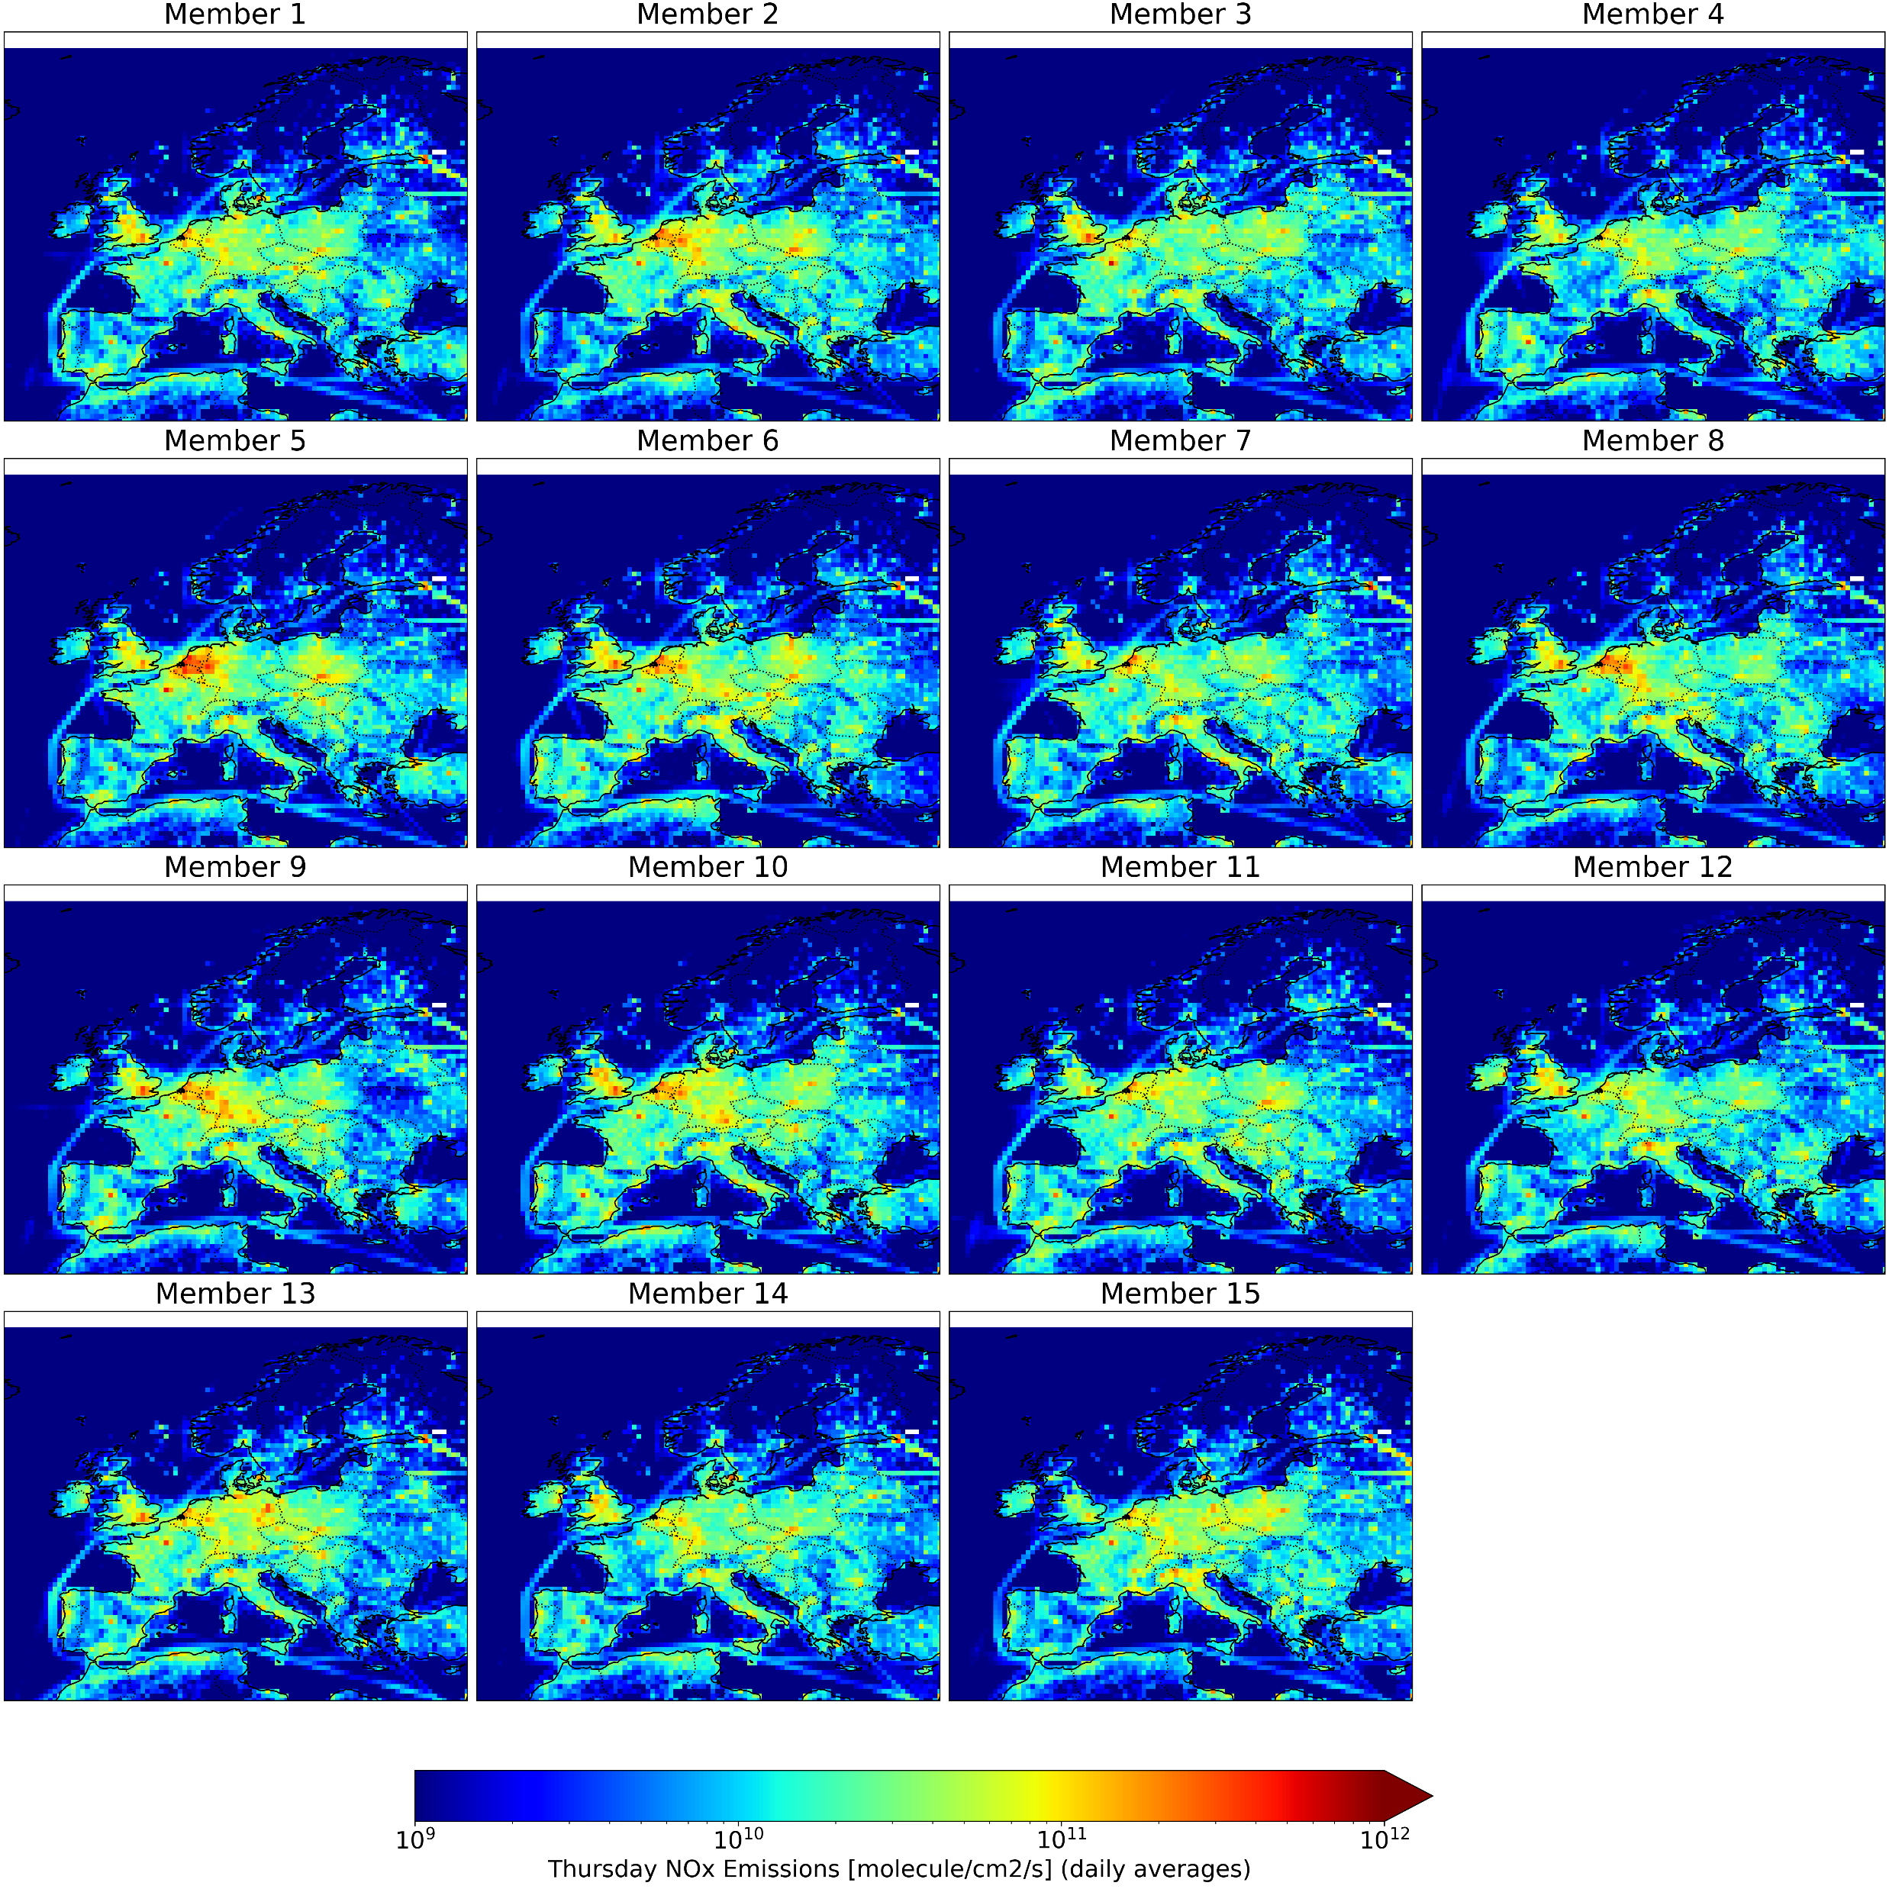
Prior emission ensemble

Slide 10
Case study characteristics
CHIMERE-DART
Model | Chimere v2023 CTM (Menut. et al., 2024)
Domain & Resolutions | Continental Europe; 0.5°x0.5°; 20 levels
A Priori Emissions Dataset | CAMS-REG-ANT v6.1 (released: 2023) + emiSURF v2023r1 (Temporal profiles: Menut et al. 2012)
Meteo & Chemical BCs | ECMWF global reanalysis; CAMS regional reanalysis
Ensemble Size | 15 members
Perturbation Technique | Spatio-temporally correlated lognormal perturbation with zero mean
Assimilation Scheme & Tool | Ensemble Adjustment Kalman Filter (EAKF, J. Anderson et al., 2009); DART (Gharamti et al., 2025)
State Vector | NO₂ concentration, NO₂ & NO emissions
Observations | Superobbed-to-model-grid TROPOMI/S5P tropospheric vertical column of NO₂ (QA>0.5)
Case test period | February 2020
Assimilation Techniques | Horizontal Localization (Gaspari-Cohn, half-width=120 km)
Assimilation Window | 1 hour (centered at the end of the CTM simulation)
Execution time
~1 h per simulated day on IRENE’s 22 CPU

Slide 11
Results
03
Notes:
Add take home messages

Slide 12
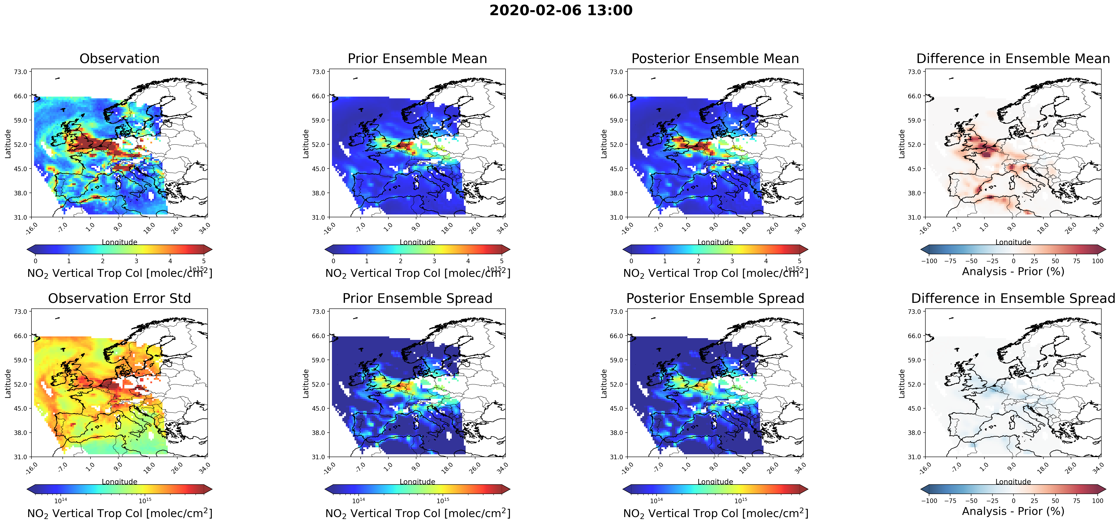
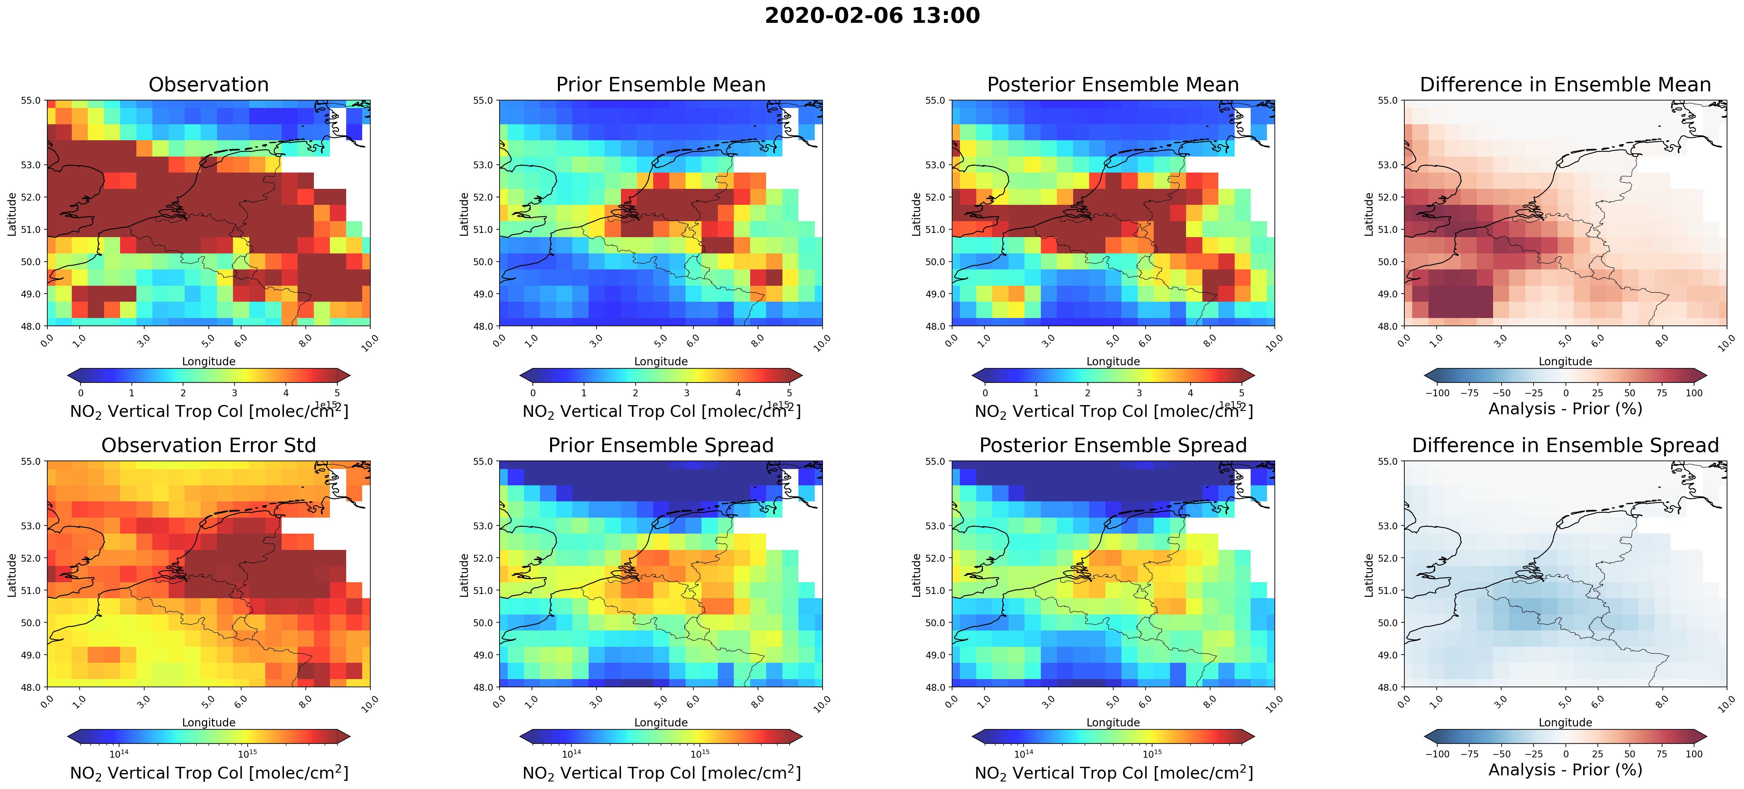
Observation space
Single overpass
The analysis moves towards the observations and the spread is reduced
2020-02-06 13:00 UTC

Slide 13
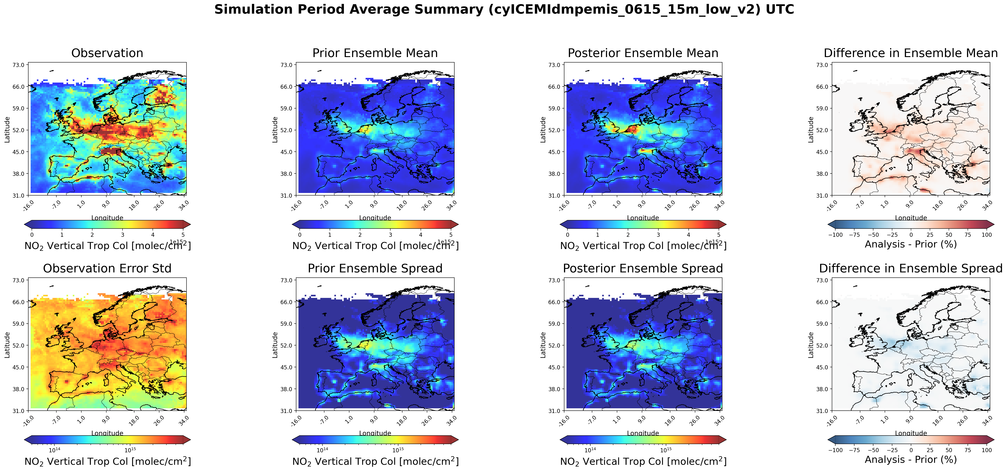
Observation space
10-day average
The analysis moves towards the observations and the spread is reduced
2020-02-06 / 15

Slide 14
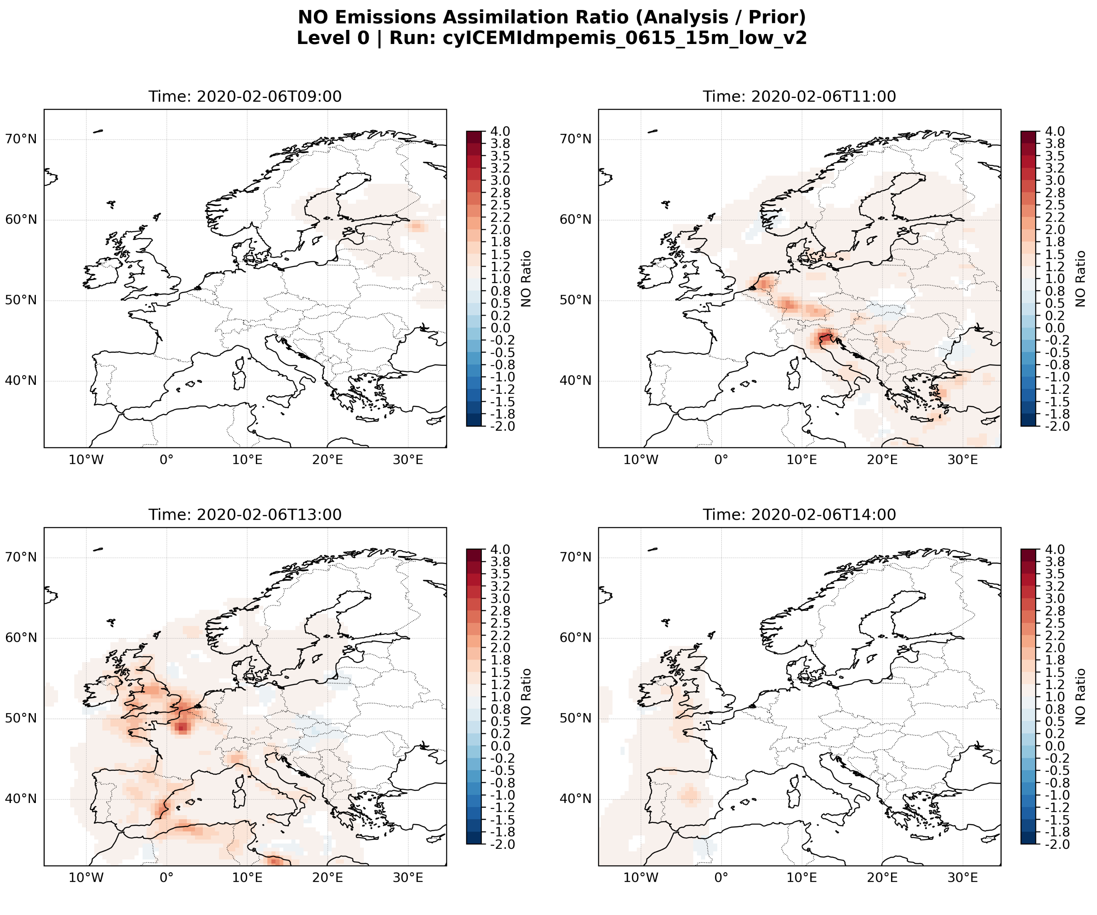
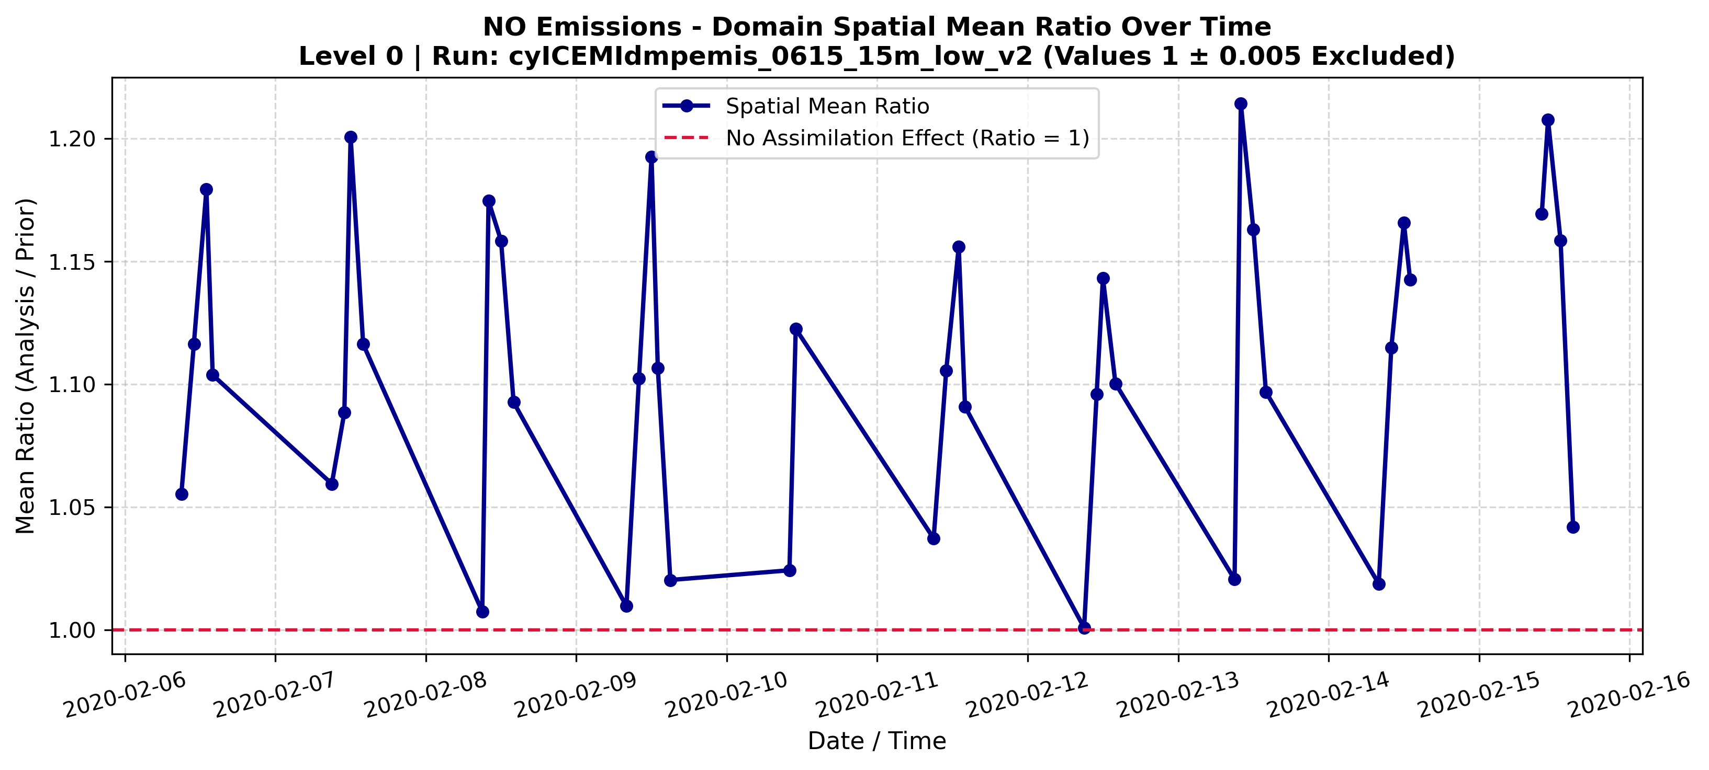
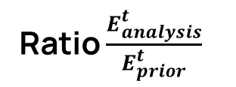
Emissions correction
Time evolution of analysis/prior NOx surface flux ratios
Emission corrections reach high levels locally, averaging around 1.1 and 1.2 as orbit means
2020-02-06
Ratio $\frac{E_{analysis}^{t}}{E_{prior}^{t}}$
Notes:
slide 14: the timeseries of the ratio, is it the mean for all the domain or only chen you have the ratio different from 1?

Slide 15
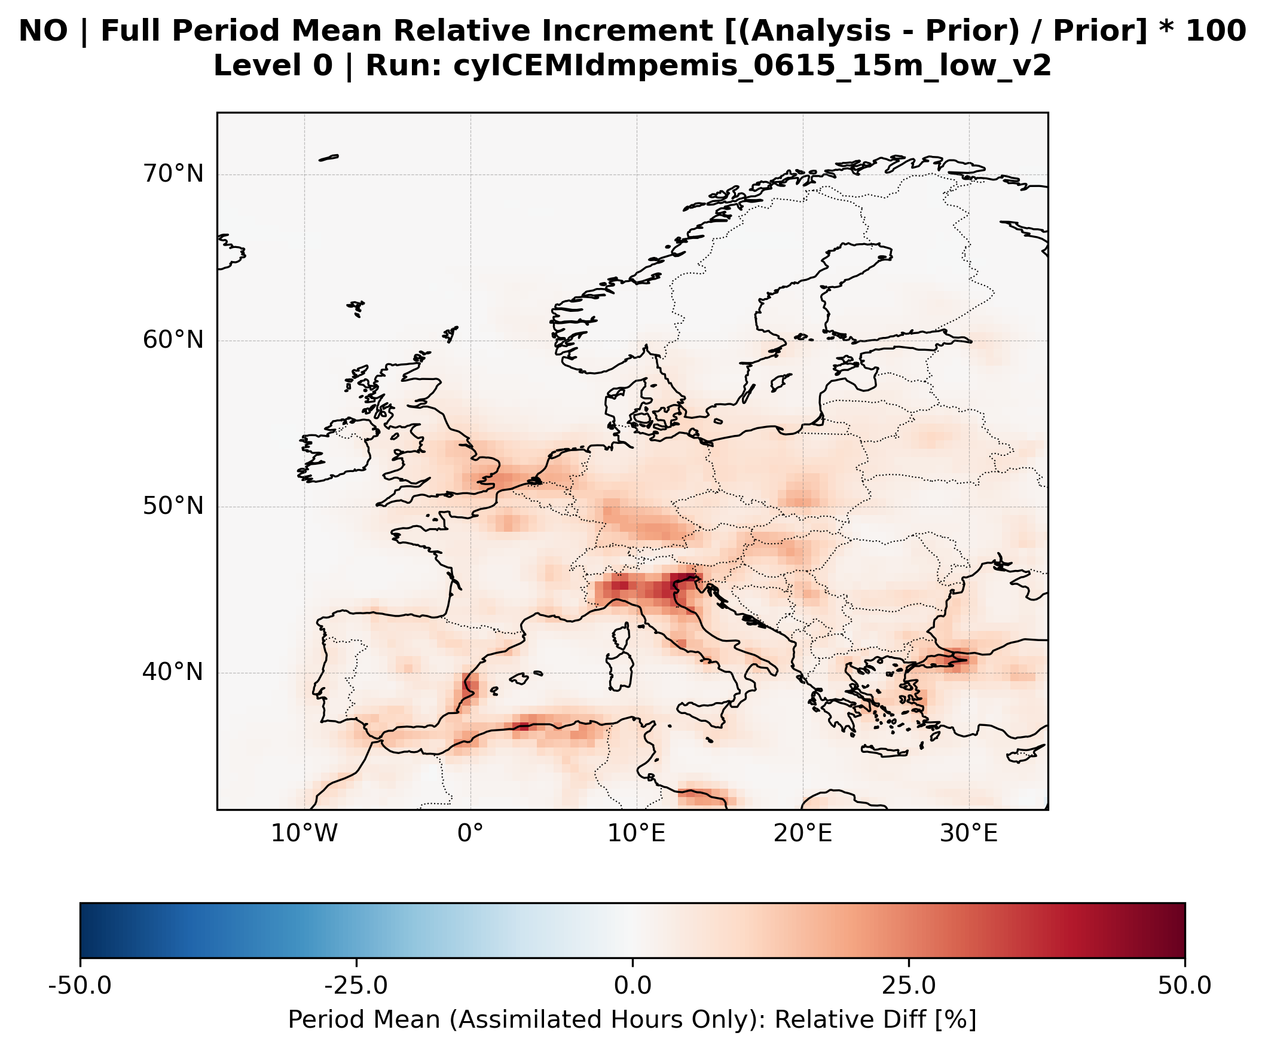

Emissions correction
Surface NOx 10-day average emission relative increment (analysis – prior)/prior [%]
$$E_{analysis}^{t+1}=\frac{E_{analysis}^{t}}{E_{prior}^{t}}∙E_{prior}^{t+1}$$
On average, inventories underestimate emission fluxes by 25% in this time period, with areas of largest corrections being the Po valley (Italy) as well as the harbours

Slide 16
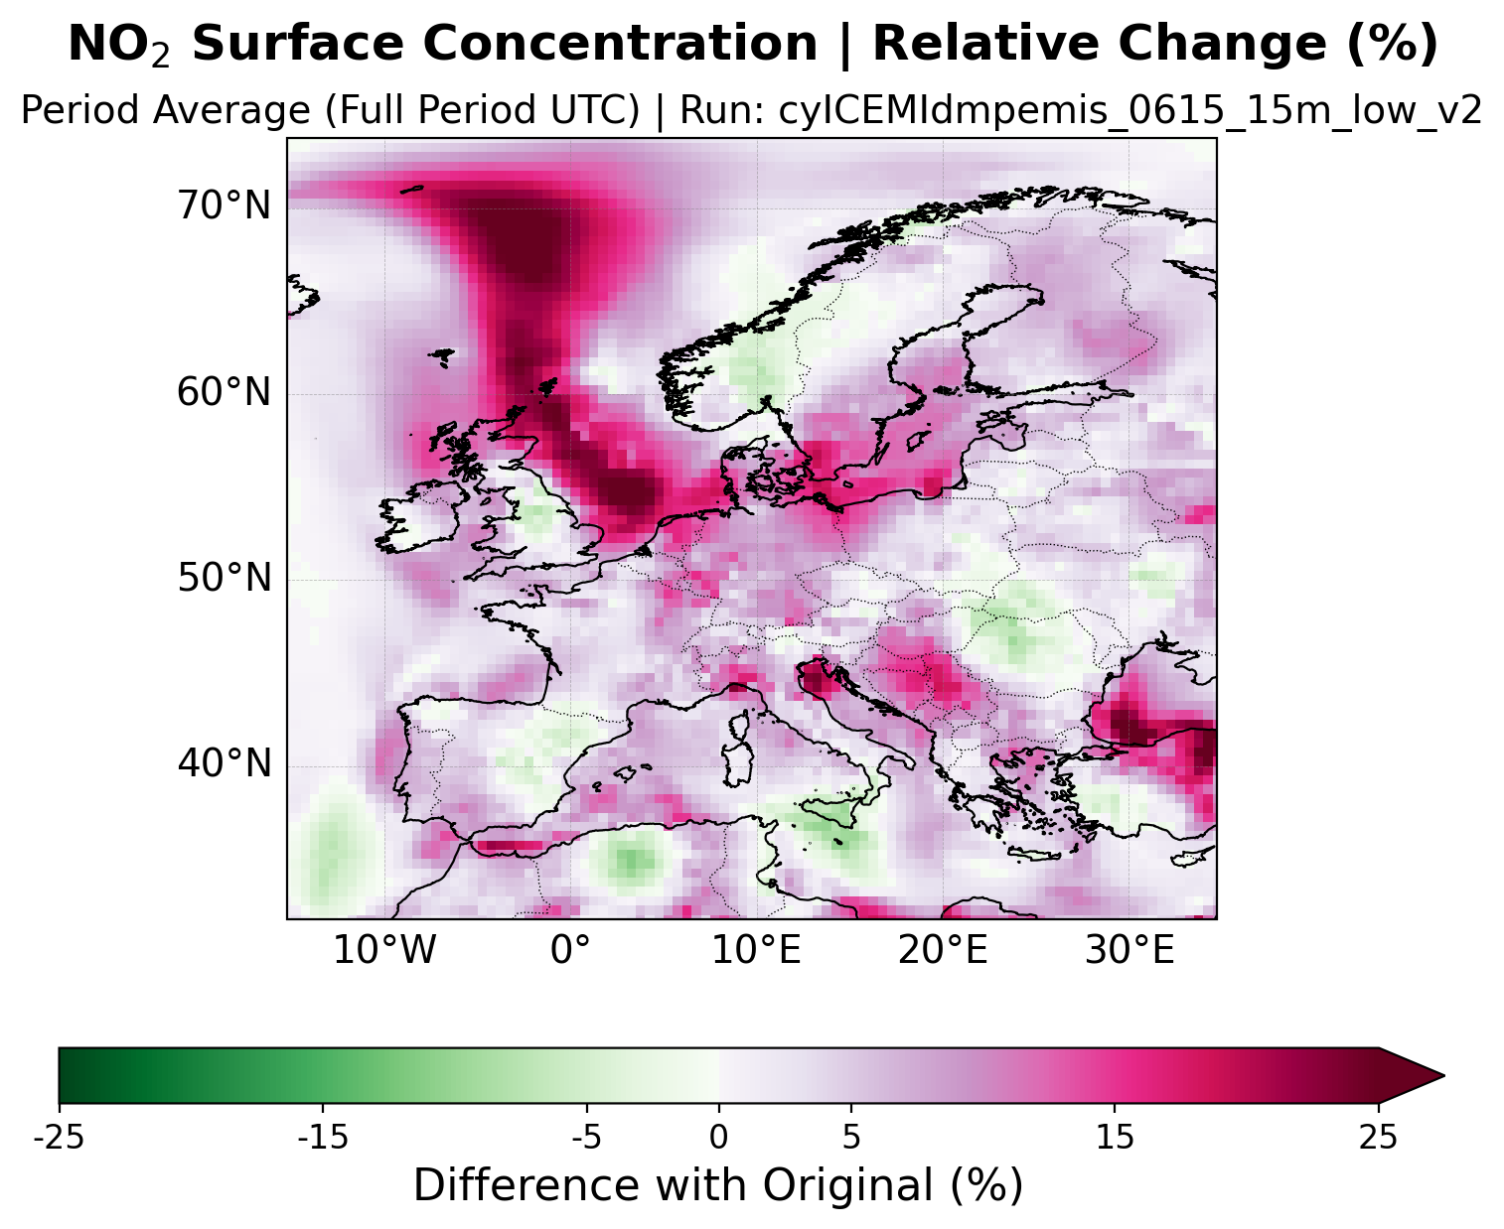
Comparison with control run
Surface NO2 10-day average concentration change
Corrections introduced by cycling ICs and emission ratios to better match satellite observations have induced Chimere simulations to both increase and reduce NO2 surface concentrations
Control Run [%]

Slide 17
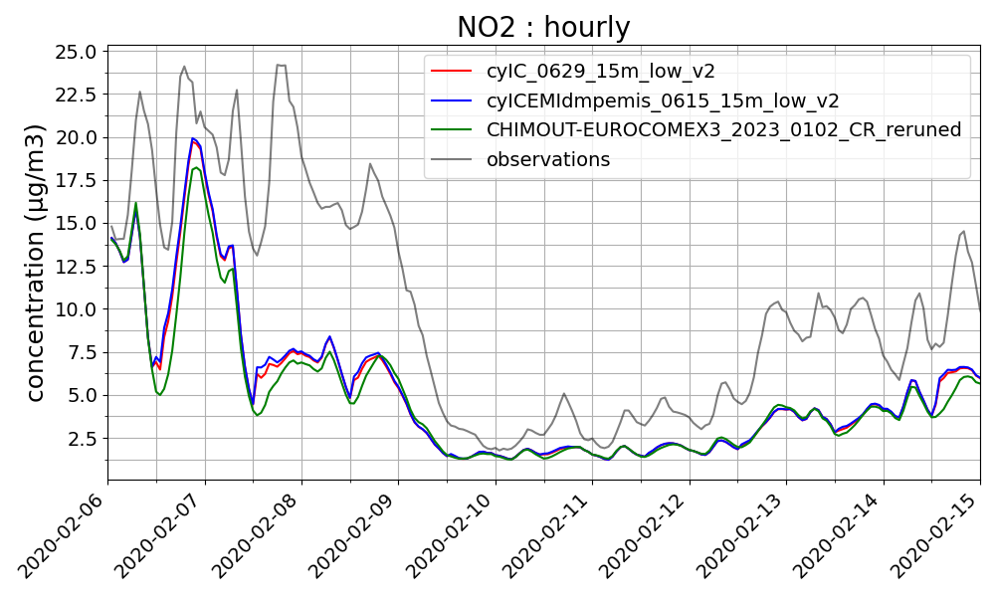
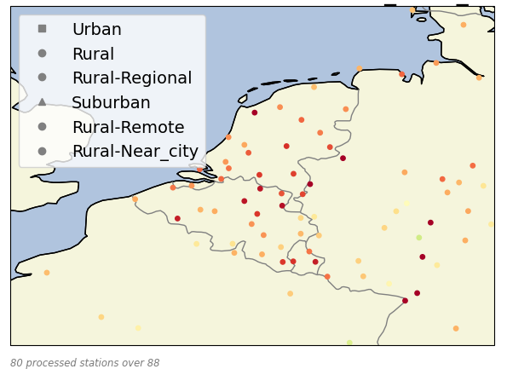
Comparison with EEA monitoring stations
Surface NO2 hourly concentration (subdomain’s stations averages)
The gain of correcting emissions in a DA system is limited by the chosen emission update scheme
Only background rural stations were selected
Notes:
Others statistics decrease but very few

Slide 18
Conclusions
03

Slide 19
Conclusions and future work
We built and tested an emission inversion system on DART-CHIMERE, using a February 2020 case study to constrain NOx emissions using NO2 observations
Rather than replacing traditional bottom-up inventories, this system provides a dynamic constraint that identifies systematic biases and highlights priority regions for inventory refinement
First results are promising, emission correction are significant but a more extensive application is needed to assess the system’s general behavior
(Current and) future work will focus on investigating the role of model perturbations, assimilation settings (e.g. inflation, vertical localization) as well as improving the design of the emission update scheme between consecutive satellite overpasses

Slide 20
Thank you
25.06.2026 | CHIMERE Workshop
Giorgia De Moliner, Gaëlle Dufour, Gaël Descombes, Alessandro D'Ausilio, Adriana Coman, Guillaume Siour, Arineh Cholakian, Giovanni Lonati
Giorgia De Moliner
PhD student
giorgia.demoliner@polimi.it
Notes:
While the approach does not aim to replace established bottom-up inventories, the results indicate that satellite-informed emission corrections can provide additional, dynamically consistent constraints, supporting their use as a complementary component in CTM-based air quality analyses.

Slide 21
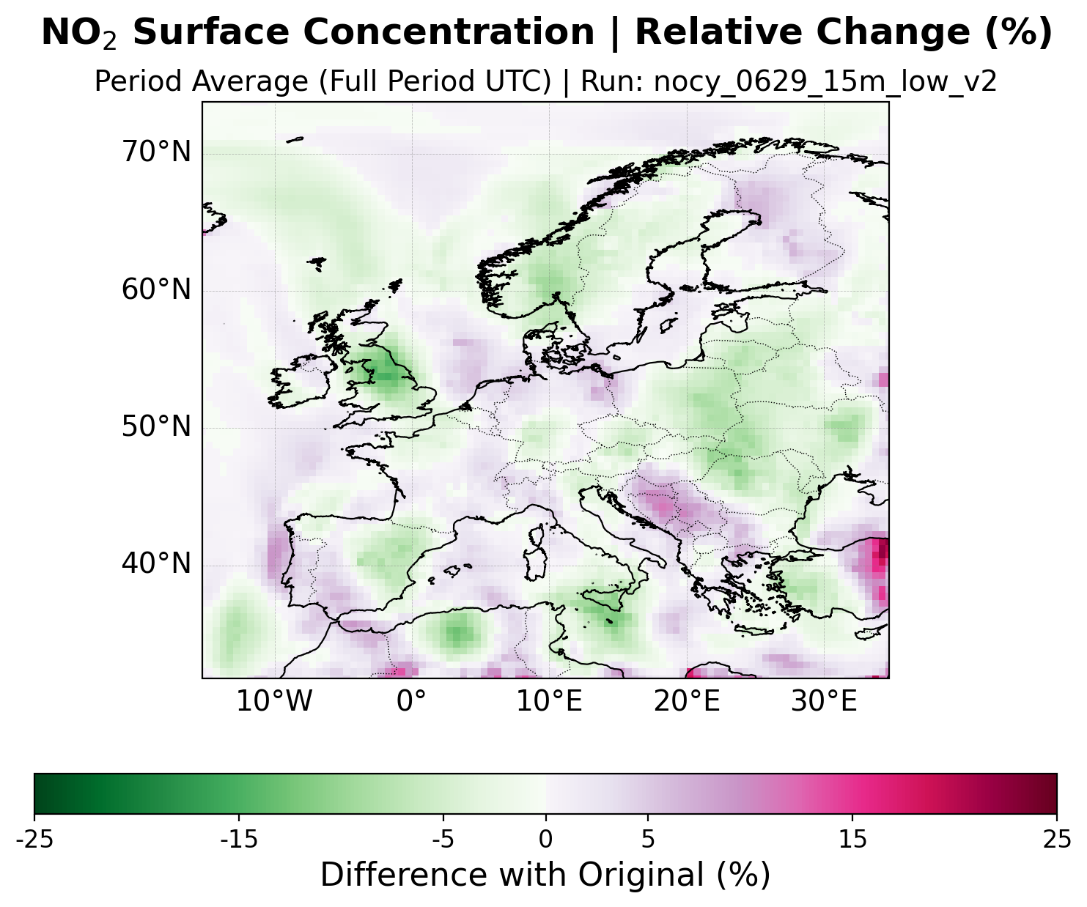
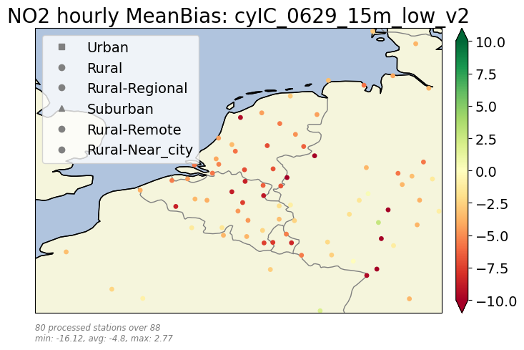
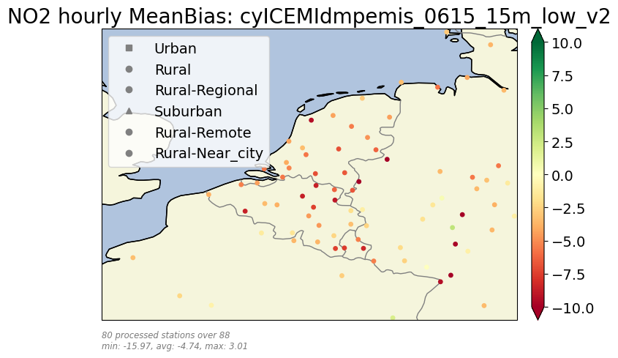
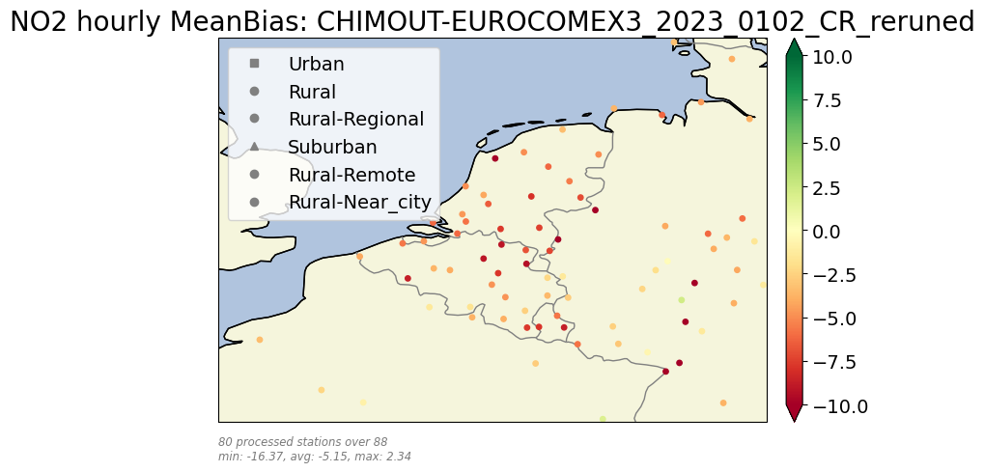
Surface stations (timeseries, timeseries modelbias and gaelle figure)
Diff of avg
Model negative bias reduced by 6.8% in the cyIC case and by 8% in the cyIcEMISdmp. A +1.4% of hourly mean bias is achived by adding IM

