Slide 1
CHIMERE workshop – 25-26 June 2026

Slide 2
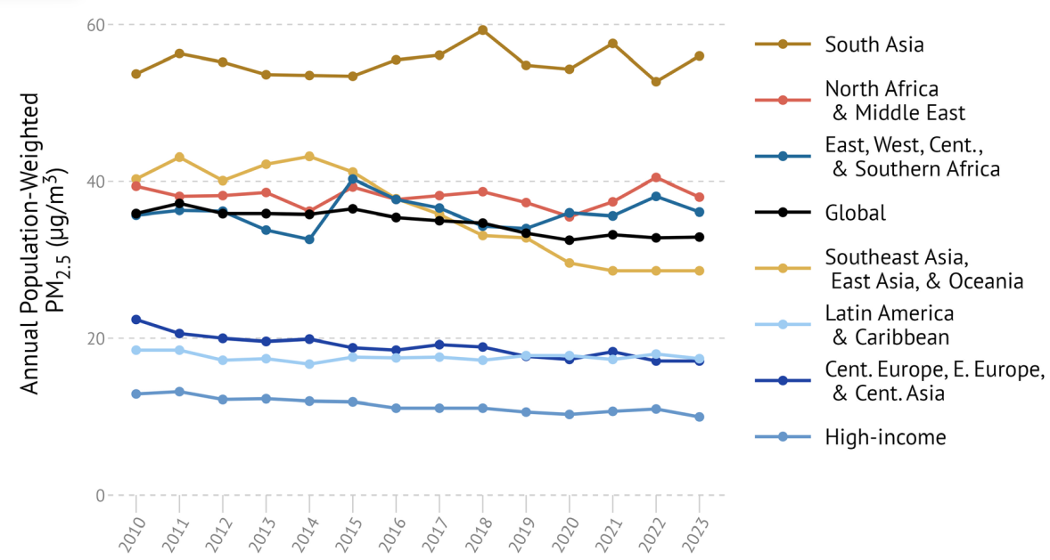
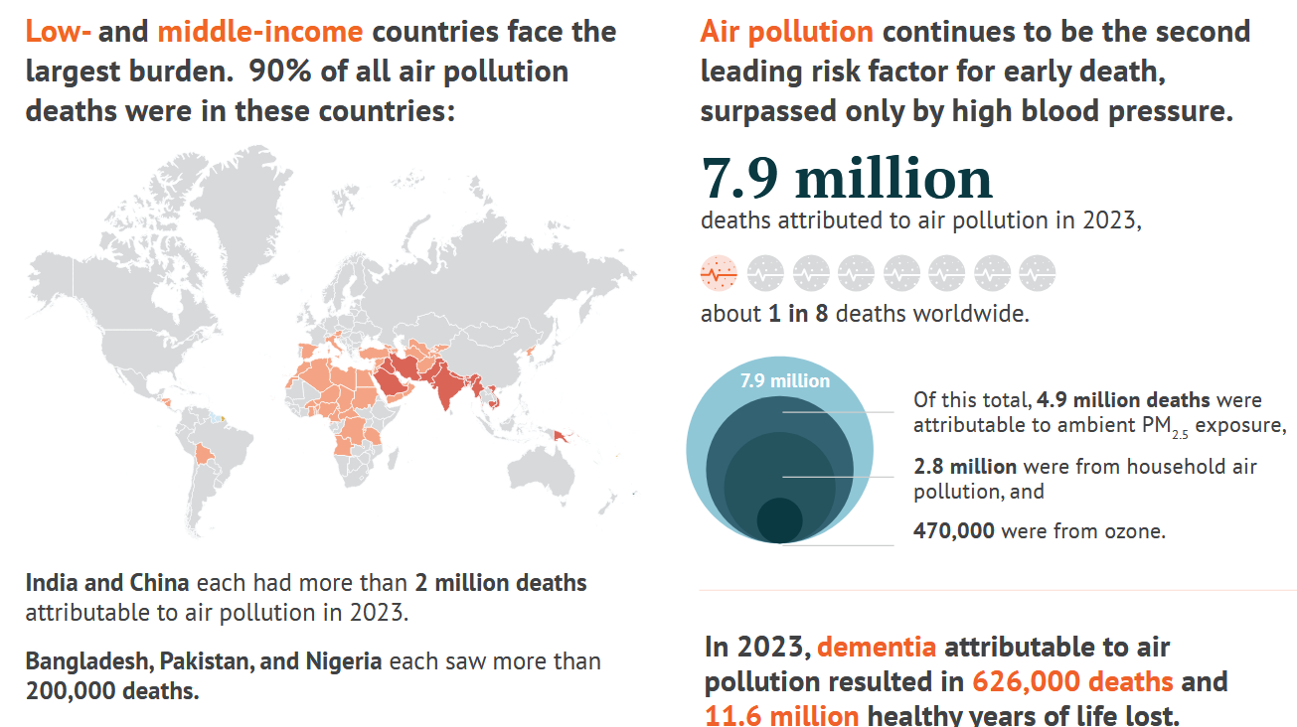
State of Global Air 2025
Changes in annual average ambient PM2.5 exposure between 2013 and 2023 among the 20 most populous countries.
https://www.stateofglobalair.org/resources/report/state-global-air-report-2025

Slide 3
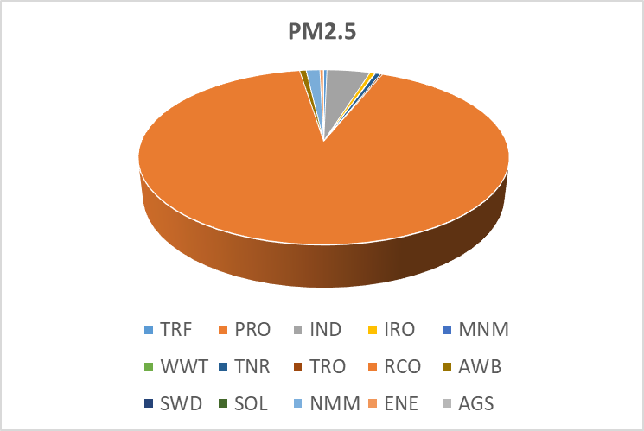
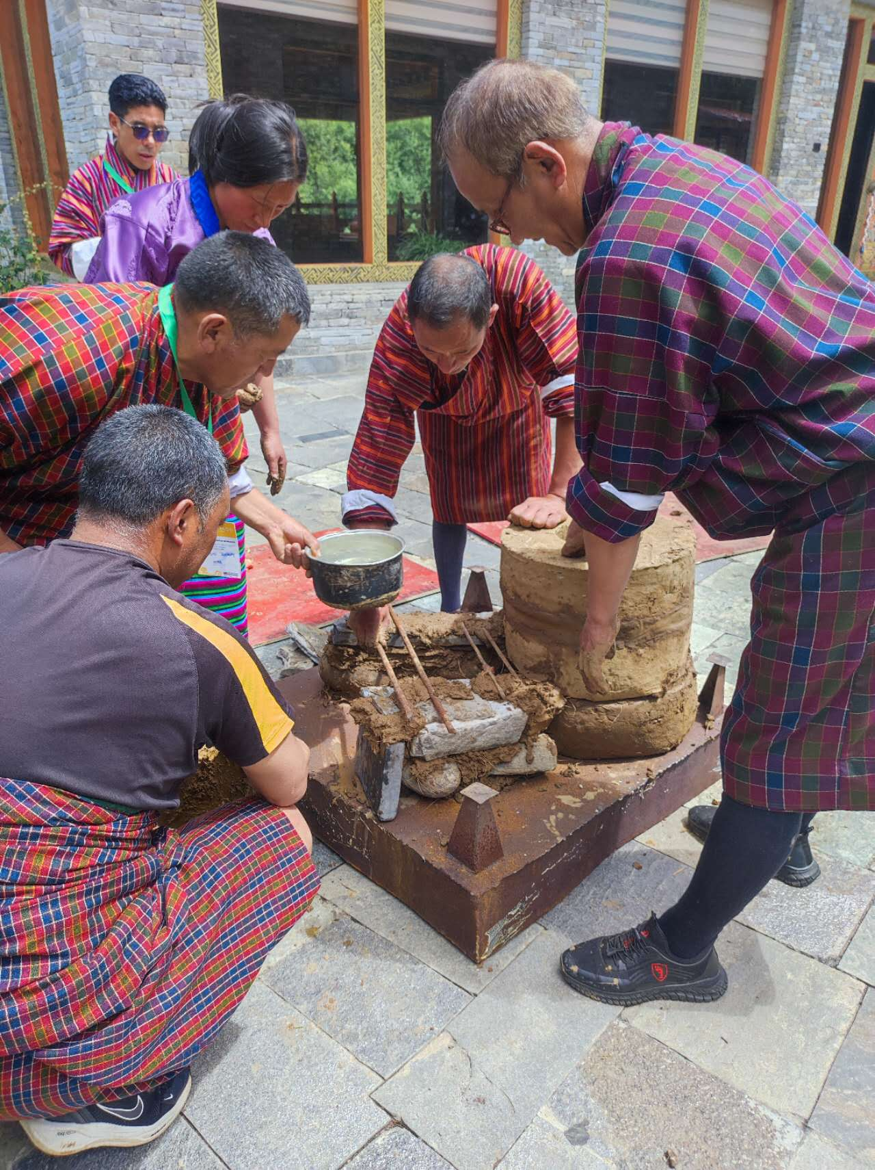
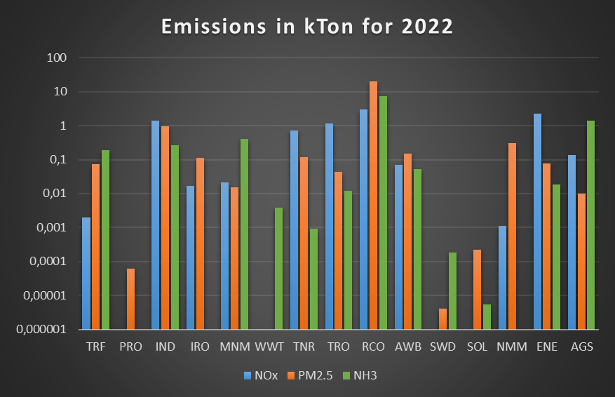
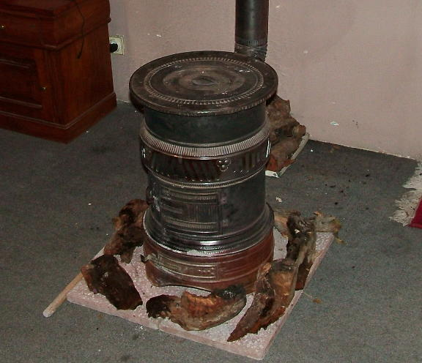
Bhutanese emissions
Residential sector (cooking, heating)
Industry
Traffic
Wildfires (pre-monsoon)
Traditional stove (bukhari)
From EDGAR

Slide 4
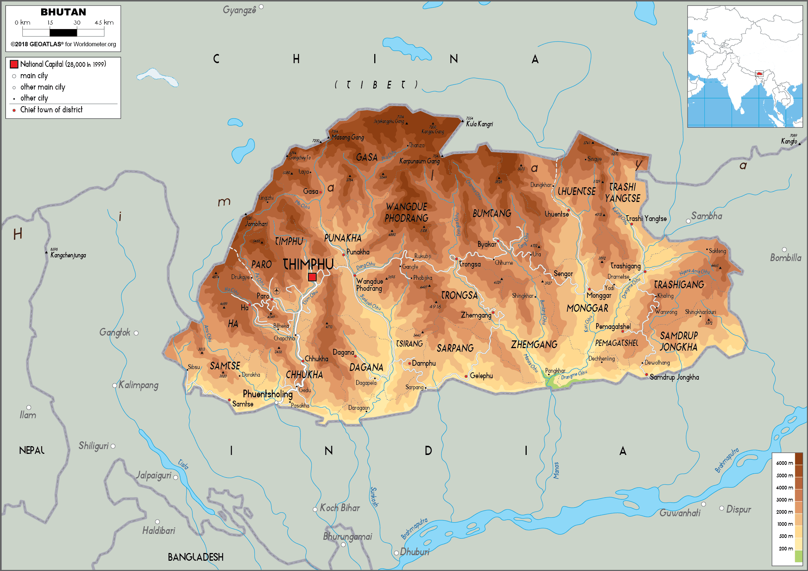
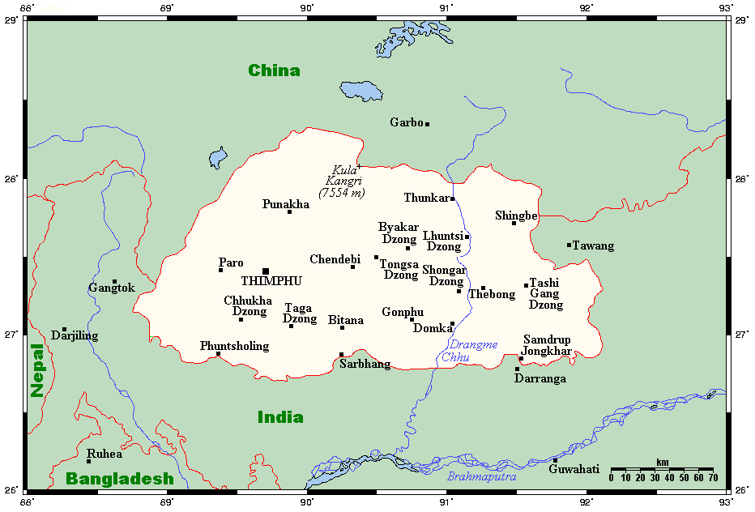
Bhutan
Population 2022 census 727 145
Density : 20.4 #/km2
Gangkhar Puensum: 7 570 m
Altitude tropical climate

Slide 5
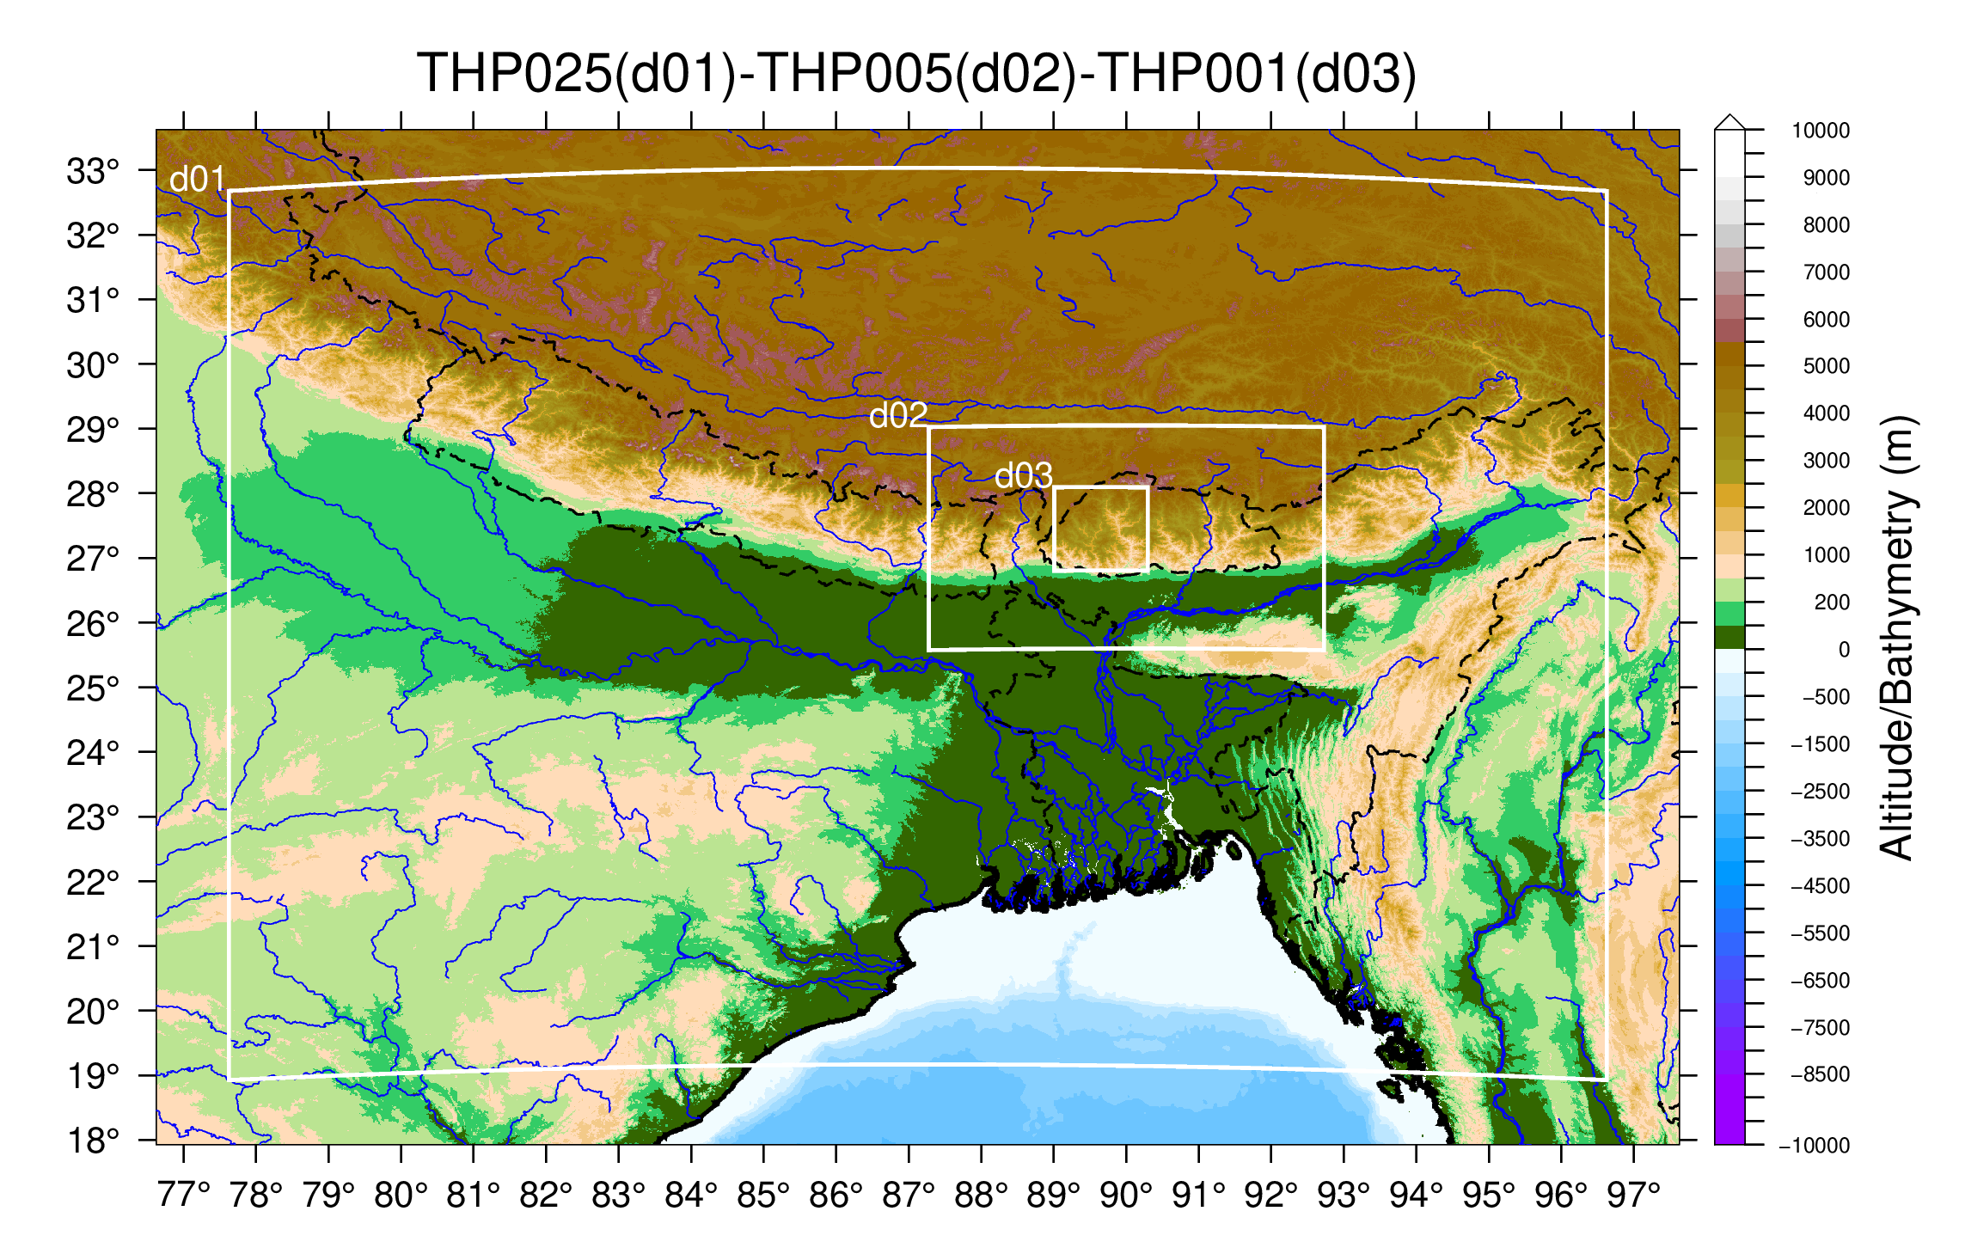
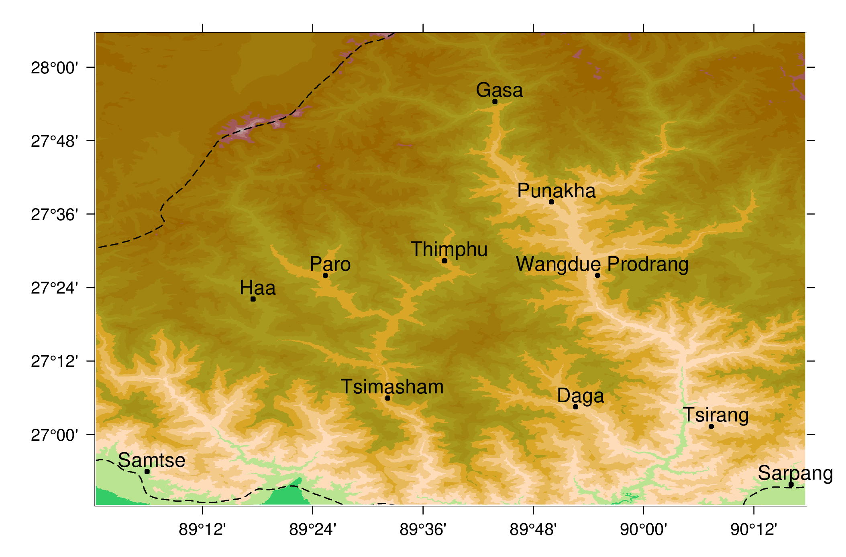
Domains for Bhutan
March 2025 (spin-up in february)
3 nested domains (0.25→0.05→0.01)

Slide 6
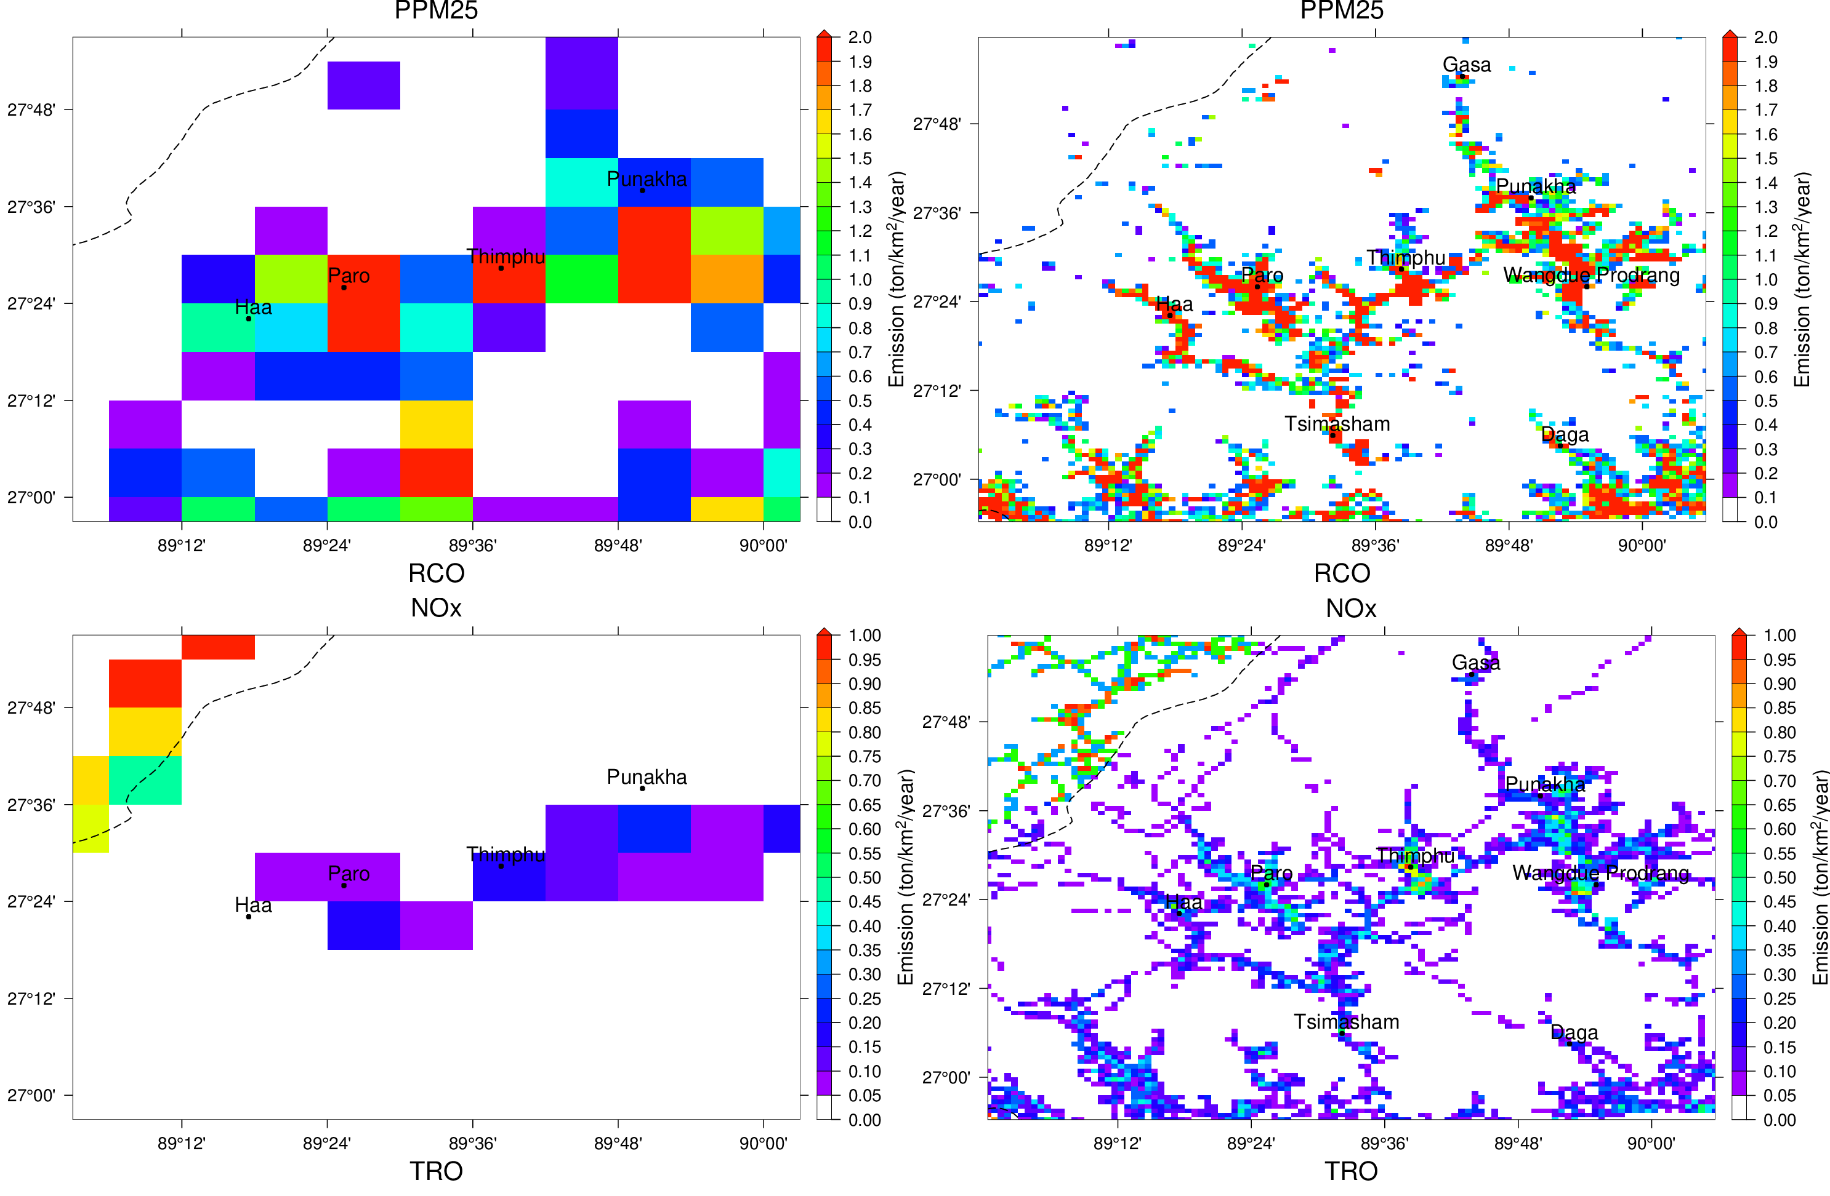
Emission spatialisation – The EDGAR database
Global EDGAR ~10km New Proxy ~1km

Slide 7
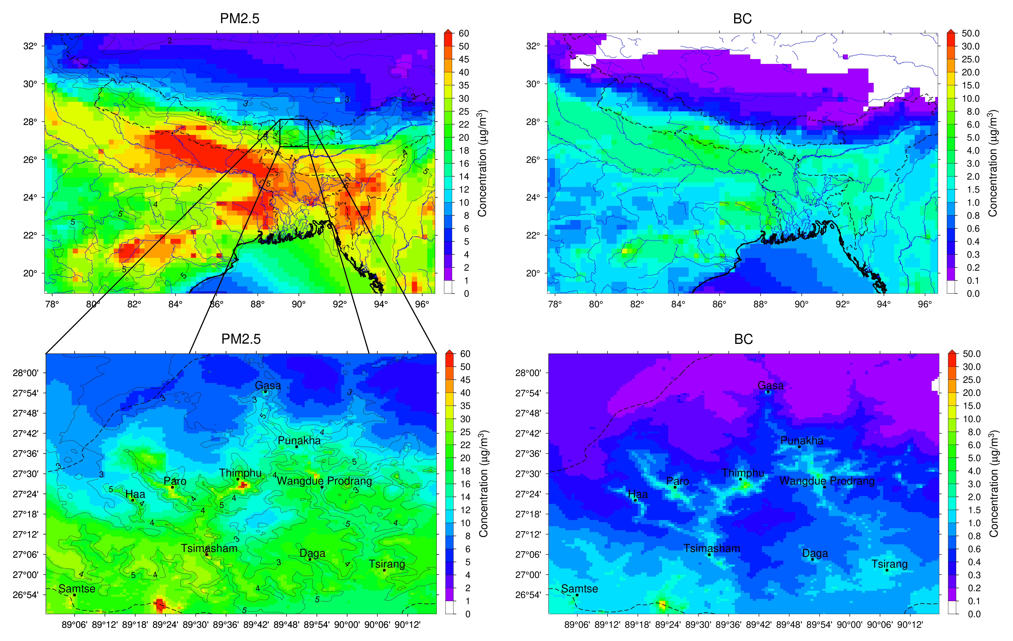
CHIMERE applied in IGP (Indo-Gangetic Plains) and Bhutan
March 2025
25 km resolution
1 km over Bhutan

Slide 8
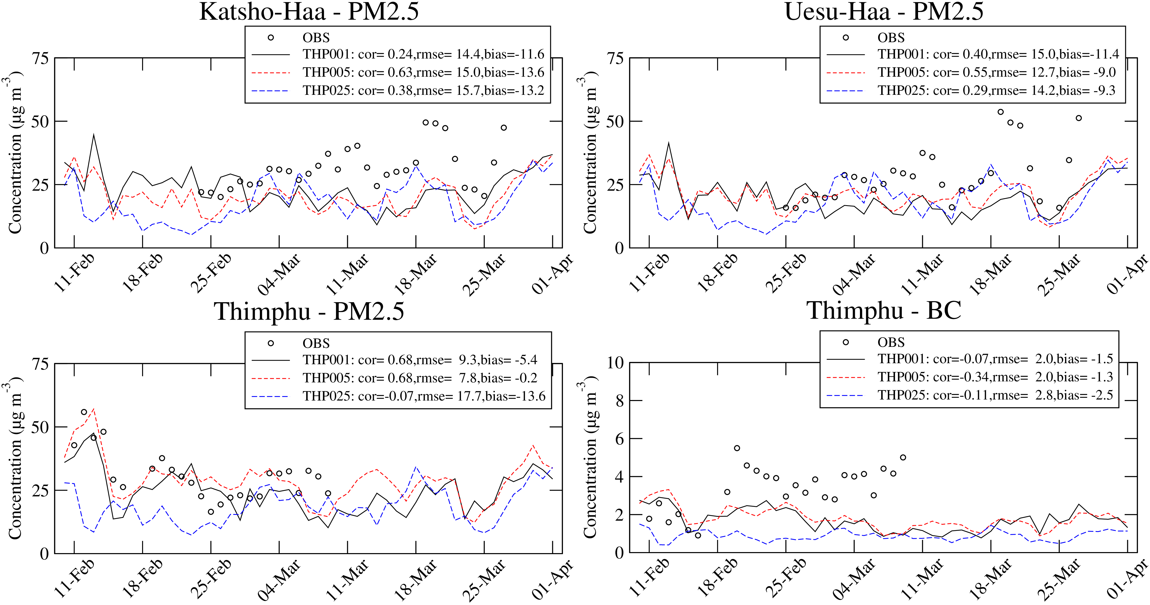
Evaluation

Slide 9
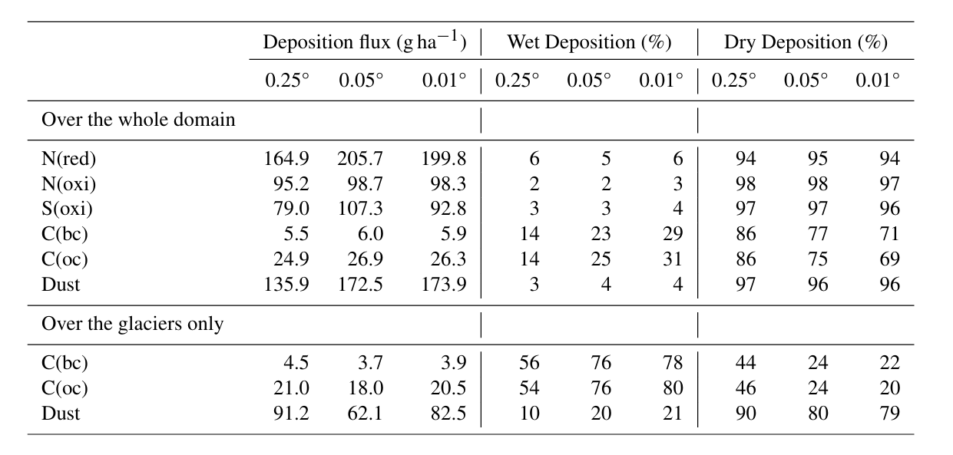
Impact of the resolution on deposition (March)

Slide 10
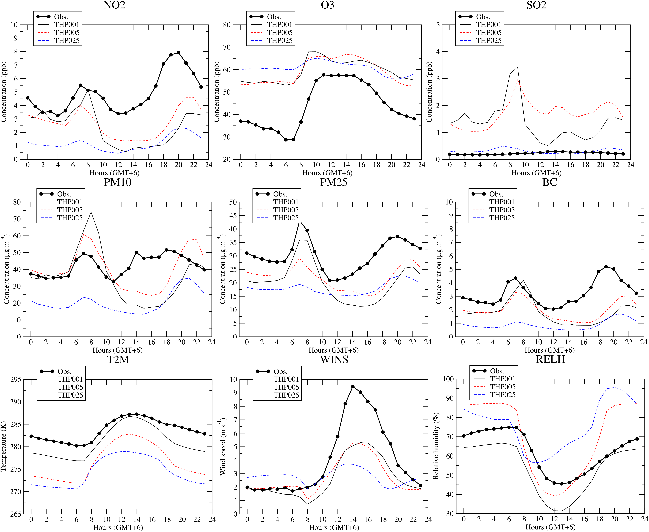
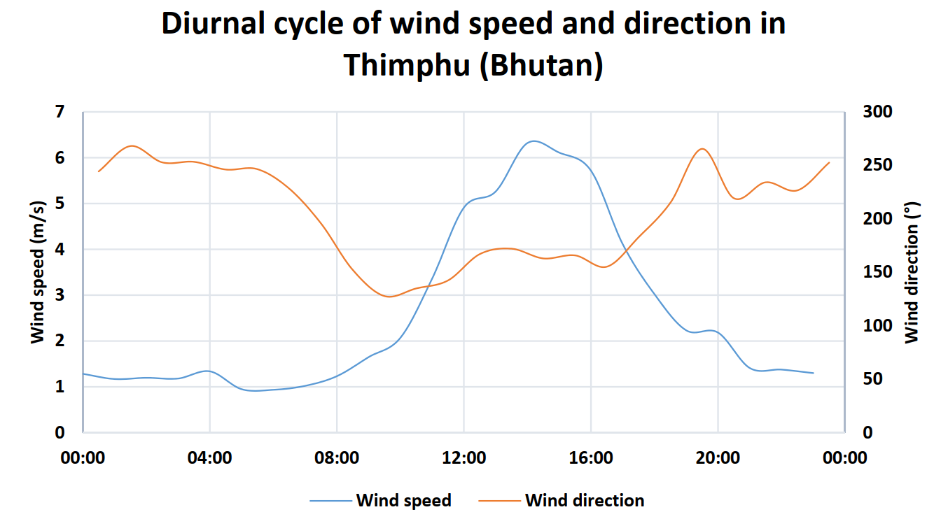
Wind speed regime within the valley

Slide 11
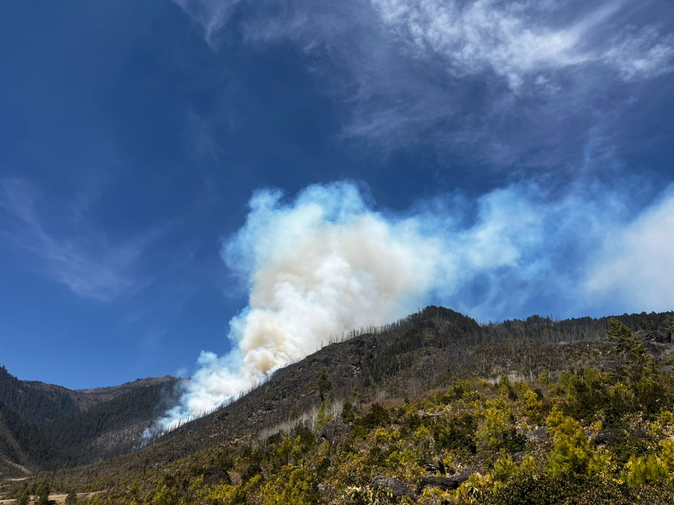
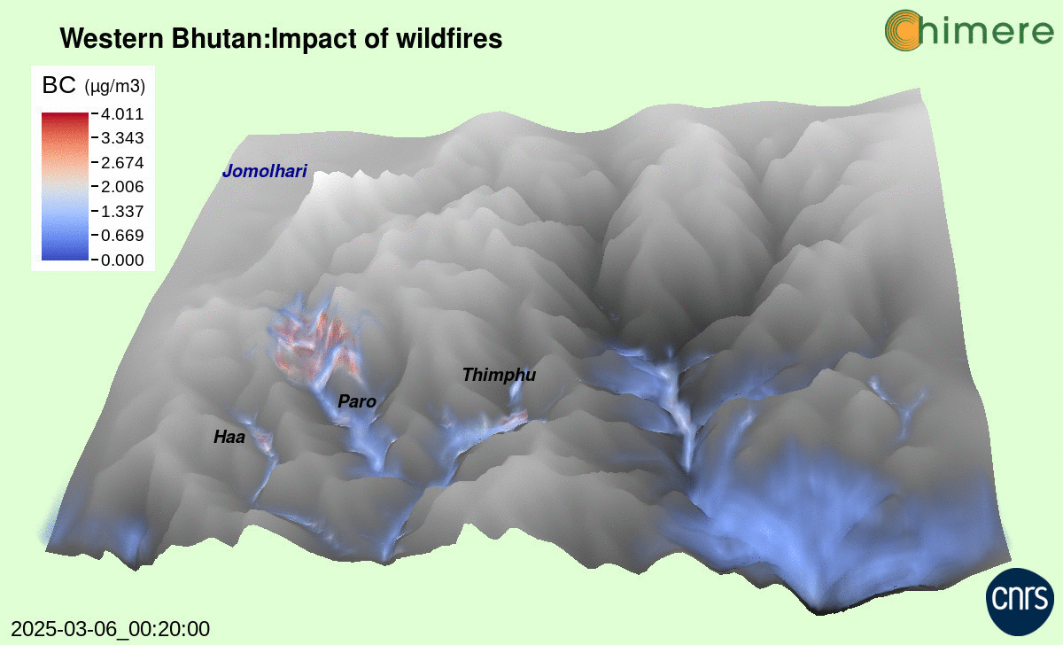
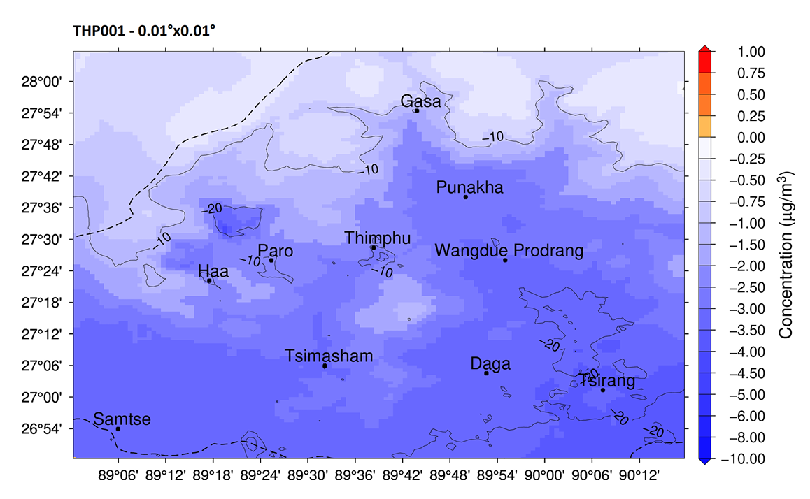
Air Quality simulations in Bhutan
CHIMERE for Vapor (NCAR)
Wildfires observed nearby Haa on March 2025 (credit: Tenzin Wangchuk).
Wildfire contribution

Slide 12
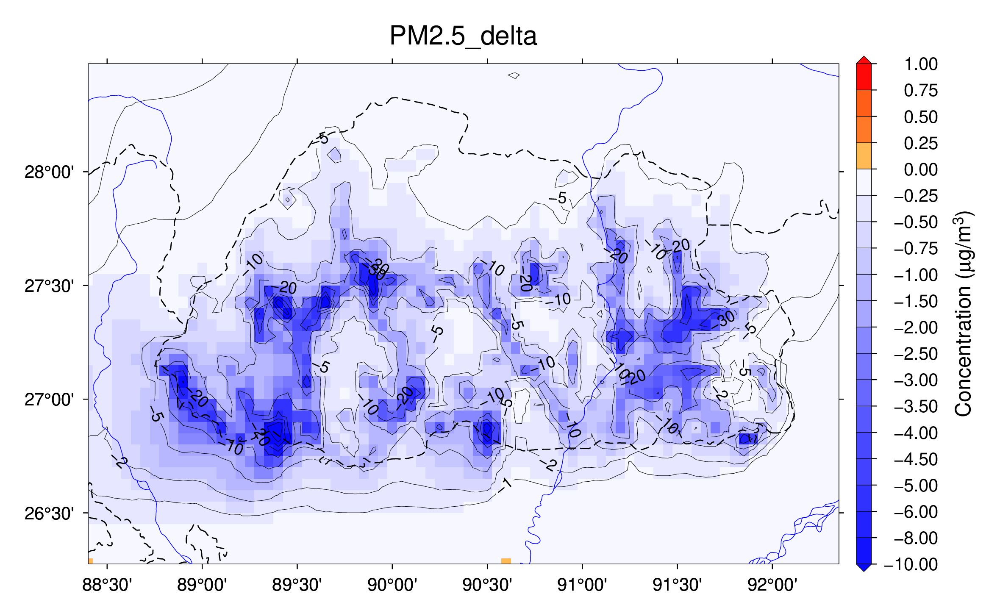
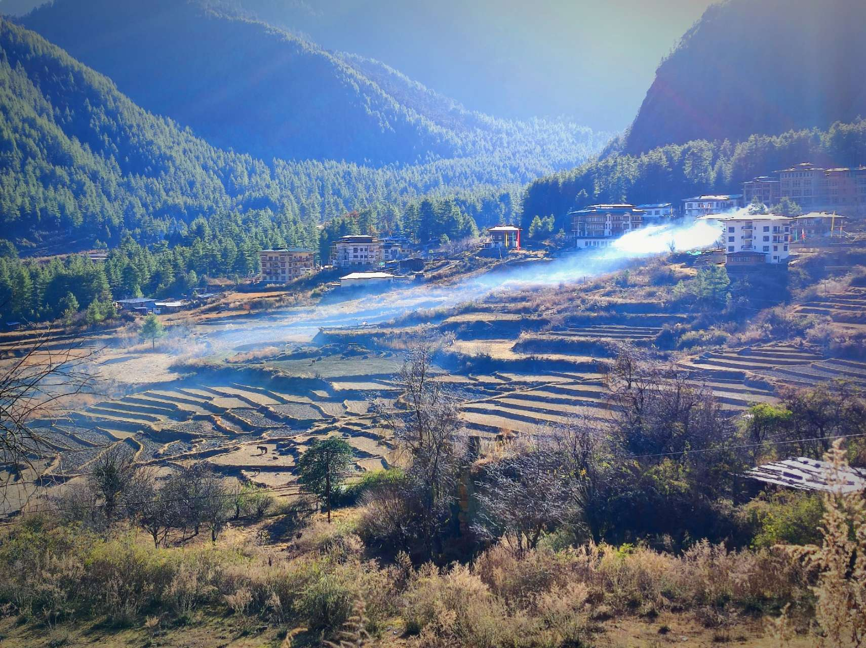
Impact of residential emissions in Bhutan
SCEN - BC
Year 2022
5 km resolution
Total reduction of residential emissions

Slide 13
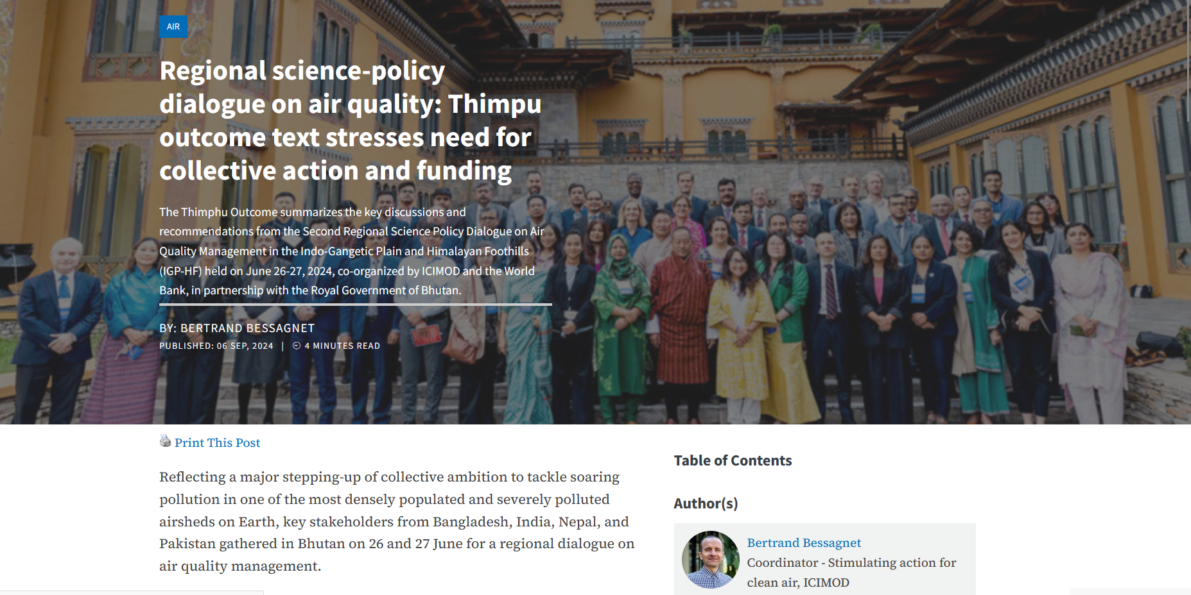
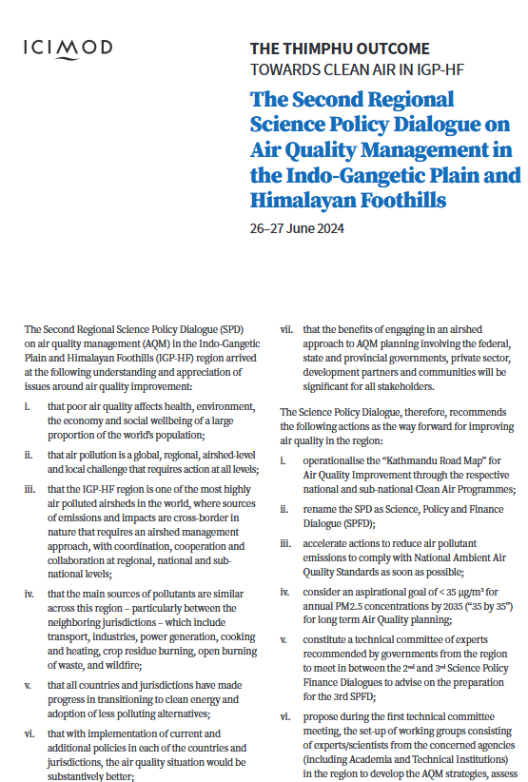
The Science Policy and Finance Dialogue on Air Quality Management (ICIMOD and World Bank)
26-27 June 2024 (Bhutan)

Slide 14
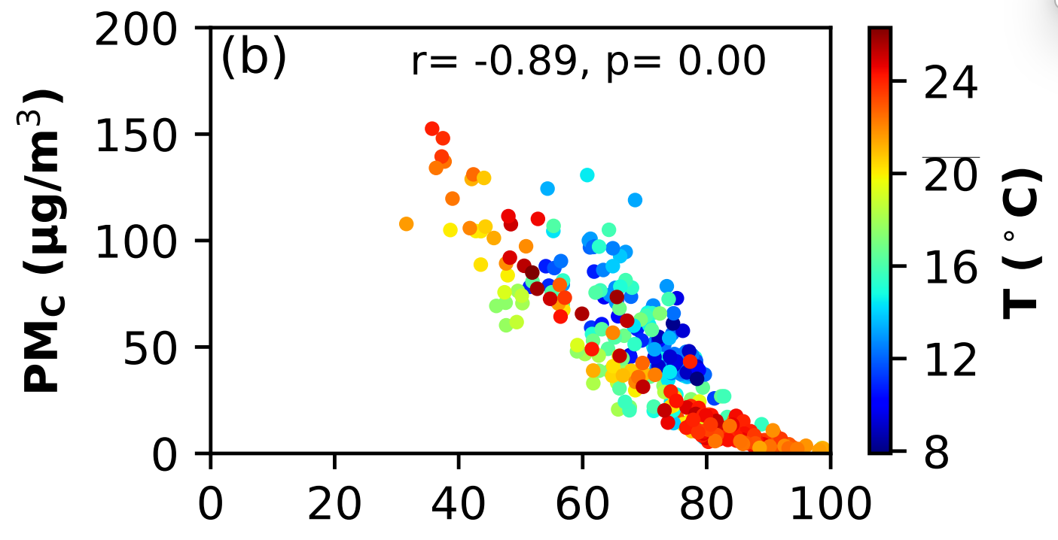
Challenges in South Asia - Peculiarities
Emissions inventories
  No official inventories
  Road dust resuspension?
  Other activity sectors like AWB to account for
Links with Climate and biodiversity (BC and some deposition fluxes)
Economics
  Health benefits?
  Cost of technologies to reduce emissions??
RH
PMcoarse versus RH (Measurements in Kathmandu)
at road trafic sites
Courtesy Dikra Prasad Bajgai

Slide 15
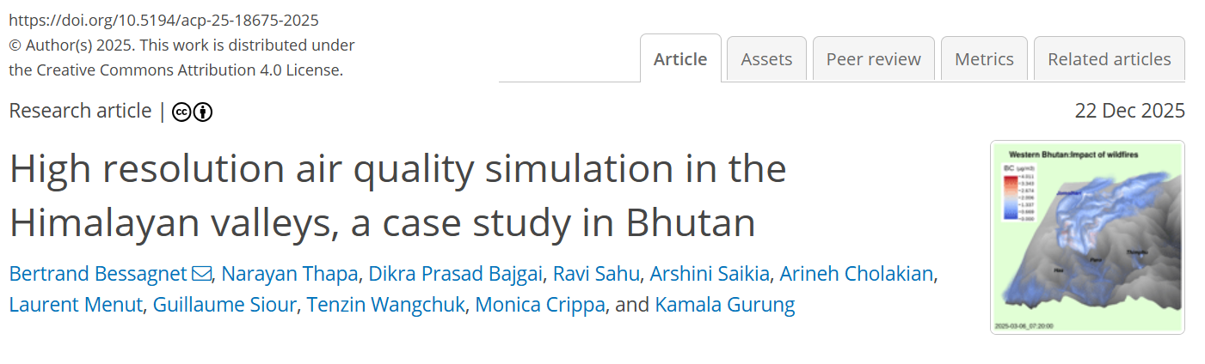
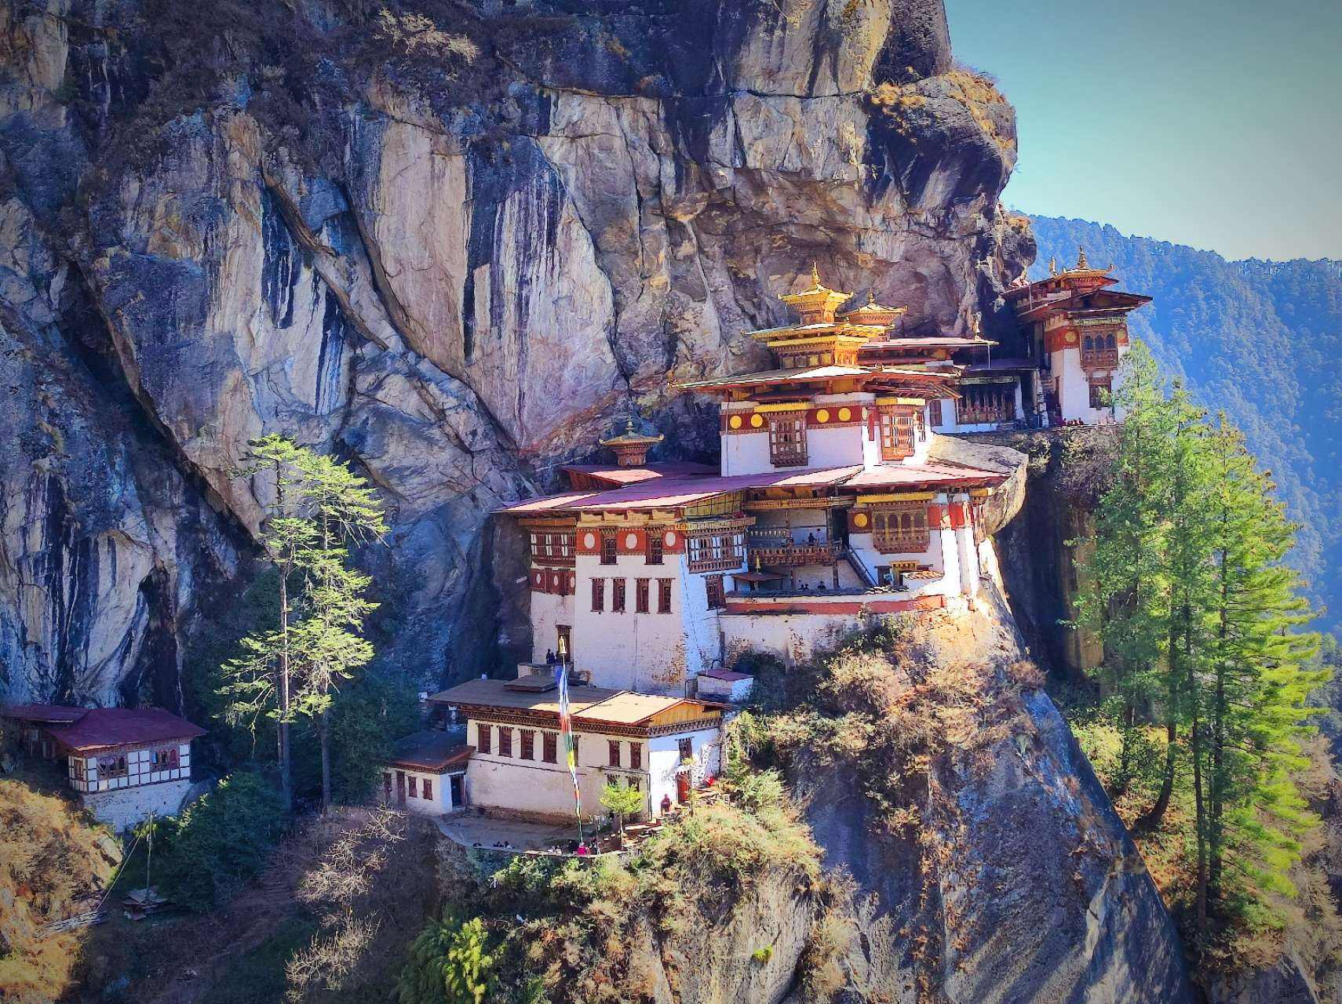
The end
Paro Taktsang (Tiger's Nest Monastery) ~ 3000m
Acknowledgements:
This work was granted access to the HPC resources of TGCC operated by GENCI.
The authors thank the National Center for Hydrology and Meteorology (NCHM) of the Royal Government of Bhutan for giving access to official meteorological data.
ICIMOD staff is being supported by the United Kingdom’s Foreign, Commonwealth and Development Office (FCDO) under their Climate Action for Resilient Asia (CARA) initiative.

