Slide 1



Challenges in modeling organic aerosols: comparing CHIMERE CTM results with measurements and PMF
Victor LANNUQUE, F. Couvidat (INERIS)
With special thanks to B. Murphy, H. Fagerli, D. Simpson (MetNO)
CHIMERE Workshop 2026
Paris, 25-26 June 2026

Slide 2
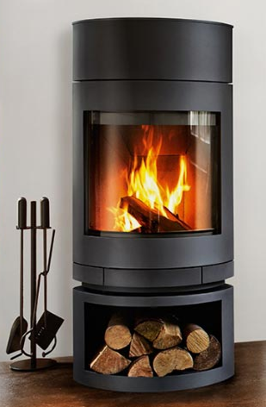

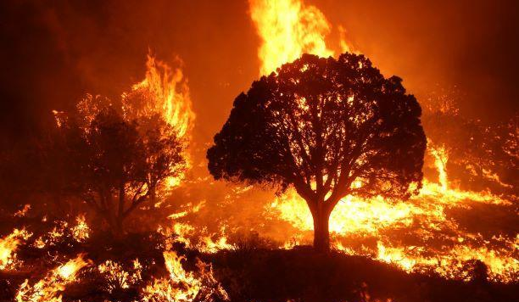
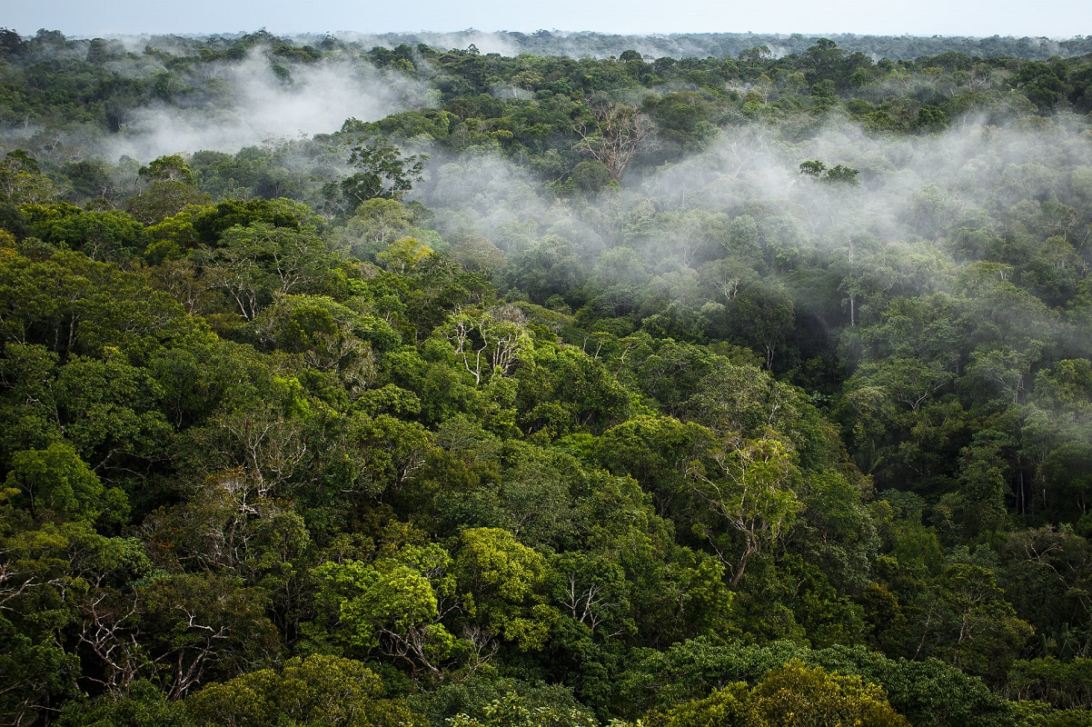
Organic Aerosol
Total OA Measurements (ACSM)
POA
Primary Organic Aerosol
Particle Emissions
Particle Emissions
SOA
Secondary Organic Aerosol
Oxidation
(OH, O₃, NO₃)
BVOC
VOC
VOC
Wood burning
Vapor Emissions
Vapor Emissions
Vapor Emissions
(Wildfires)
Fossil Fuel Sources
Biogenic Sources
Biomass Burning Sources
French National Institute for Industrial Environment and Risks (Ineris) - CHIMERE Workshop 2026

Slide 3
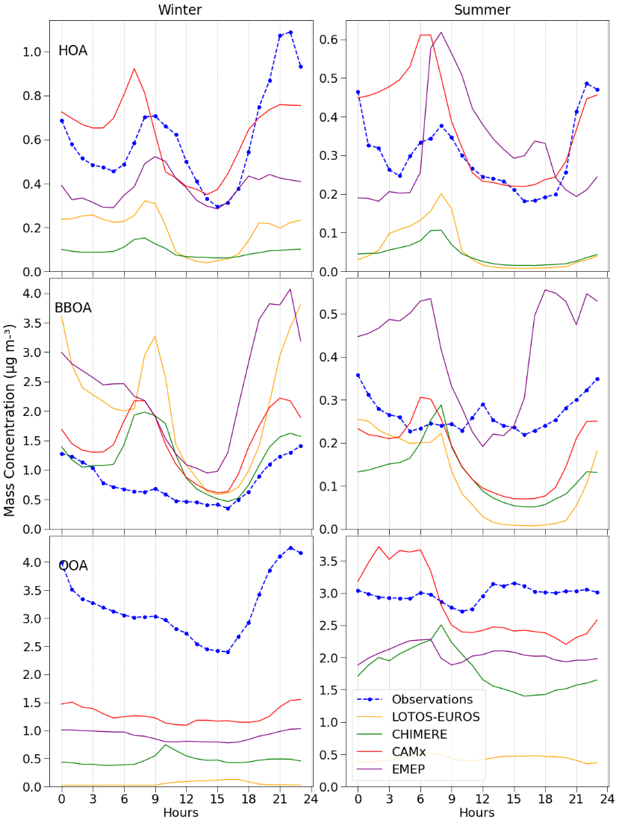
PMF: Positive Matrix Factorization
→ method used to quantify sources contributions to OA from ACSM measurements
HOA: Hydrocarbon-like organic aerosol
minimally oxidized or not oxidized → Fossil fuel POA
BBOA: Biomass burning organic aerosol
corelated with the levoglucosan signal→ Biomass burning POA
OOA: Oxygenated organic aerosol
highly oxidized → SOA
Modeling PMF : the results from RI-URBANS
Comparison of diurnal profiles:
None of the models reproduces the PMF-derived diurnal profiles satisfactorily
The treatment of POA differs among models
BBOA is overestimated in winter, and all models except EMEP predict a morning peak that do not appear in the PMF results
OOA is strongly underestimated, particularly in winter
→ How to explain and reduce the discrepancies ?
French National Institute for Industrial Environment and Risks (Ineris) - CHIMERE Workshop 2026

Slide 4
Organic Aerosol
Total OA Measurements (ACSM)
POA
HOA
POA
BBOA
→ Considering Semi-volatility of emitted POA
Particle Emissions
Particle Emissions
SOA
OOA
SVOC
SVOC
Emissions
Emissions
Oxidation
(OH, O₃, NO₃)
BVOC
VOC
VOC
Wood burning
Vapor Emissions
Vapor Emissions
Vapor Emissions
(Wildfires)
Fossil Fuel Sources
Biogenic Sources
Biomass Burning Sources
French National Institute for Industrial Environment and Risks (Ineris) - CHIMERE Workshop 2026

Slide 5
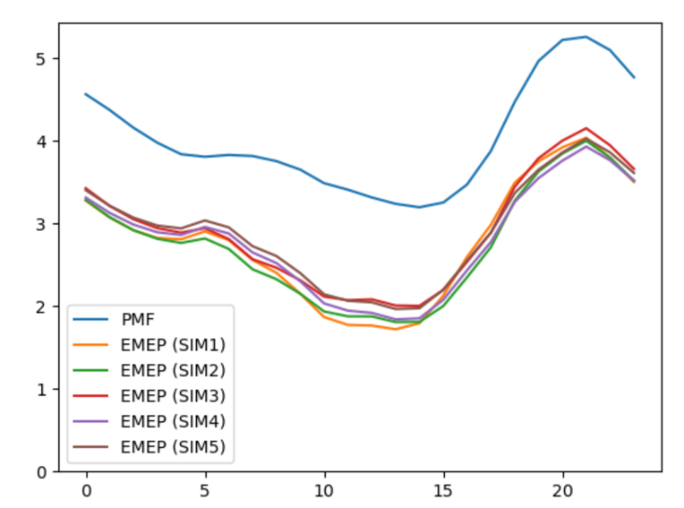
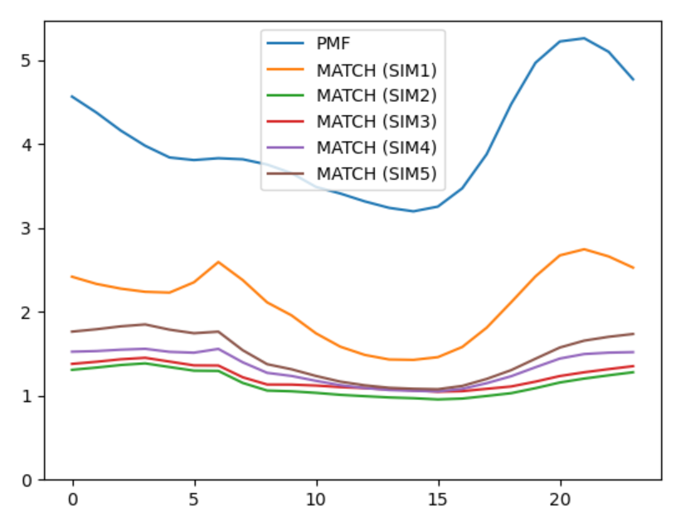
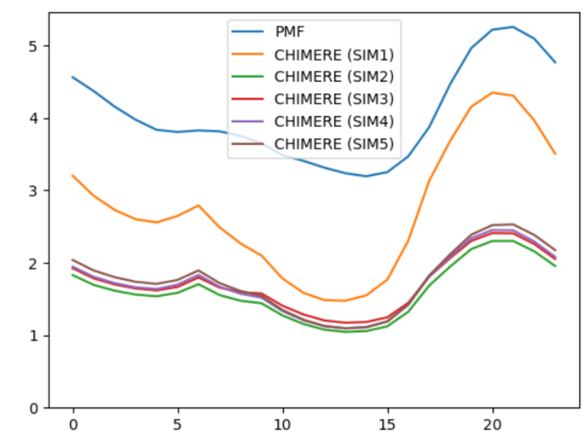
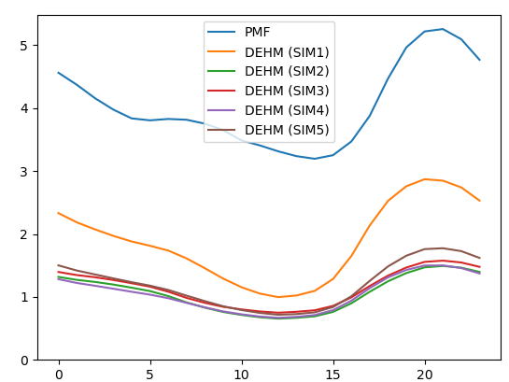
Considering Semi-Volatile POA
WP7 of CAMAERA Project:
→ 4 CTMs
→ 5 one-year simulations (2019) with classic VBS schemes for Semi-Volatile POA
SIM1: non-volatile POA
SIM2 to 5: semi-volatile POA
≠ distributions (Robinson2007, May2013/Huang2018)
≠ aging (kinetics, volatility decrease, mass increase, NO₃ reactivity)
EMEP
→ Large differences between non-volatile and semi-volatiles configurations for simulated OA
→ Only minor differences are observed among the semi-volatile POA configurations
Underestimation occurs mainly in winter:
Very low simulated SOA/OOA concentrations, below 1 µg/m3 compared to 4 µg/m3 in ACSM measurements
The underestimation cannot be explained by a lack of POA emissions
MATCH
µg/m³
CHIMERE
DEHM
Average annual diurnal cycle (total OA)
French National Institute for Industrial Environment and Risks (Ineris) - CHIMERE Workshop 2026

Slide 6
Organic Aerosol
Total OA Measurements (ACSM)
POA
HOA
POA
BBOA
→ Are we missing large VOC emissions of SOA precursors ?
SOA
OOA
SVOC
SVOC
Emissions
Emissions
IVOC
Oxidation
(OH, O₃, NO₃)
IVOC
Vapor Emissions
BVOC
Vapor Emissions
VOC
VOC
Wood burning
Vapor Emissions
Vapor Emissions
Vapor Emissions
(Wildfires)
Fossil Fuel Sources
Biogenic Sources
Biomass Burning Sources
French National Institute for Industrial Environment and Risks (Ineris) - CHIMERE Workshop 2026

Slide 7
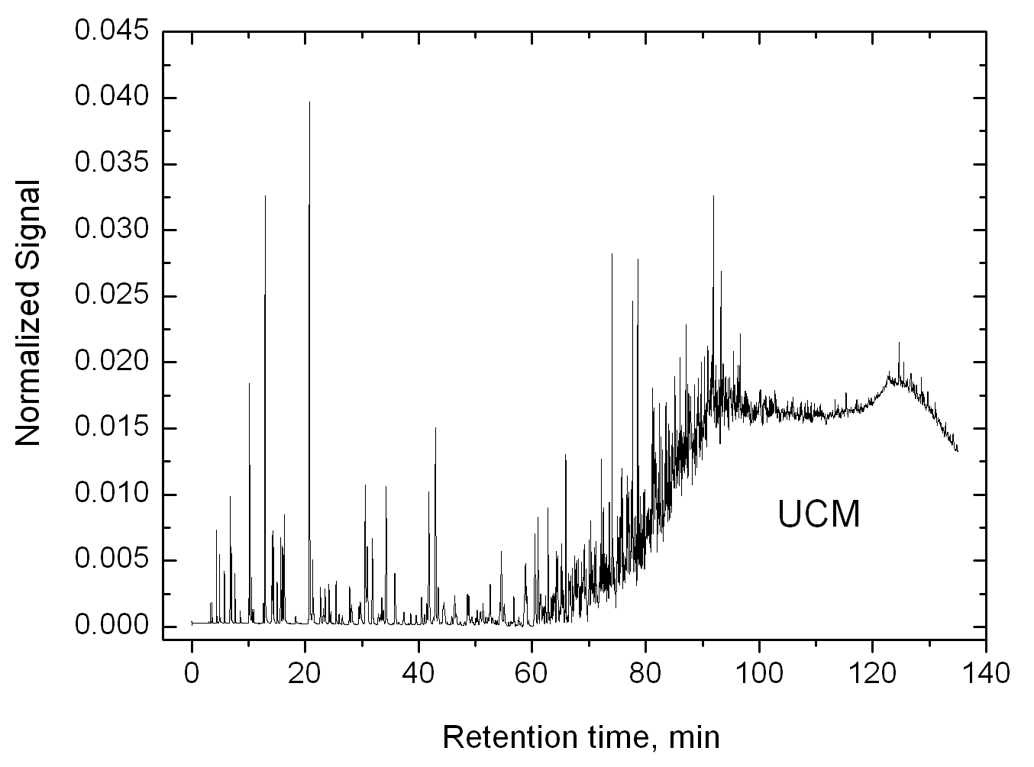
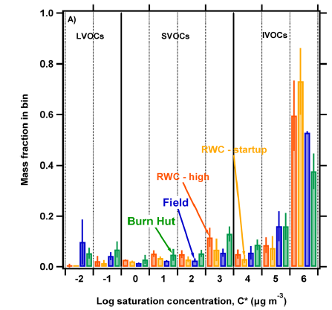
About Intermediate Volatility Organic Compounds (IVOC)
Example of Gas Chromatography
In theory, all gaseous compounds (including IVOC) should be included in the NMVOC emissions
IVOC emissions:
IVOC are commenly associated with the Unresolved Complex Mixture (UCM) observed in gas chromatography. UCM is due to the great number of compounds with many carbons (combination of millions of signal peaks). As the UCM correspond to heavy compounds, UCM should correspond to less volatile part of emissions.
A few studies on European passenger cars suggests relatively low amount of IVOC from european passenger cars (<10% of road-transport NMVOC emissions)
Residential Wood Burning: Very large IVOC emissions have been reported by several studies with IVOC/POA (including condensables) ratio between 2 and 5
Sinha et al. (2023)
French National Institute for Industrial Environment and Risks (Ineris) - CHIMERE Workshop 2026

Slide 8
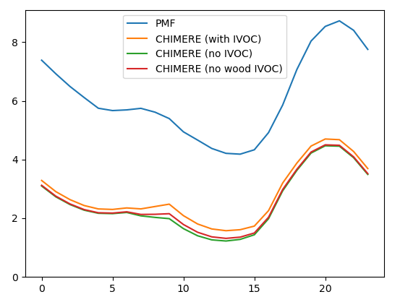
Considering IVOC from FF and BB sources (CAMAERA WP8)
Average winter diurnal cycle
Use of the standard VBS approach proposed by Ciarelli et al. (2017) based on chamber studies on oxidation of wood burning emissions by OH: IVOC/POA ratio of 4.75 for BB
VBS with IVOC/NMVOC ratio of 0.1 for FF
→ Only limited changes…
→ Are key IVOC and SVOC oxidation pathways missing from the model?
total OA (µg/m³)
→ Are model species being assigned correctly to PMF factors?
POA
HOA
POA
BBOA
?
→ More complex mechanisms are needed to answer
SOA
OOA
?
?
French National Institute for Industrial Environment and Risks (Ineris) - CHIMERE Workshop 2026

Slide 9
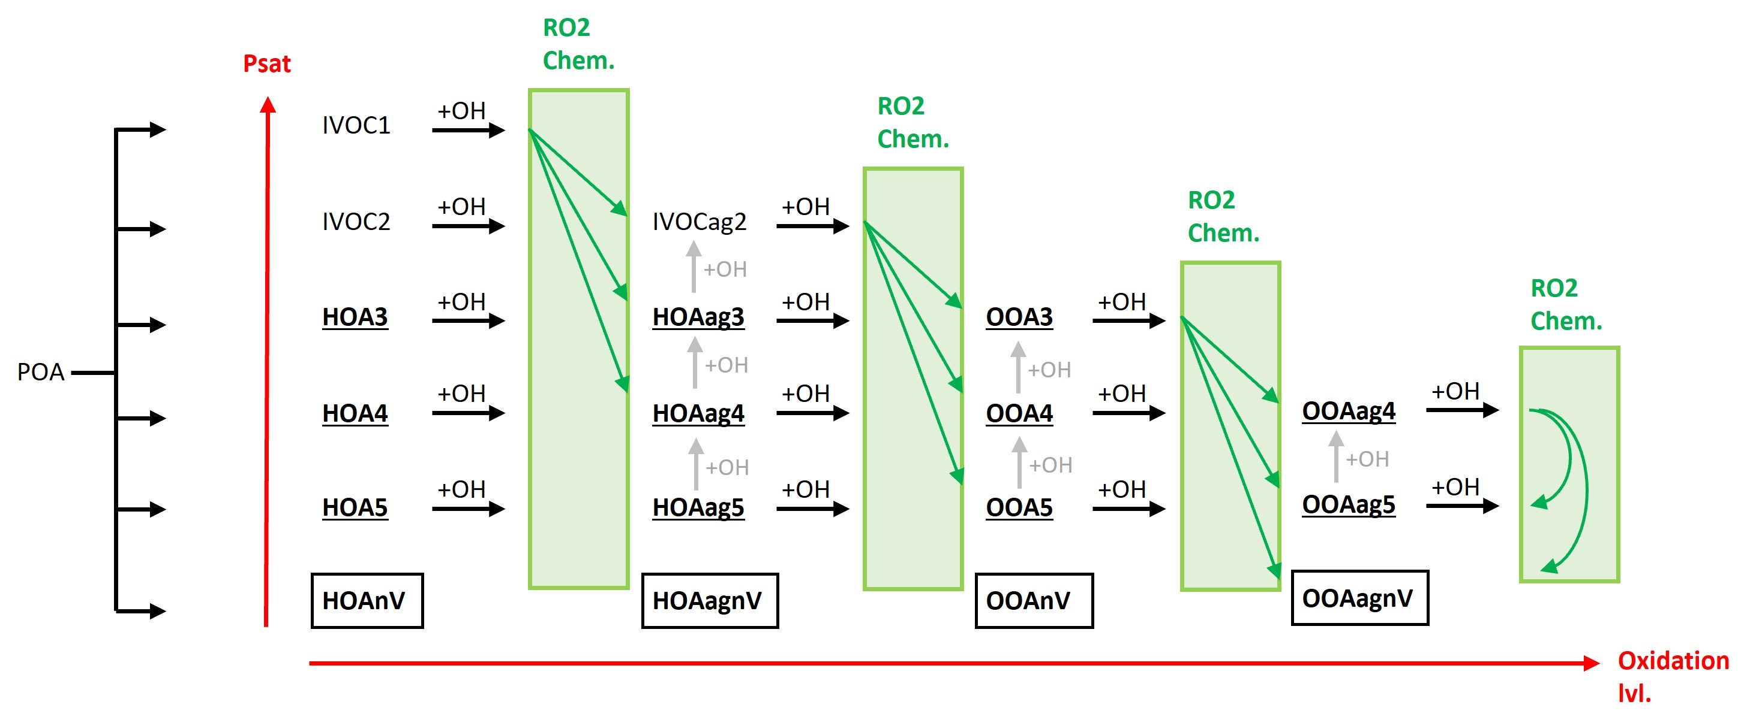
Development of a complex deterministic mechanisms for FF OA
Fossil Fuel semi-volatile POA
For simulations with
CHIMERE-SSHaerosol
Emission distribution based on May et al. (2013) Work
Explicit molecular structures used to calculate properties (non-ideality, solubility, …)
Chemistry based on SAR from GECKO-A and MCM mechanisms
OH chemistry representing functionalization, fragmentation or function modification
RO2 chemistry representing effect of NOx regime or autoxidation on added functions and loss of volatility
Possibility to represent IVOCs
Adjustable HOA and OOA separation
Volatility nb. | Structure (linear alkane) | LOG(Psat) (atm) | Mw
1 | C10 | -3 | 142
2 | C15 | -5 | 212
3 | C20 | -7 | 282
4 | C25 | -9 | 352
5 | C30 | -11 | 422
nV | C35 | -13 | 492
Added functions per ox. Step:
+ 47% nitrate
+ 48% alcohol
+ 71% ketone
+ 3% hydroper.
(-5 /ox. Step)
(-20 /ox. Step)
French National Institute for Industrial Environment and Risks (Ineris) - CHIMERE Workshop 2026

Slide 10
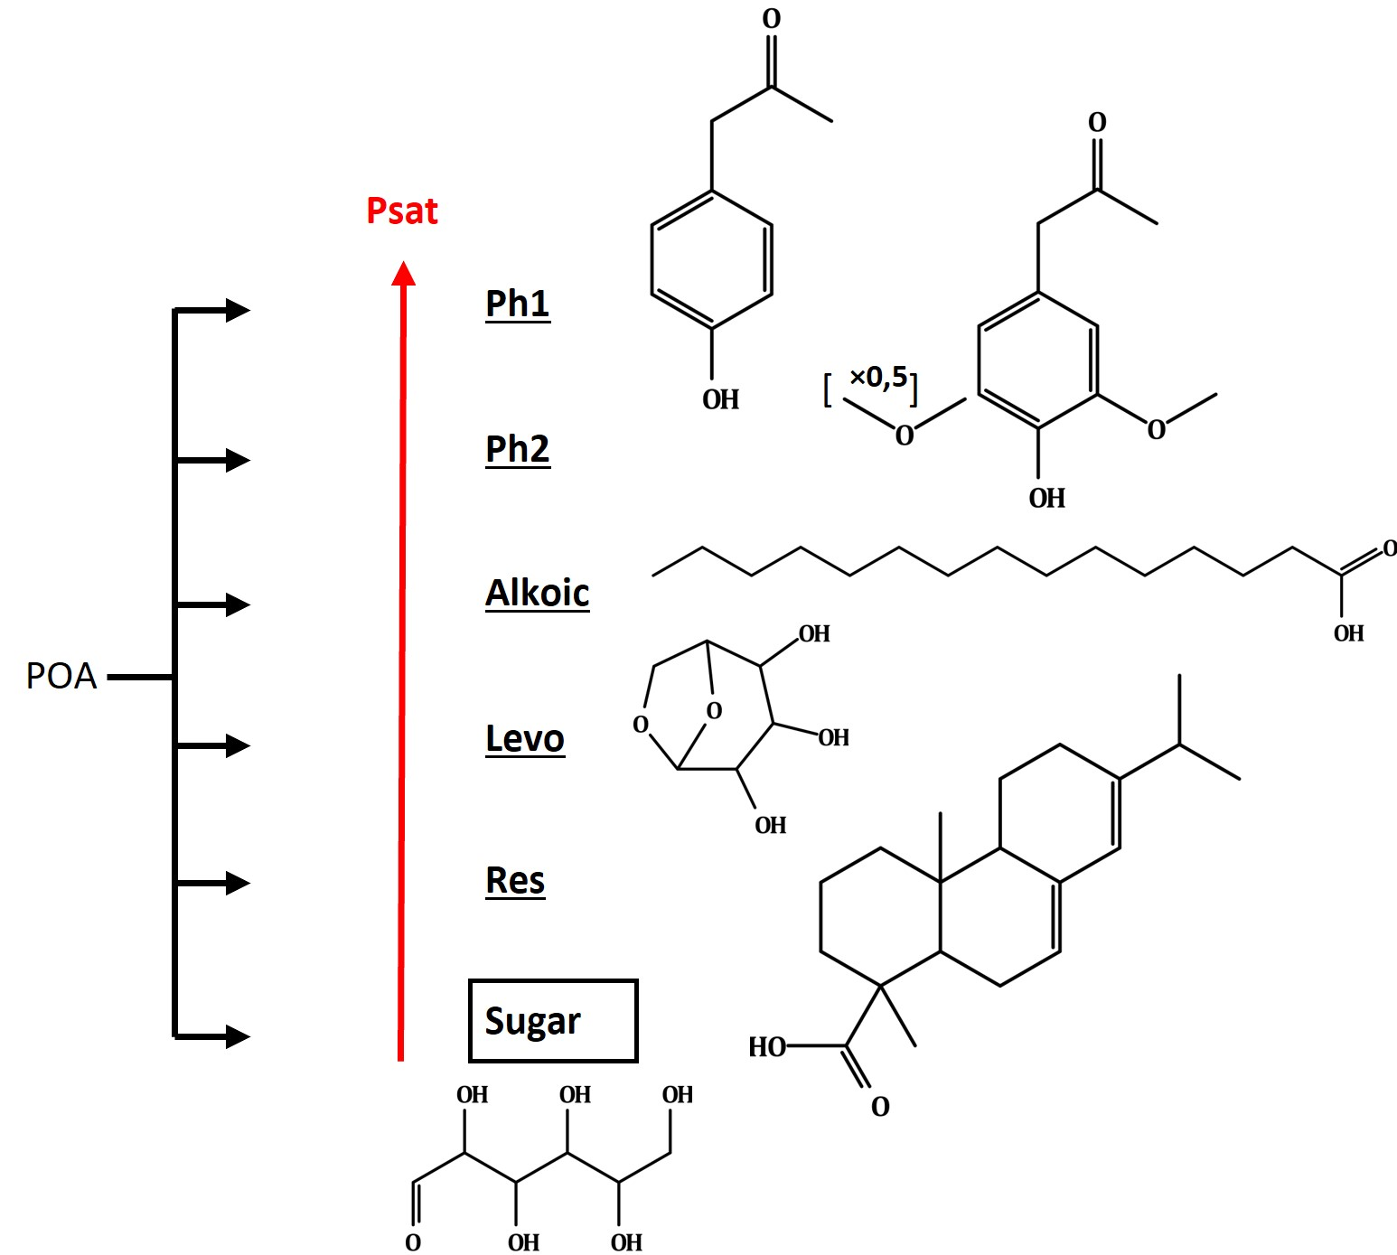
Development of a complex deterministic mechanisms for BB OA
Biomass Burning semi-volatile POA
Complex mixture of chemically diverse compounds: molecular approach
Speciation based on Schauer et al. (2001) and Hatch et al. (2018)
Distribution based on May et al. (2013) and Hatch et al. (2018)
Oxidation based on SAR from GECKO-A, simplified (RO2 chemistry, etc.)
BBOA and OOA adjustable separation (BBOA only linked to levoglucosan/sugar?)
Species | Psat (atm)
Ph1 | 3,2 × 10⁻⁶
Ph2 | 3,2 × 10⁻⁸
Alkoic | 10⁻⁸
Levo | 2,5 × 10⁻⁹
Res | 10⁻¹¹
Sugar | 10⁻¹³
→ Ph1 is IVOC
→ Phenols Ph1 and Ph2 can react rapidly and across multiple oxidation steps with NO3.
→ Levoglusosan oxidation produces more volatile compounds
French National Institute for Industrial Environment and Risks (Ineris) - CHIMERE Workshop 2026

Slide 11
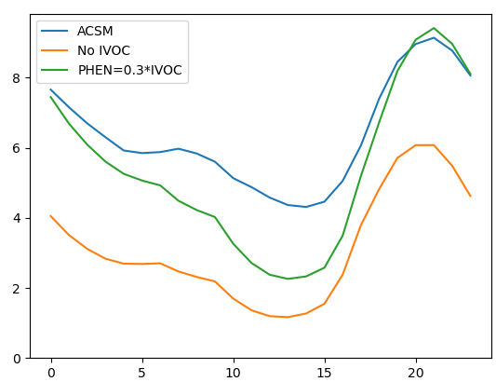
Lastest IVOC test results
Night-time chemistry could be important. Part of compounds could be phenolic compounds with high reactivity
with the NO₃ radical
  Oxidation by OH lifetime around a few days in winter
  Oxidation by NO3 lifetime around 1h in winter
Hypothesis: Phenolic compounds = 30% IVOC
(10-30% found in experimental studies)
Average winter diurnal cycle
+ NO3
+ NO3
Ph1
Ph1N
Ph1NN
Total OA (µg/m³)
→ Strong concentrations increase are observed at night while concentrations remain too low during daytime.
→NO₃ driven IVOC chemistry could explain a large fraction of the discrepancy between simulations measurements
Hour of the day
French National Institute for Industrial Environment and Risks (Ineris) - CHIMERE Workshop 2026

Slide 12
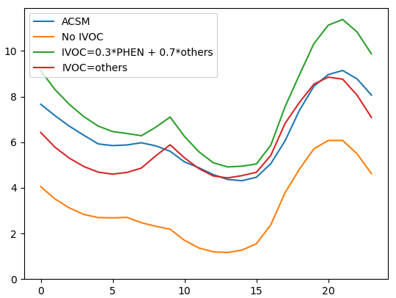
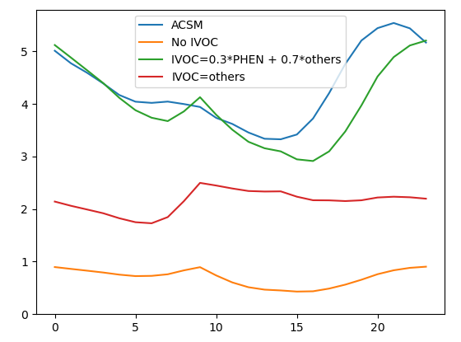
Last IVOC test results
Average winter diurnal cycle
Green: Addition of IVOC representing phenolic and non-phenolic (using the mechanism for alkanes) compounds
Red: All IVOC compounds are represented using the alkanes oxidation mechanism
Total OA (µg/m³)
→ The model-measurment gap can largely be closed
→ Observed OOA concentrations can be reproduced when phenolic compounds are included
OOA (µg/m³)
French National Institute for Industrial Environment and Risks (Ineris) - CHIMERE Workshop 2026

Slide 13
Conclusions and perspectives
Missing phenolic IVOCs and their NO₃ chemistry may explain a large part of the winter organic aerosol underestimation in CHIMERE
Standard semi-volatile POA treatments do not increase simulated OA and do not explain the winter OOA deficit.
Adding IVOC emissions using standard VBS approaches leads to only limited improvements.
Deterministic molecular mechanisms highlight the importance of phenolic IVOCs emitted by residential wood burning.
Night-time oxidation by NO₃ radicals appears to be a key pathway for winter SOA formation.
Including phenolic IVOCs substantially improves agreement with ACSM measurements and PMF-derived OOA.
Perspectives
Improve European IVOC emission inventories, especially for residential wood combustion.
Better constrain IVOC composition and volatility distributions using laboratory and field measurements.
Consider new sources for OA: Volatile Chemical Products IVOC (solvents) or Cooking emissions
Refine the mapping between model species and PMF factors (HOA, BBOA and OOA).
French National Institute for Industrial Environment and Risks (Ineris) - CHIMERE Workshop 2026

Slide 14
Conclusions and perspectives
French National Institute for Industrial Environment and Risks (Ineris) - CHIMERE Workshop 2026

Slide 15
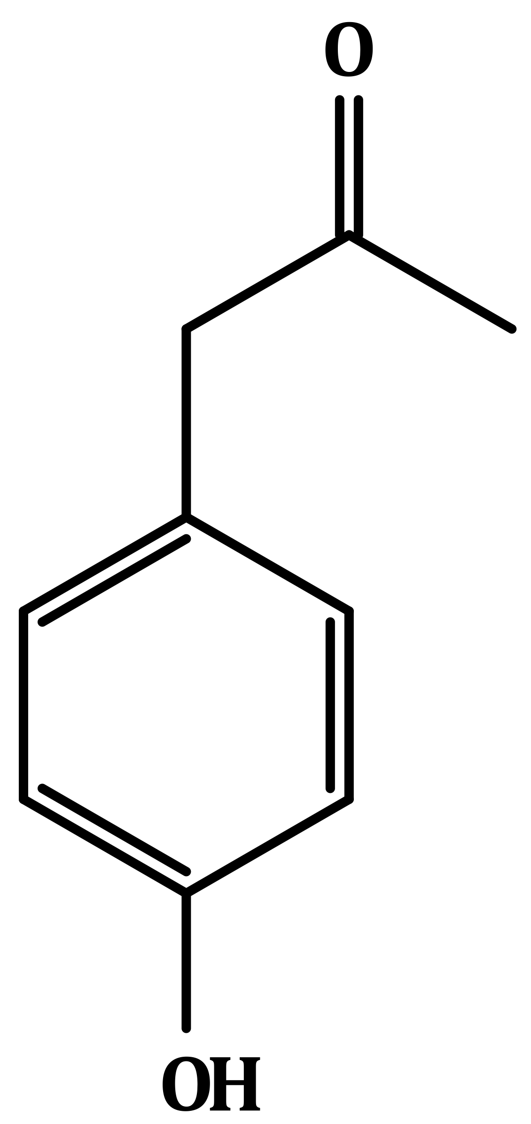
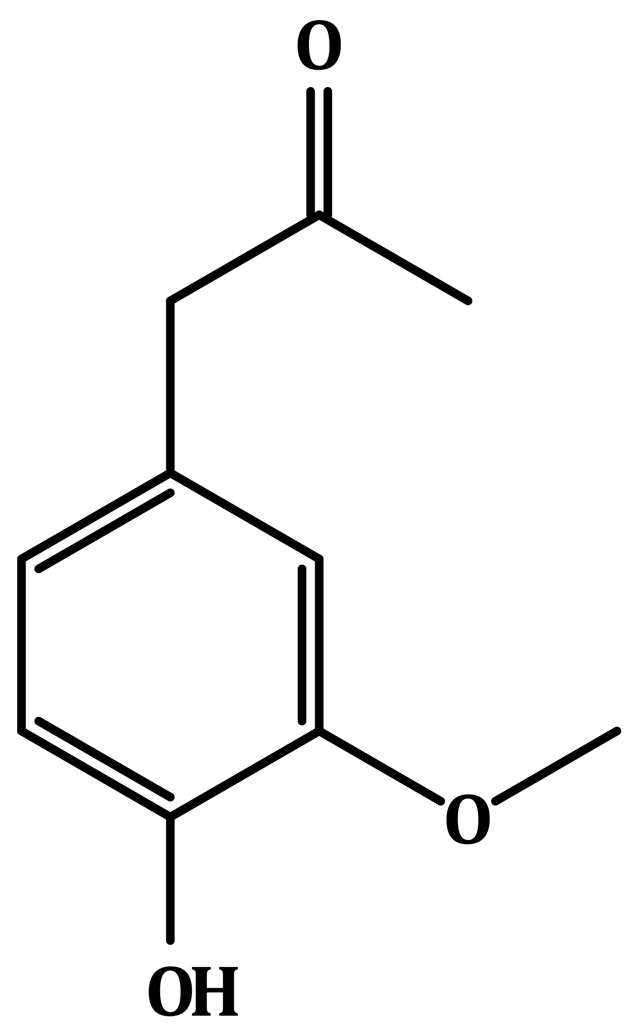

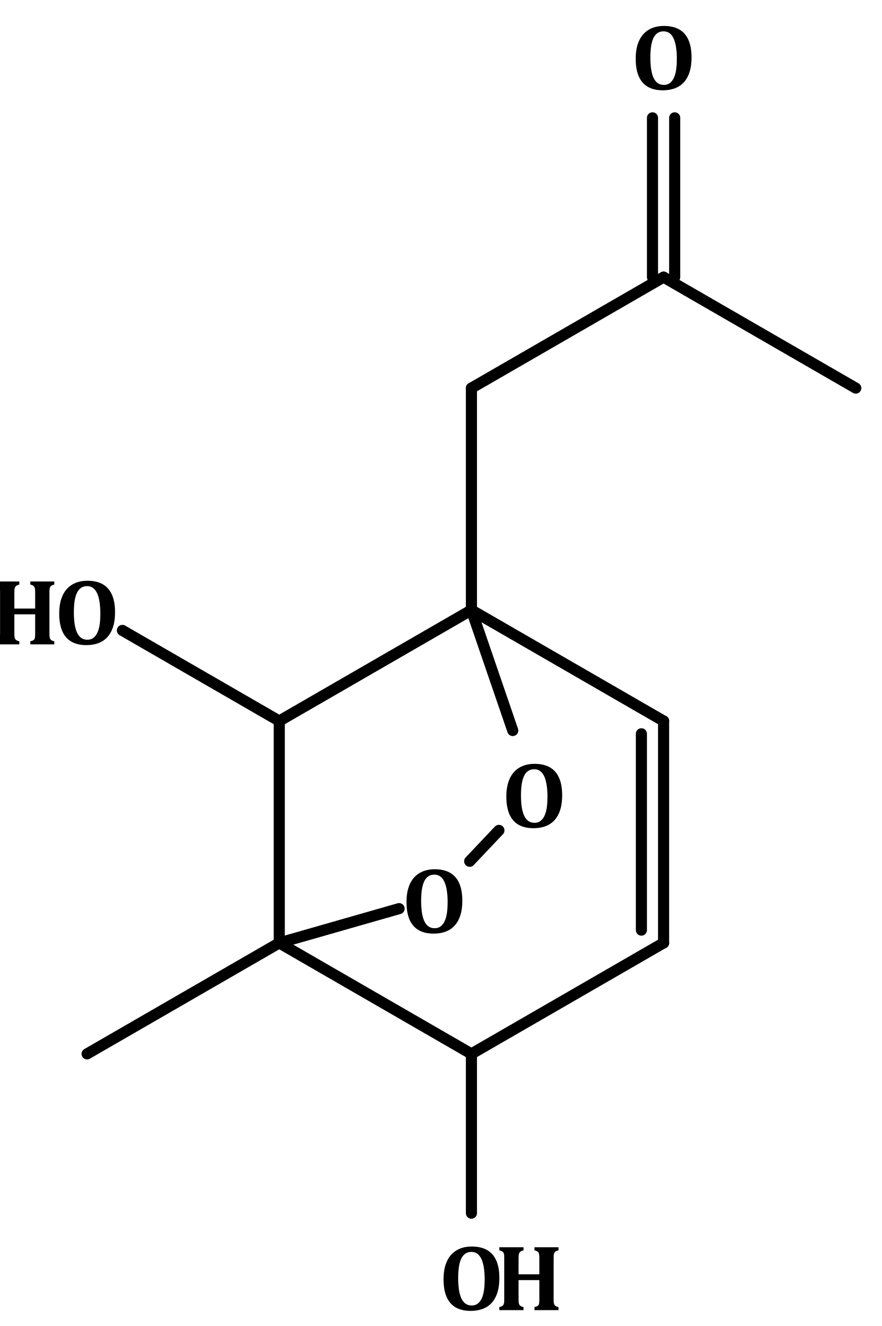
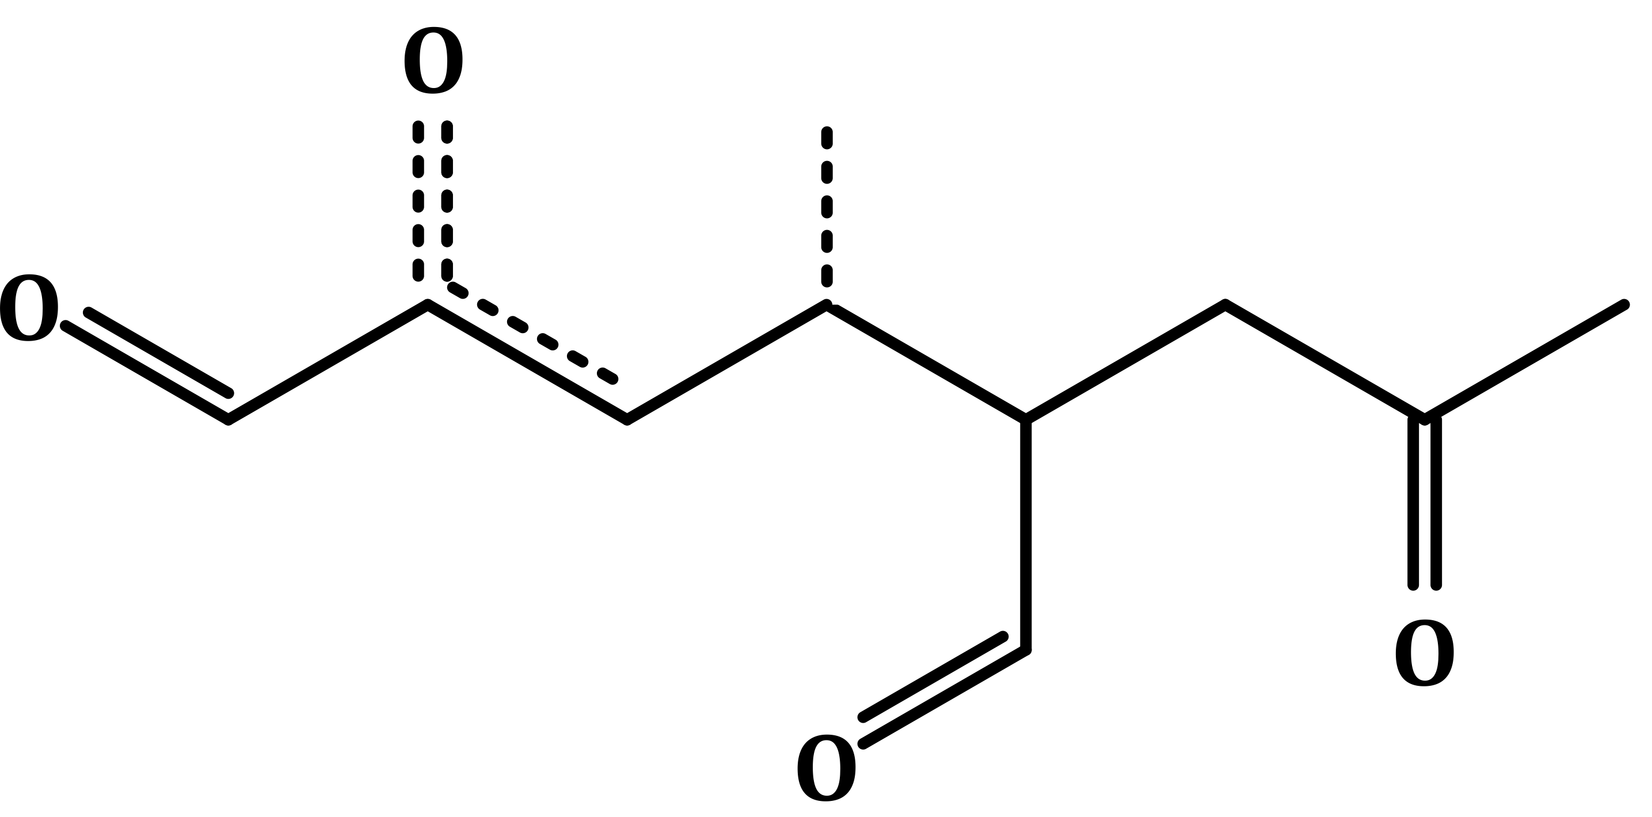
Phenol mechanism
Inclut la chimie radicalaire
N: ajout fonction nitrite
O: ajout fonction alcool
→ Ph1 et Ph2
Log(Psat)
+ OH
Pour Ph1 uniquement
+ NO3
x
Ph
×0,5
[ ]
-2
PhN
PhO
-4
PhON
PhOO
Ph1open:
PhNN
[-NO2/=O/-OH/-OOH]
Ph1BpnV:
-6
PhOON
PhOOO
PhONN
Phopen
[-NO2/-OH/-OOH]
-8
PhBpnV
Log(Heff)
x
+5
+10
French National Institute for Industrial Environment and Risks (Ineris) - CHIMERE Workshop 2026

Slide 16
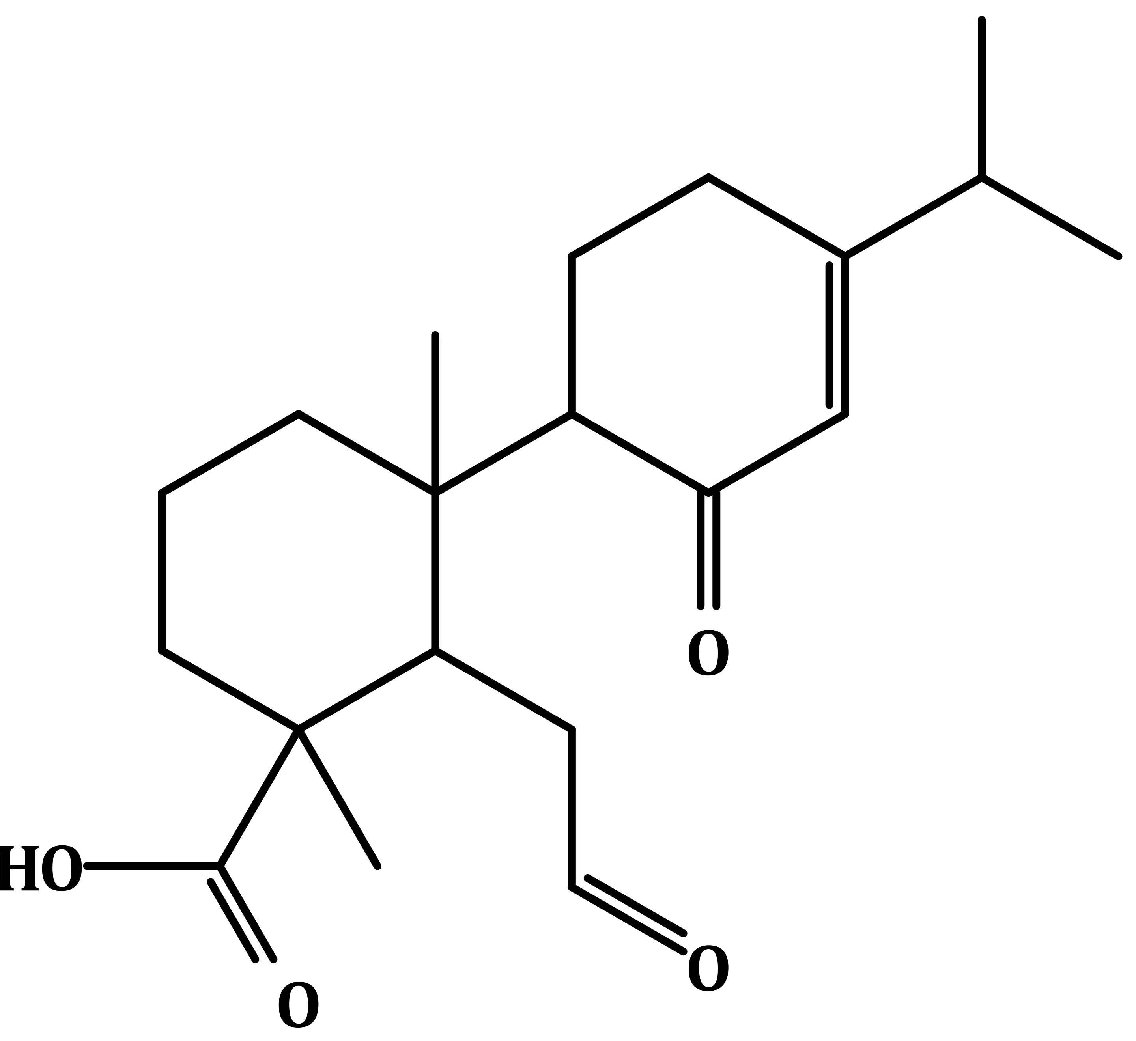
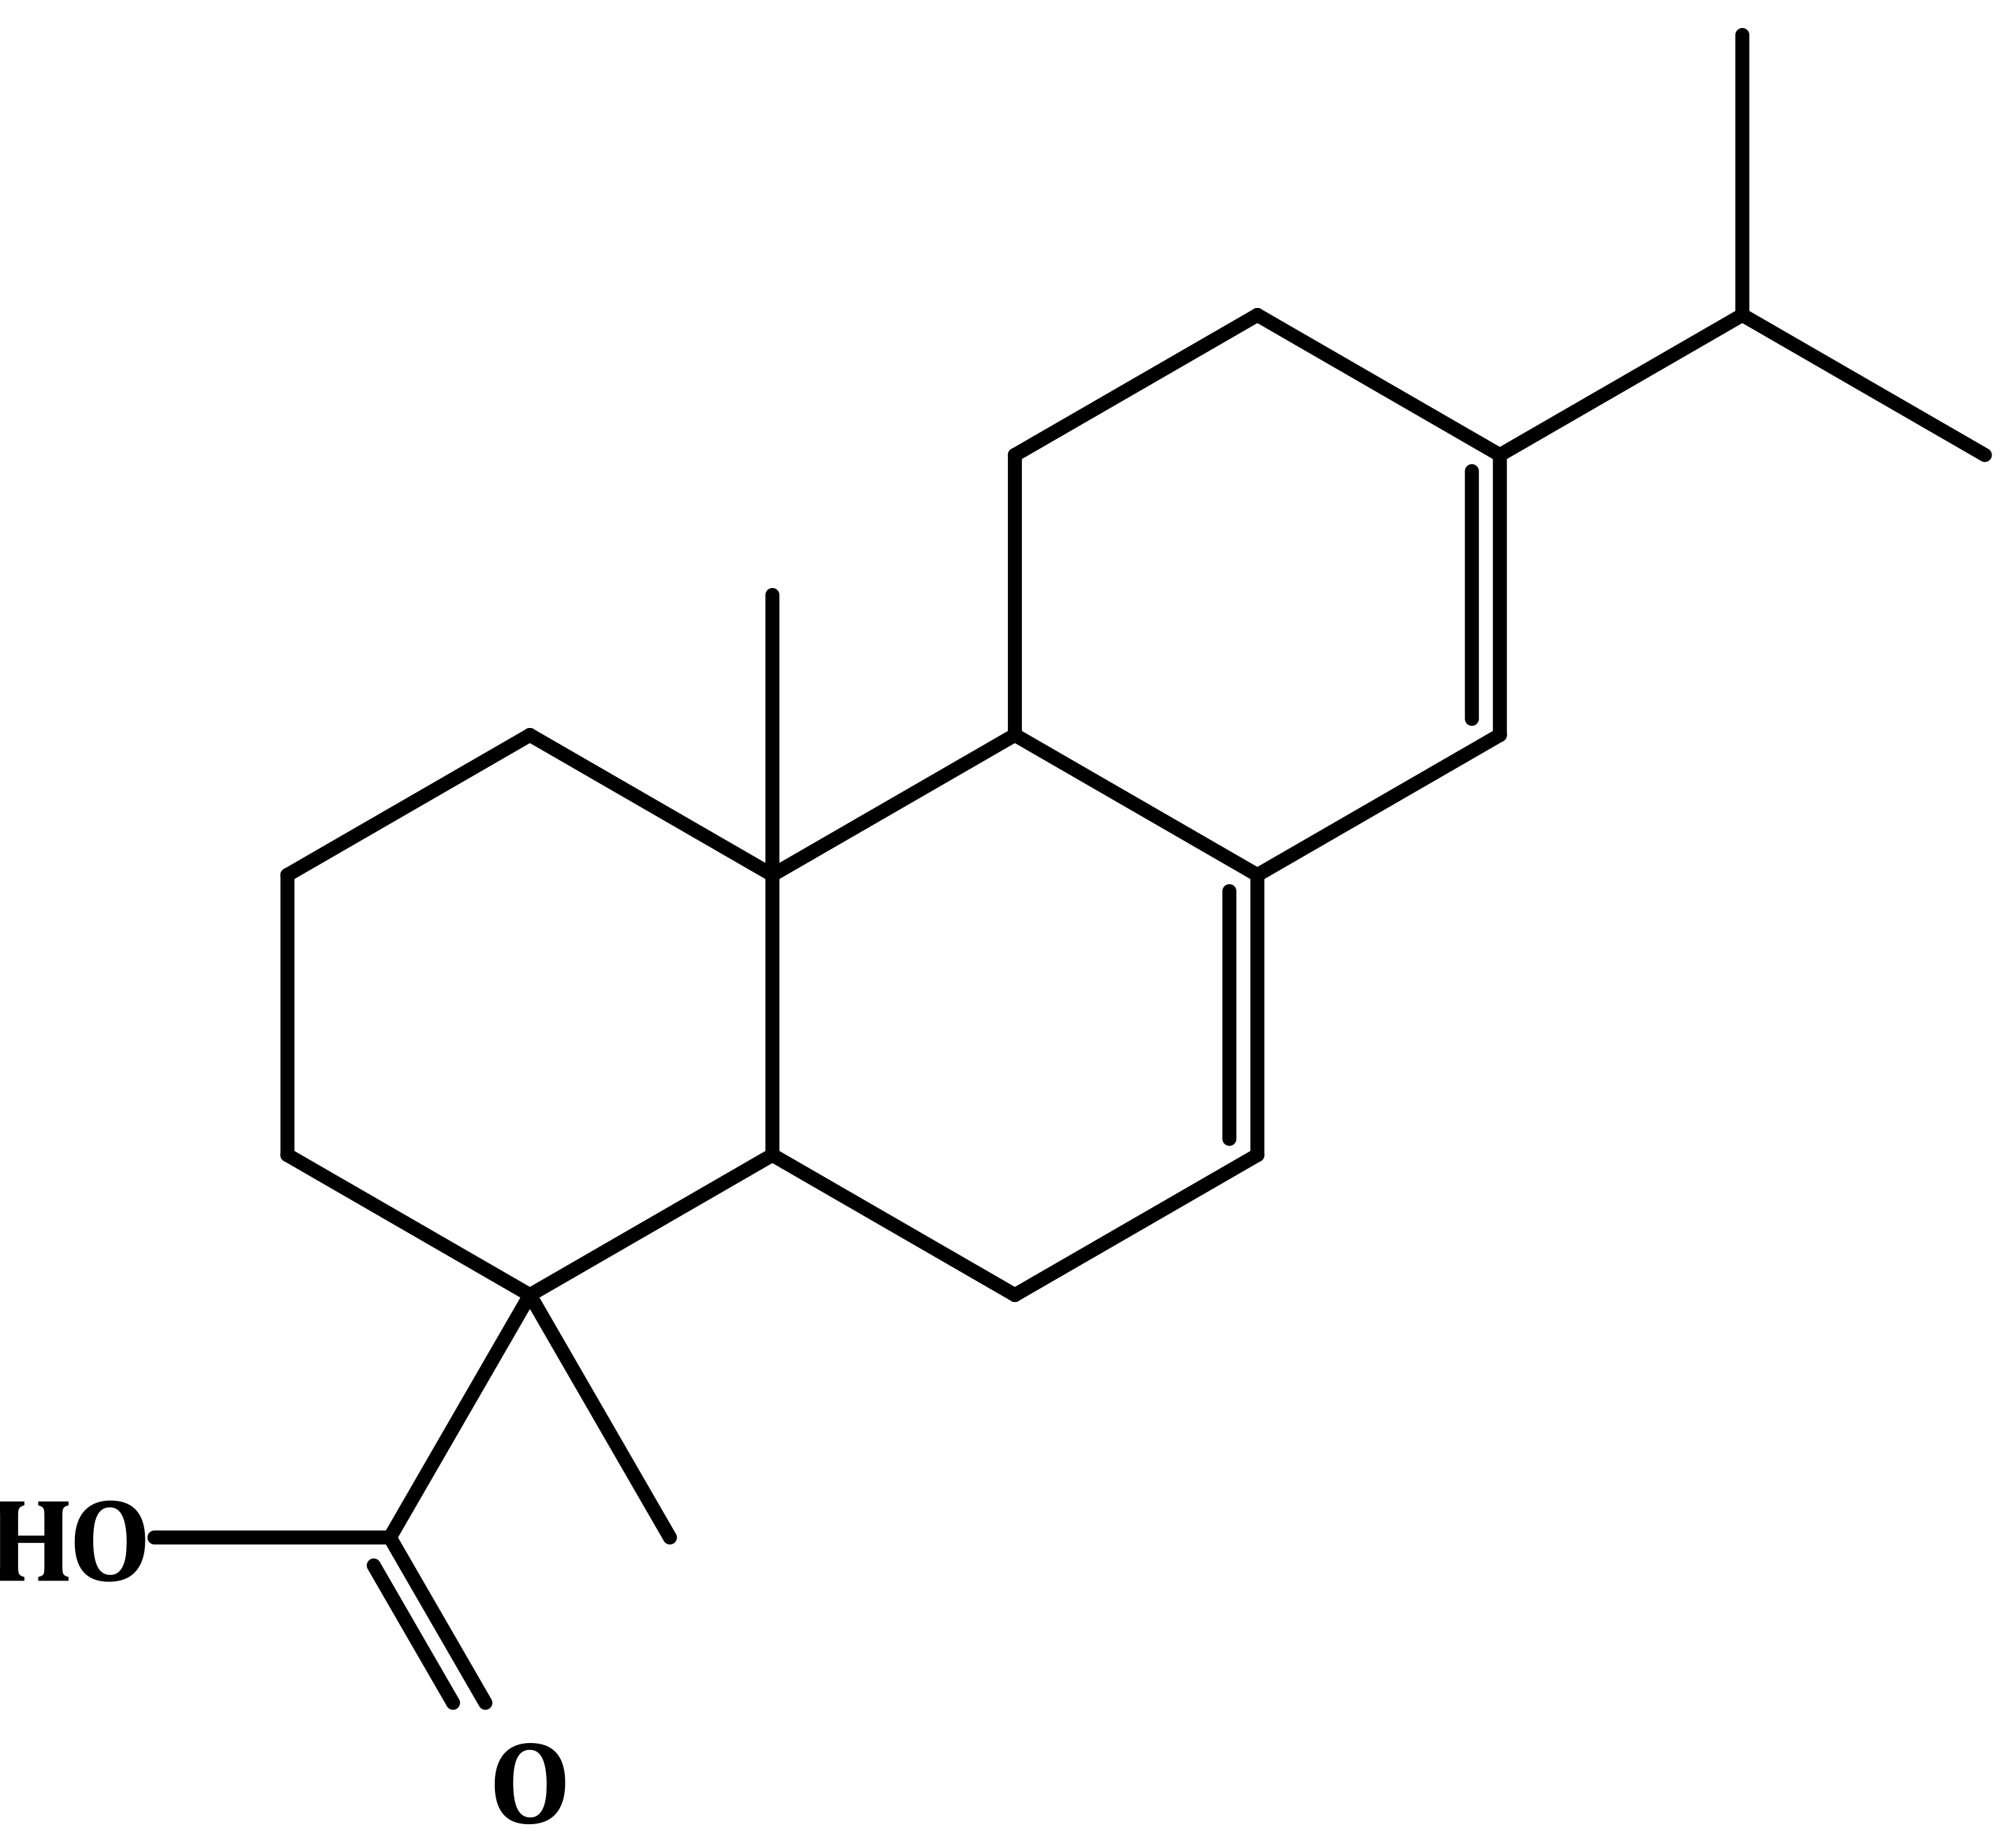
Resine mechanism
→ Sugar : non-volatil
→ Alkoic : vieillissement similaire aux POA du trafic
→ Res :
+ OH
+ NO3
+ O3
+ NO / HO2
Resopen
RO2
C20 avec:
1 double liaison
0.43 alcool
1 cétone
0.74 aldéhyde
1 acide
0.97 nitrate
0.27 hydroperoxyde
Res
ResnV:
French National Institute for Industrial Environment and Risks (Ineris) - CHIMERE Workshop 2026

Slide 17
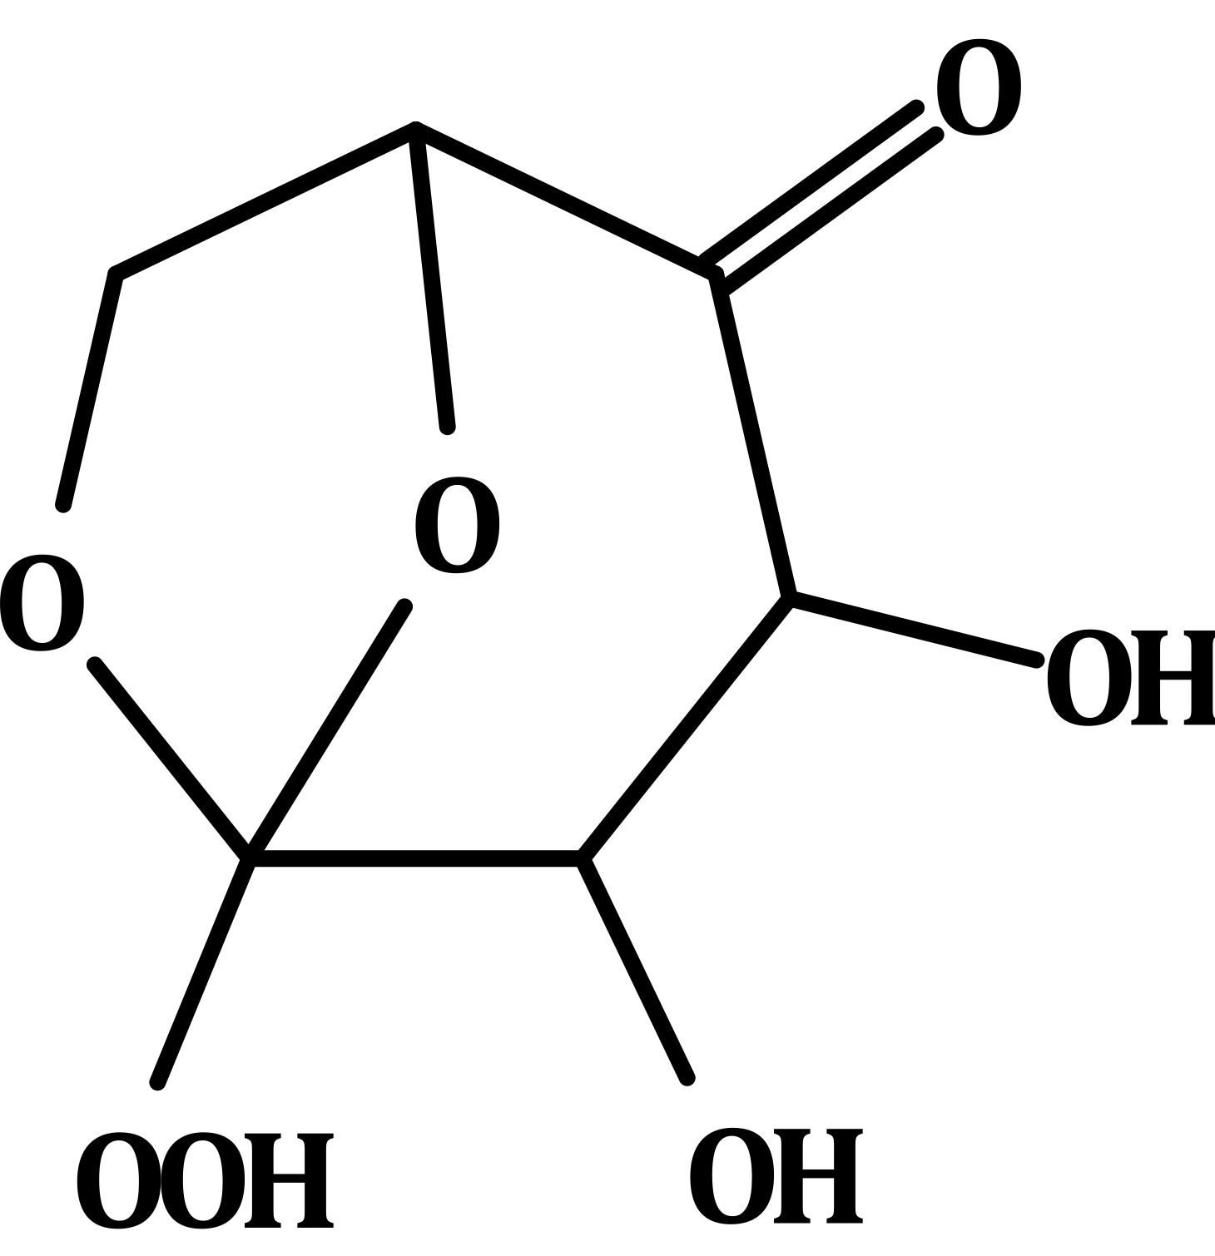
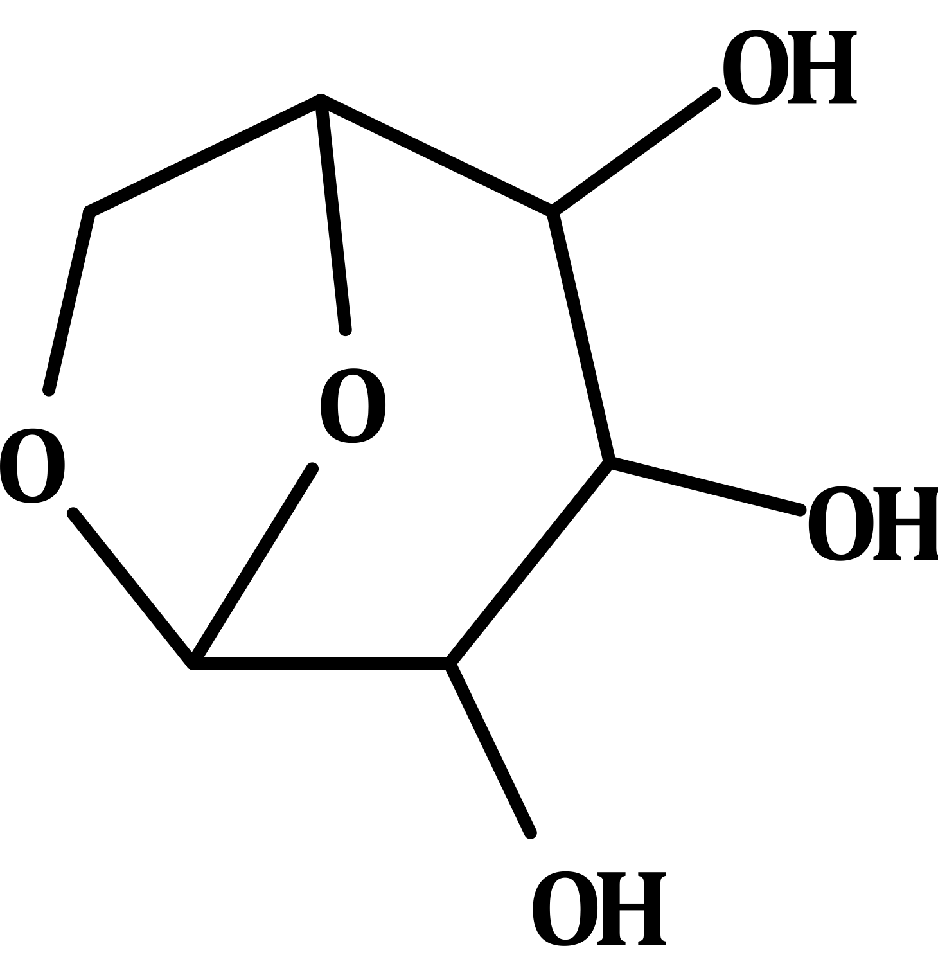
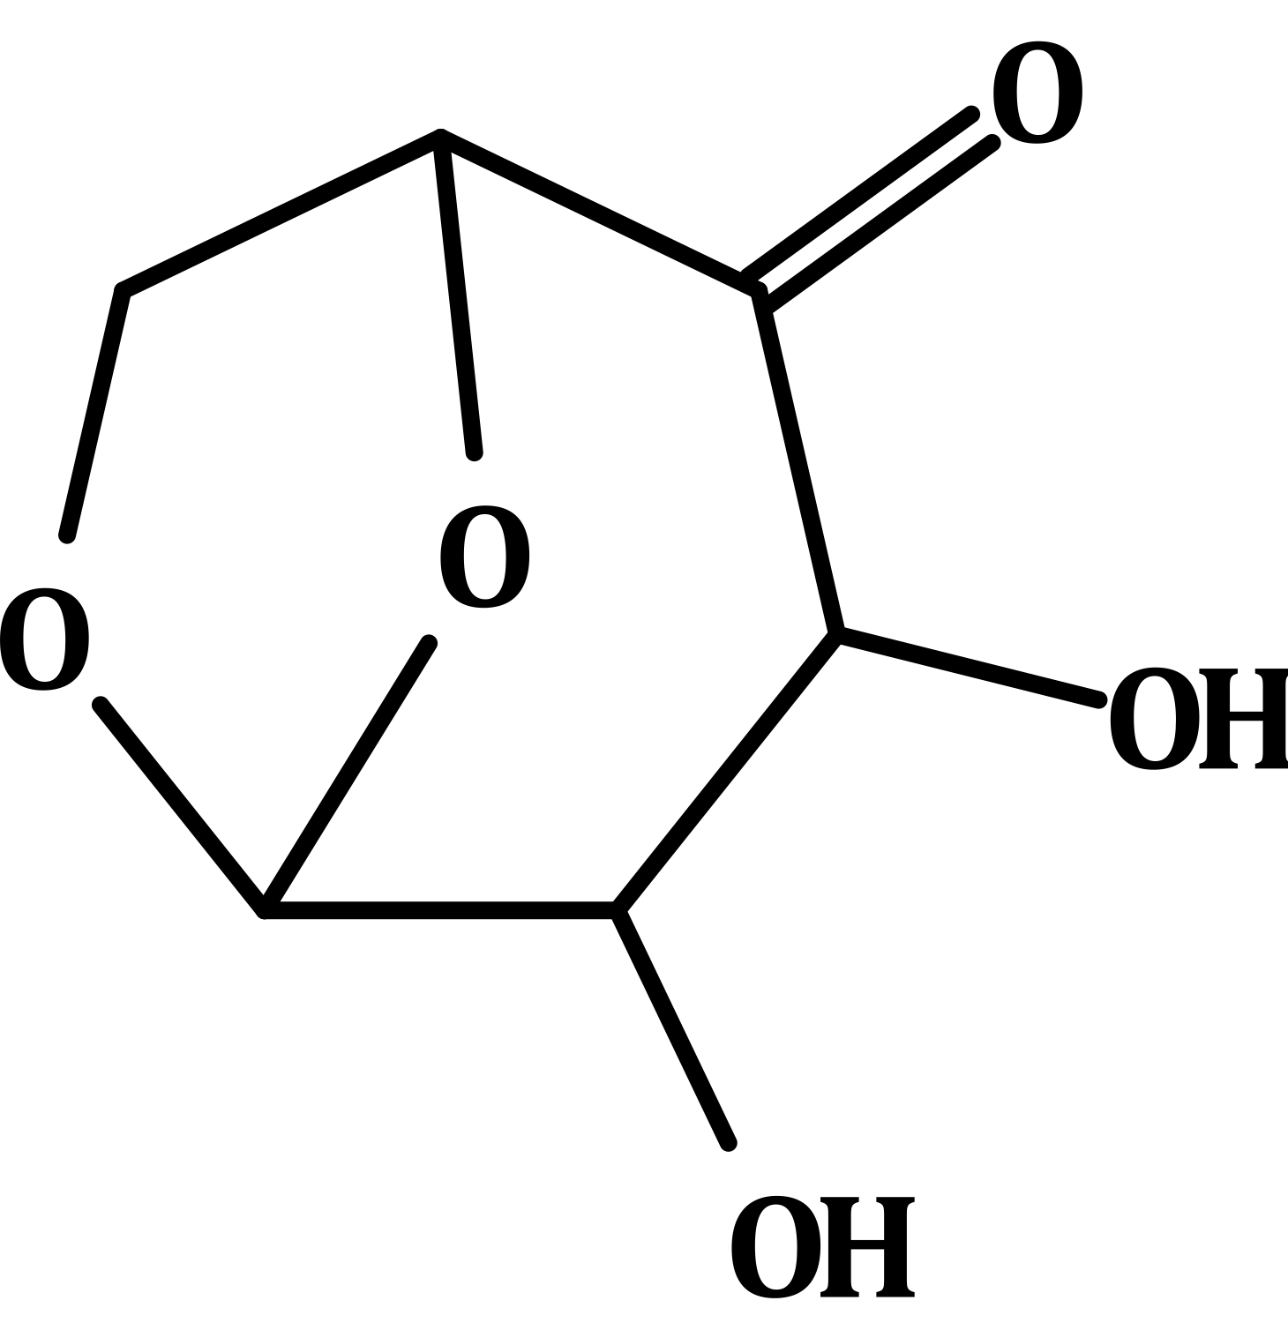
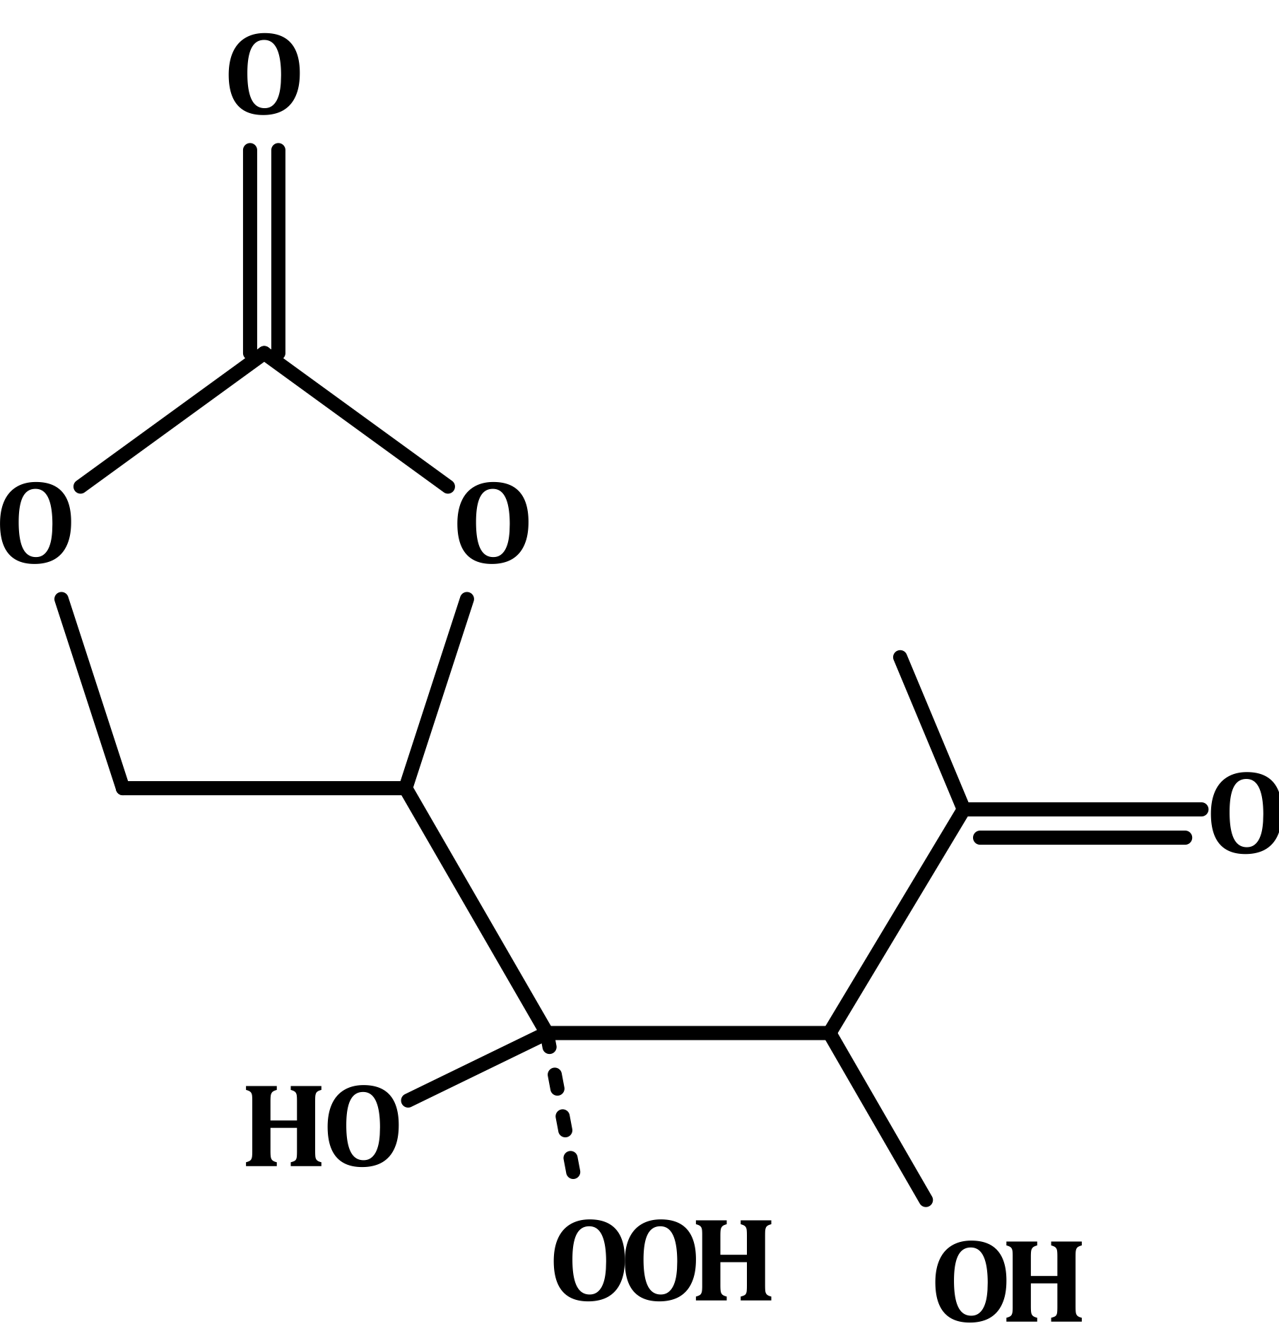
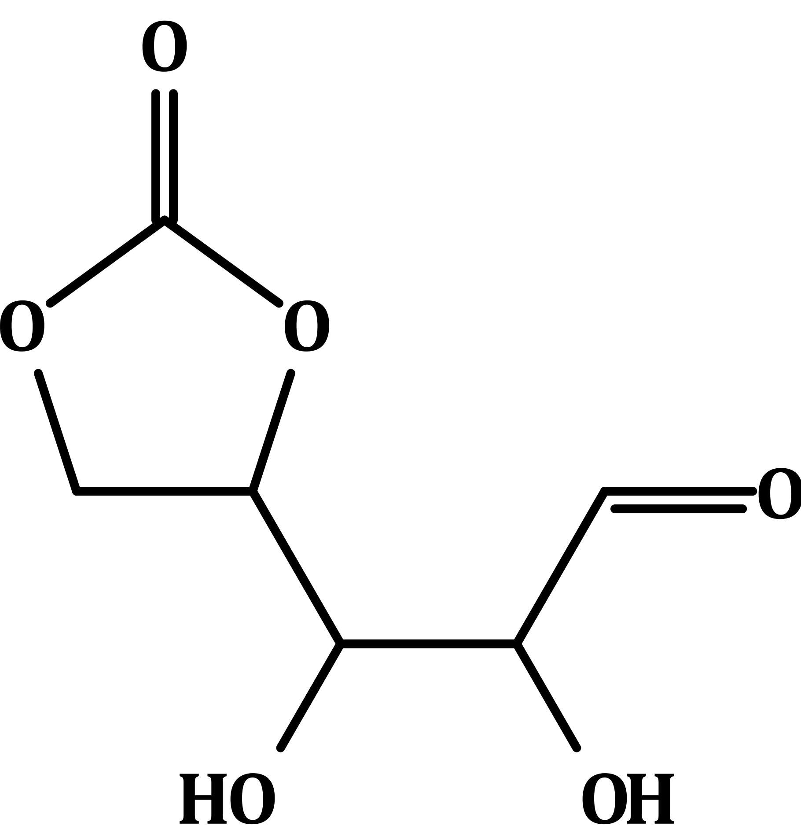
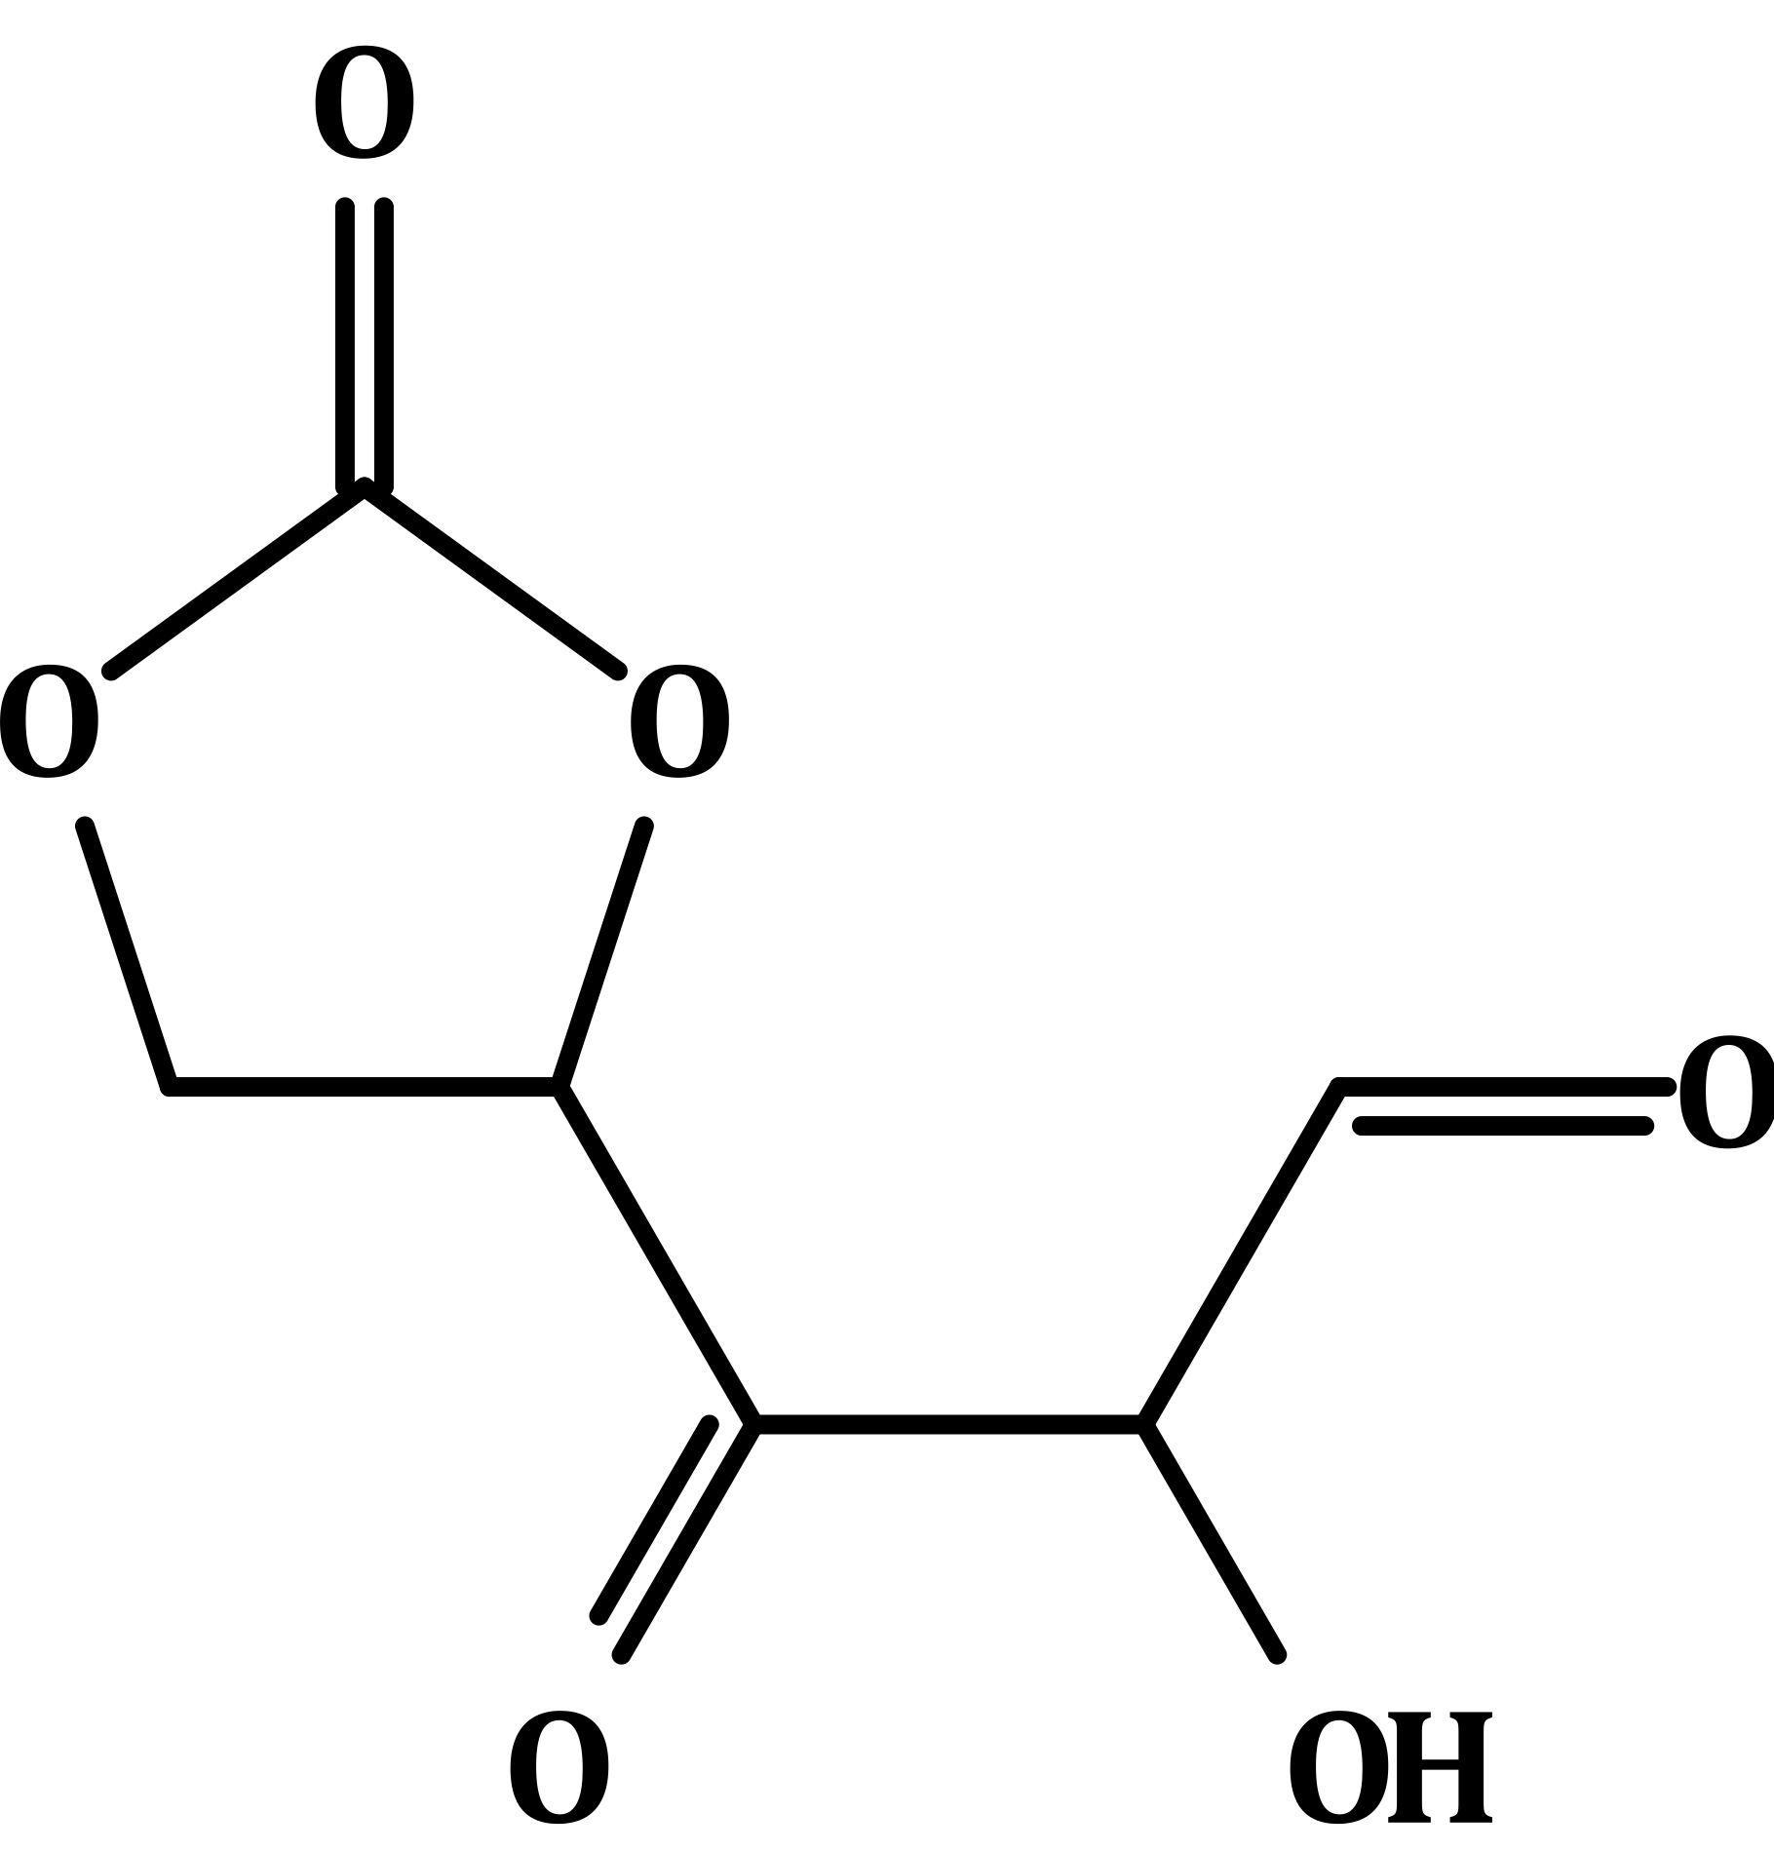
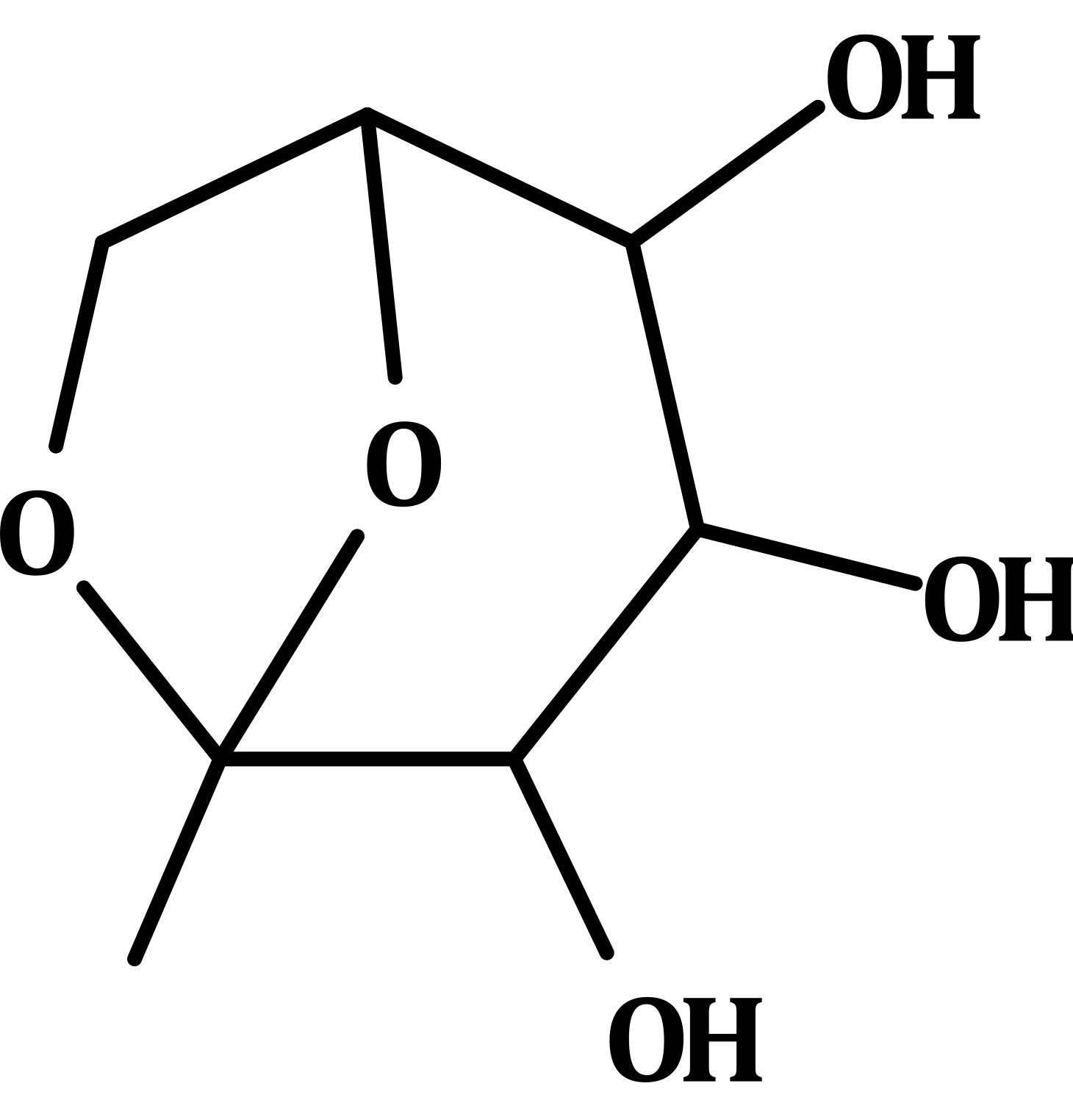
Levoglucosan mechanism
→ Levo :
+ OH
+ HO2
+ NO3
RO2
+ NO2 / HO2
[-OONO2/-OOH/-OH]
+ NO
RO2
+ NO2 / HO2
[ ]
RO2
RO2
+ NO / HO2
+ NO
[ONO2/OH/OOH]
French National Institute for Industrial Environment and Risks (Ineris) - CHIMERE Workshop 2026

