Slide 1

Towards more realistic and efficient organic aerosol modeling in chemistry–transport models
Florian Couvidat, Karine Sartelet, Victor Lannuque, Lya Lugon, Youngseob Kim, Zhizhao Wang, Yijie Shi, Palmira Messina

Slide 2
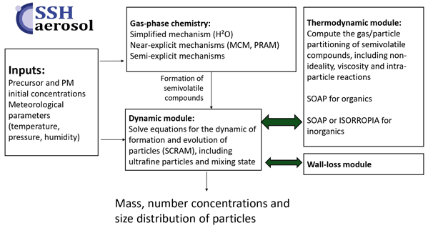
SSH-aerosol v2.0
Sartelet et al. (2026, https://doi.org/10.5194/gmd-19-389-2026)
New features:
New SOA mechanisms
Module to represent wall losses for simulation of SOA in environnemental chambers
Coupled SOA/Inorganics thermodynamics
Effect of SOA composition on viscosity
Particle-phase reactions

Slide 3
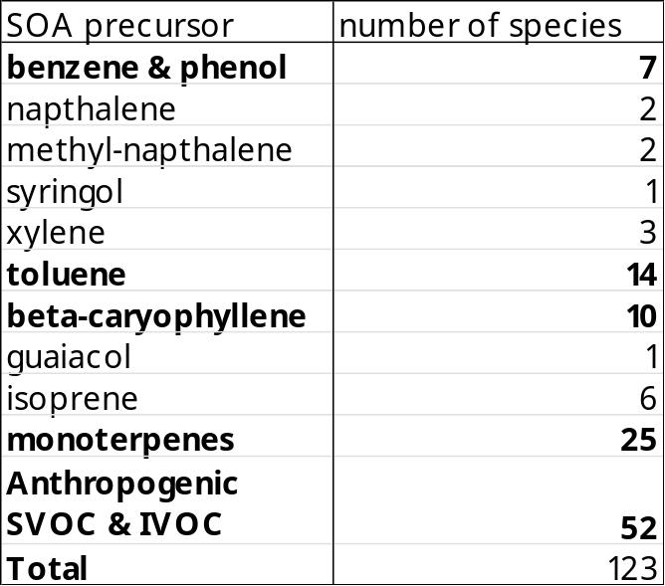
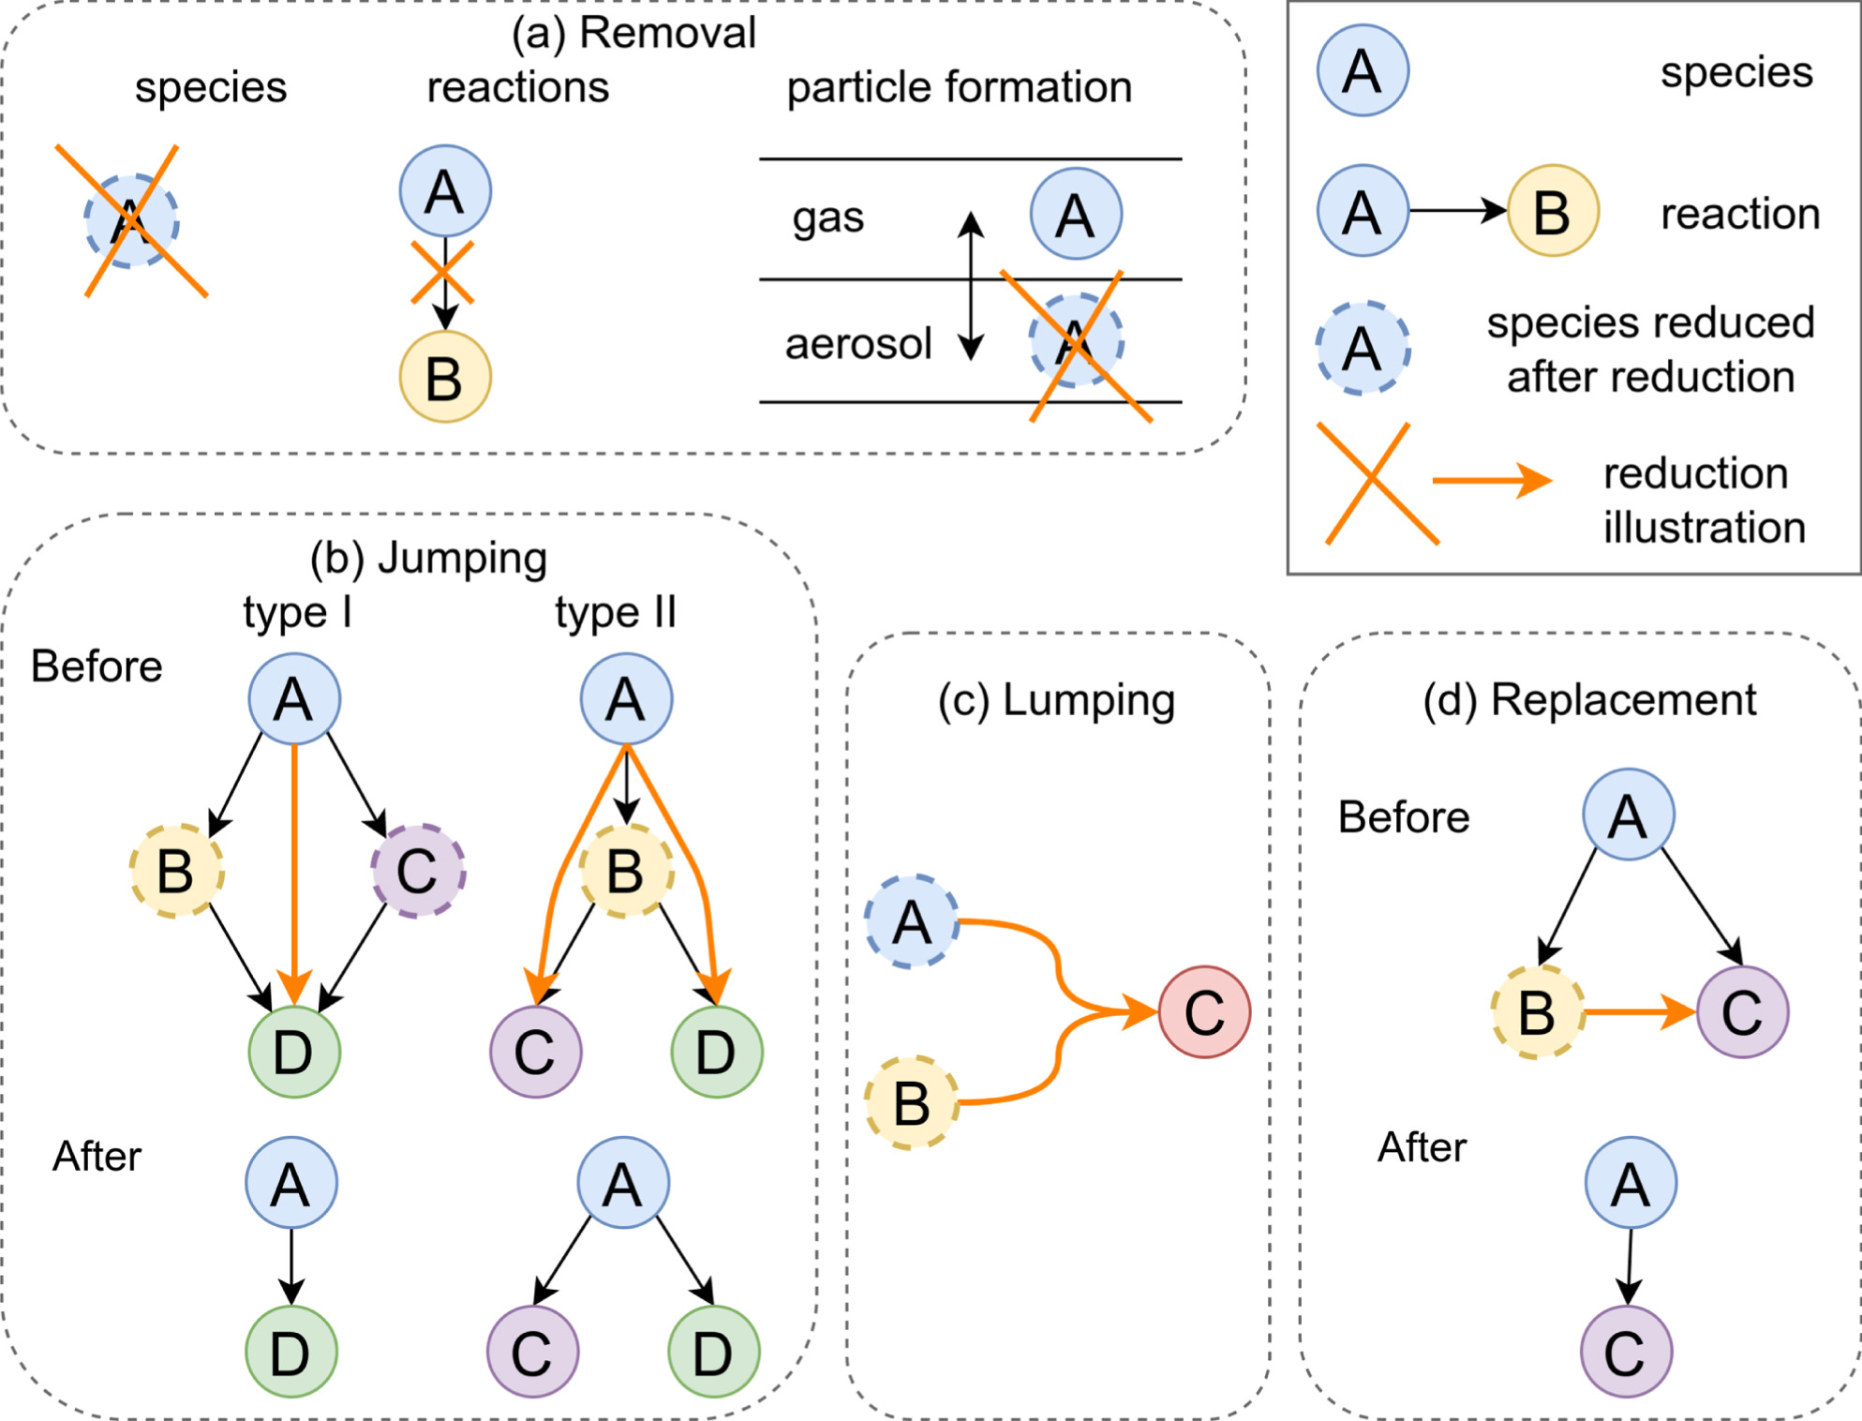
Reduction of mechanisms
SOA mechanism development strategy:
Development of a full explicit mechanism evaluated against chamber data
Reduction of the mechanism using an algorithm
Errors of the reduction around a few percents on most atmospherically relevant conditions
Current reduced mechanism
Bold: semiexplicit mechanisms reduced from
quasi explicit mechanisms
3

Slide 4
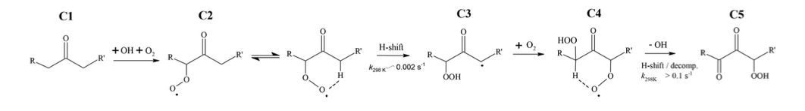
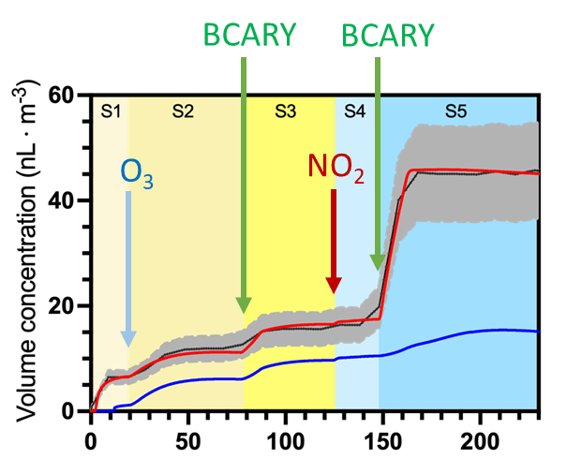

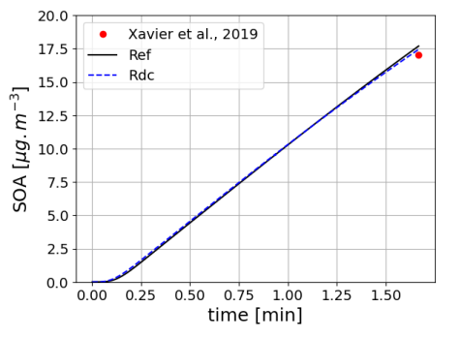
SOA chemistry
Example of new SOA formation pathways: autoxidation
Monoterpene SOA formed by autoxidation
Beta-caryophyllene SOA
with and without autoxidation
Number concentrations
Shi et al. 2026, 10.1039/d5ea00133a

Slide 5
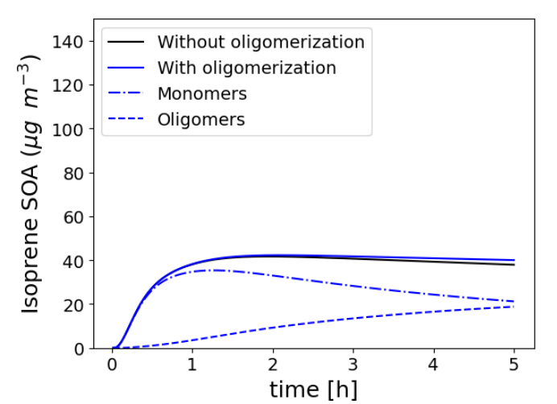
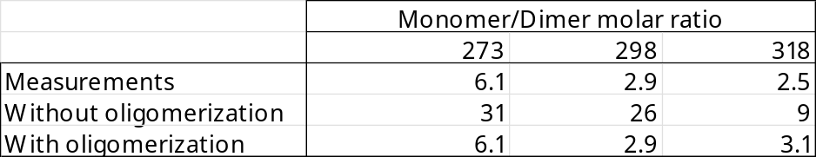
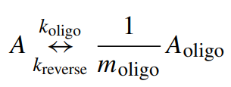
Particle phase reactions
Evolution of monomer and dimer for isoprene SOA
Several type of particle-phase reactions are represented:
1st order non-reversible reactions
2nd order reversible reactions for oligomerization
Hydratation of aldehydes
Reaction with inorganics ions
Evaluation of dimer composition
Example of oligomerization

Slide 6
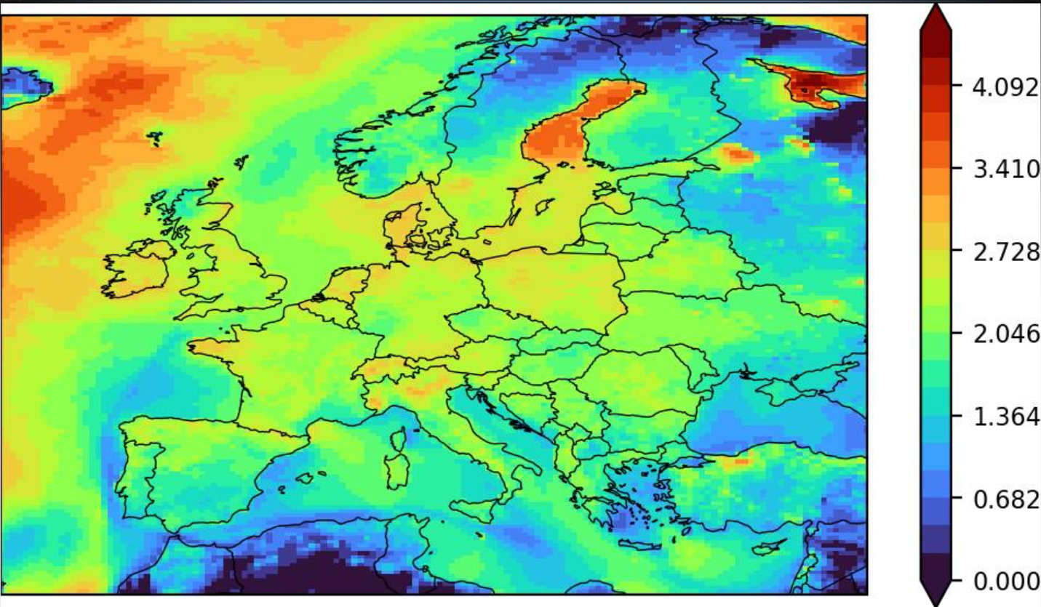
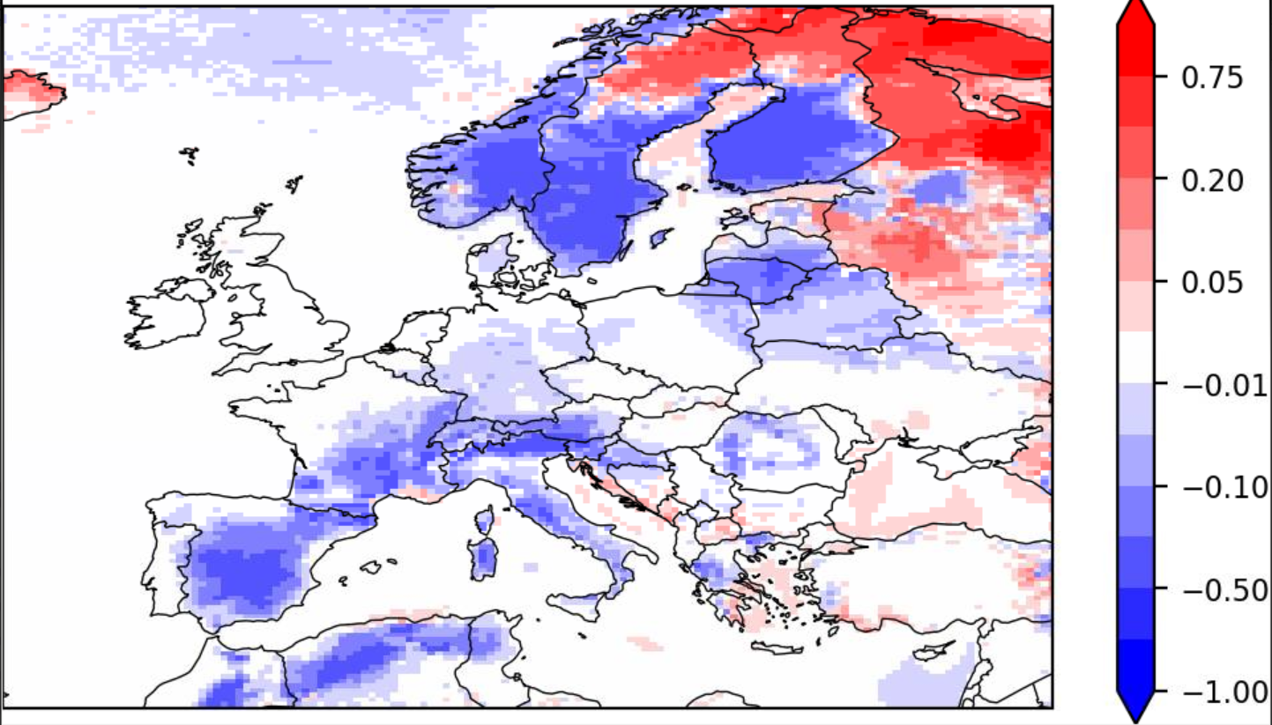
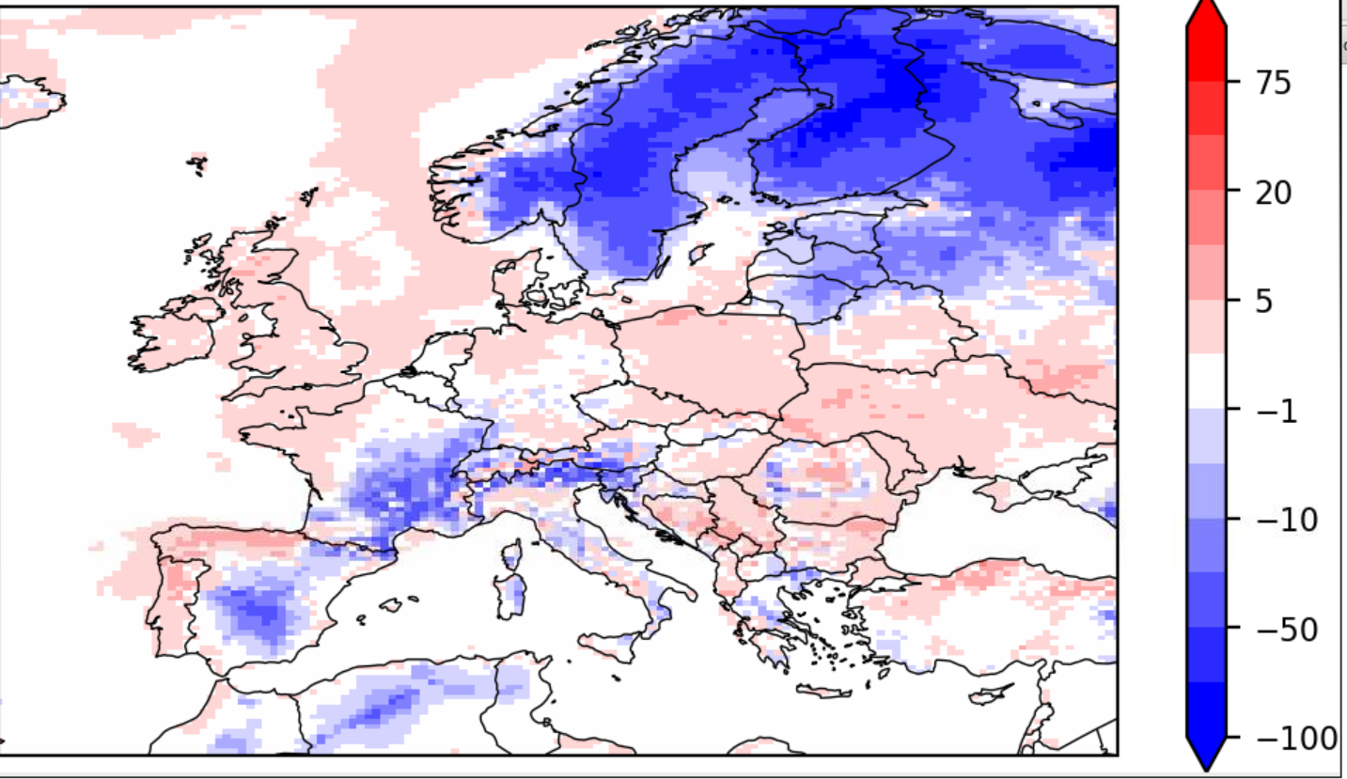
Inorganic-organic interactions
(preliminary results)
Use of SOAP to compute thermodynamic equilibria instead of ISORROPIA:
Very complex numerically because of pH calculation
Coherent thermodynamic equilibrium organics and inorganics
Similar performances on total PM but high impact on water (from +5% to -80%) concentrations and pH
pH with SOAP
(July 2018)
Effect of organics on pH
Effect of organics on pWATER

Slide 7
Challenges in implementing complex SOA scheme
Implementing complex SOA scheme in 3D air quality models still remains challenging due to CPU time
Using GBM represents an increase by a factor 3 compared to SOA typ=2
The use of 10 bins complexify greatly the use of complex SOA schemes in CHIMERE. One additionnal organic aerosol species => 10 model species
Most models in CAMS use simple aerosol approach (model approach or use of 1 or 2 bins) => not as precise but faster
How to preverse the complexity of processes without degrading the results?

Slide 8
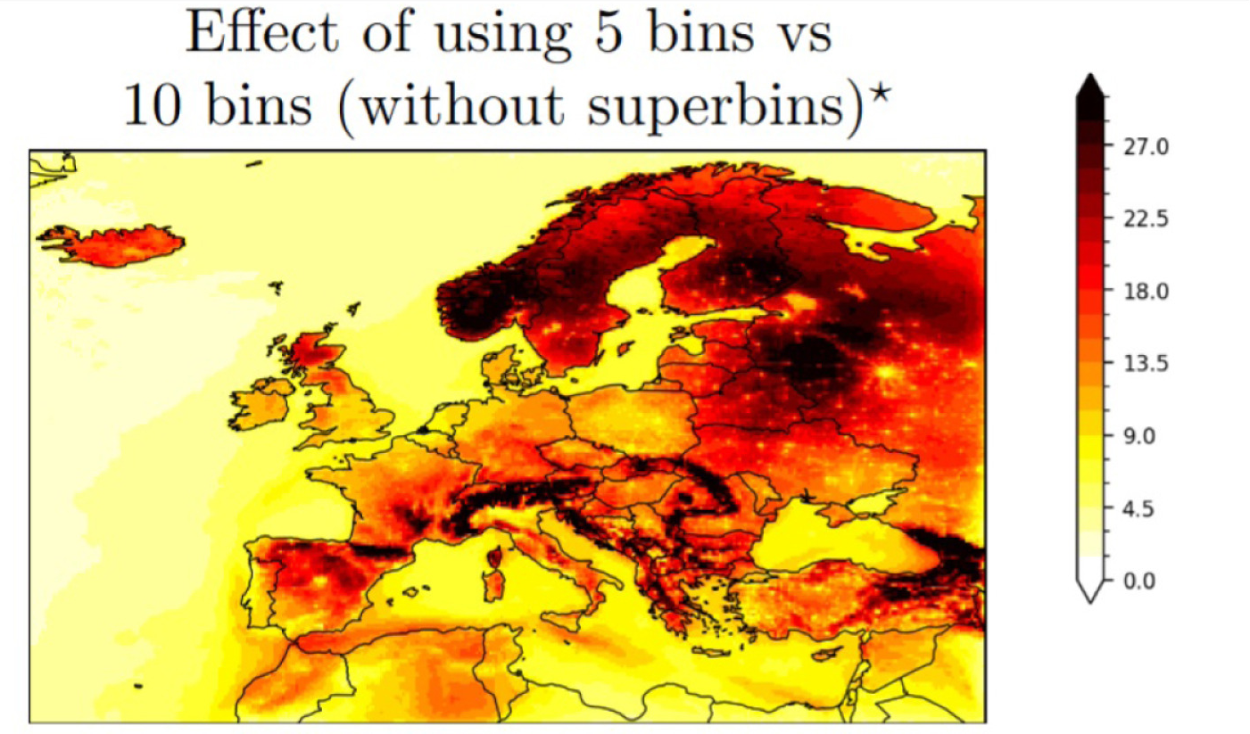
Reducing the number of bins?
Decrease by 2 the CPU time but lead to high differences (>9%)
Comparison to AQ e-reporting data:
Increase the absolute bias (+0.8 µg/m3)
Increase the RMSE (+0.11 µg/m3)
Increase MFE (+11%)
Annual MFE (%)

Slide 9
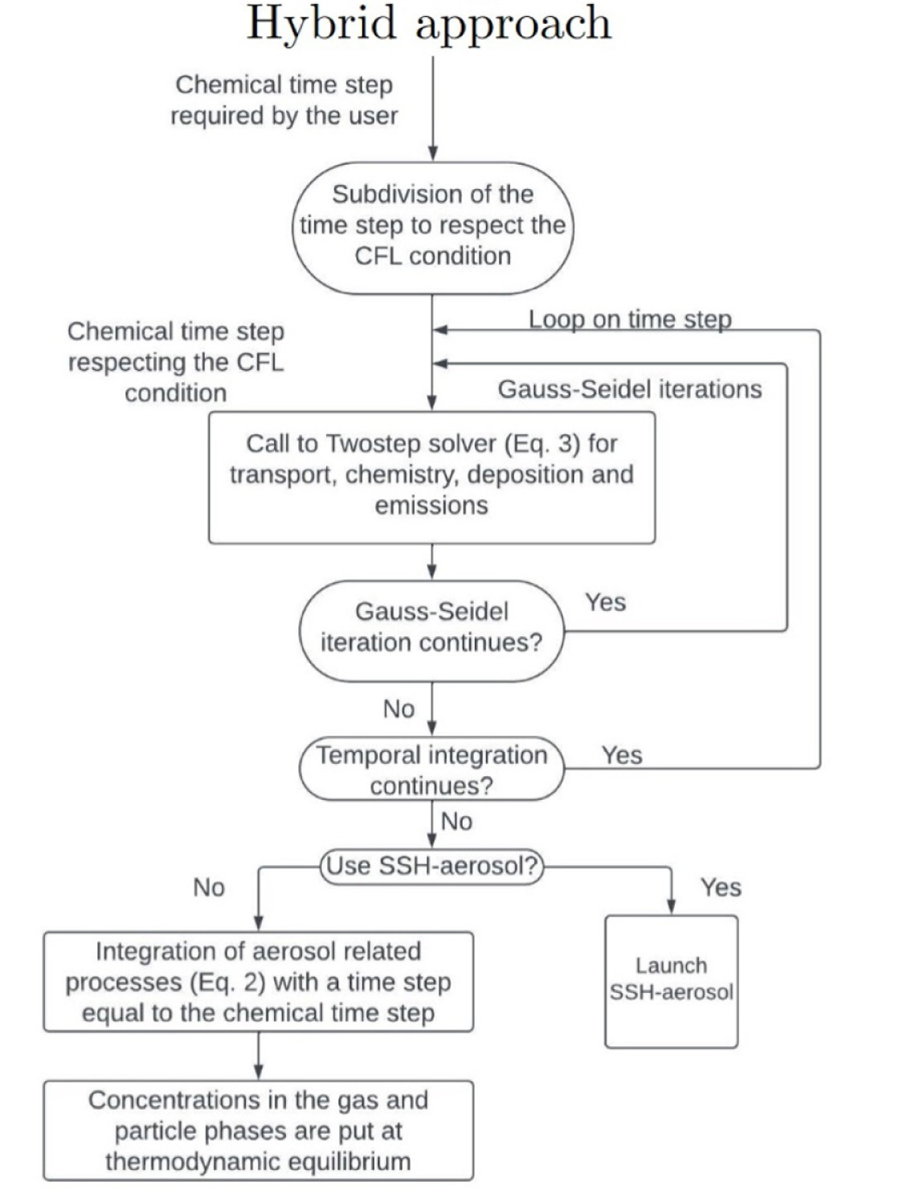
Revision of algorithms
Development of an hybrid numerical solver between splitting and twostep:
Twostep (all processes solved as the same time): more robust to solve chemical reactions but not ideal for aerosol formation (fake condensation/evaporation kinetics, lost of call of coagu and absor)
Splitting: less efficient ti solve chemistry (error due to the splitting of processes, integrating chemistry is CPU time consuming) but more CPU time efficient to solve aerosol formation and better to respect gas/particle partitioning
Hybrid uses the twostep approach for transport and chemistry but split the formation of aerosol

Slide 10
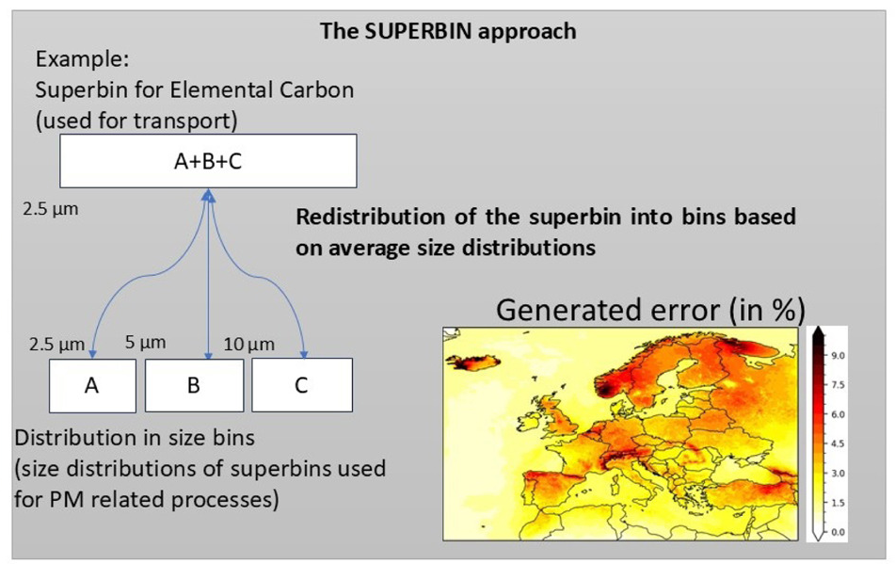
Implementation of a superbin approach
Superbins = group of several bins for a single species
The model calculate transport for species superbin instead of each species
When necessary (deposition, chemistry, thermodynamics) the model disaggregate the superbin using a climatology of size distribution
The lumping of species is done in order to ensure low errors on deposition velocities

Slide 11
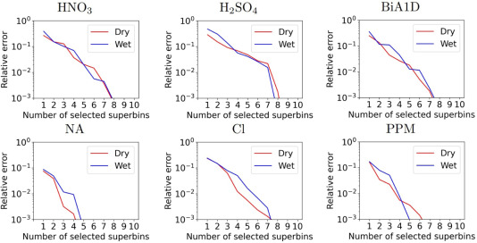
Errors on deposition fluxes

Slide 12
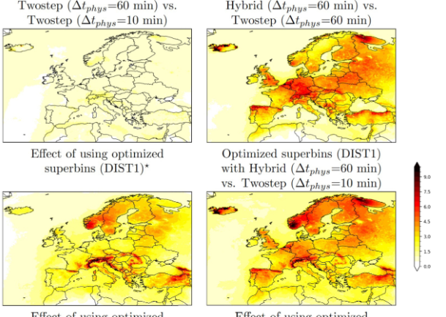
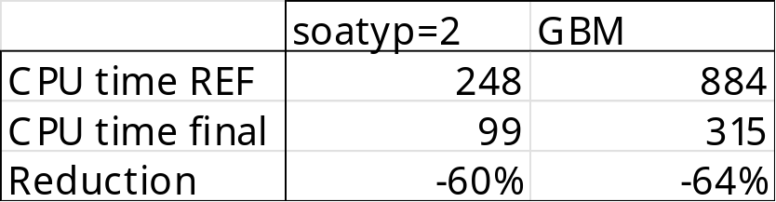
Results
Using the superbin approach give an error around 1%. -40% on CPU time
Using the hybrid approach with high chemical timestep give an error around 2-5%. -35% on CPU time (-11% due to the hybrid, -24% due to the time step)
Comparison to measurements give slightly better performance

Slide 13
Conclusions
Lots of progress on SOA mechanisms
Talk of Victor on the development and implementation in CHIMERE
Development of explicit and reduced mechanism for isoprene (and some other less important precursor) still have to be done.
The developed SOA scheme are very complex with high number of species and very CPU time consuming, but complex SOA schemes could be used operationally with a CPU time equivalent to the current use of CHIMERE by using the superbin approach. More aggressive mechanism reduction will be investigated in the future.
The importance of complex processes (oligomerization, viscosity, inorganic-organic interactions, ELVOC nucleation) on SOA formation could be investigated in the future.

