Slide 1


Evaluation of CHIMERE performance in estimating Benzo(a)Pyrene and VOCs at a European scale: A multi-model intercomparison
Marta Garcia Vivanco, Mark Theobald, Coralina Hernández, Victoria Gil, Juan Luis Garrido
Atmospheric Modelling Unit. Environmental Department. CIEMAT
CHIMERE Workshop, Paris, June 25-26 2026

Slide 2
Performance of CHIMERE for BaP modelling
Performance of CHIMERE for VOC modelling

Slide 3
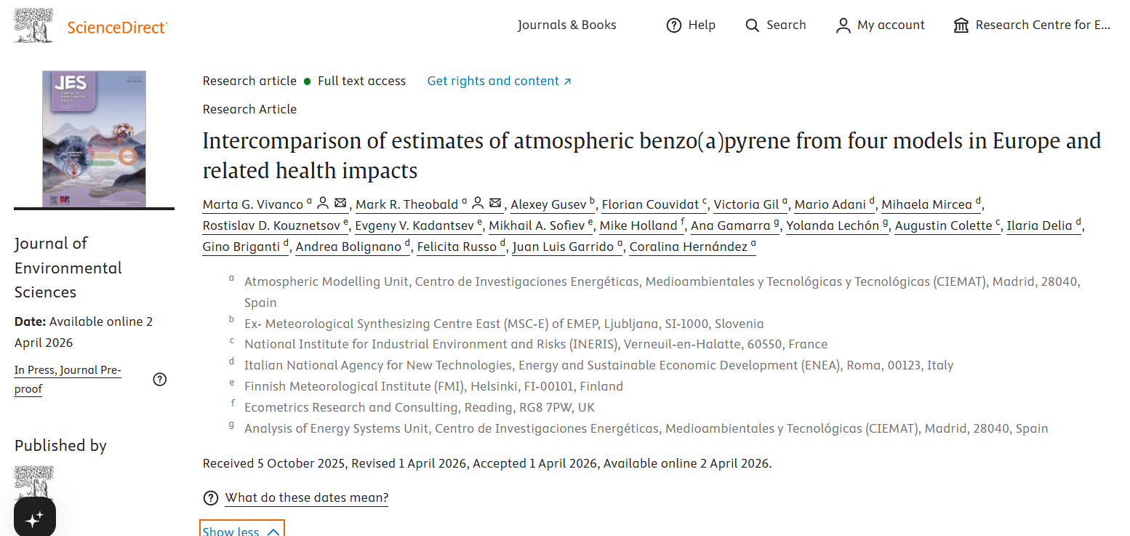
Performance of CHIMERE for BaP modelling
Vivanco et al. 2026

Slide 4
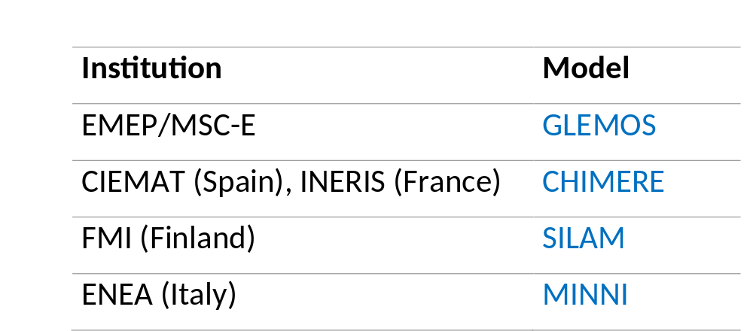
Eurodelta-Carb B(a)P multi-model intercomparison study
Work developed within the Task Force on Measurements and Modelling
(TFMM) framework (CLRTAP)
Participating models
Prescribed modelling domain
Prescribed B(a)P annual emissions (2018)
Prescribed emissions for other pollutants (CAMs)
Free: Meteorological input (2018)
CHIMERE versión: CHIMERE 2020 modified to include BaP (collaboration with Florian Couvidat, INERIS)

Slide 5
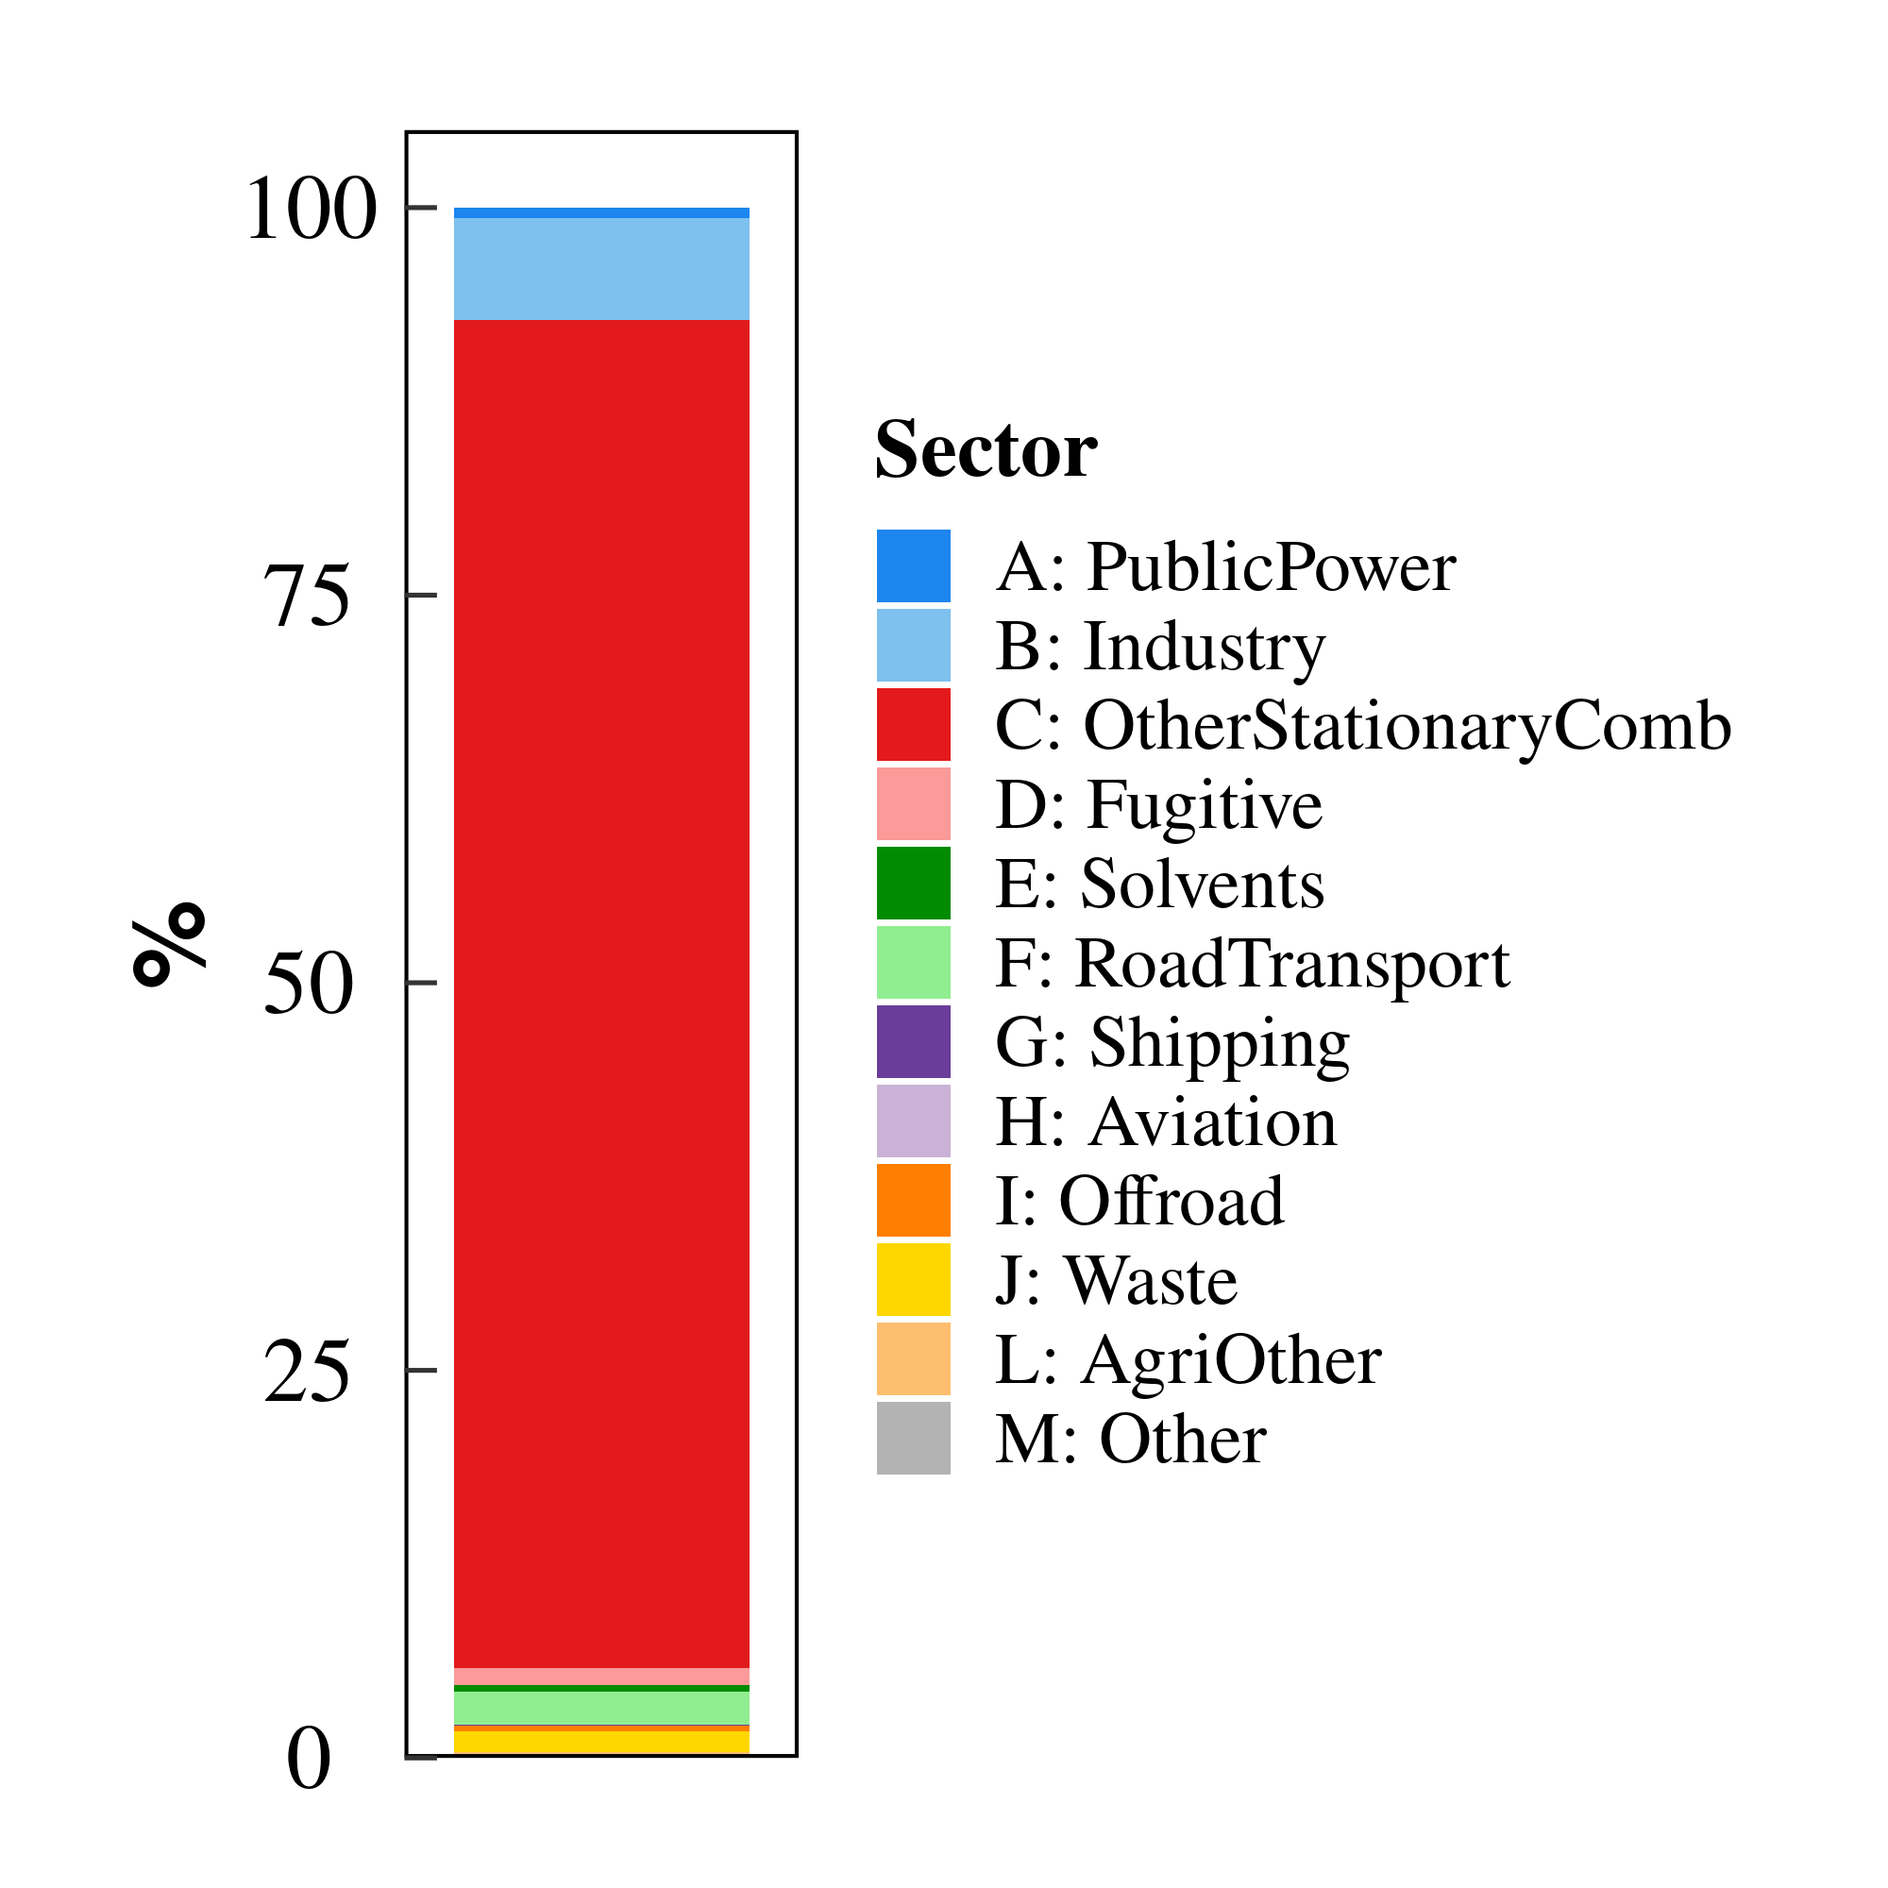
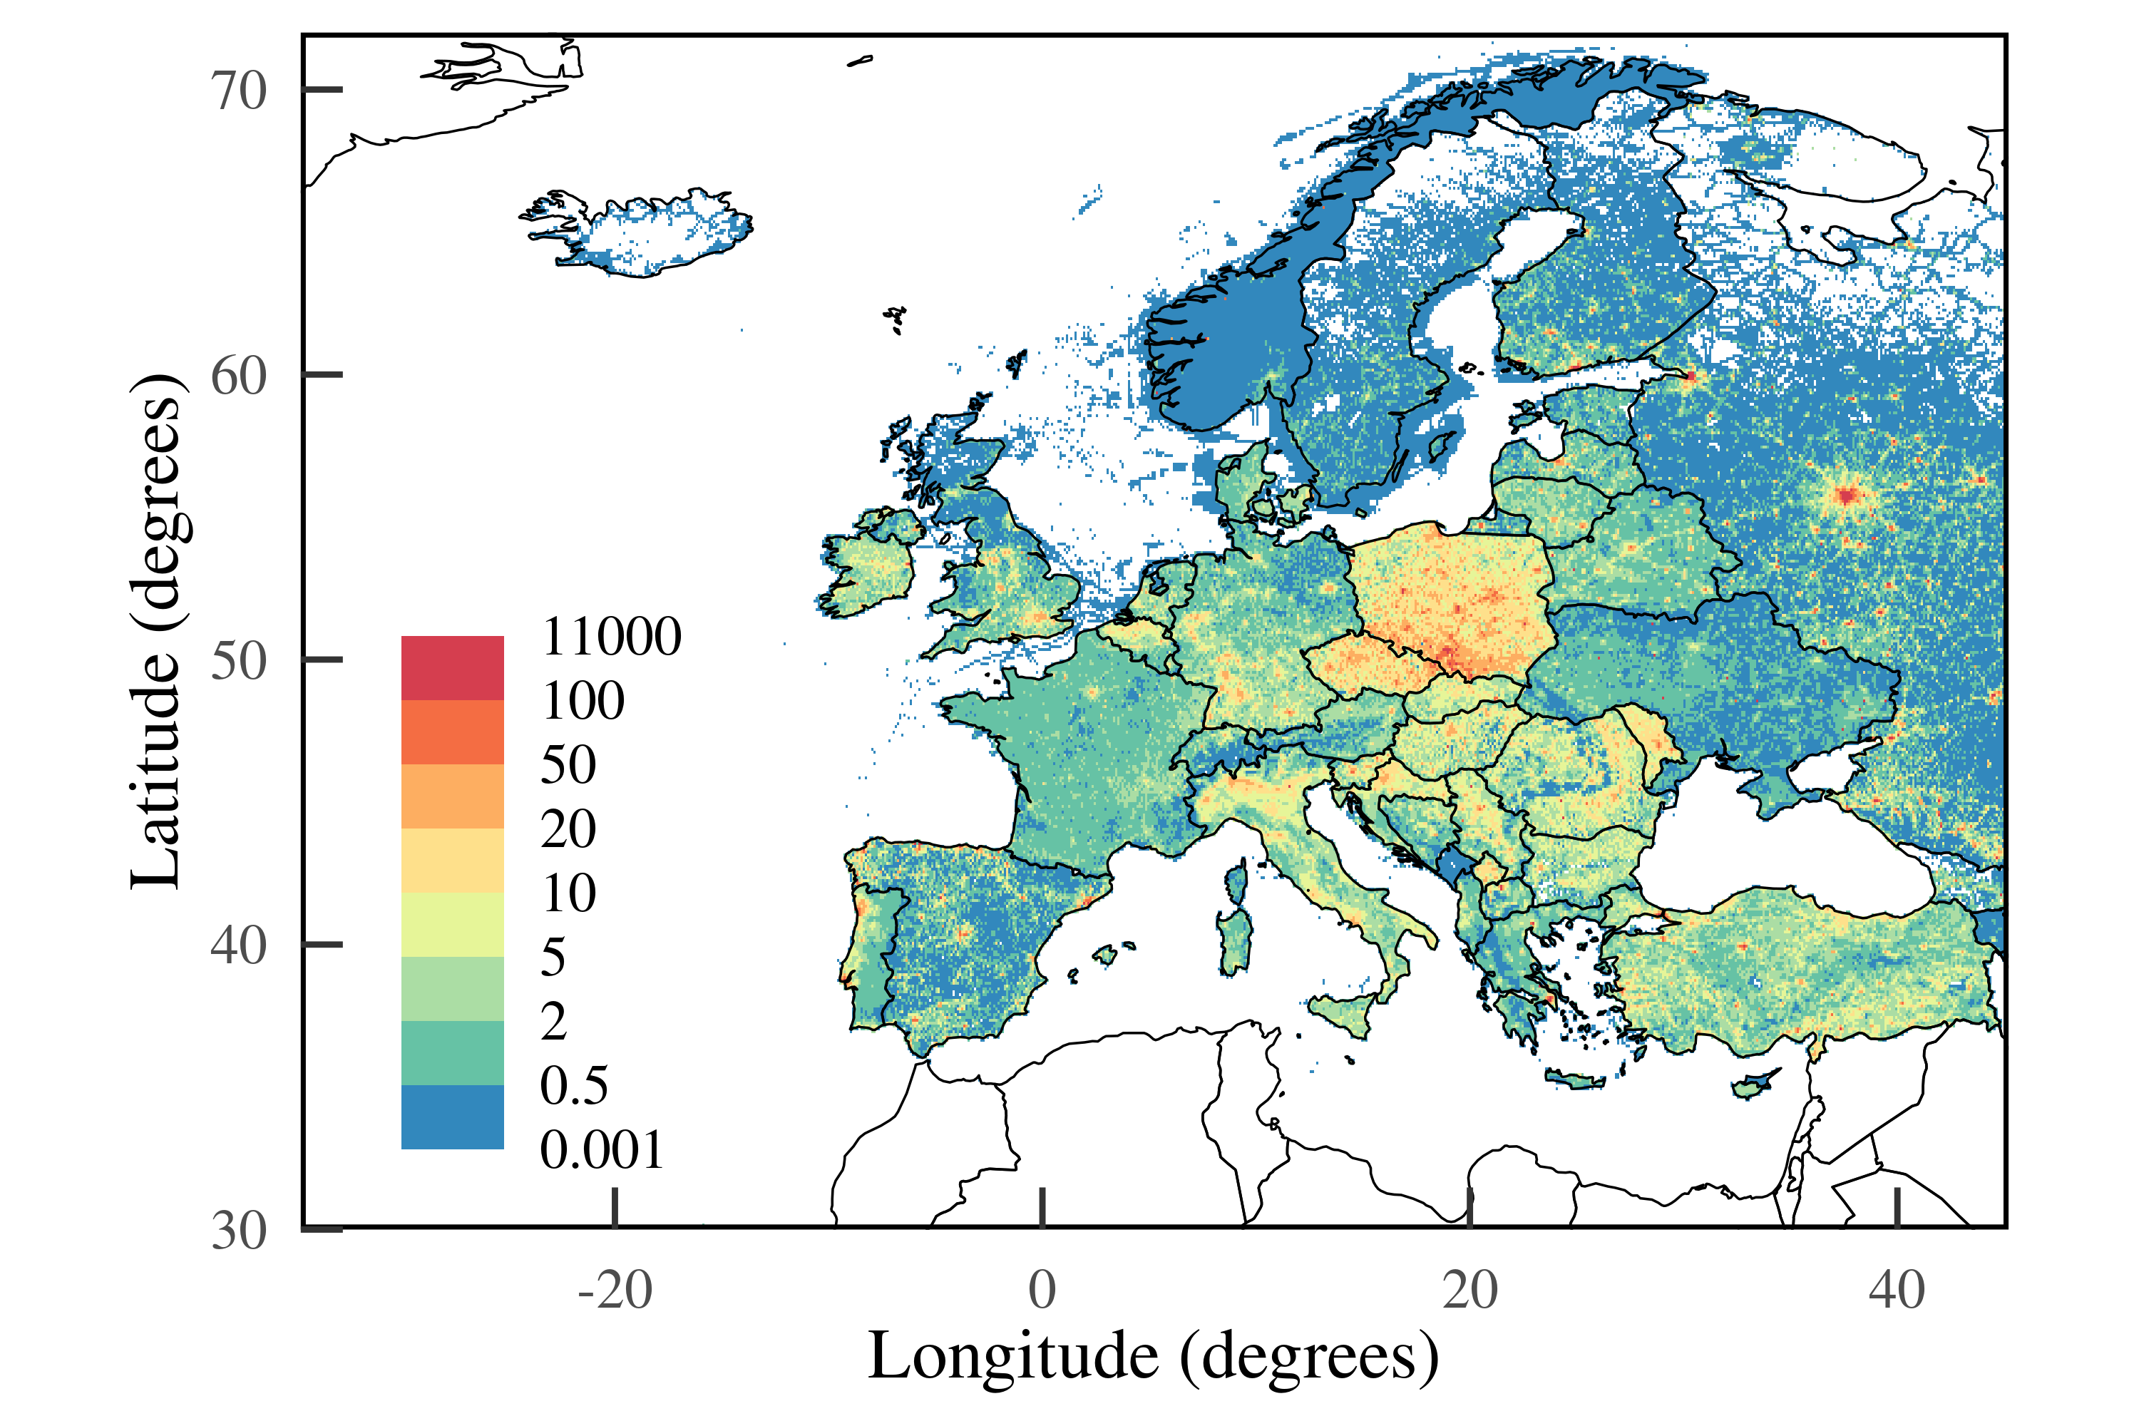
2018 BaP Emissions

Slide 6
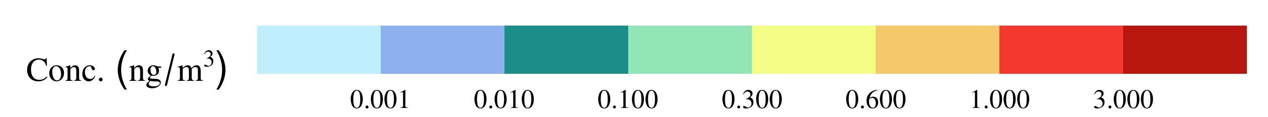
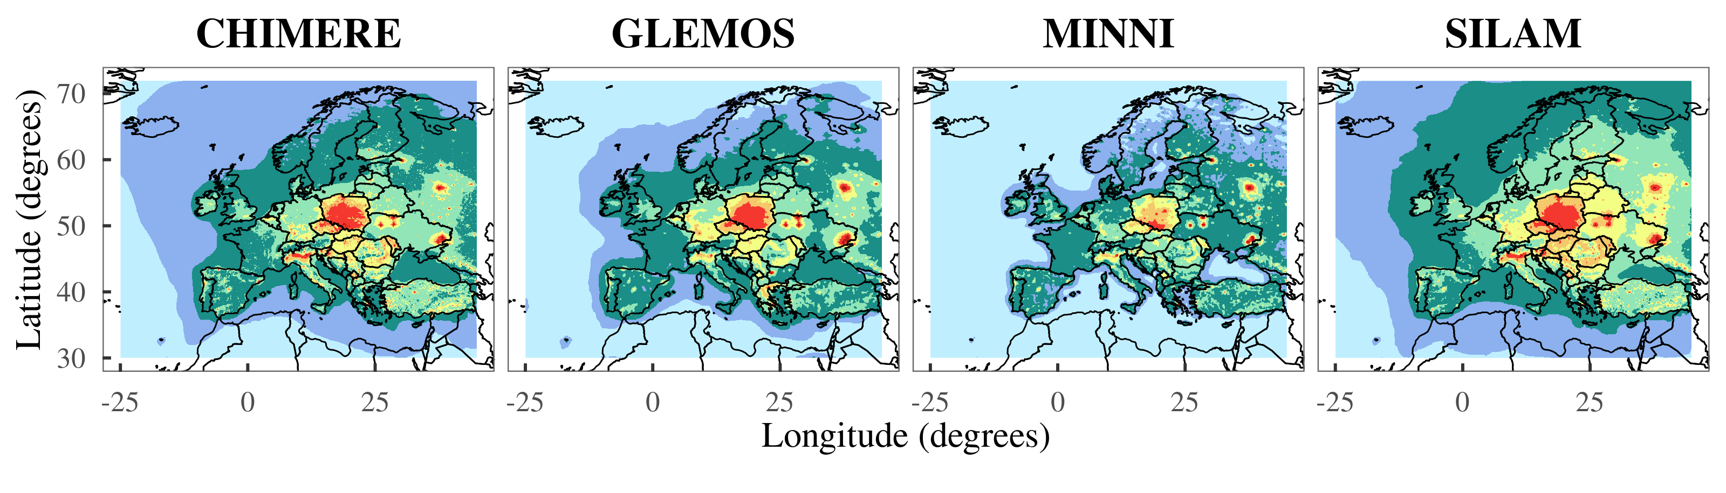
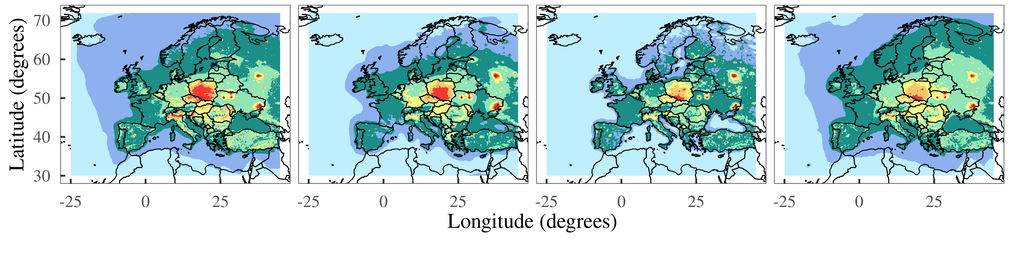
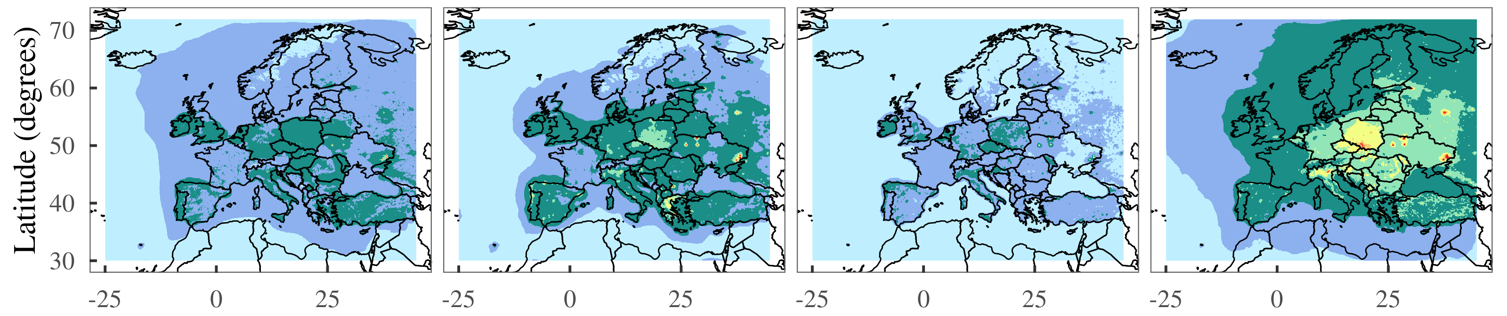
BaP annual mean concentration
B(a)P conc.
Aerosol + Gas
Aerosol
Gas

Slide 7
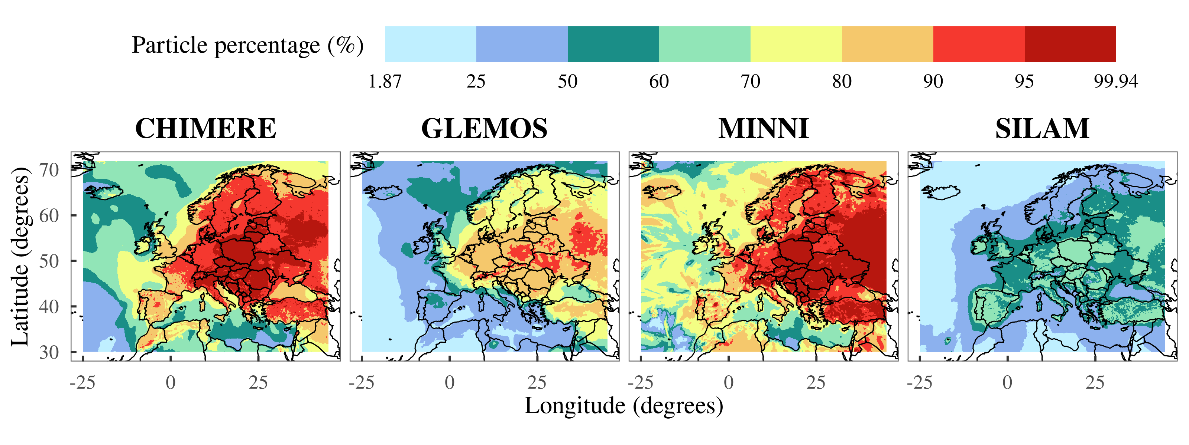
Aerosol / Gas

Slide 8
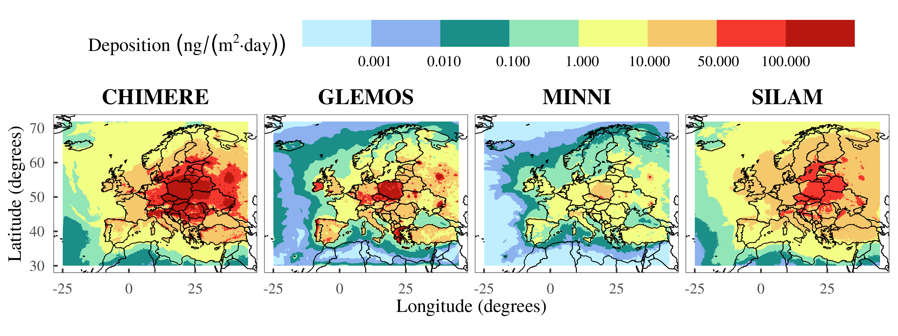
Deposition

Slide 9
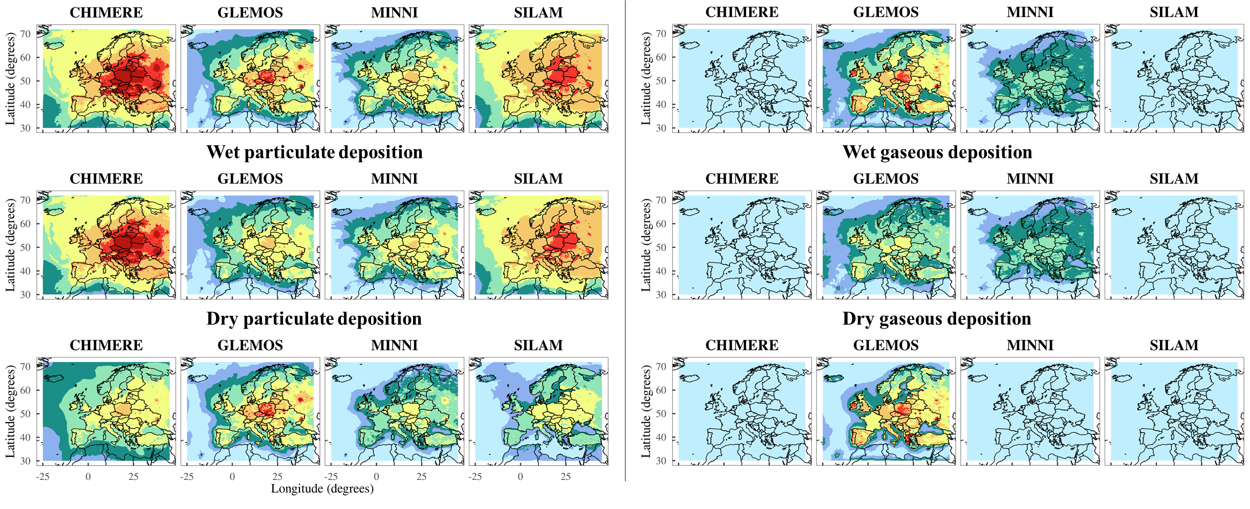
Deposition
PARTICLE
GAS
TOTAL
WET
DRY

Slide 10
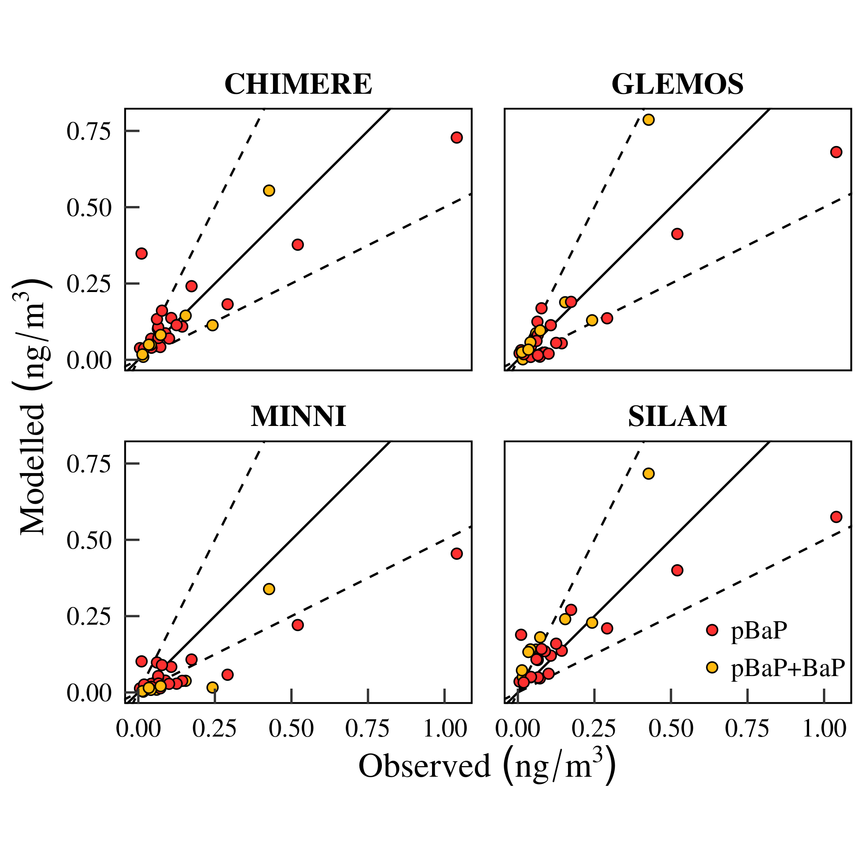
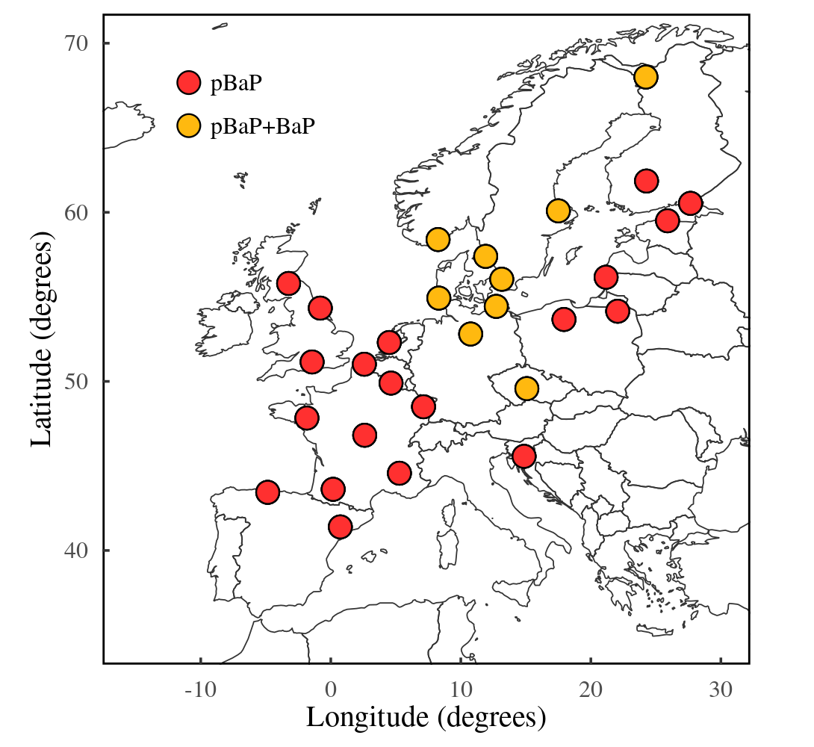
2018 Mean annual BaP (in PM10) air concentrations estimated by CHIMERE, GLEMOS, MINNI and SILAM for 2018 versus the values observed at EMEP monitoring stations

Slide 11
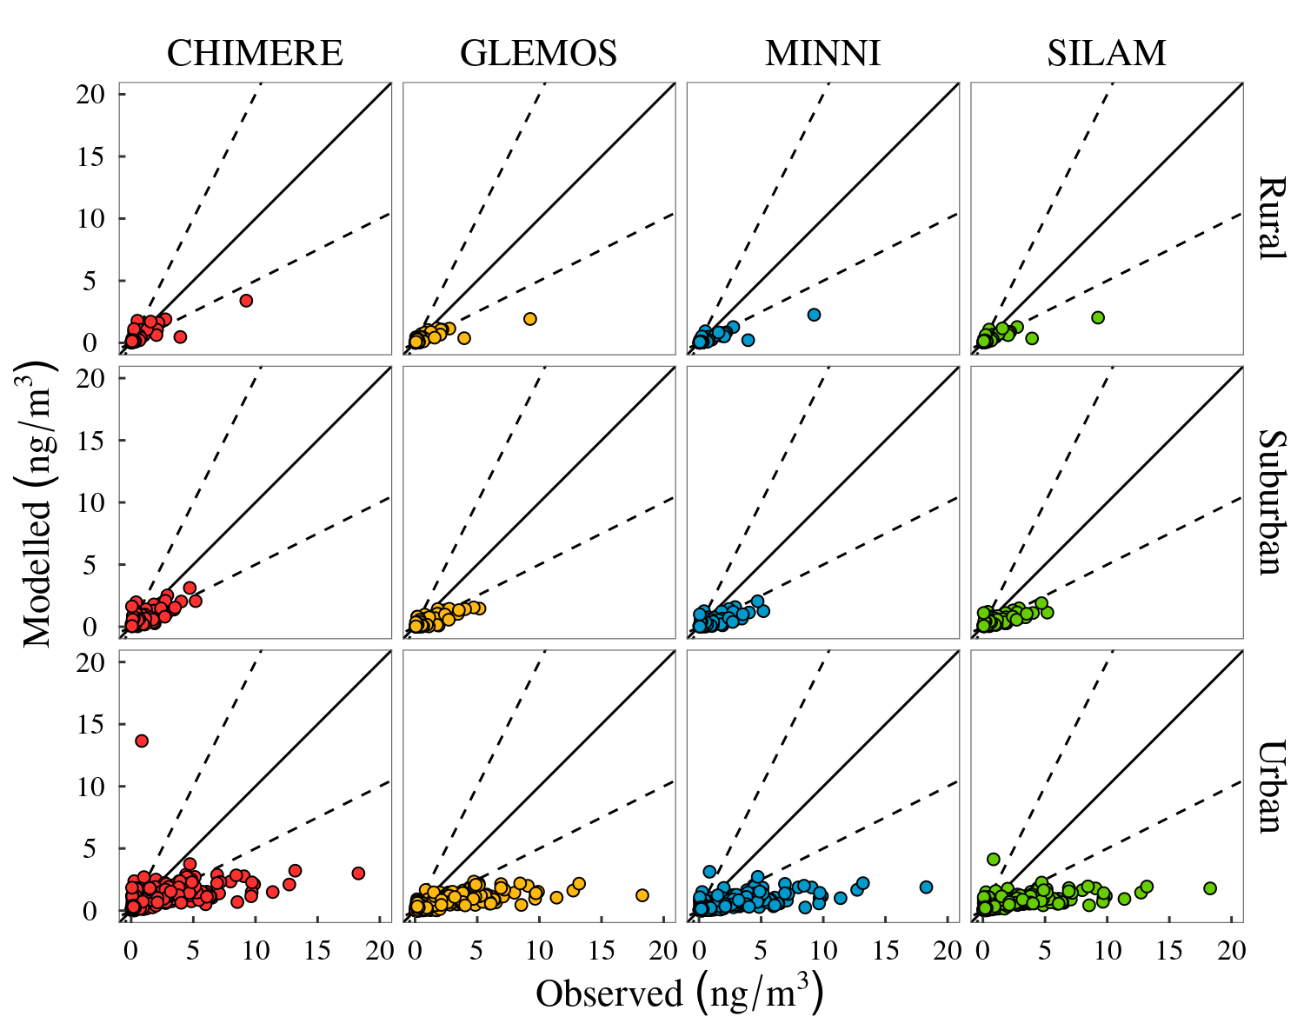
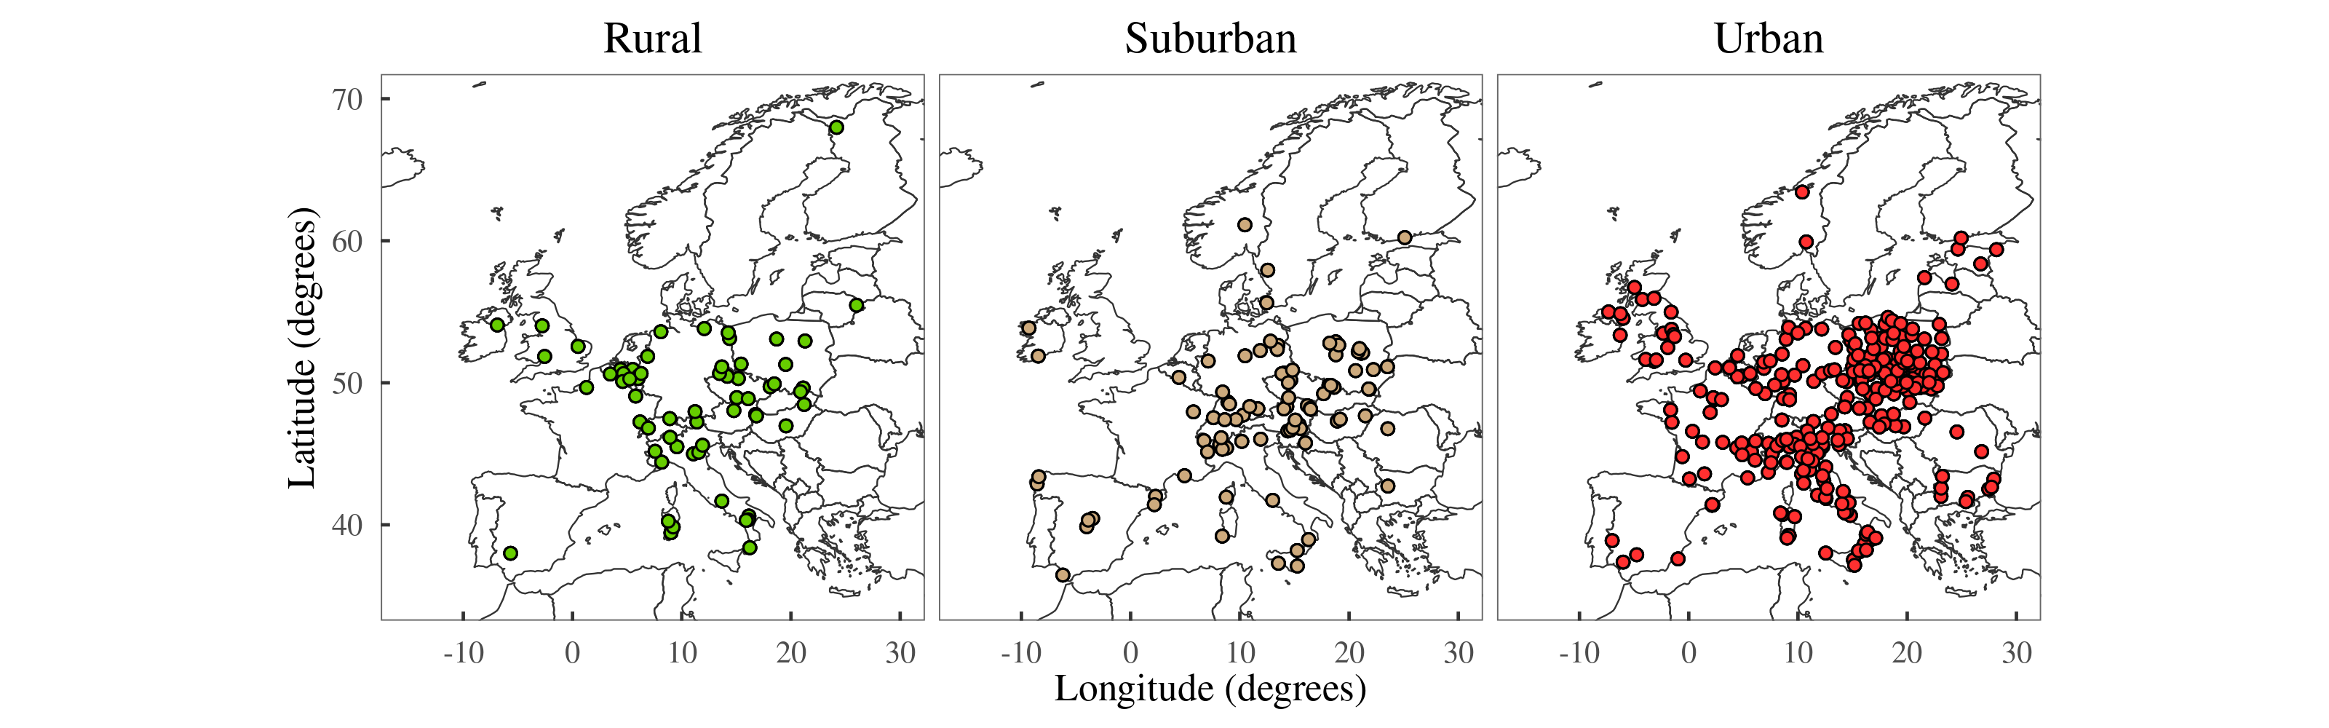
Mean annual BaP (in PM10) air concentrations estimated by CHIMERE, GLEMOS, MINNI and SILAM for 2018 versus the values observed at the rural, suburban and urban background AQER stations
(The official network of monitoring stations validated and reported to the European Environment Agency)

Slide 12
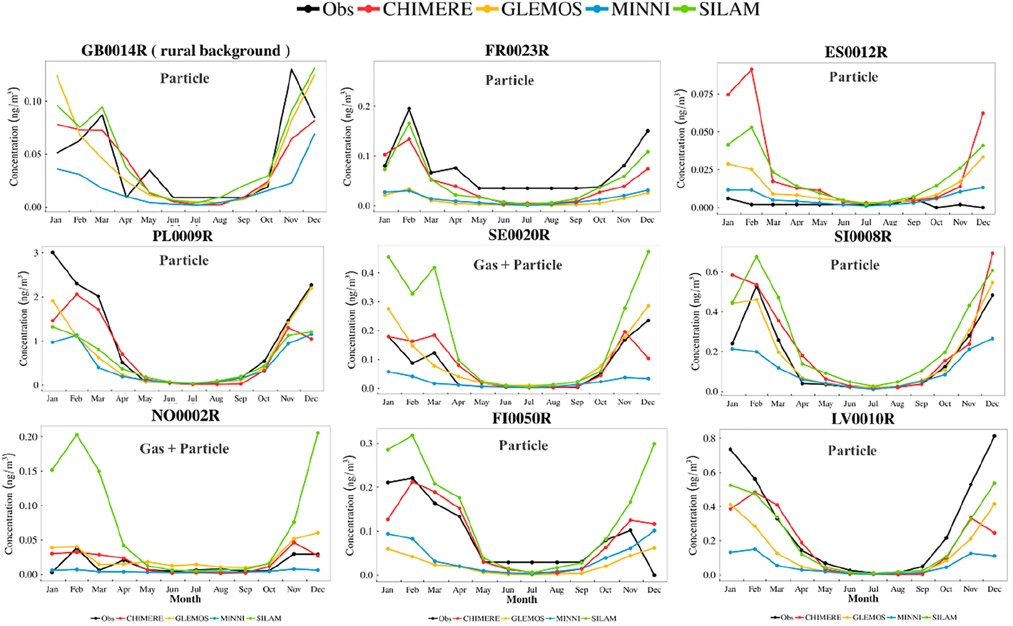
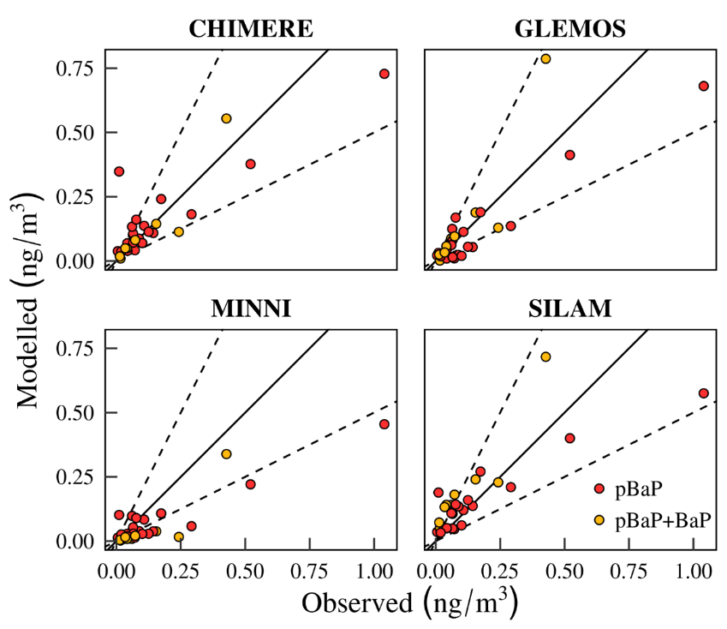
EMEP sites

Slide 13
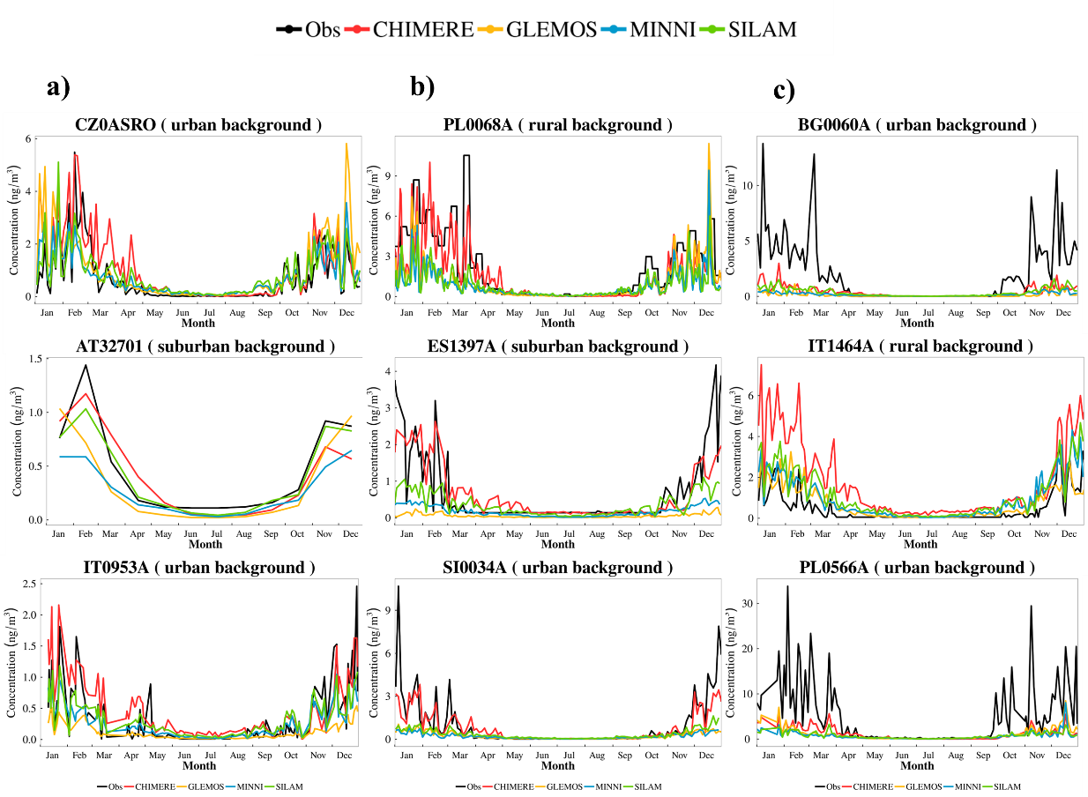
AQER sites

Slide 14
Particle/gas conversion
Few publications provide specific gas/particle ratios for BaP based on field measurements.
Most studies indicate a very low gaseous fraction (a few percent at most), with particulate ratios typically close to 100 %.
    Measurements in Turkey: particulate ratio of around 97 % at suburban sites and almost 100 % at urban sites (Demircioglu et al., 2011).
    Similarly, Gao et al. (2015) reported comparable values at various sites in China.
    These high particulate ratios are in line with the estimates from CHIMERE and MINNI and suggest an overestimation of the gas phase by GLEMOS and, to a greater extent, SILAM.
Nevertheless: Chimjarn et al. (2021) observed particulate fractions of approximately 74 % during winter in Strasbourg. If this were representative, it would imply a slight overestimation of the particulate phase by GLEMOS, a larger overestimation by CHIMERE and MINNI, and an underestimation by SILAM (although winter values may not be representative of annual mean values)
More year-round measurements are needed to better evaluate the particulate fractions estimated by the models.

Slide 15
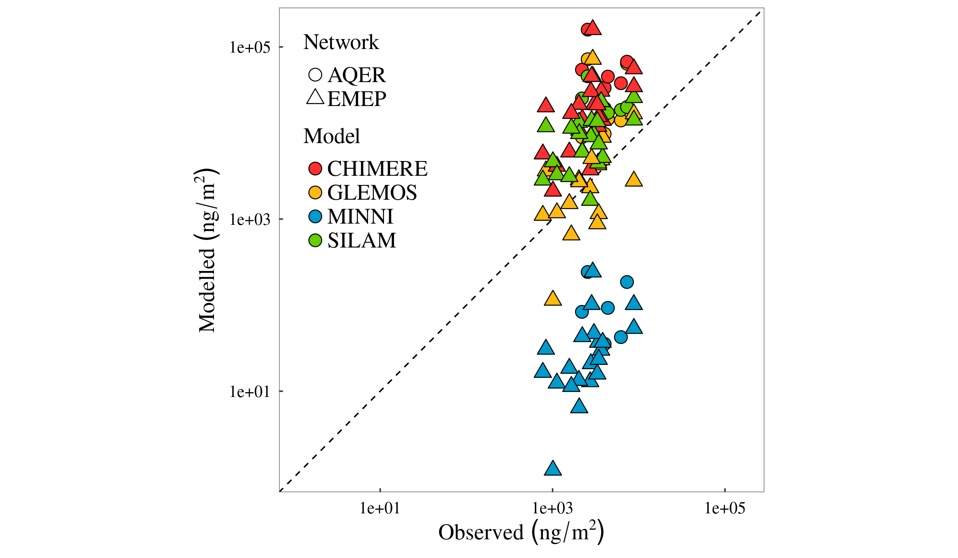
values.
Deposition patterns.
CHIMERE and SILAM: highest deposition values (consistent with their omission of heterogeneous O3 chemistry; a larger fraction of BaP mass remains available in the atmosphere to be removed via deposition processes). Furthermore, these two models have the shallowest first vertical layers (approximately 20 m), a factor that contributes to lower initial dilution of ground-level emissions.
Observed and modelled deposition values at EMEP (triangles) and AQER (circle) sites
Note that the axes logarithmic. The dashed line indicates the 1:1 relationship.
CHIMERE:
Overestimation of Deposition

Slide 16
Performance of CHIMERE for VOCs modelling
O₃/VOC/SOA EMEP Intensive Measurement Period of 2022
Work developed within the TFMM framework
7 MODELS: HCHO, ISOPRENE, ETHANE, ETHENE
Including slides from Vivanco, M.G., C. Hernández, V. Gil, M. R. Theobad (2025). Advances in the modelling of O₃/VOC/SOA EMEP Intensive Measurement Period of 2022 with the CHIMERE model. Task Force on Measurements and Modelling, 5 - 7 May. 2025, Potsdam, Germany. Participants in the exercise: Joanna Struzewska (TFMM leader), Tomasz Przybyła, Aleksander Norowski, Oriol Jorba, Risto Hänninen, Mikhail Sofiev, Augustin Colette, Florian Couvidat, Mihaela Mircea, Gino Briganti, Andrea Bolignano, Felicita Russo, Marta G. Vivanco, Mark Theobald, Coralina Hernández, Victoria Gil, Marie Dury, David Simpson, Massimo Vieno, Janice Scheffler, Corina Keller, and Dominik Brunner.
Series temporales por estación (red EMEP) — campaña de julio
ONLY CHIMERE (different configurations): LIMONENE, APINEN, BPINEN, CH3CHO, GLYOXAL
CIEMAT: CHIM13m · CHIM23R3muscarb1 ·
EMEP EM.
CLIM. BC
CAMS EM.
CAMS BC.
CIEMAT
CIEMAT
Different boundary conditions and emissions (CAMS, EMEP)

Slide 17
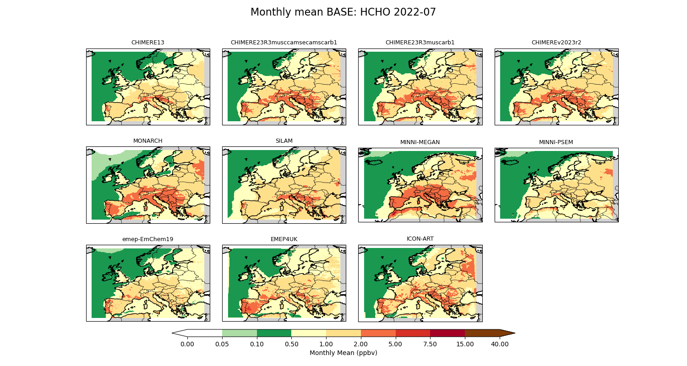
MONTHLY MEAN 2022-07
HCHO
CHIM23R3
CHIM13m
EM. EMEP
BC. CLIM
EM. CAMS
BC. CAMS
CIEMAT
CIEMAT
CIEMAT
CHIMERE23-R3

Slide 18
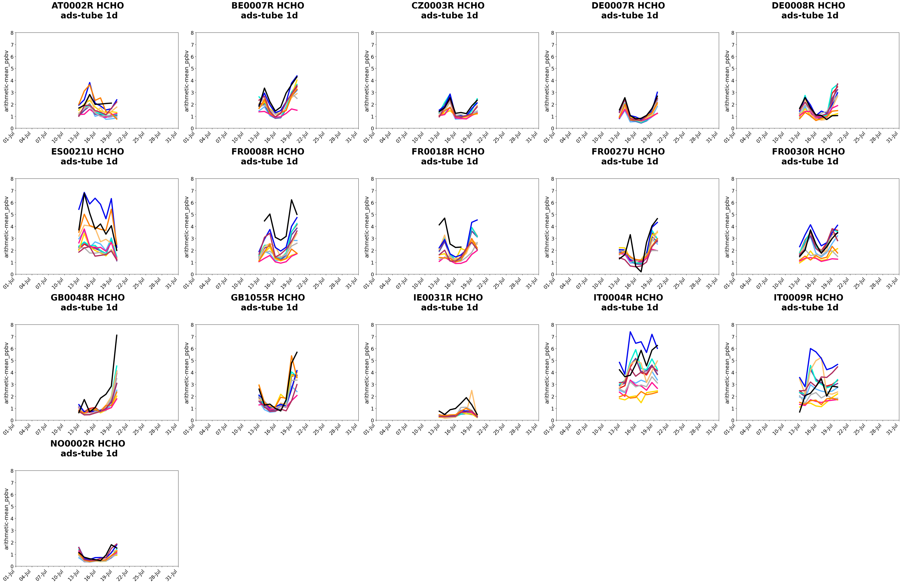
All the models;
All the sites
HCHO
ES
FR
IT

Slide 19
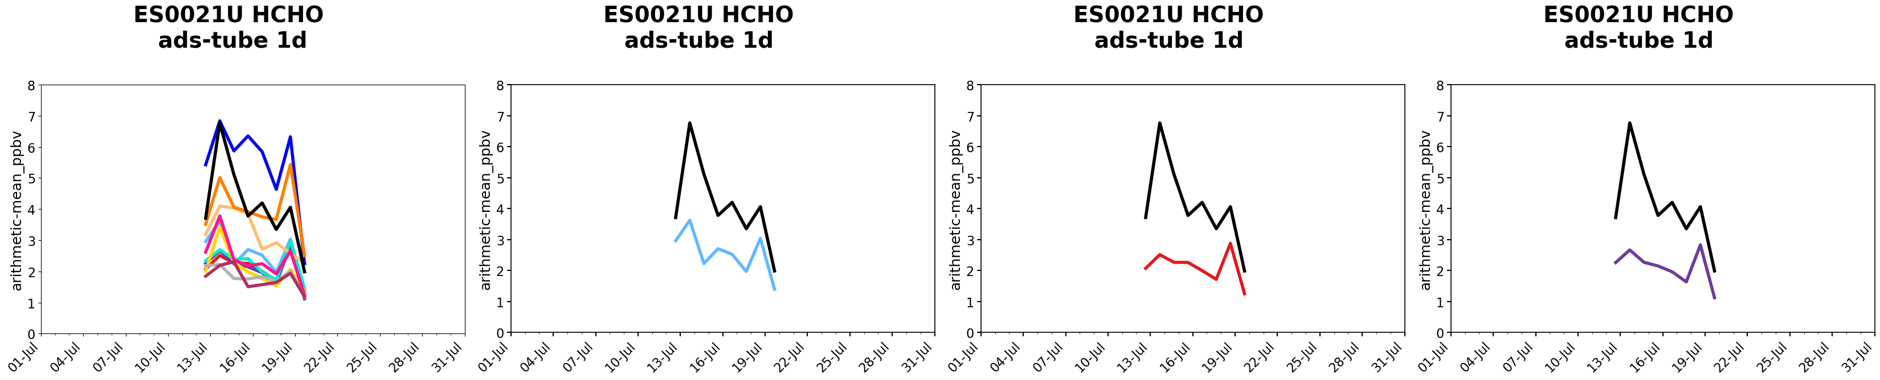
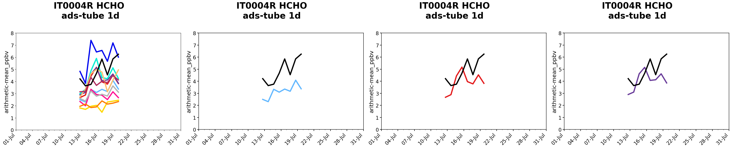
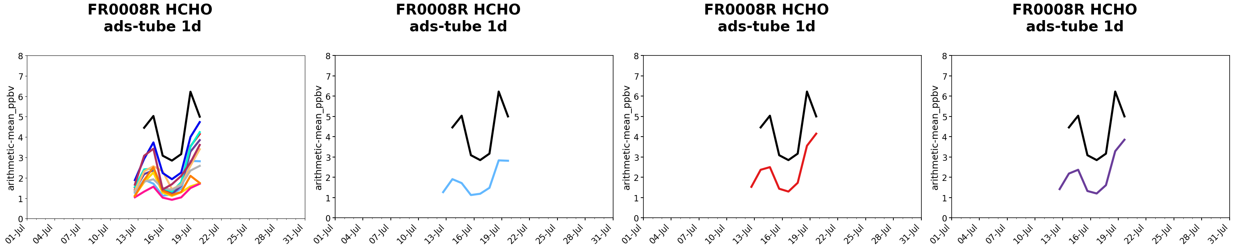
CHIM23r3
HCHO
CHIM13m
EM. EMEP
BC. CLIM
EM. CAMS
BC. CAMS
CIEMAT
CIEMAT
CHIMERE23-R3
ES0021U
IT0004R
FR0020R

Slide 20
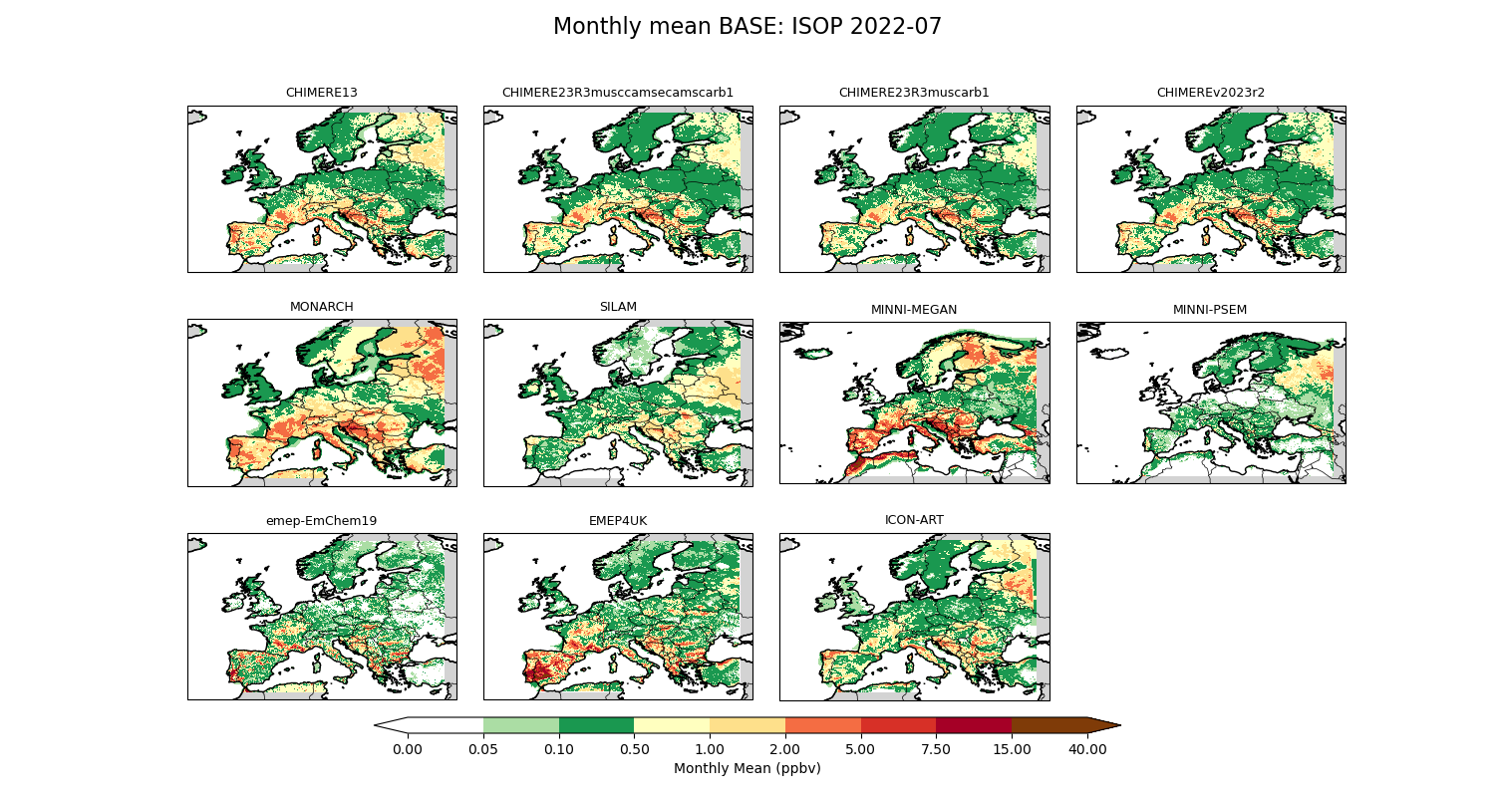
C5H8
CHIM23r3
CHIM13m
CHIMv2023r2
EM. EMEP
BC. CLIM
EM. CAMS
BC. CAMS
CIEMAT
CIEMAT
CHIMERE23-R3
CIEMAT

Slide 21
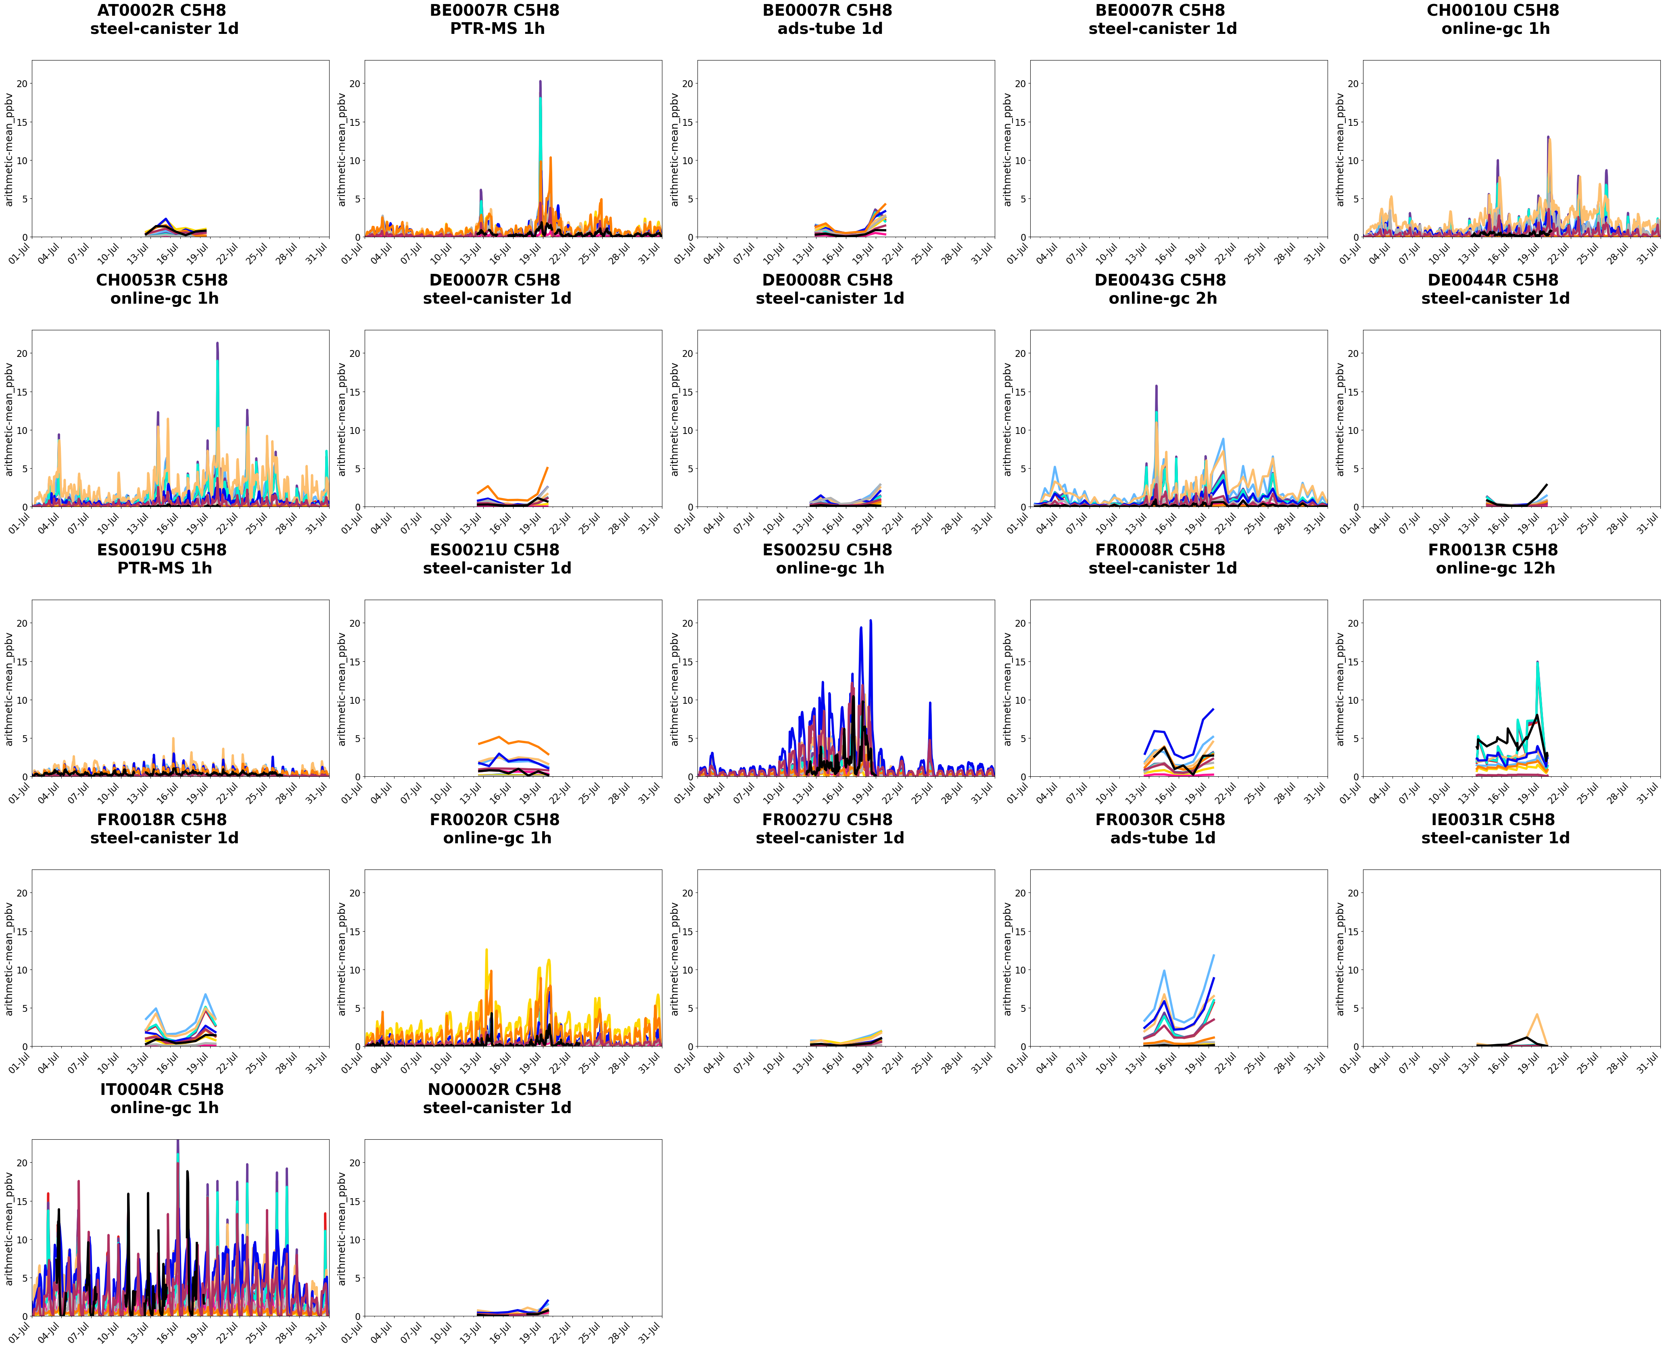
All the models;
All the sites
C5H8

Slide 22
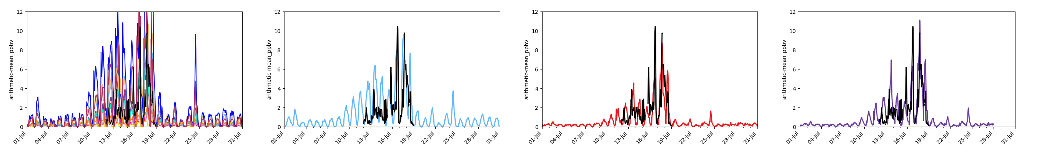
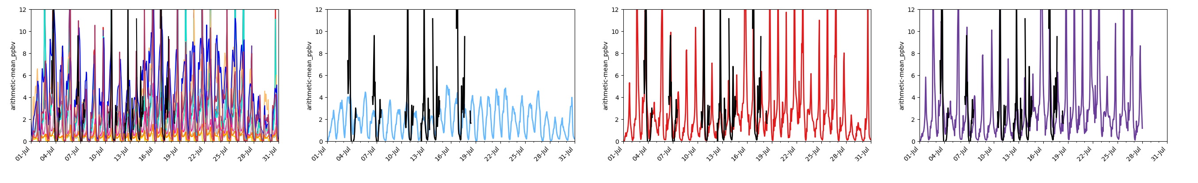
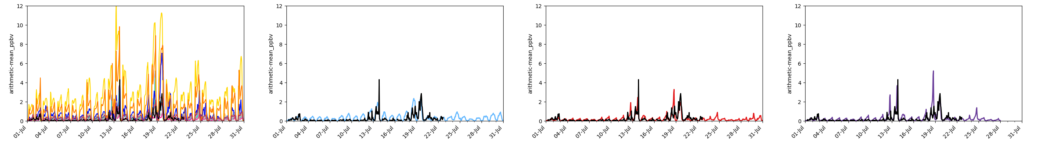
CIEMAT
C5H8
CHIM23r3
ES0025U
EM. EMEP
BC. CLIM
EM. CAMS
BC. CAMS
CIEMAT
CIEMAT
CHIM13m
CHIMERE23-R3
IT0004R
FR0020R

Slide 23
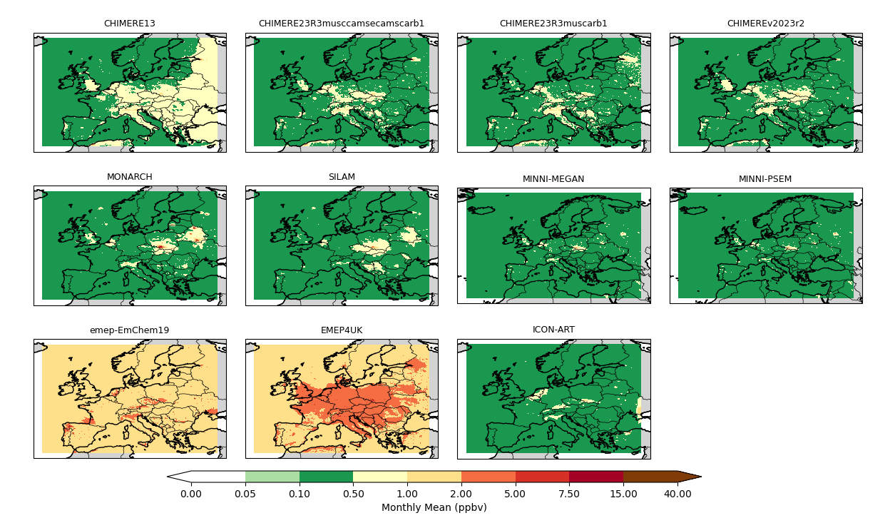
Ethane
C2H6
CHIM23R3
CHIM13m
EM. EMEP
BC. CLIM
EM. CAMS
BC. CAMS
CIEMAT
CIEMAT
CIEMAT
CHIMERE23-R3

Slide 24
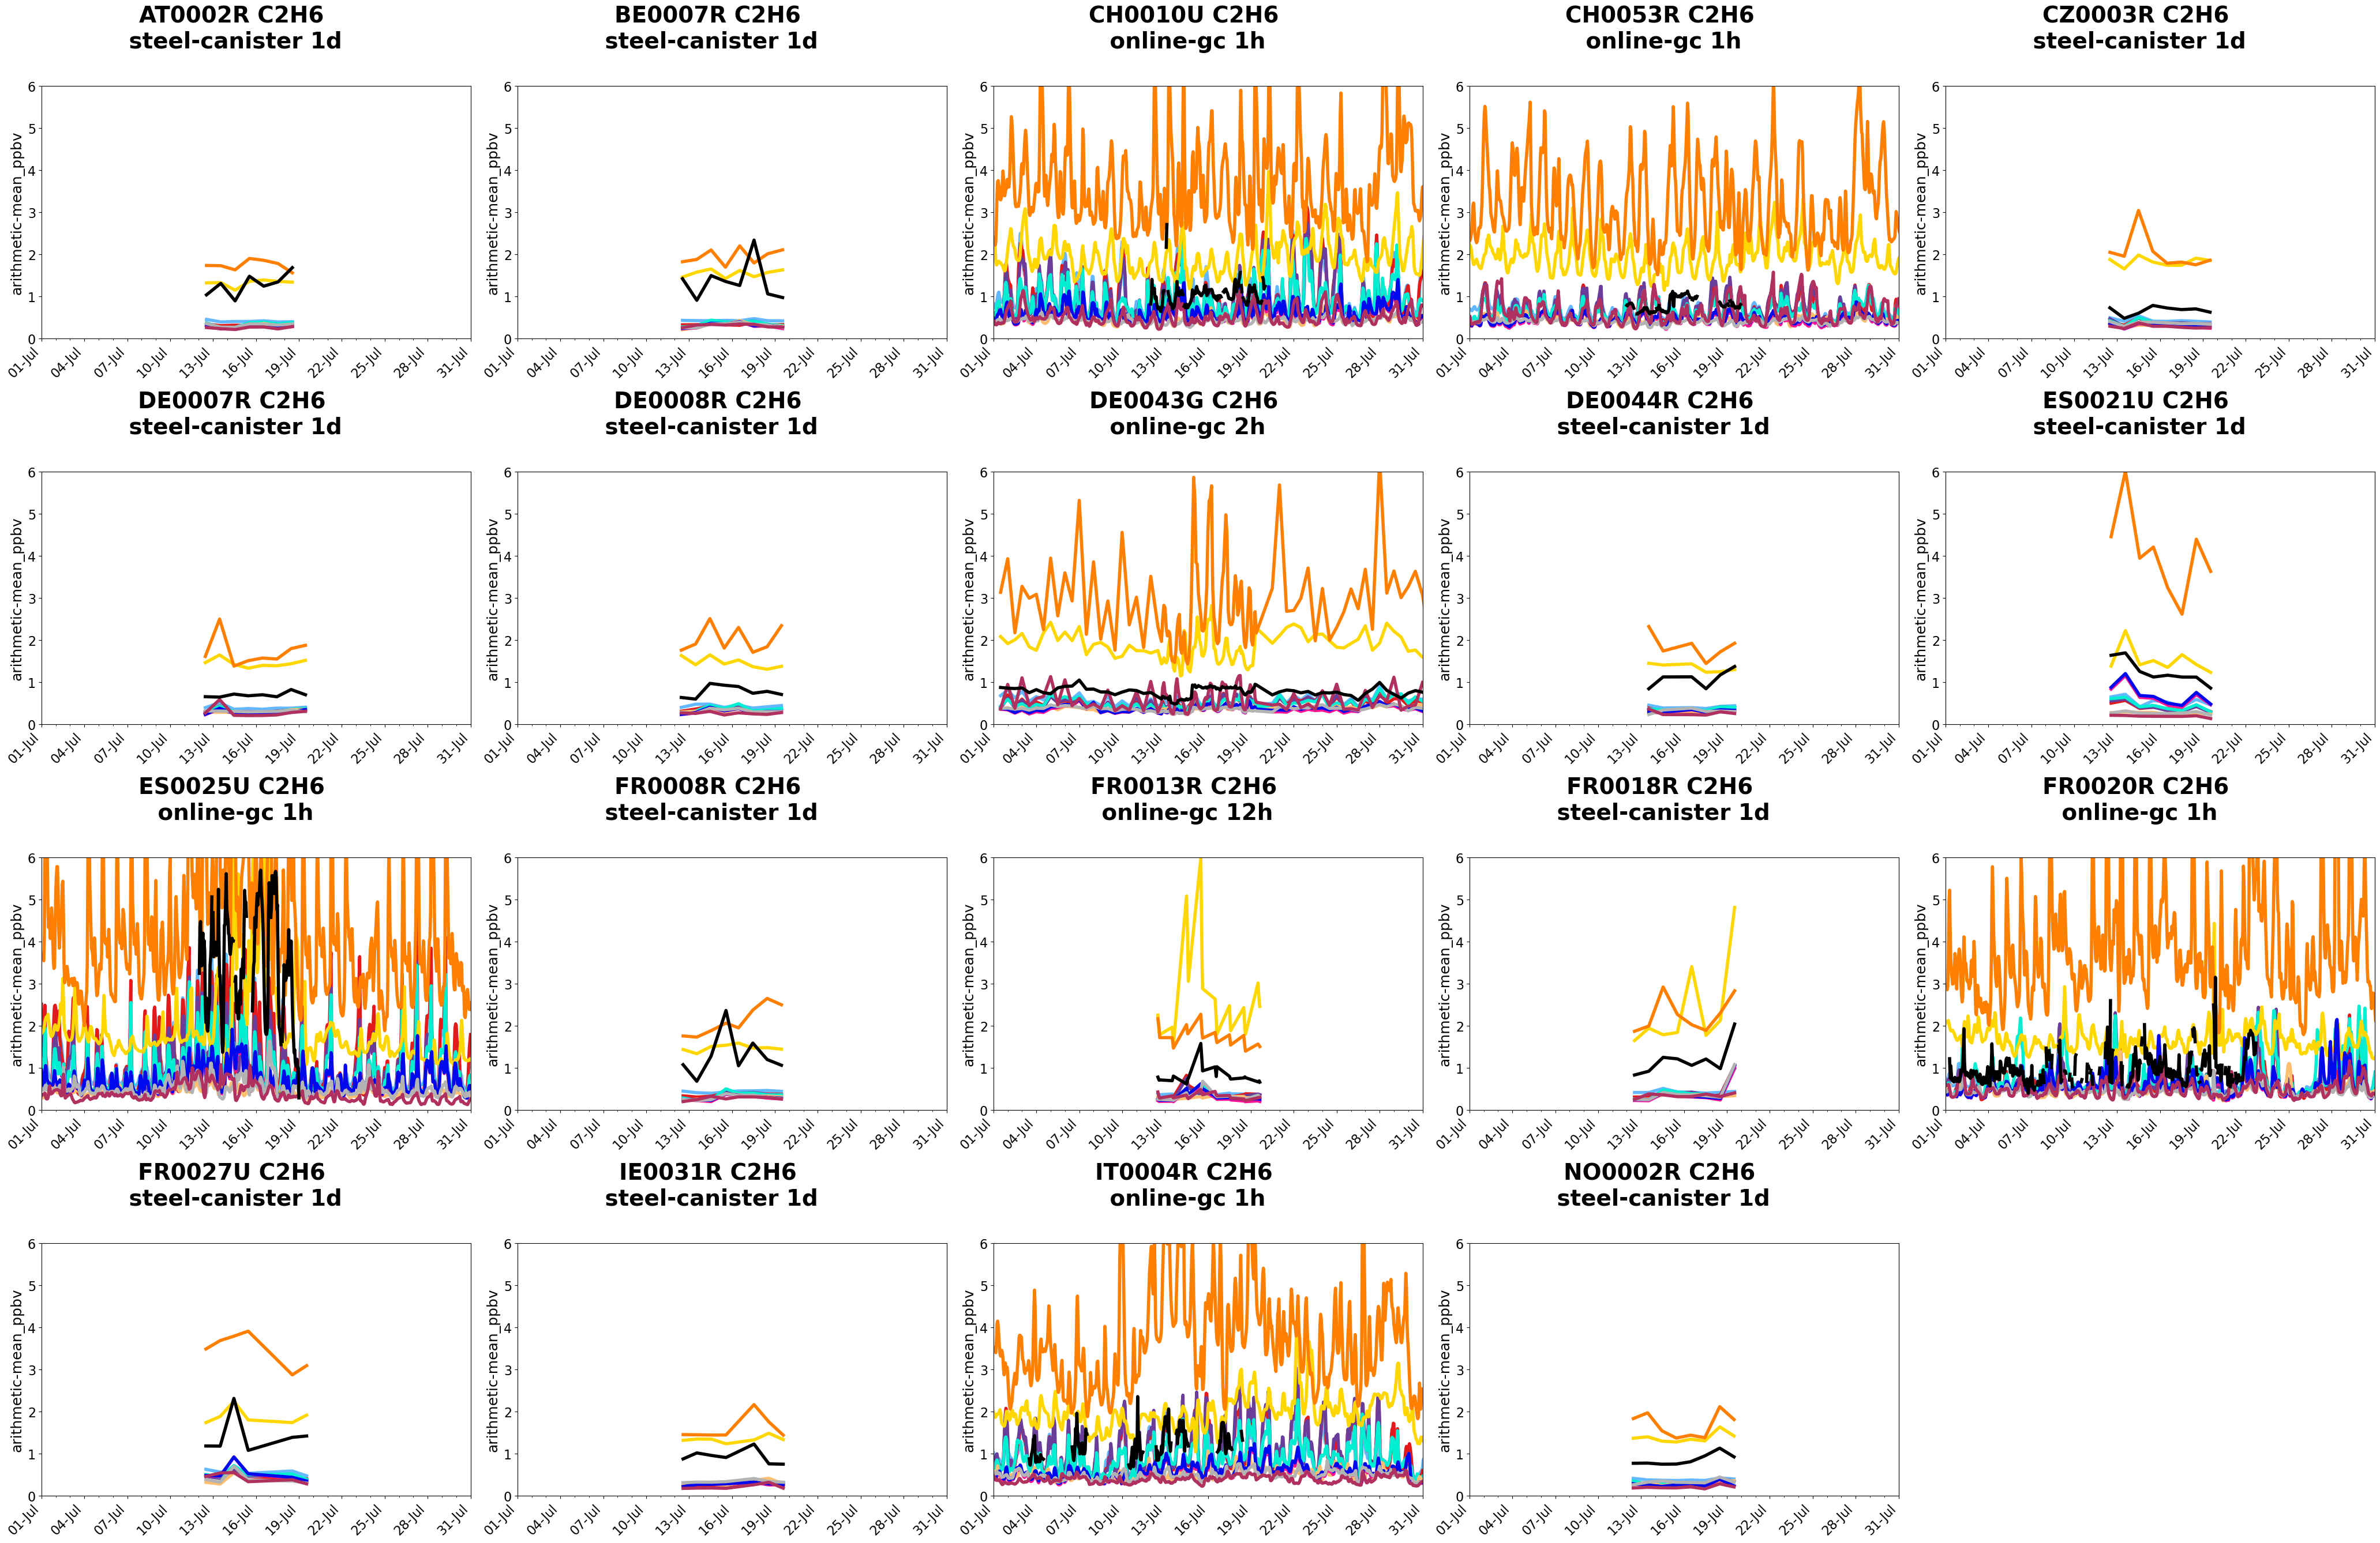
All the models;
All the sites
C2H6

Slide 25
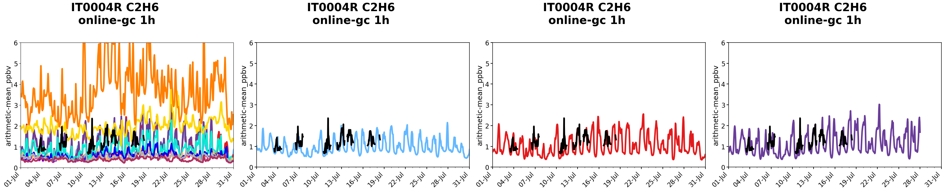
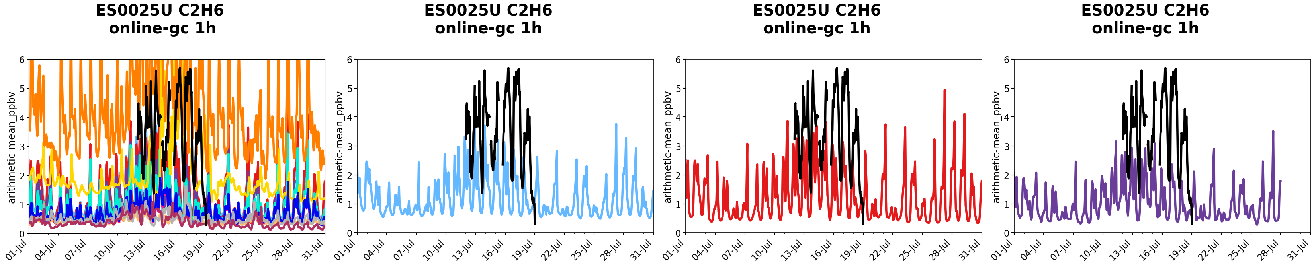
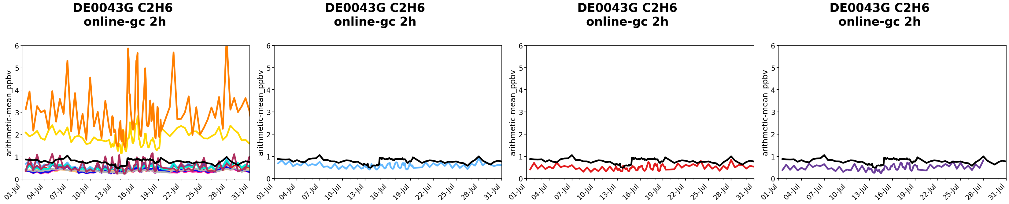
C2H6
CHIM23r3
CHIM13m
EM. EMEP
BC. CLIM
EM. CAMS
BC. CAMS
IT0004R
CIEMAT
CIEMAT
CHIMERE23-R3
ES0025U
DE0043G

Slide 26
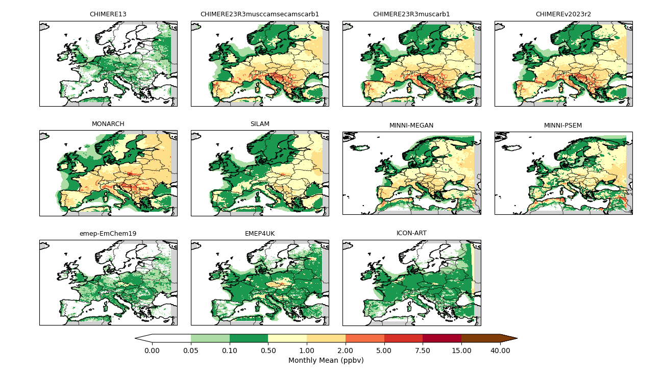
C2H4
CHIM23R3
CHIM13m
EM. EMEP
BC. CLIM
EM. CAMS
BC. CAMS
CIEMAT
CIEMAT
CIEMAT
CHIMERE23-R3

Slide 27
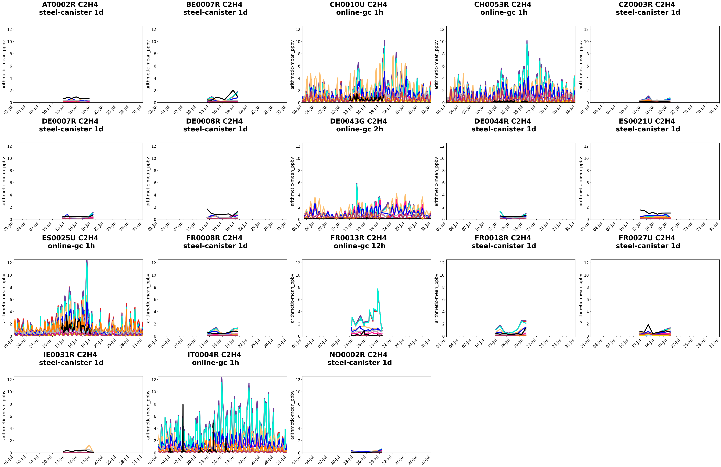
All the models;
All the sites
C2H4

Slide 28
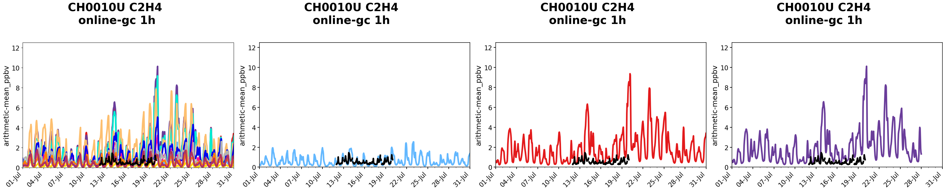
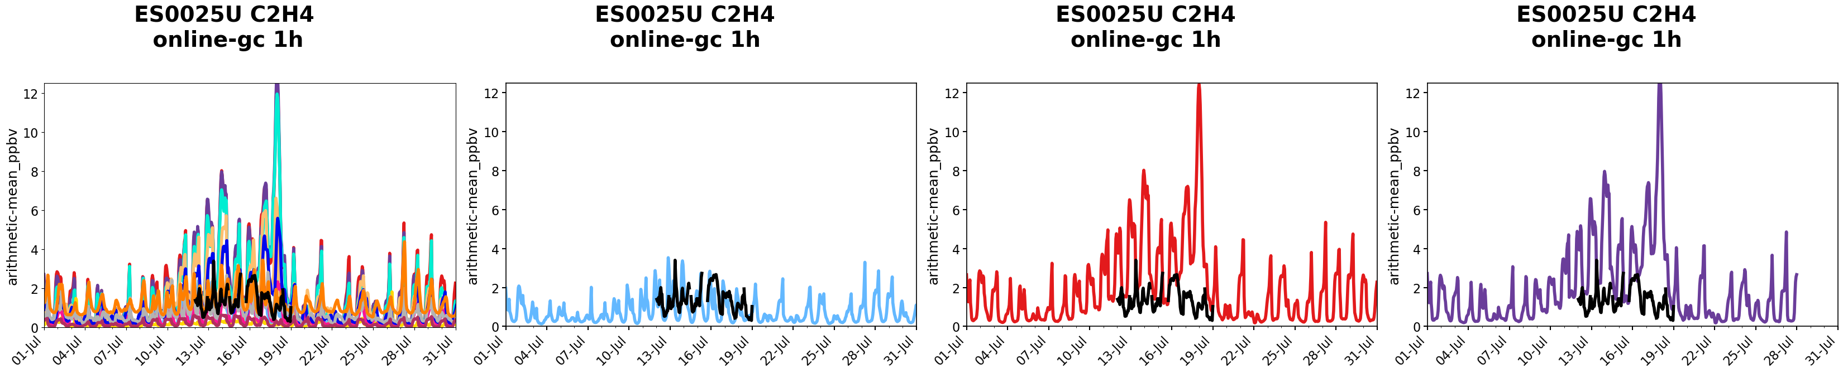
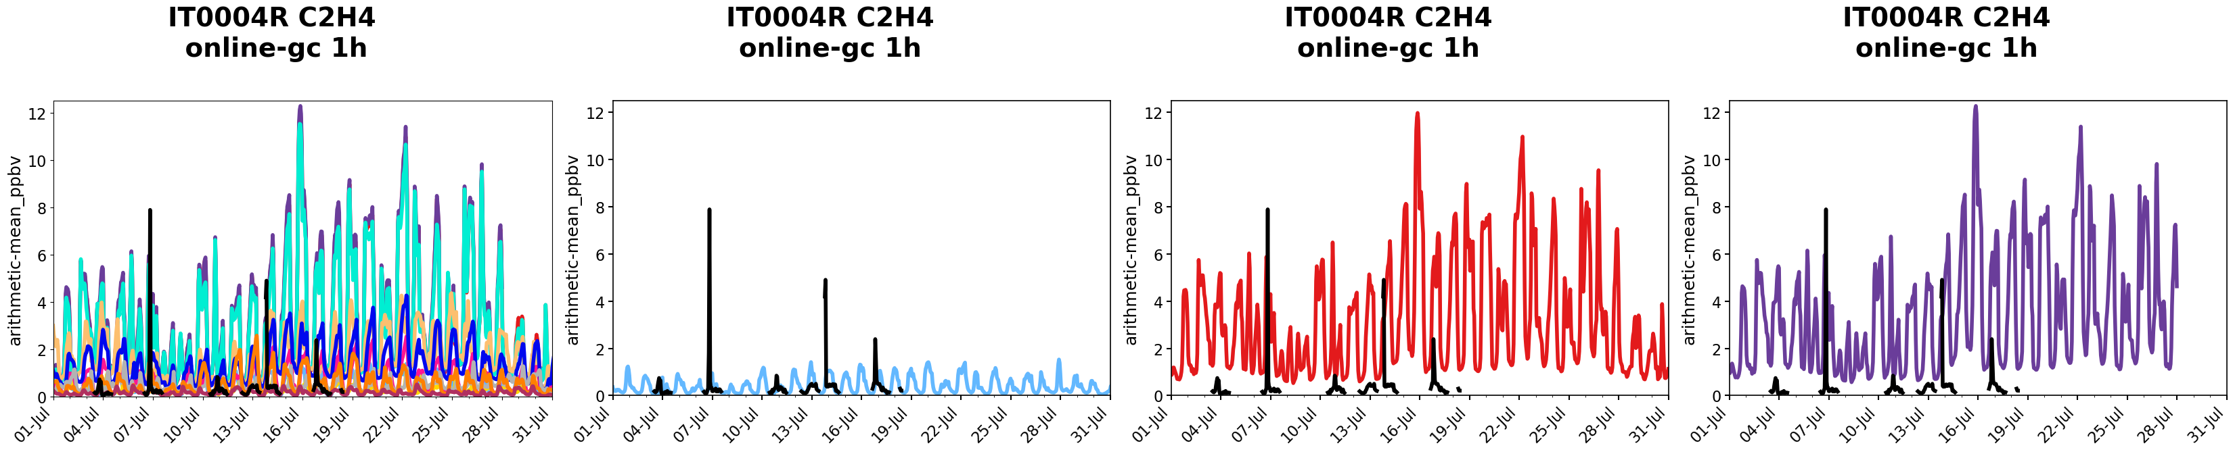
CHIM23r3
C2H4
CH0010U
CHIM13m
EM. EMEP
BC. CLIM
EM. CAMS
BC. CAMS
CIEMAT
CIEMAT
CHIMERE23-R3
ES0025U
IT0004R
C2H4: Significant Overestimation in CHIM23

Slide 29
Only CHIMERE results
1
Limonene
2
α-pinene
3
β-pinene
4
CH₃CHO (acetaldehyde)
5
Glyoxal

Slide 30
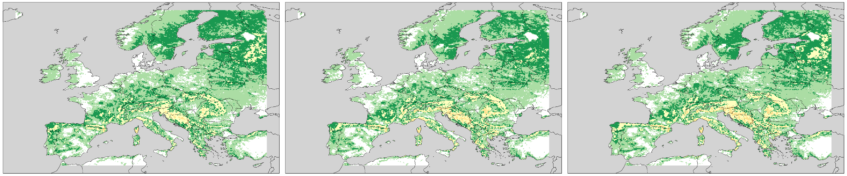
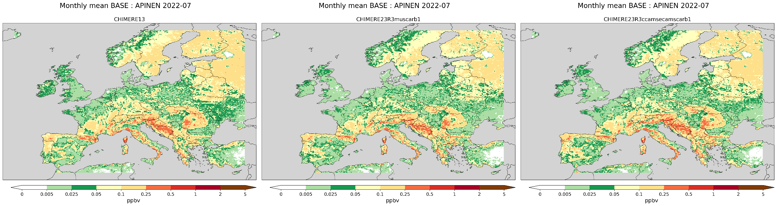
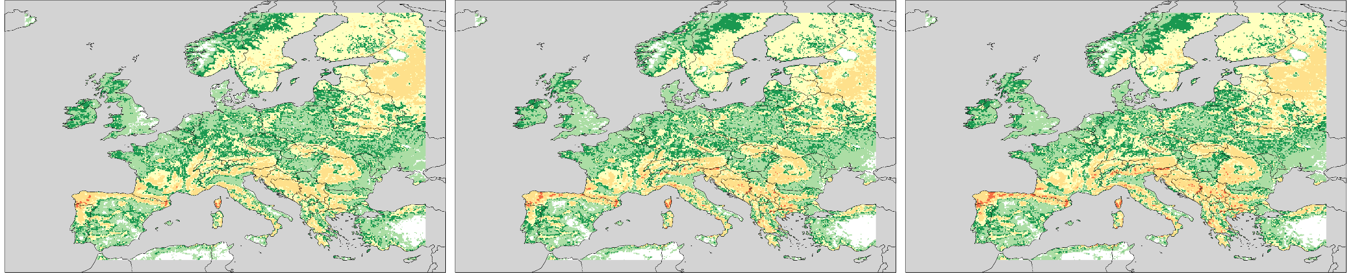
CHIM13m
CHIM23R3
EM. EMEP
BC. CLIM
CHIM23R3
EM. CAMS
BC. CAMS
LIMONENE
α-PINENO
β-PINENO

Slide 31
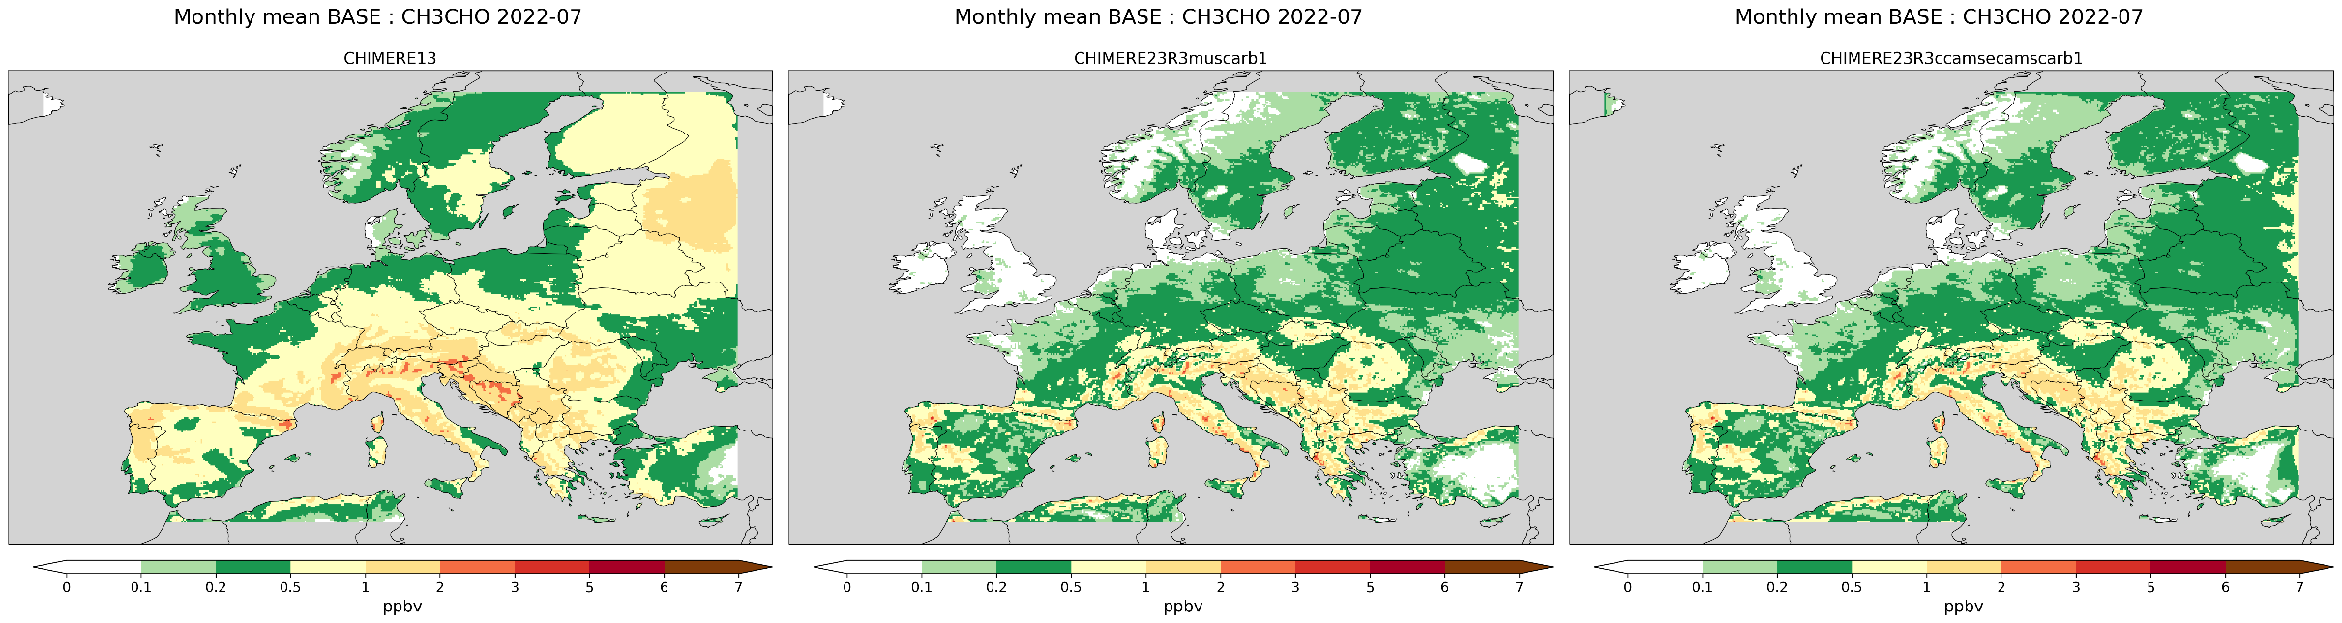
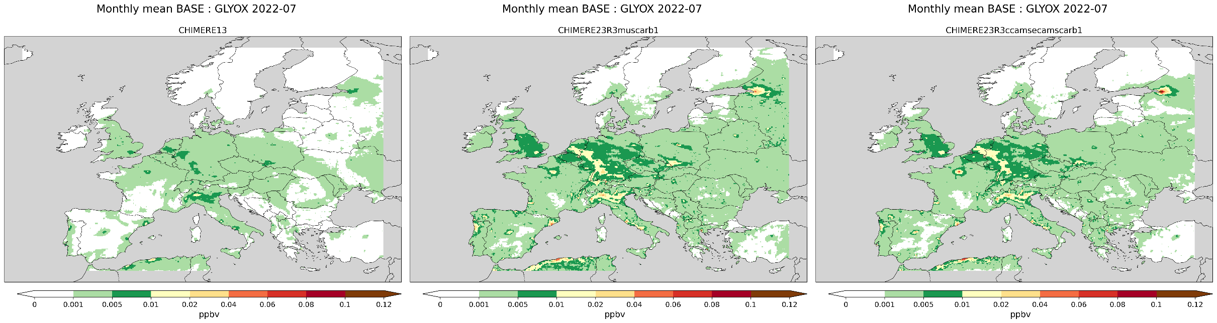
CHIM13m
CHIM23R3
EM. EMEP
BC. CLIM
CHIM23R3
EM. CAMS
BC. CAMS
CH₃CHO
GLIOXAL · 1 de 2

Slide 32
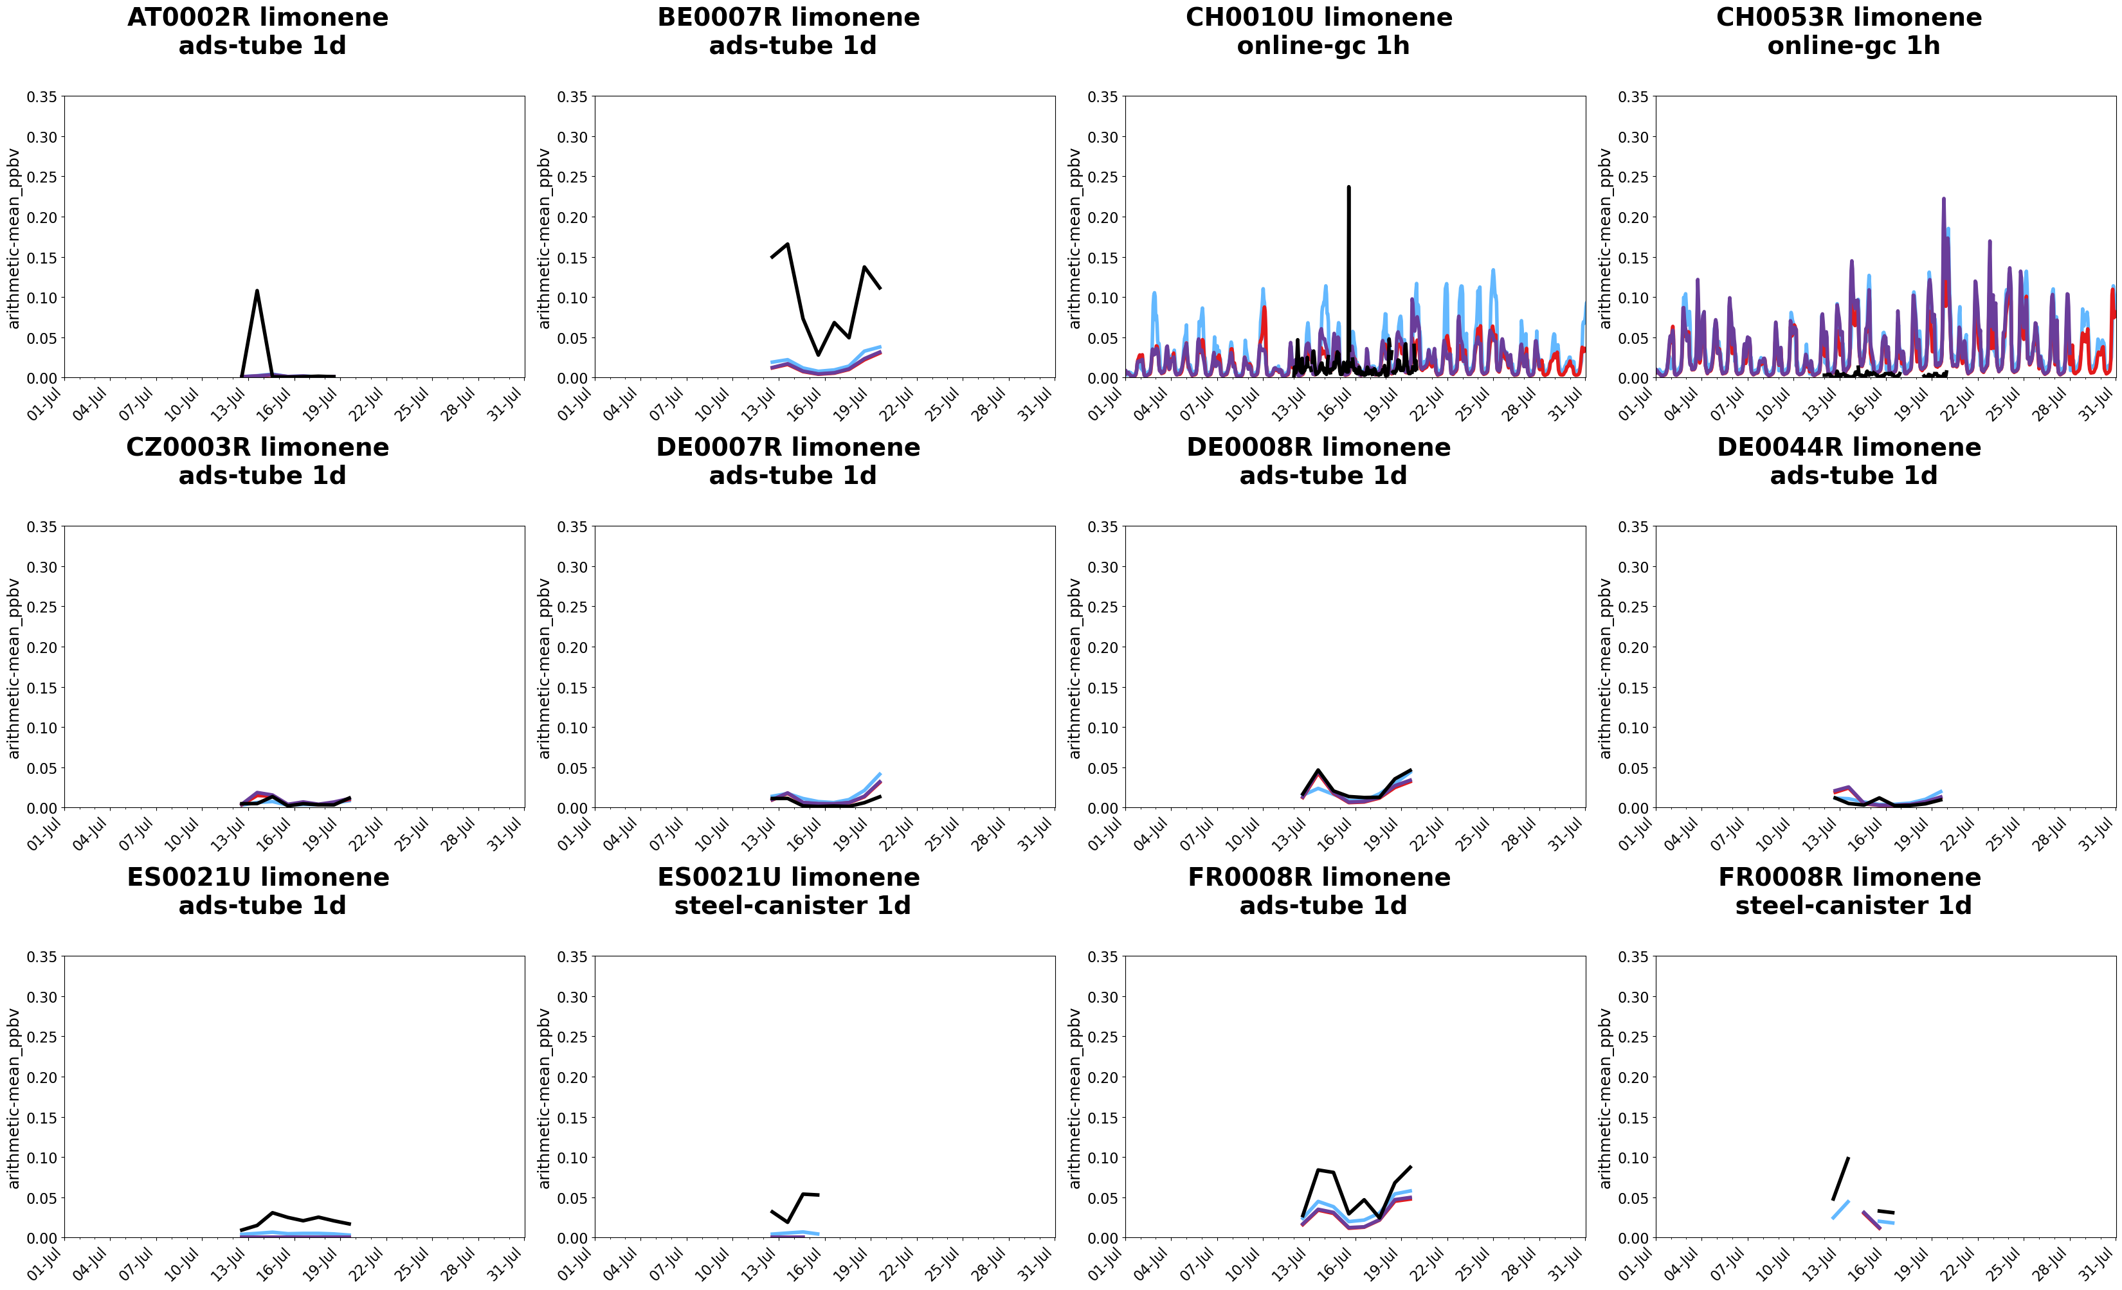
LIMONENE · 1 of 2

Slide 33
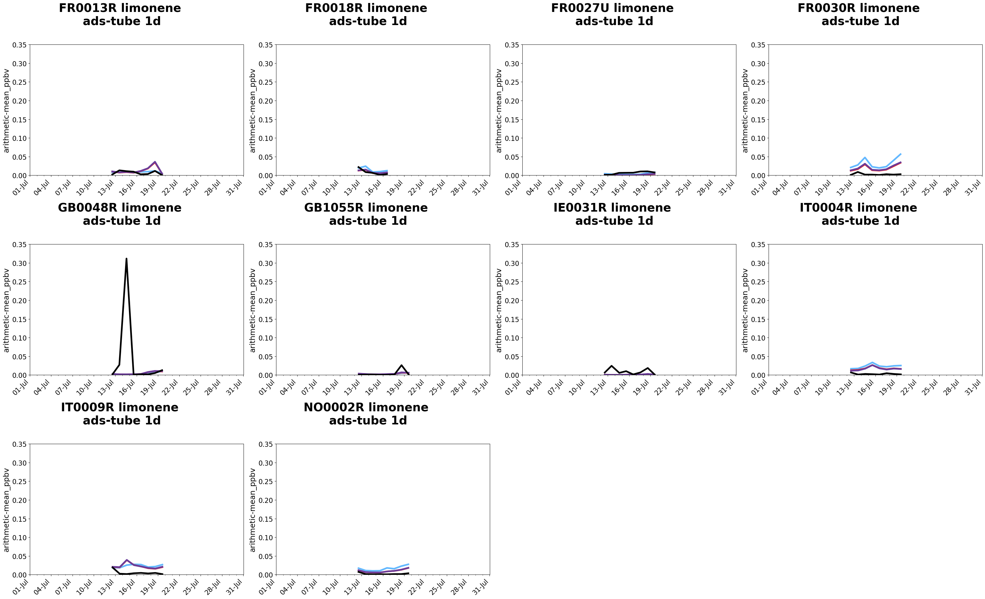
LIMONENE · 2 de 2

Slide 34
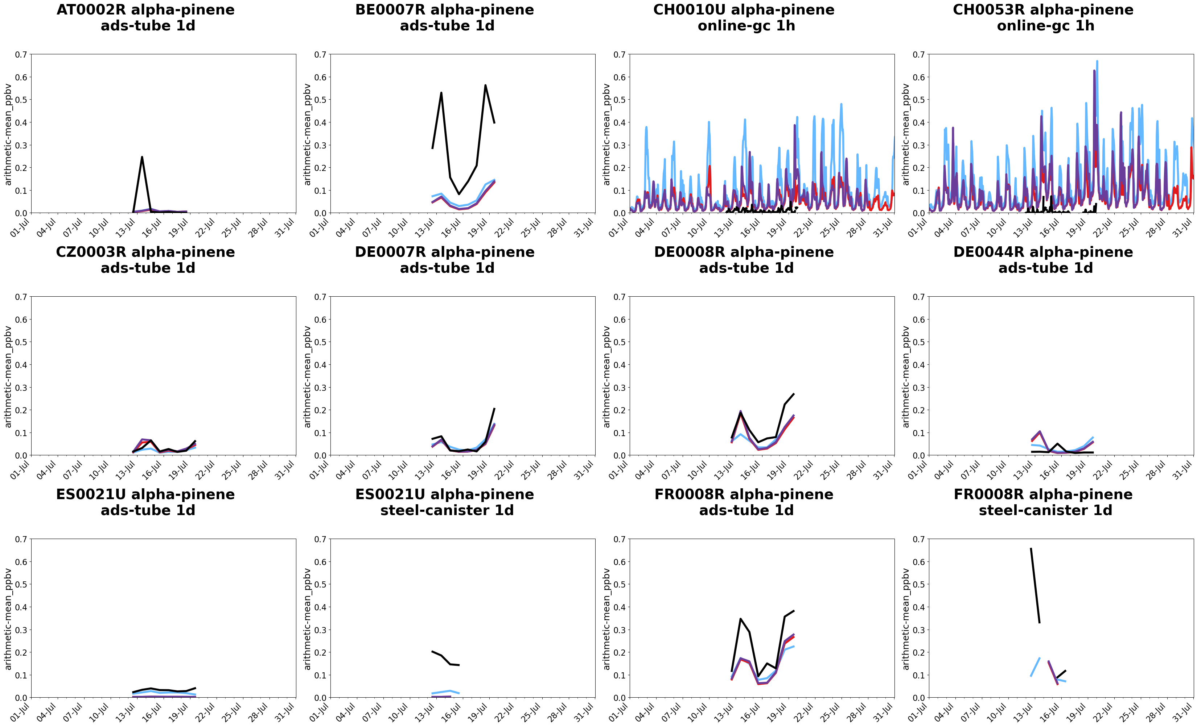
Significant overestimation
α-PINENE · 1 de 2

Slide 35
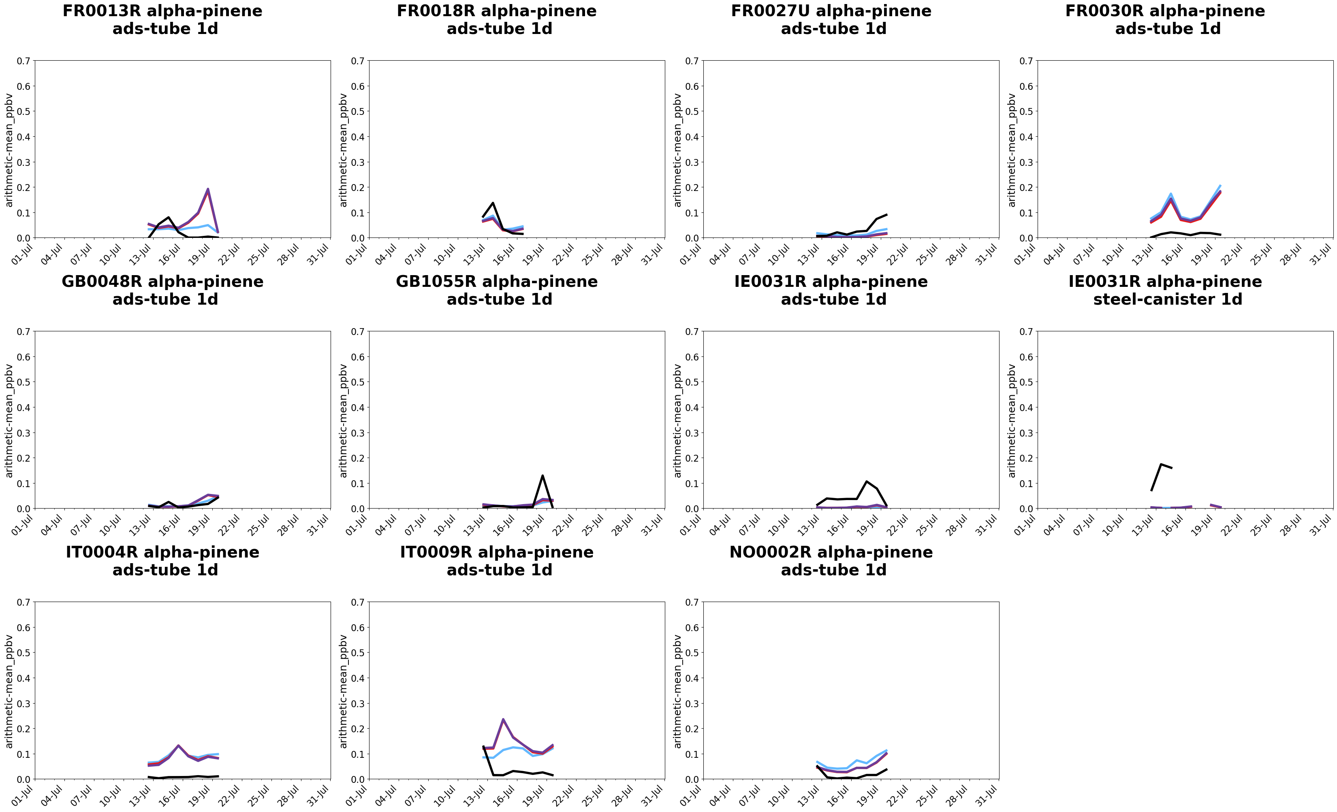
α-PINENE · 2 de 2

Slide 36
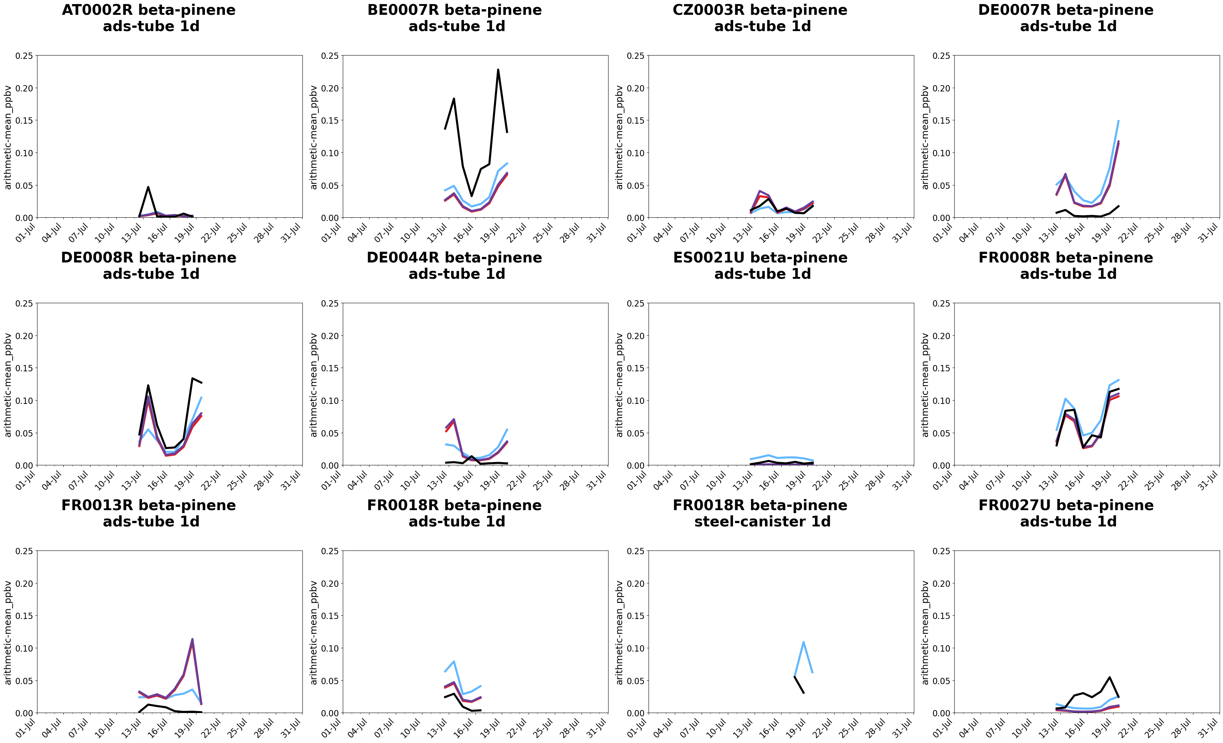
β-PINENE · 1 de 2

Slide 37
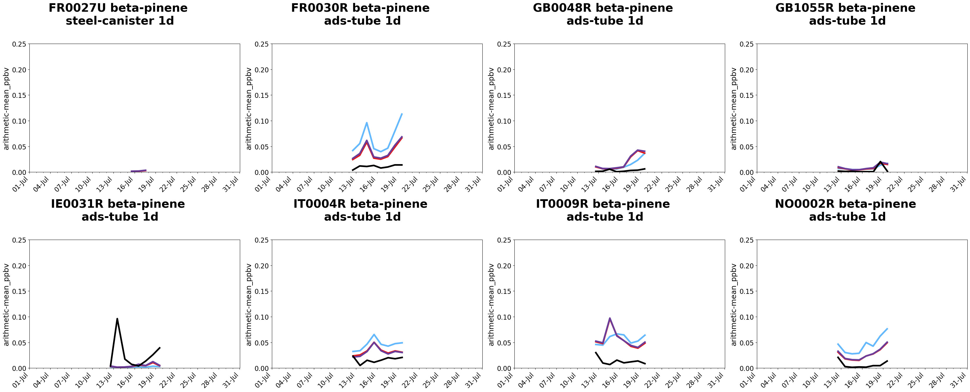
β-PINENE · 2 de 2

Slide 38

CH₃CHO · 1 de 2

Slide 39

CH₃CHO · 2 de 2

Slide 40

GLYOXAL · 1 de 2

Slide 41

GLYOXAL · 2 de 2

Slide 42
Next steps at CIEMAT:
Include metals (As, Pb, Cd, Ni, Cu, Cr, Zn) in CHIMERE 2023. Move also BaP and bencene to this versión (now available in CHIMERE 2013).

Slide 43

Thank you!
We thank the Ministry for the Ecological Transition and Demographic Challenge
m.garcia@ciemat.es
mark.theobald@ciemat.es

