Slide 1
Implementation of Chimere for air quality forecasting in France (Prév'air system) and
in Europe (Copernicus)
F.Meleux, A.Ung, F.Couvidat, V.Lannuque, A.Guion, A.Colette - Ineris
CHIMERE workshop, 26 June 2026

Slide 2
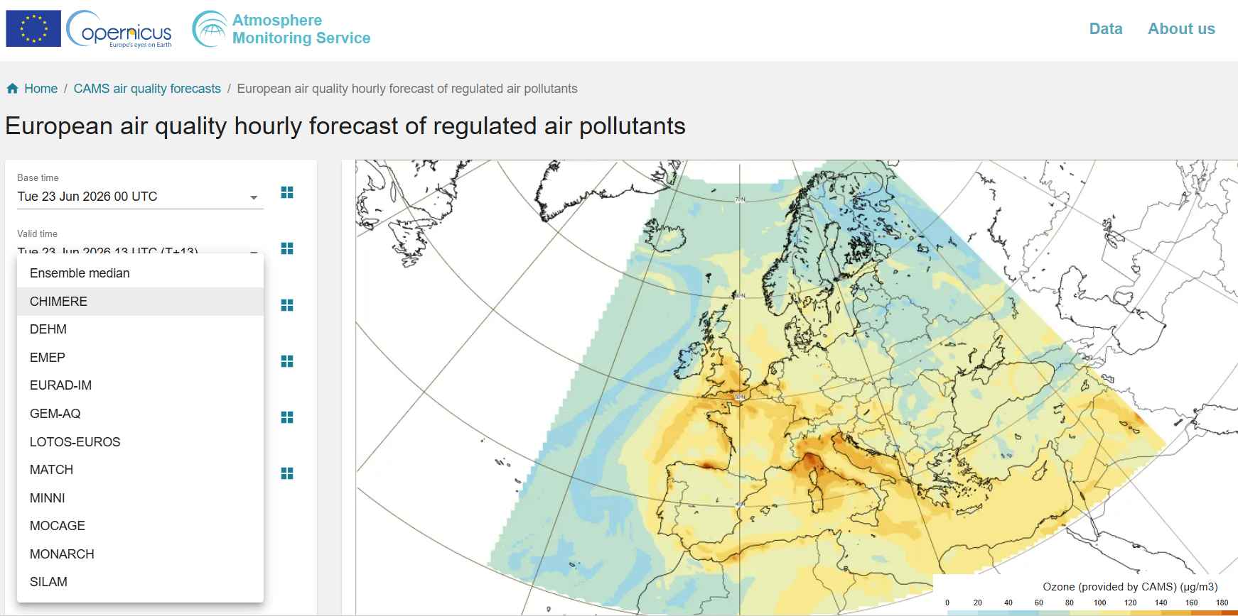
Copernicus Atmospheric Monitoring Service –
European Air Quality component
11 European teams provide hourly air quality forecasts
Computation of the Ensemble Forecasts (median value)
22 pollutants :
  Regulated polluants: O3, NO2, PM10, PM2.5
  Additional species: NH3, CO, SIA , Dust, Fire tracer, Seasalt, Ecres, …)
0.1° of resolution
10 levels from surface to 5000m
96h (D+0 to D+3)
6 pollens (Alder, Birch, Grass, Mugworth, Olive, Ragweed)
https://regional.atmosphere.copernicus.eu/
https://ads.atmosphere.copernicus.eu/

Slide 3
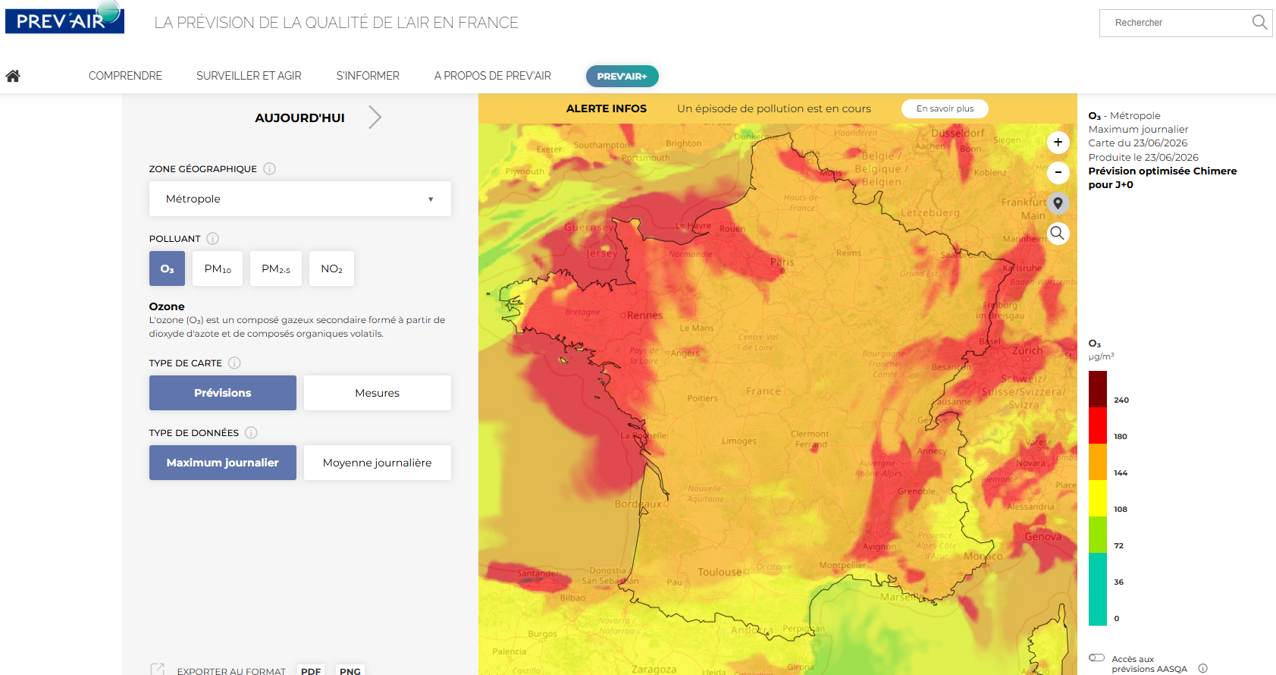
French national air quality platform Prev’air
www.prevair.org
Daily and hourly forecasts from D+0 to D+5
Mainly focusing on regulatory pollutants O3, NO2, PM10 and PM2.5
CHIMERE: 10 levels from surface to 5000m- Resolution of 4 km
Refined at 2 km with statistical processing.
Provision of forecast maps and numerical data (to the public, authorities, research organizations and the private sector)
Communication in case of a risk of a nationwide pollution episode (3 subregions and persistence of 2 days)
available in open data: data.gouv.fr

Slide 4
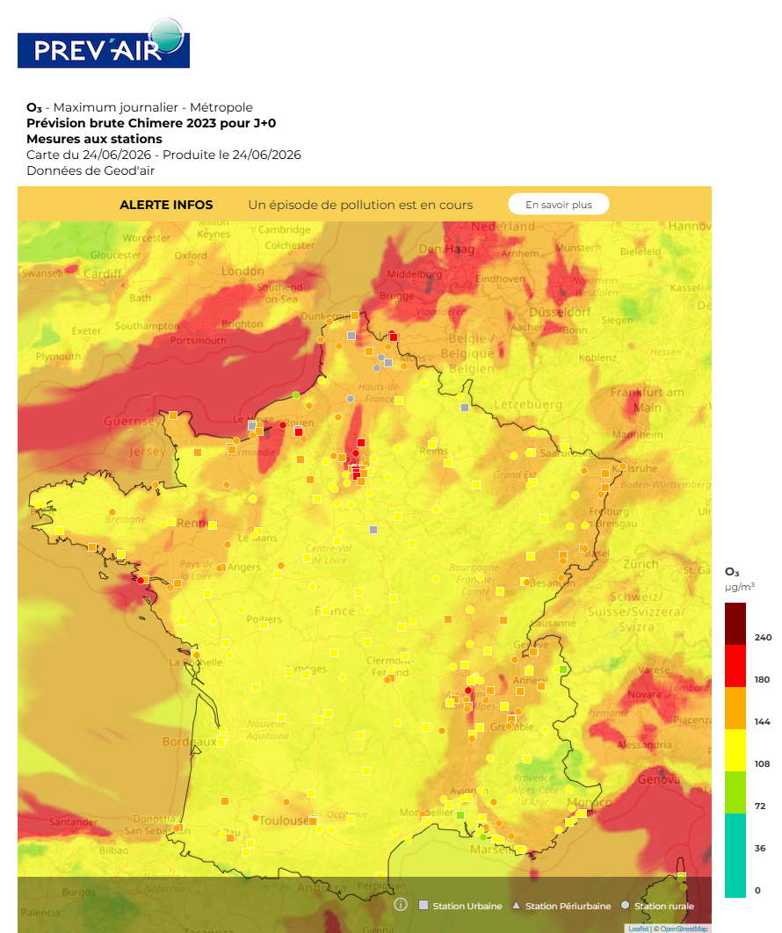
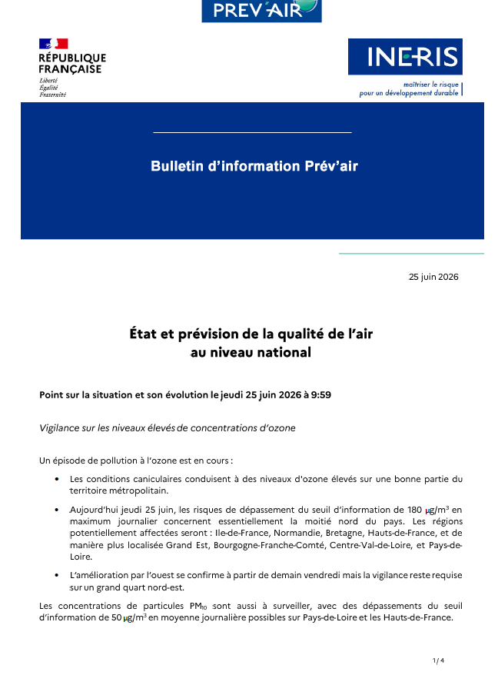
Air quality report
In case of pollution episode
Provides a description of the pollution episode
  meteorological conditions
  emission sources driving the deterioration of the air quality
List of subregions that could be affected by high concentrations
Duration of the episode
Sent to all actors of the air quality monitoring (including Ministries and AASQA) and to national media (AFP, …)
And published on networks

Slide 5
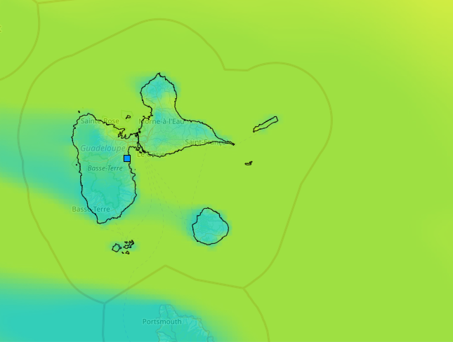
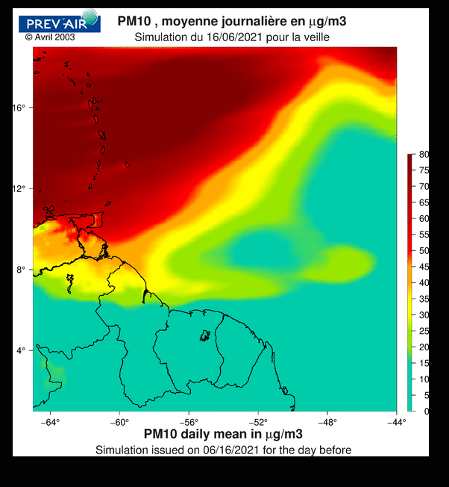
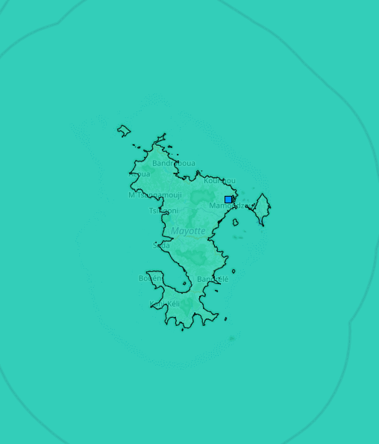
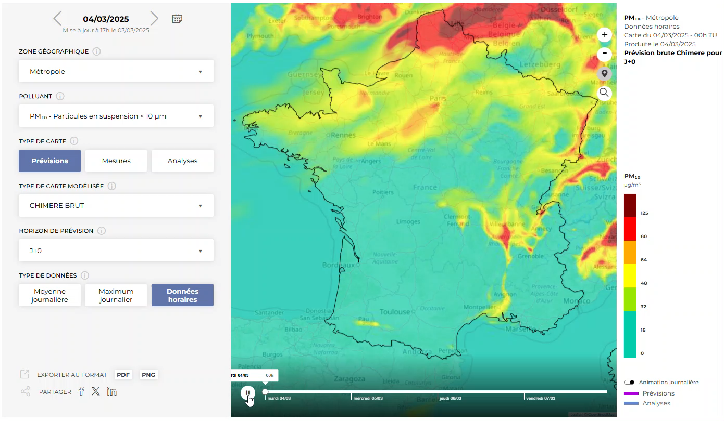
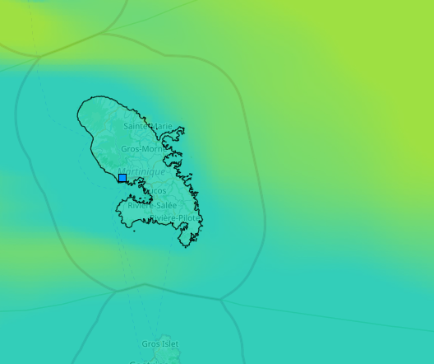
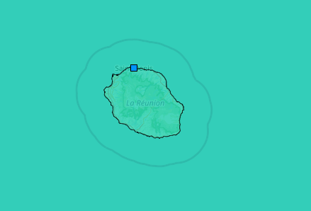
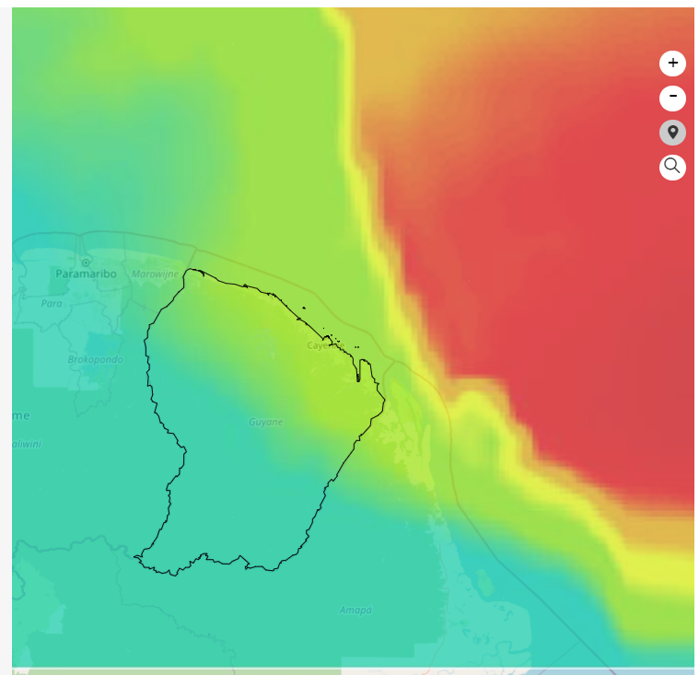
Prév’air (www.prevair.org)
Guadeloupe
Caraïbes
Mayotte
Métropole
Martinique
Réunion
Guyane
Monitoring also for overseas territories with similar modelling set-up ( model version, horizontal and vertical resolutions …)

Slide 6
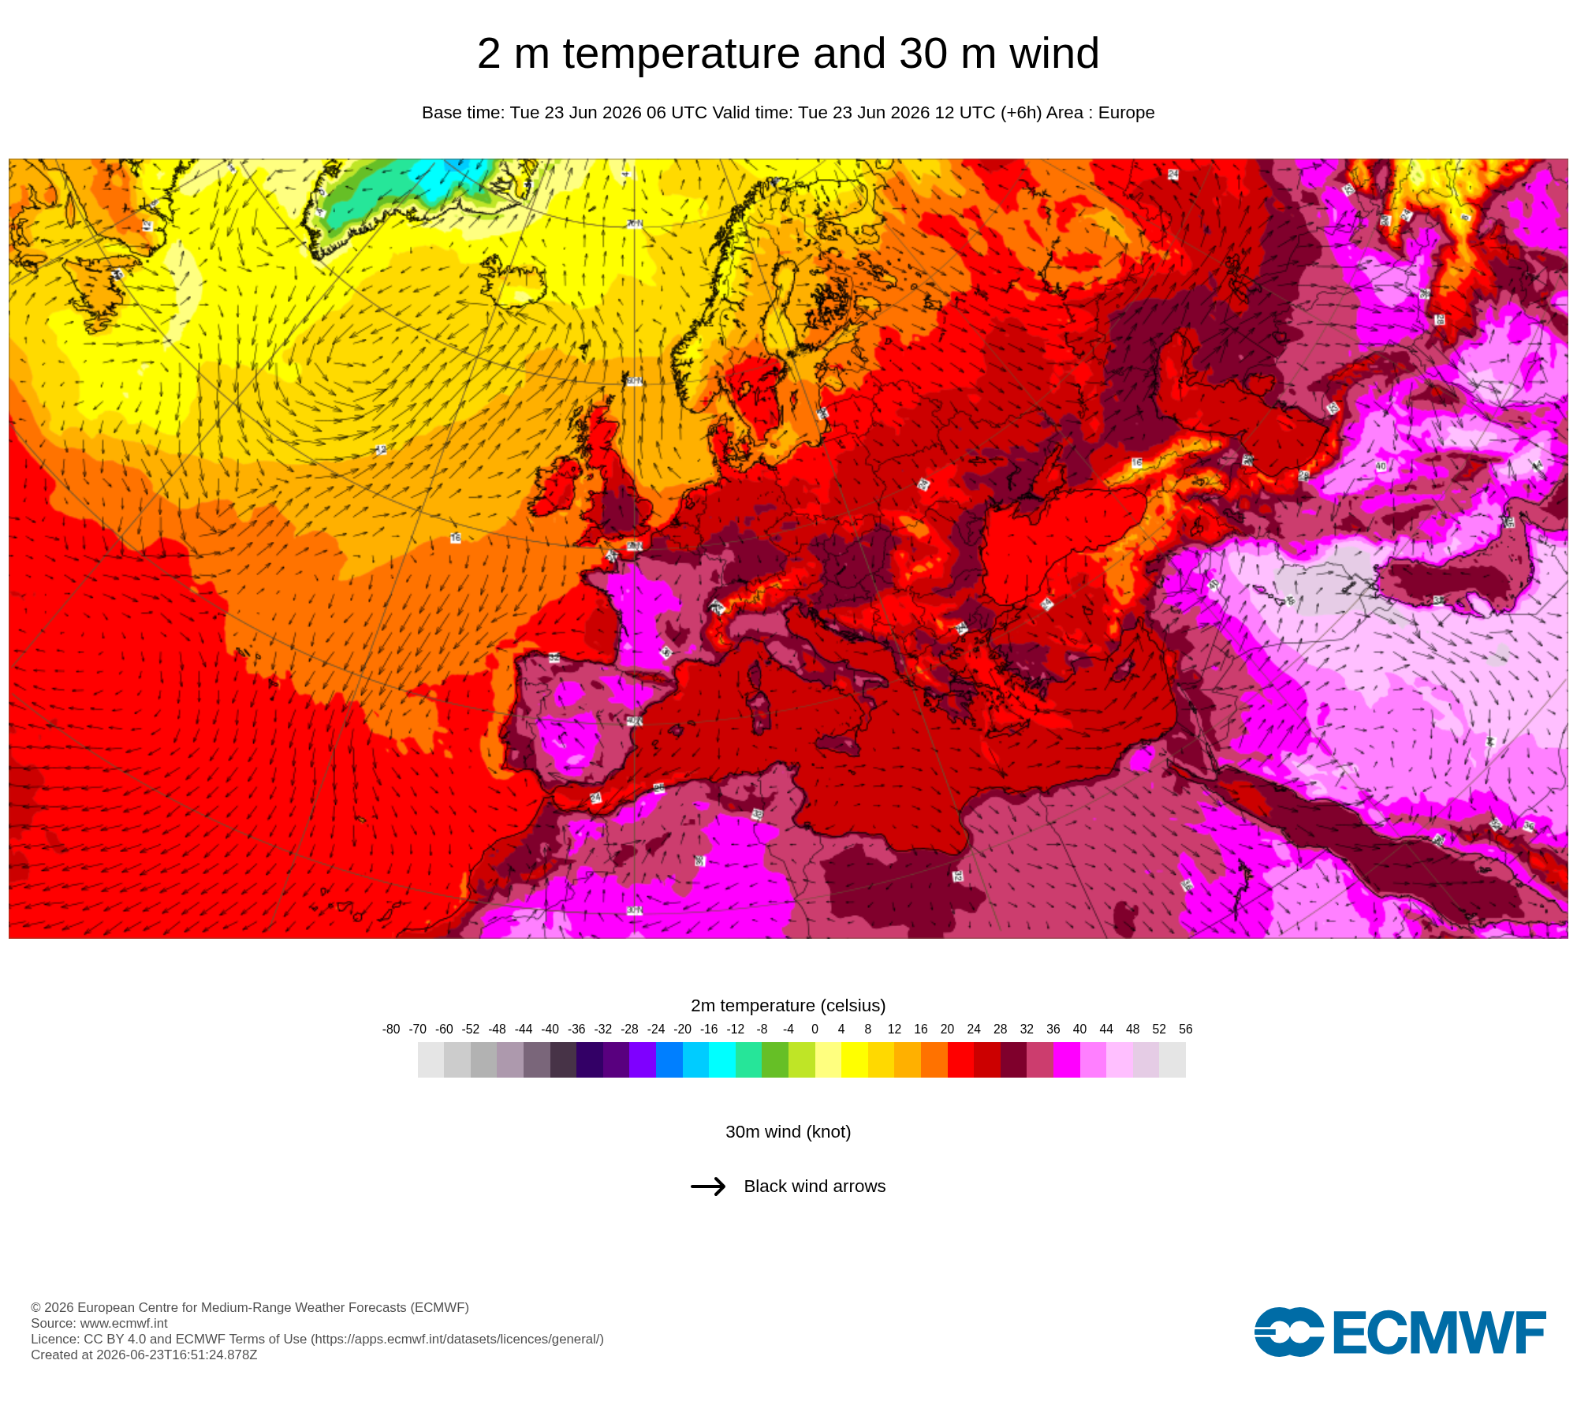
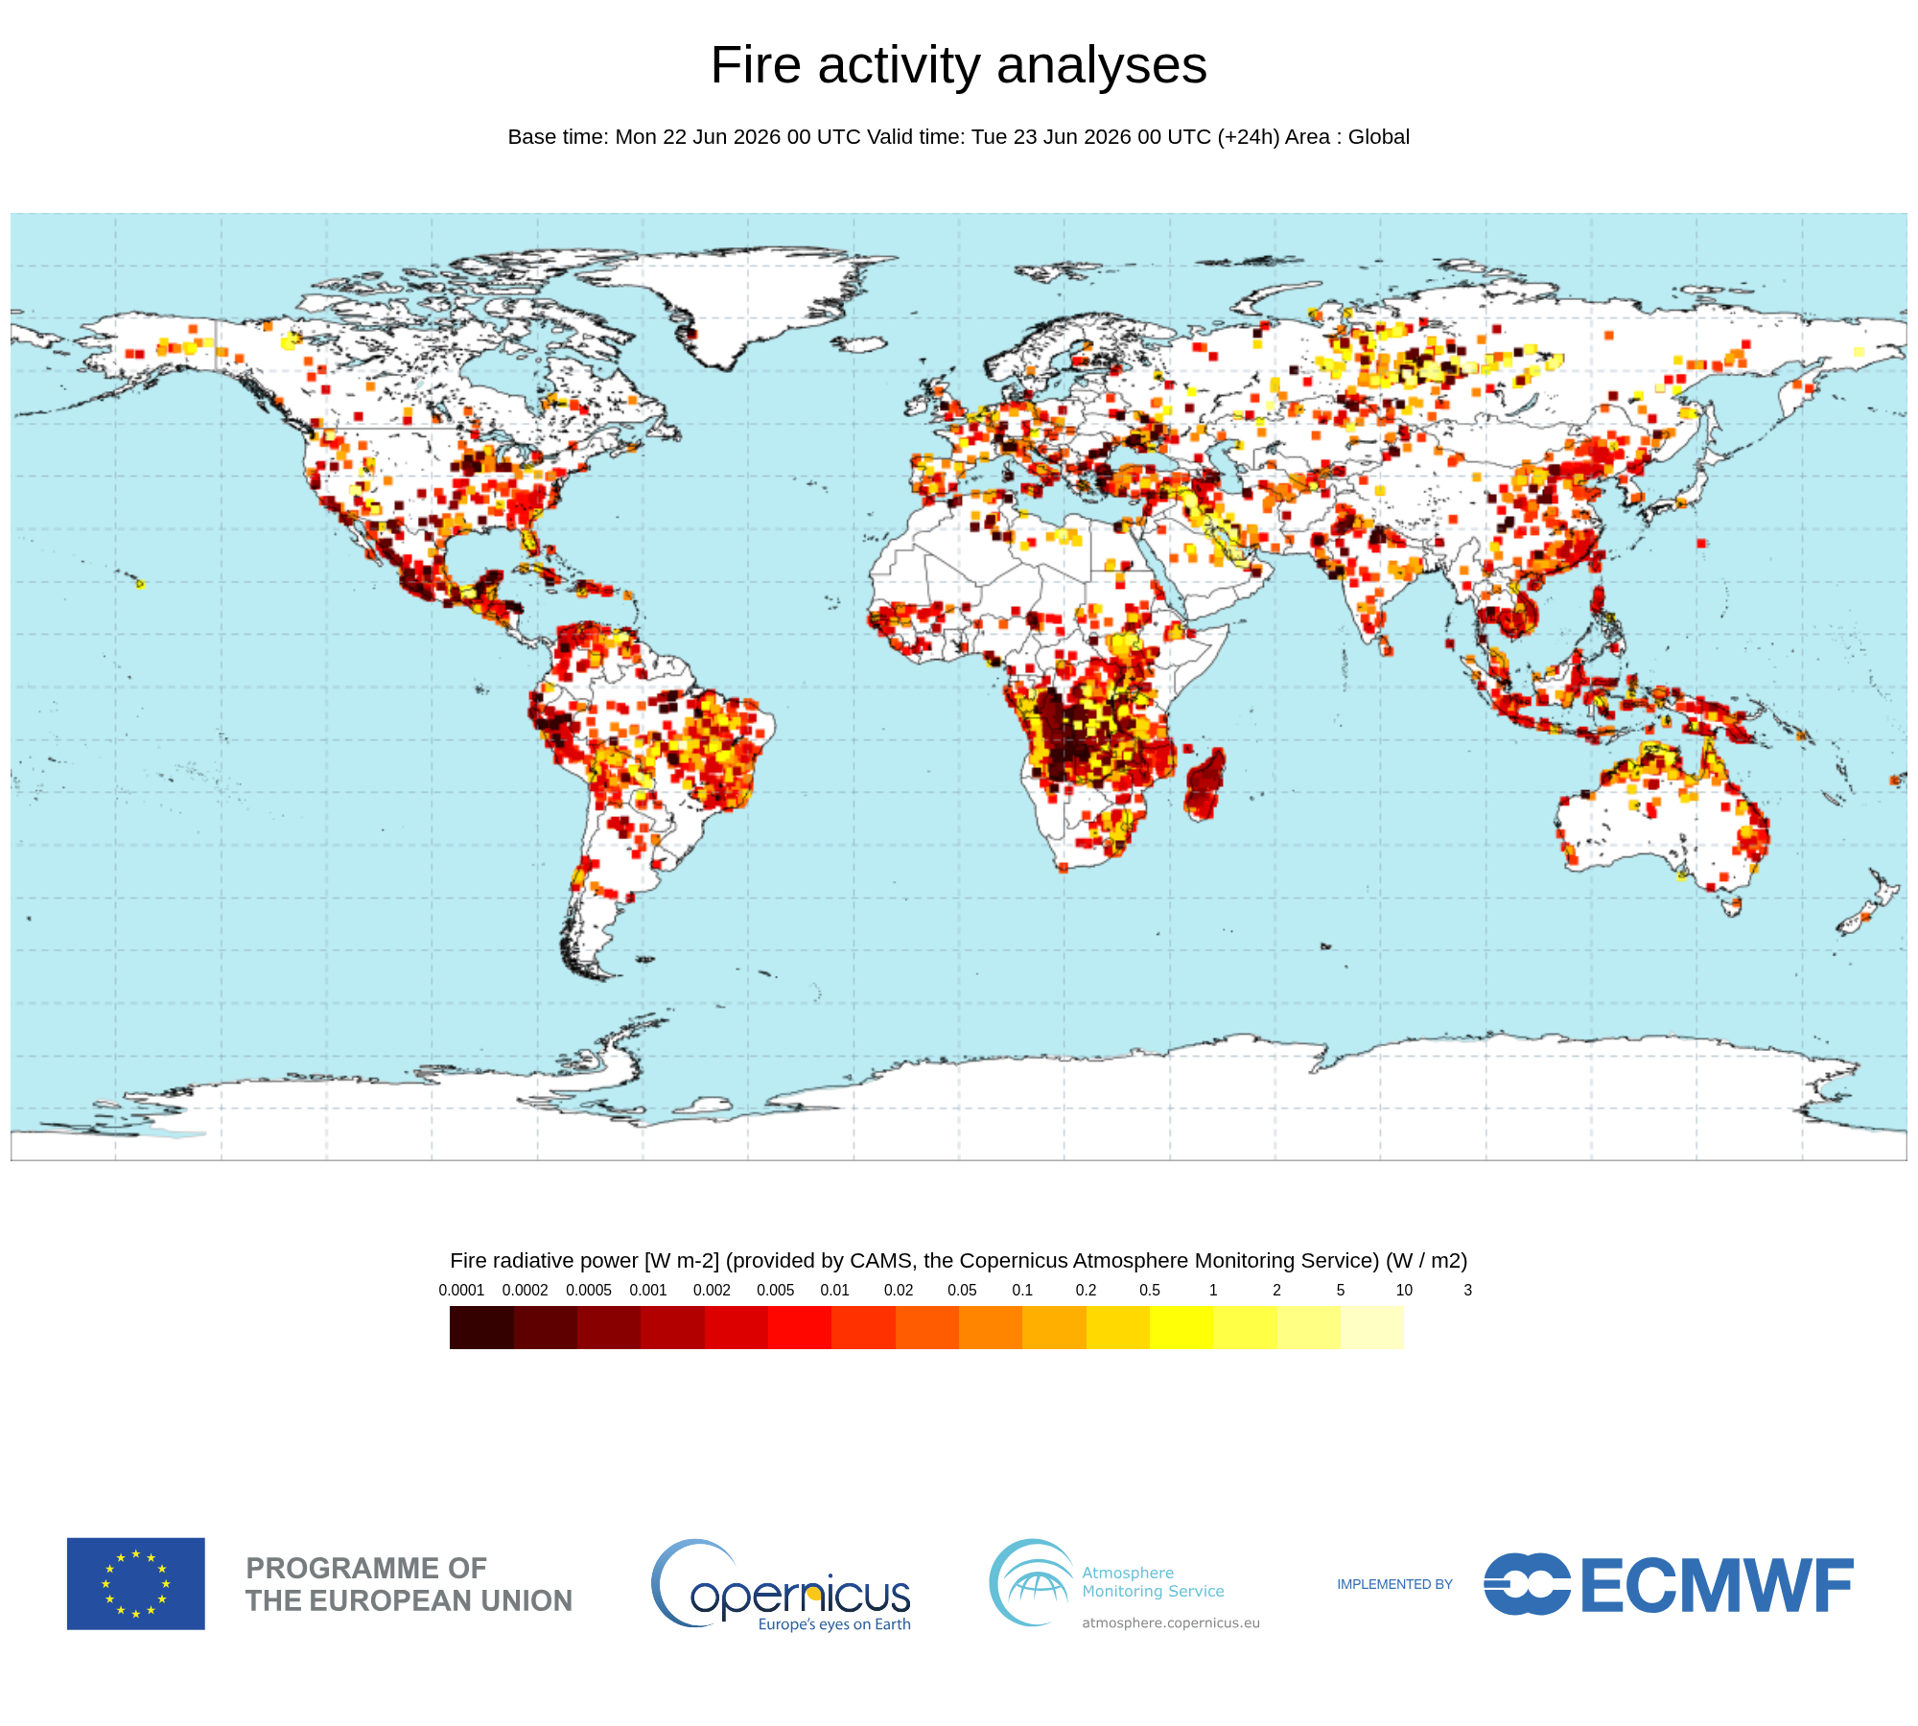
Operational dependencies between Prév’air and CAMS
CAMS Global datasets
IFS (ECMWF)
European datasets
CAMS regional emissions (0.1° x 0.05°) - v8_1 – 2024
CHIMERE CAMS European Forecast
=> CAMS Ensemble Forecast
Weather conditions
Chemical conditions (Transboundary pollution)
CAMS global emissions (overseas territories)
GFAS – Fire emissions
CAMS TEMPO v5.1

Slide 7
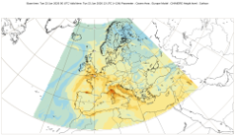
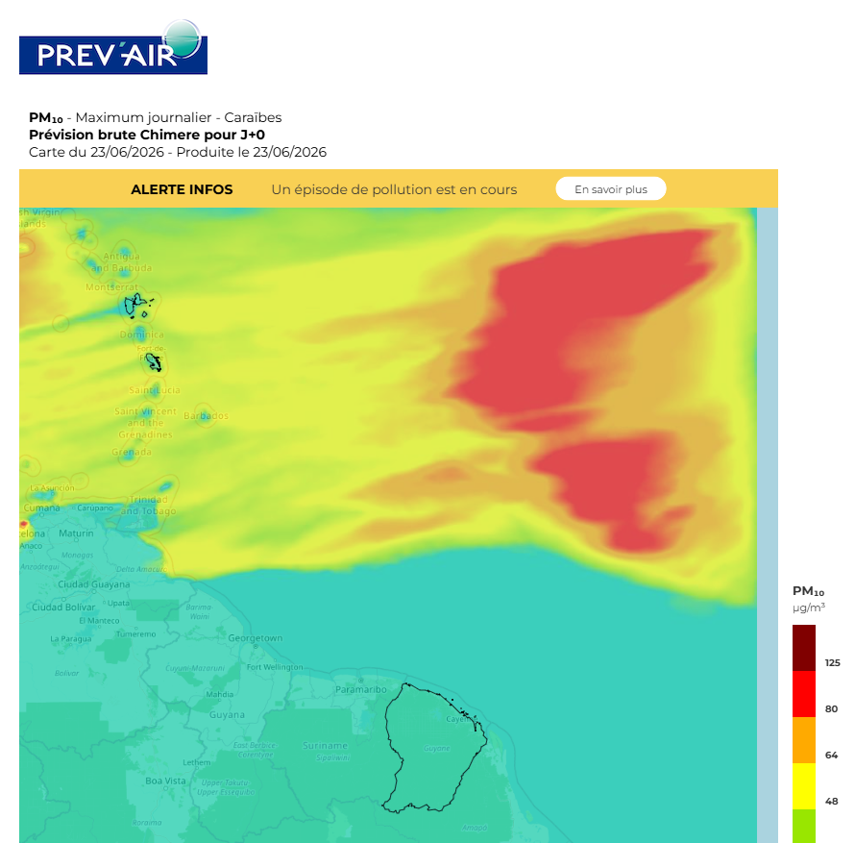
Operational dependencies between Prév’air and CAMS
CAMS Global datasets
IFS (ECMWF)
European datasets
CAMS regional emissions (0.1° x 0.05°)
Weather conditions
GFAS – Fire emissions
CHIMERE CAMS regional air quality Forecast
CHIMERE Prev’air Forecast
v8_1 – 2024
CAMS TEMPO v5.1

Slide 8
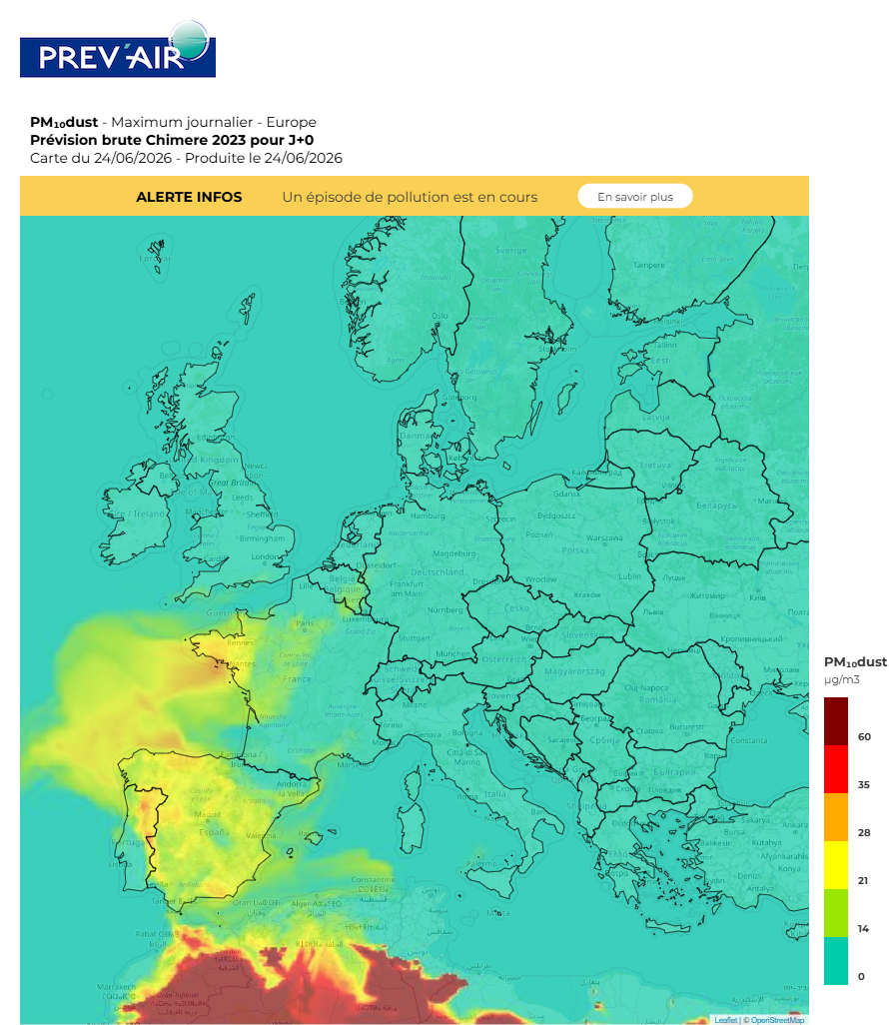
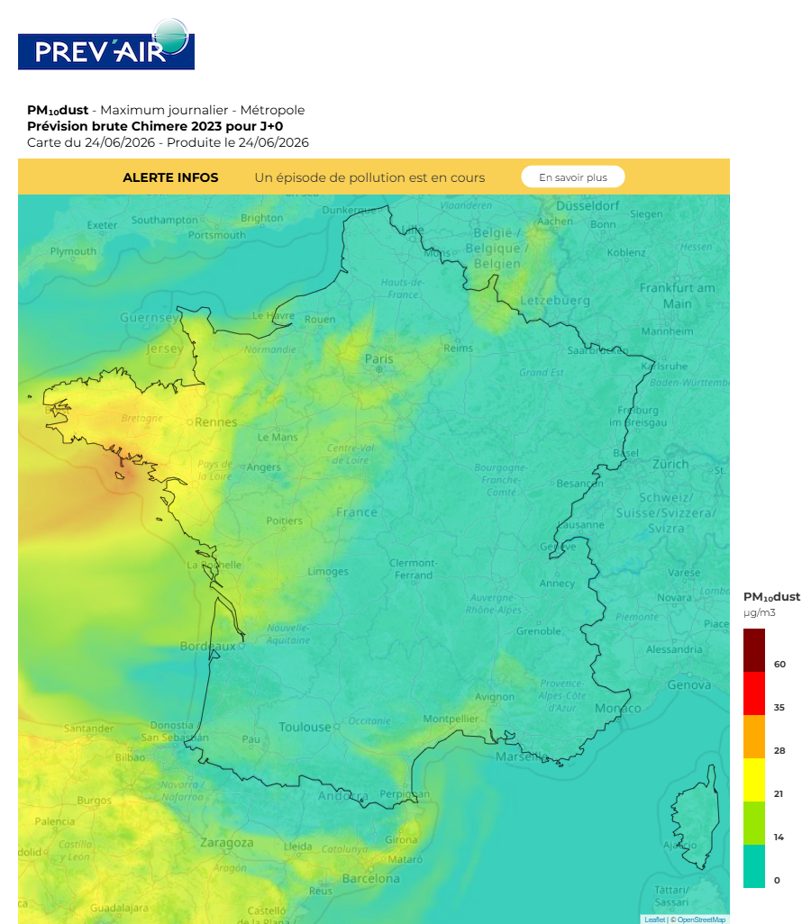
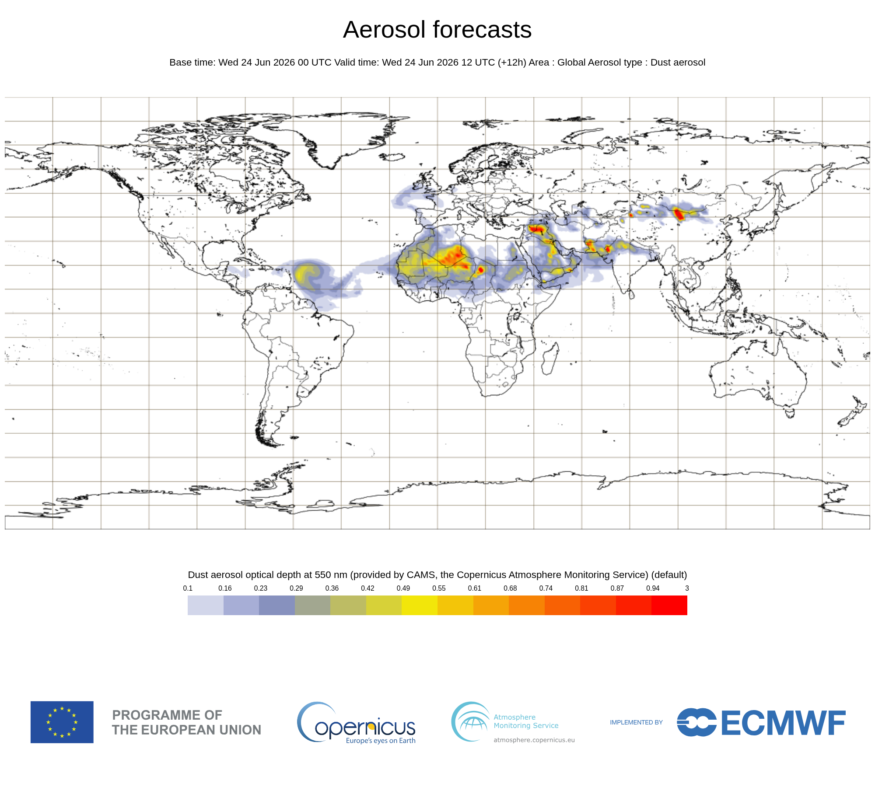
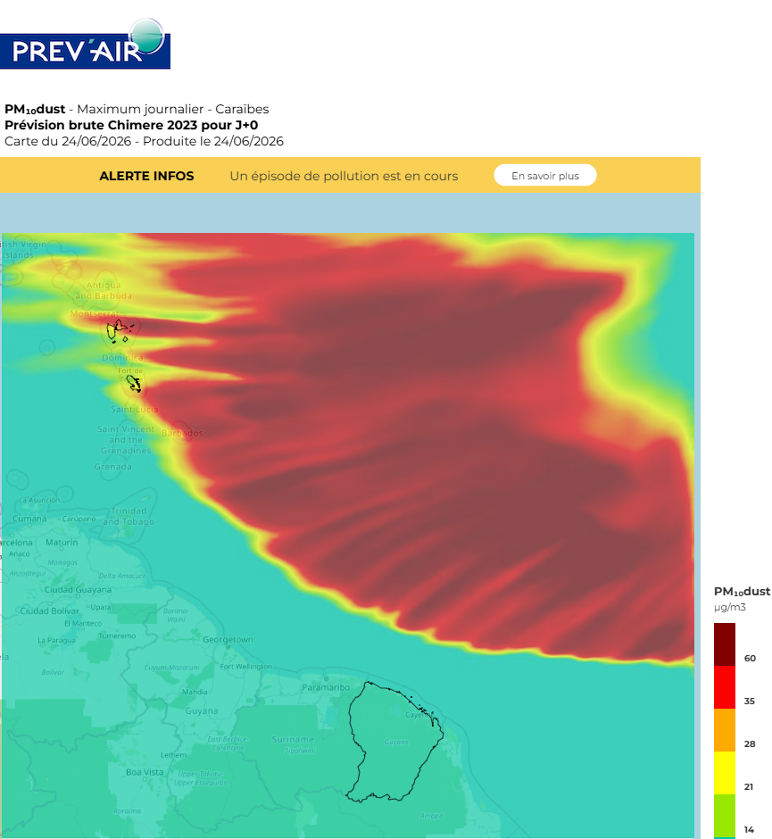
Illustration: PM₁₀ forecast for last Wednesday
Dust transport from Sahara towards Europe and towards Caribbean
=> Significant contributions to PM₁₀ concentrations

Slide 9
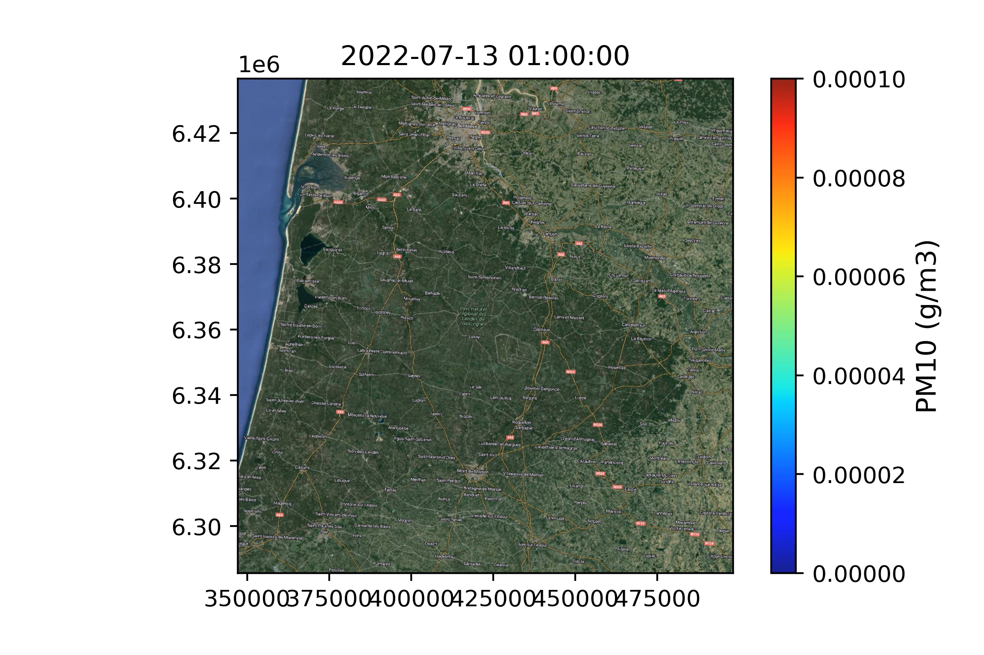
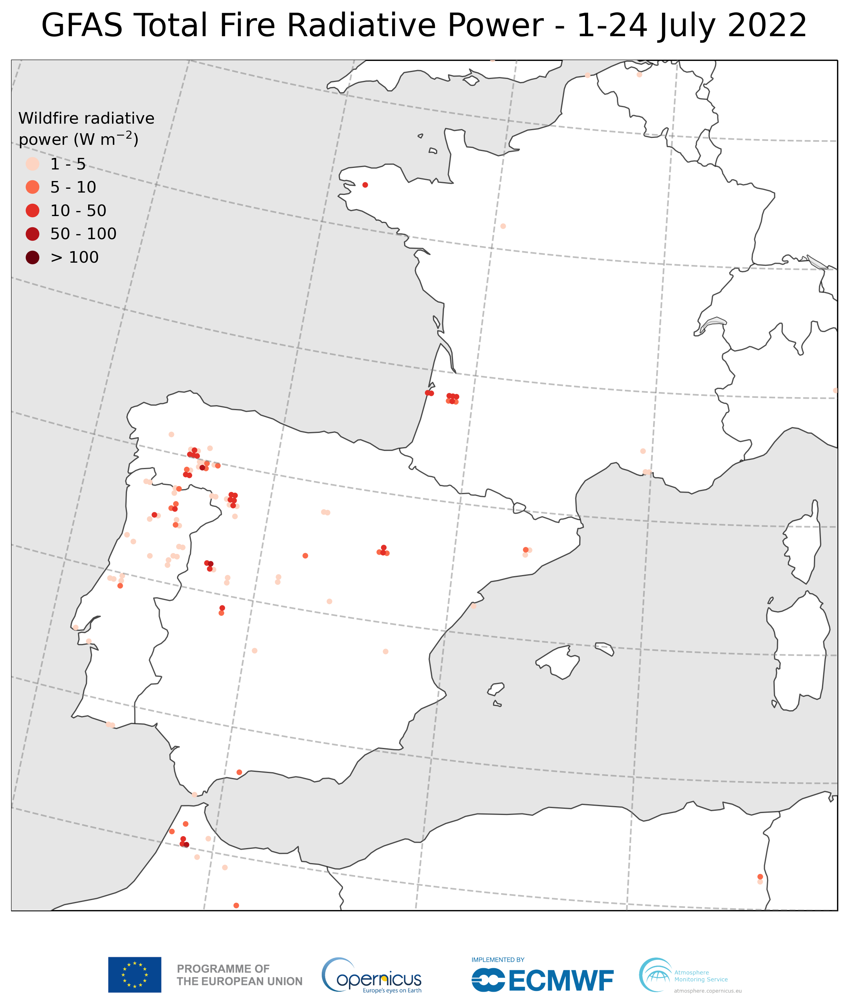
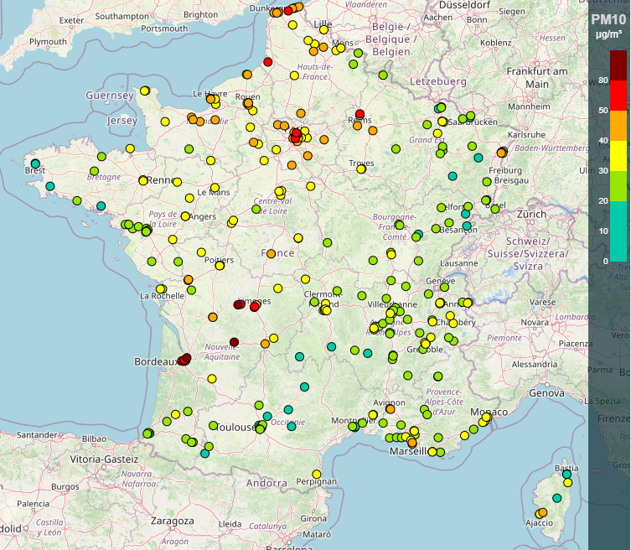
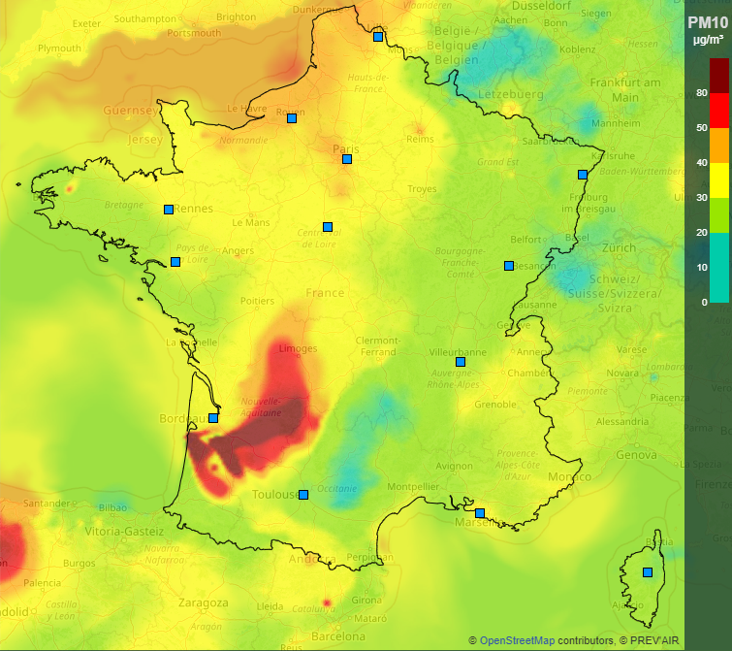
Wildfires
Fire Radiative Power detected in real time by satellite
Source Term accounting for fire dynamic and vegetation map
Operational dispersion of gaseous and particulate pollutants in CHIMERE versions used for France and Europe
Copernicus – service GFAS
https://atmosphere.copernicus.eu/global-fire-emissions

Slide 10
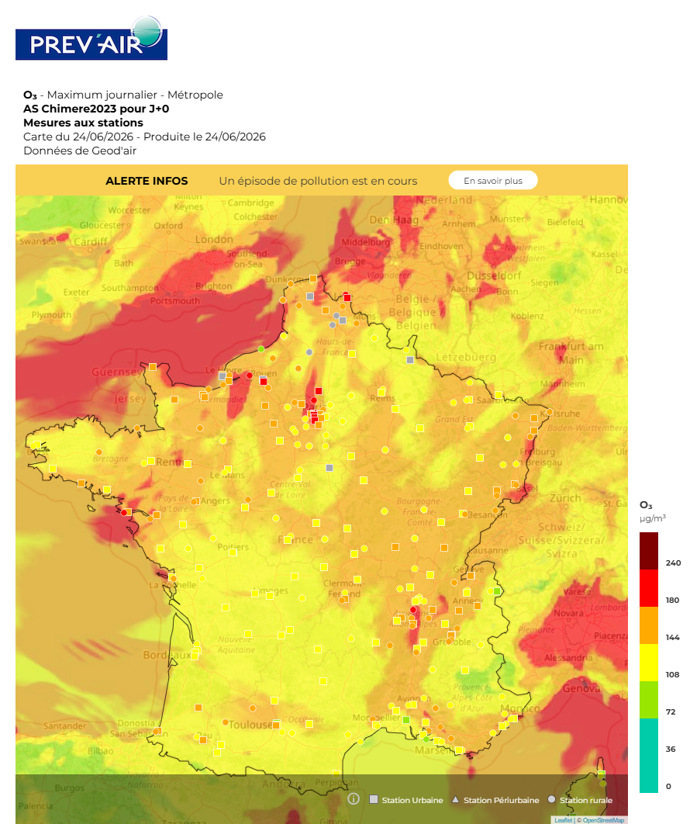
Chimere modelling and observations
Model Output Statistics (MOS Forecasts)
Forecasting using Deep learning and machine learning technics (AI) to optimize the forecast performances at monitoring stations
  Chimere is part of the explanatory variables (meteorological data, observations …)
  A new method has been developed within CAMS based upon a global learning over Europe over a limited period of times (from several days to severals weeks):
    Deployed recently in Prév’air
    Allowing hourly predictions for surface concentrations of for D+0 to D+5 for O₃, NO₂, PM₁₀ and PM_{2.5}
  Mapping with geostatistical kriging (with Chimere as external drift)
    Resolution:2 km
    Reference forecast of Prév’air supporting the air quality expertise
    Available on the homepage of the Prev’air website.
Notes:
Bertrand, J.-M., Meleux, F., Ung, A., Descombes, G., and Colette, A.: Technical note: Improving the European air quality forecast of the Copernicus Atmosphere Monitoring Service using machine learning techniques, Atmos. Chem. Phys., 23, 5317–5333, https://doi.org/10.5194/acp-23-5317-2023, 2023.

Slide 11

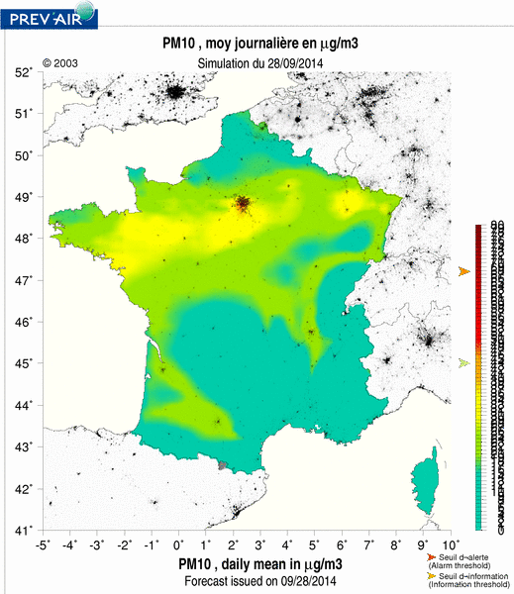
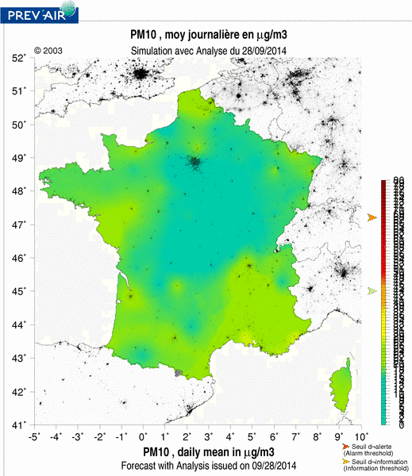
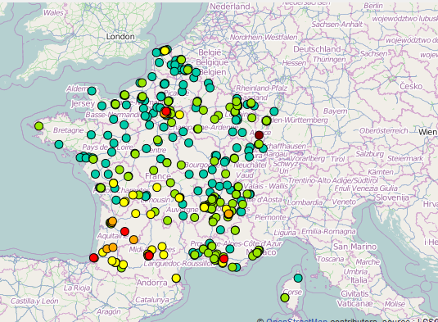
Chimere modelling and observations
Data Fusion
Geokriging using Chimere outputs and in-situ measurements
  to compute the best estimate of the surface concentrations for regulated pollutants
  To support the reporting activities required by the air quality directive
    Air quality indicators (annual average … are in respect with limit values)
    Annual French air quality assessment report
    Air quality mapping library (more than 20 years of air quality indicators over France)
Data fusion using reference station and geostatistical kriging

Slide 12
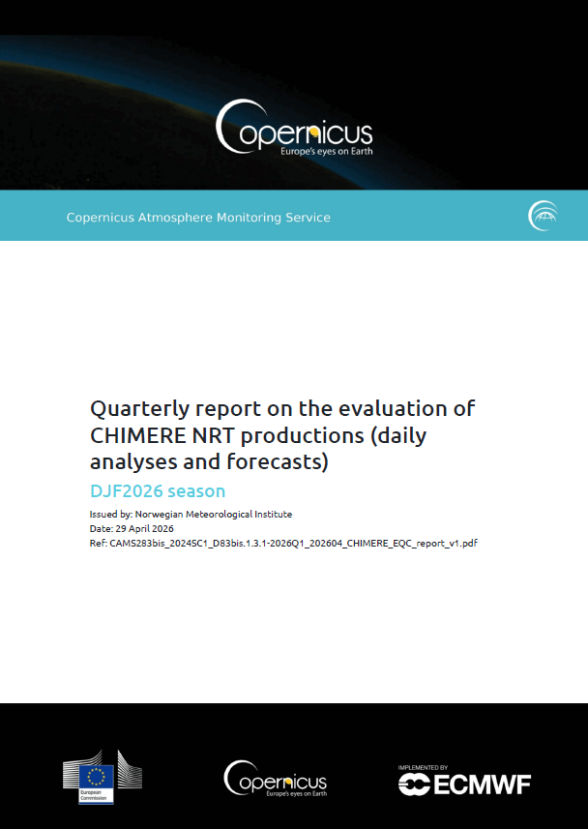
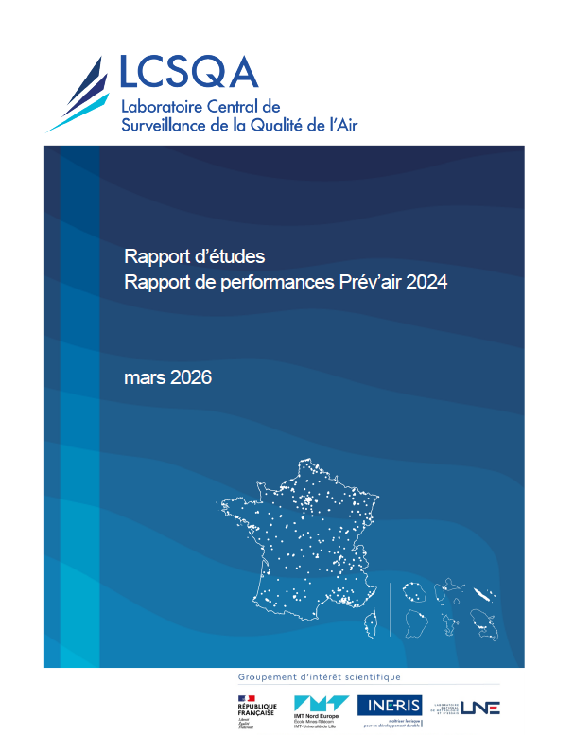
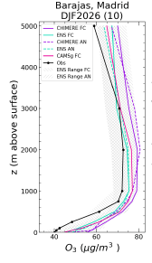
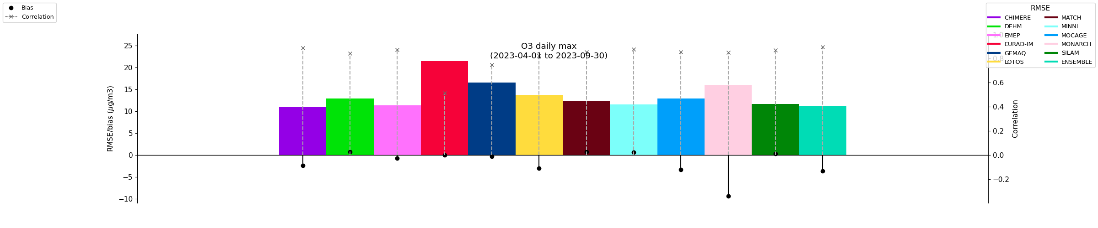
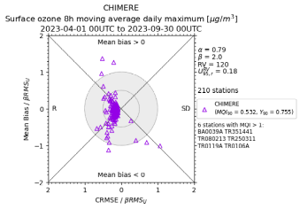
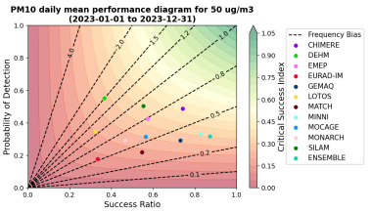
Chimere modelling and observations
Quality control
Both in Copernicus and in Prev’air, a wide range of scores is computed in order to assess the quality of the regional products (Forecasts and Reanalyses):
  Skill scores (bias, RMSE, correlation) – over season – over multi-years …
  Capability to detect threshold exceedances (Contingency table, performance diagram)
  Fairmode metrics to evaluate if a model output has the quality required for being used for European air quality reporting.
  Upper levels evaluations with IAGOS, Ozonesondes and Tropomi
  CAMS EQC reports: Regional services | Copernicus
  Prev’air EQC reports on LCSQA website

Slide 13
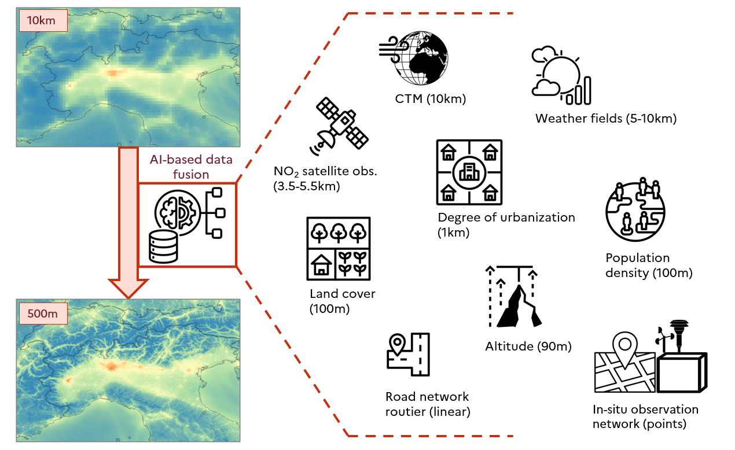

The future of CHIMERE in CAMS and Prév’air
Upcoming developments in CAMS air quality productions :
  Add 2 new levels – at the surface and at the top
  Update and harmonisation of Land-Use Data (Baptiste Thomas talk)
  Initialisation of Forecasts with data assimilation
  New provisions:
    Pollen species (hazel and cypress)
    Deposition flux
  Initialisation of Forecasts with data assimilation
Increase of resolution (downscaling):
With hybrid approach combining model and data-driven approach (CAMS evolution) for higher resolution .
Chimere and CHROMAP to deliver High-resolution air quality mapping
Strengthening the relation between CAMS and Prév’air through the national collaboration program
  Downscaling with national Chimere runs using CAMS-ENS as boundary conditions for pollutants and pollens (Ineris)
  Optimized forecast with CAMS-ENS, Arome and Chimere analyses (Météo-France)
Guion et al., 2026
CHROMAP : Computational model for High-ResOlution air quality MAPs based on data fusion using artificial intelligence
13
Notes:
Guion, A., Gressent, A., Descombes, G., Janati, Y., Real, E., Ung, A., Meleux, F., Schucht, S., and Colette, A.: High-resolution mapping of air quality across Europe: an ensemble machine and deep learning framework integrating multi-scale spatial predictors (CHROMAP v1.0), EGUsphere [preprint], https://doi.org/10.5194/egusphere-2026-1109, 2026.

Slide 14
Thank you for your attention!

