Slide 1

Operationalizing CHIMERE
From research advances to decision-ready air quality services
Fanny Velay
26.06.2026
Notes:
Good morning everyone and thank you for giving us the opportunity to present some of our work.
Fanny unfortunately could not attend the workshop, so I will be presenting on her behalf. My name is Inès Makni, and I am an air quality engineer at SUEZ Aria Technologies.
Today, I will focus on how we operationalize CHIMERE in our projects, and how we adapt the model to address a wide range of client needs ; from research-oriented developments to operational air quality services that support decision-making.

Slide 2

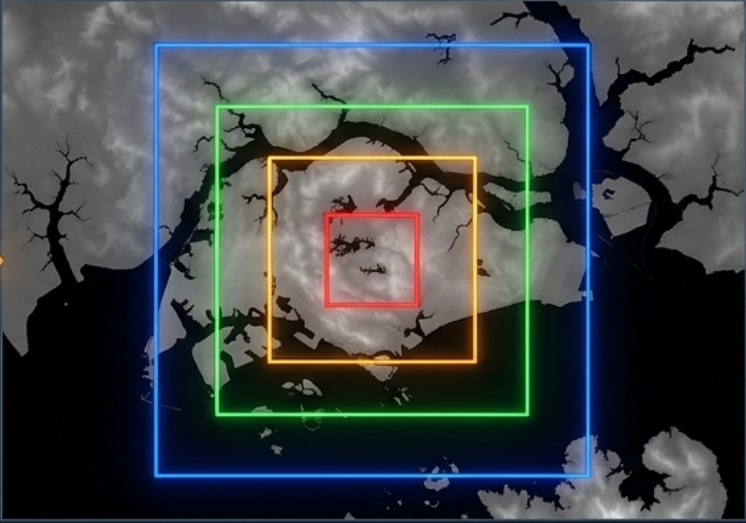

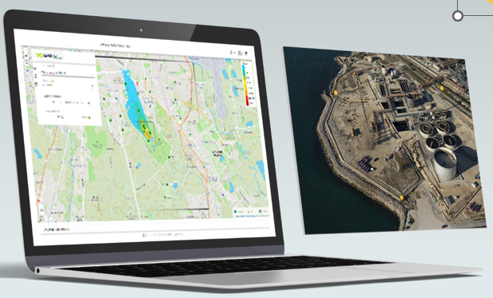
Multi-scale modeling chains
High resolution for local action services
Meteorological forcing
Regional air quality
WRF
CHIMERE
Local-scale modeling
Decision support
PMSS ; SIRANE
Impact maps
Integration to operational air quality services

Slide 3
Air Quality Operational systems
Goals
Daily monitoring of air quality and forecasts for D+1 and D+2
Dissemination of information to the public
Decision support for the Implementation of Emissions Reduction Policies
Tailored operational solutions
3D modeling approach to simulate pollutant dispersion, from continental to street level
Solutions for analyzing and comparing different scenarios
Integration of fixed and/or mobile microsensors to ensure extensive spatial coverage
Clients
Ministry of the Environment, national agencies, regional air quality monitoring networks, World bank, United Nations…
Participation in H2020 and ANR research projects
A solution adapted to each challenges
Emission inventories
Air quality forecasts
Emission scenarios
Web platforms
Application to many different geographical and institutional context

Slide 4
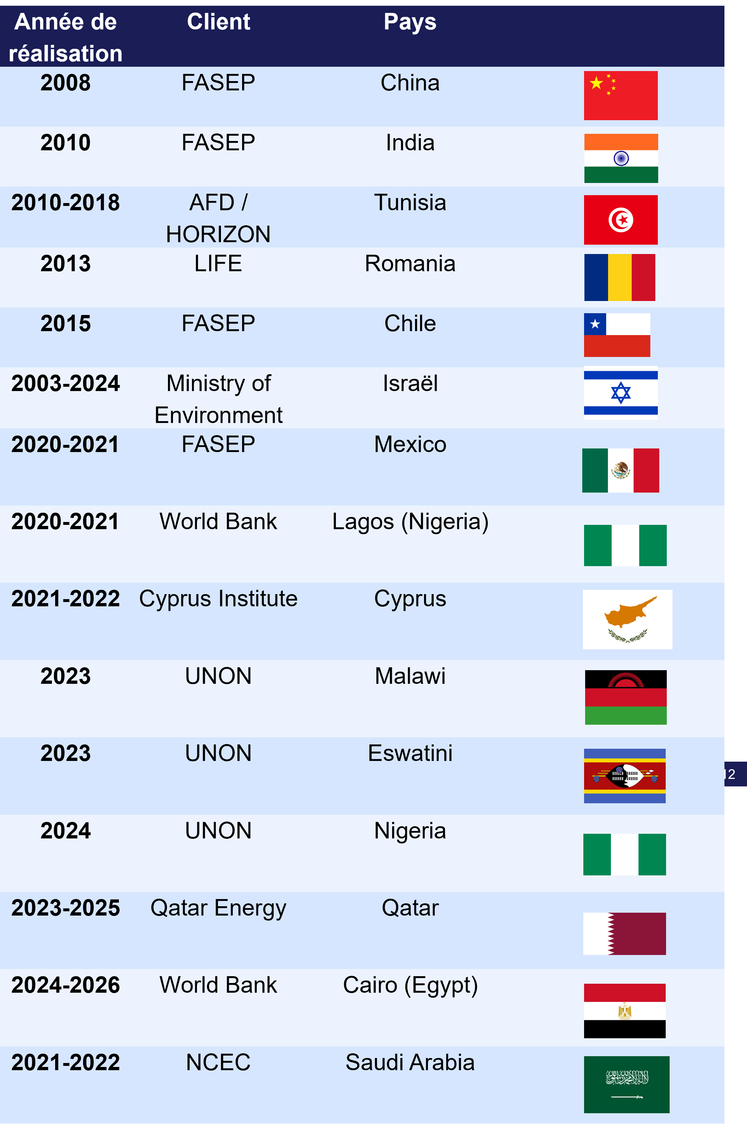
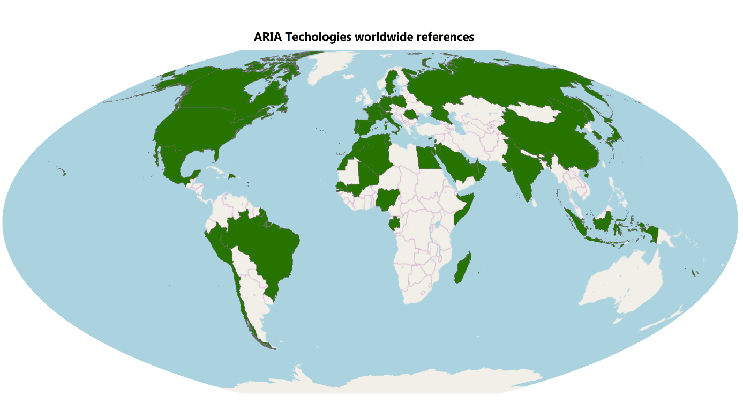
An international presence
Key partners
Universities: IPSL Laboratories (LISA, LSCE, LMD…)
CITEPA
INERIS
ASQAA
Engineering Firms

Slide 5
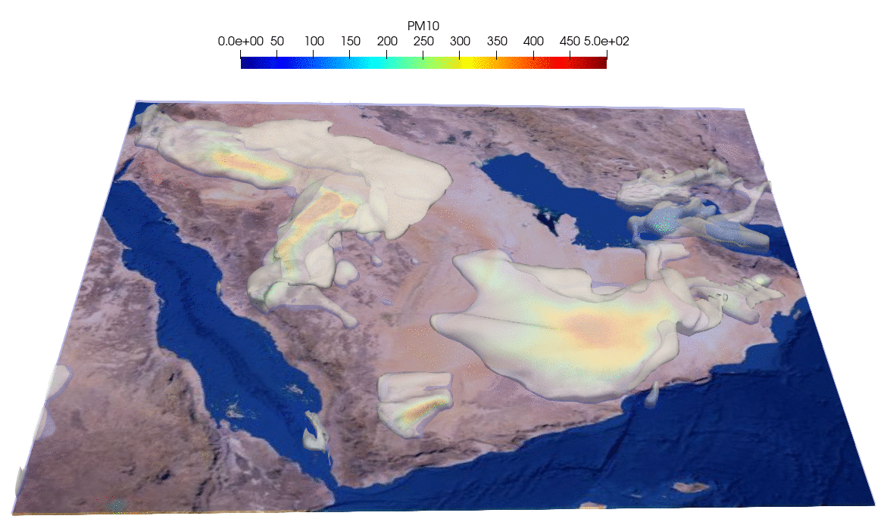
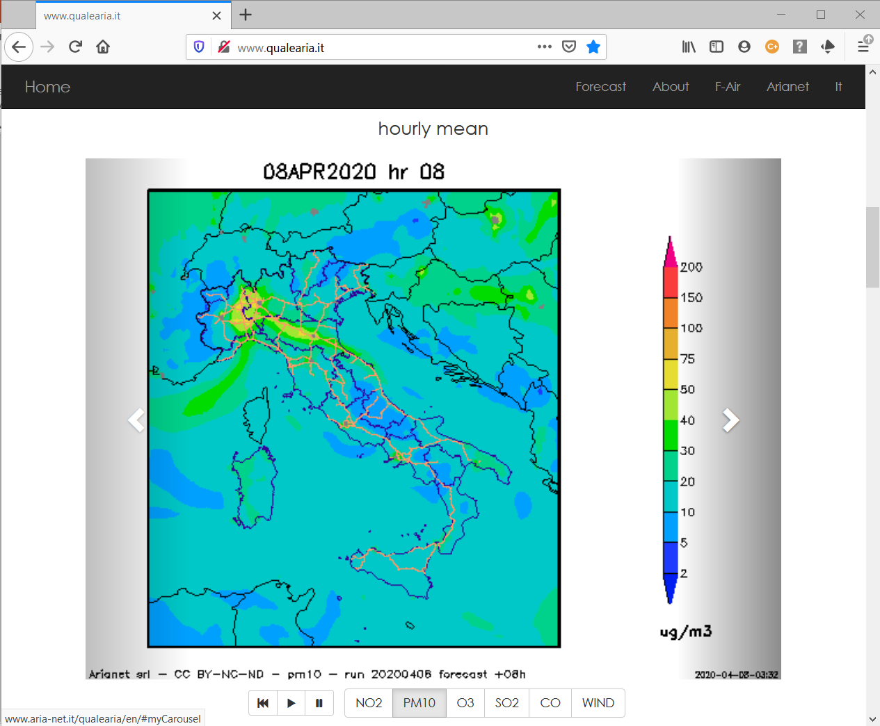
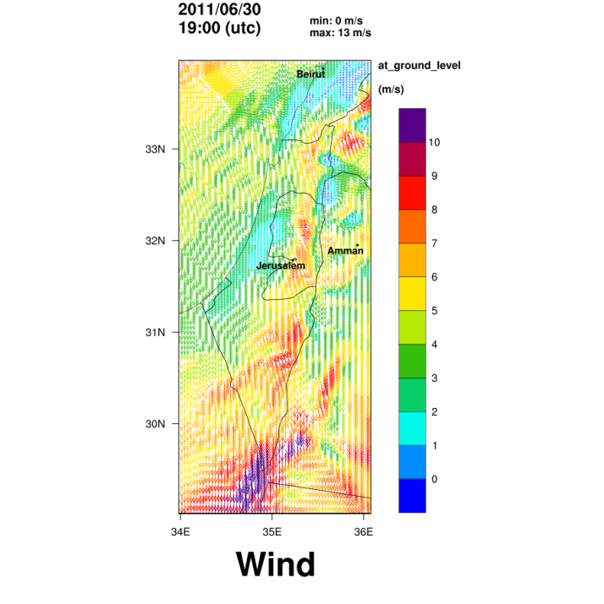
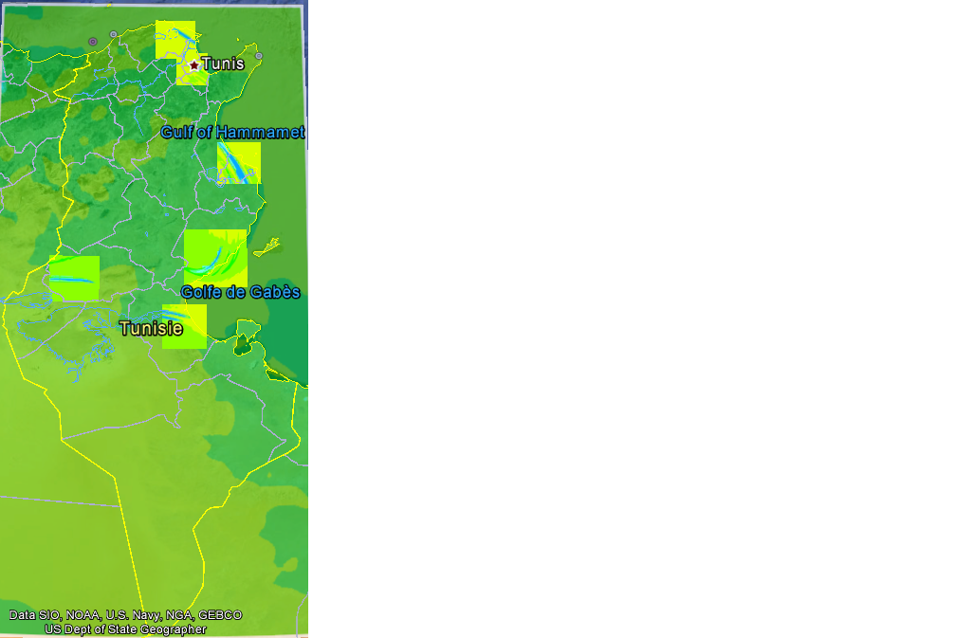
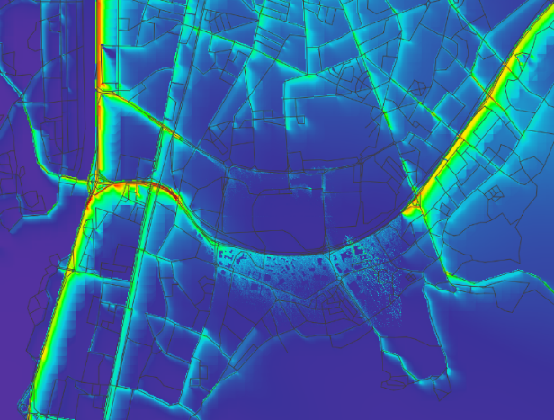
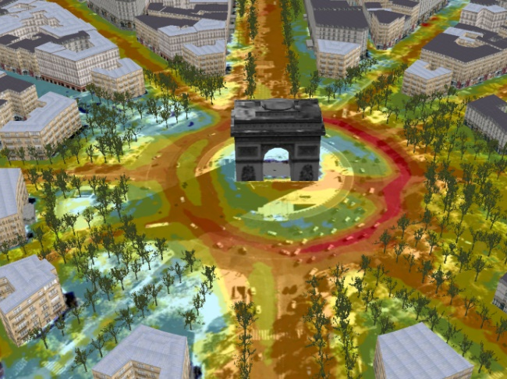
Presentation of projects examples
Desert Dust
Saudi Arabia (WRF/CHIMERE)
Notes:
I will now illustrate this approach through several project examples, starting with systems where CHIMERE is a core operational component.

Slide 6

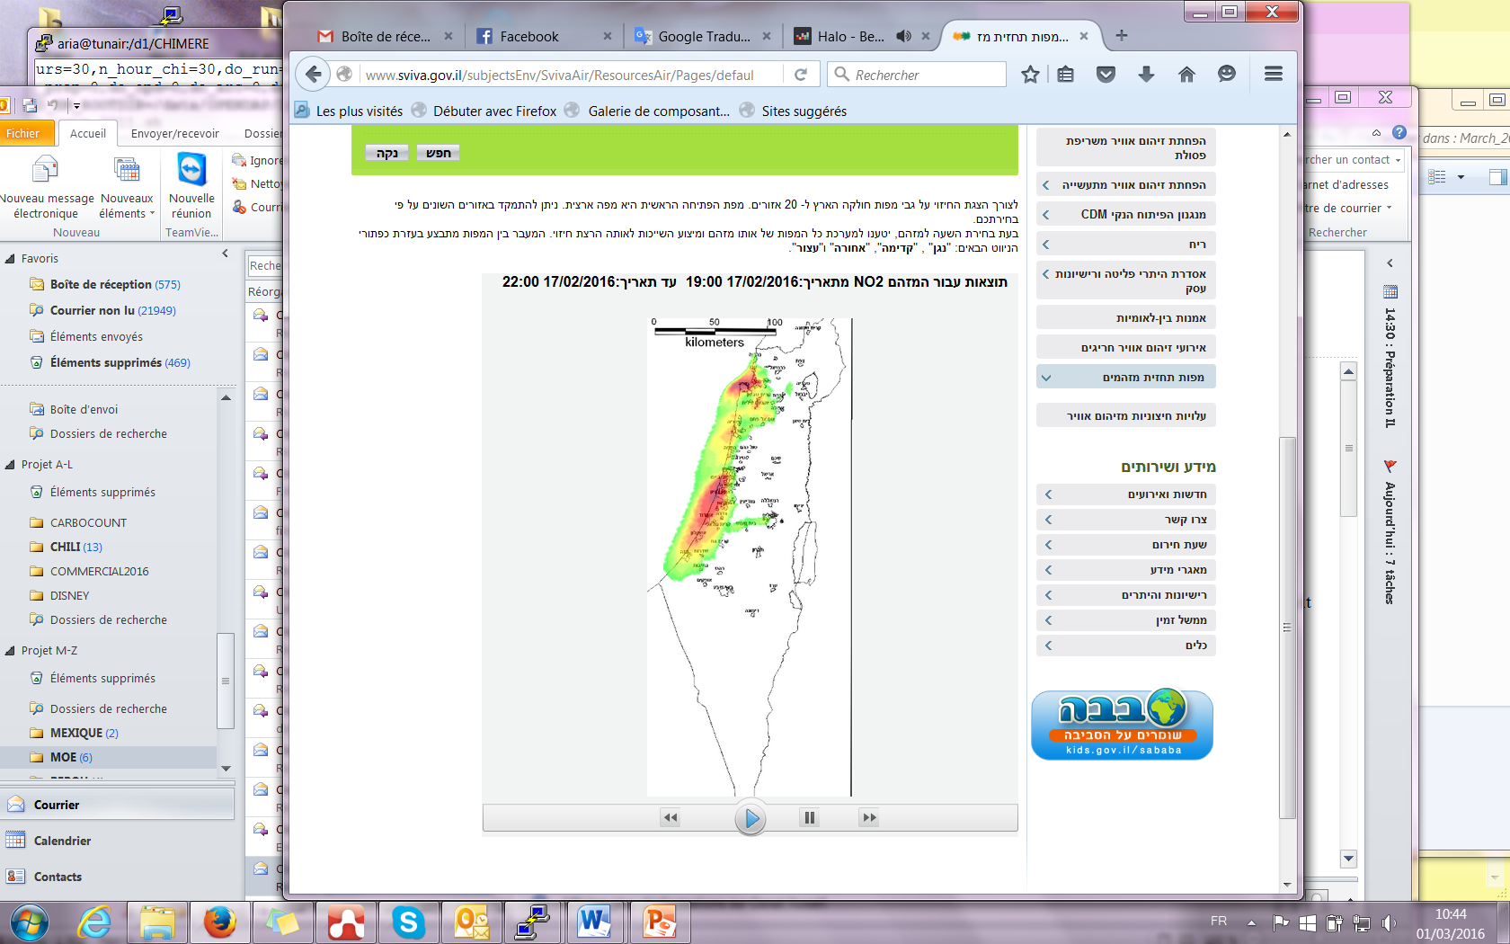
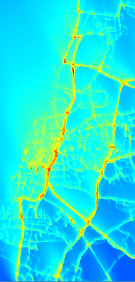
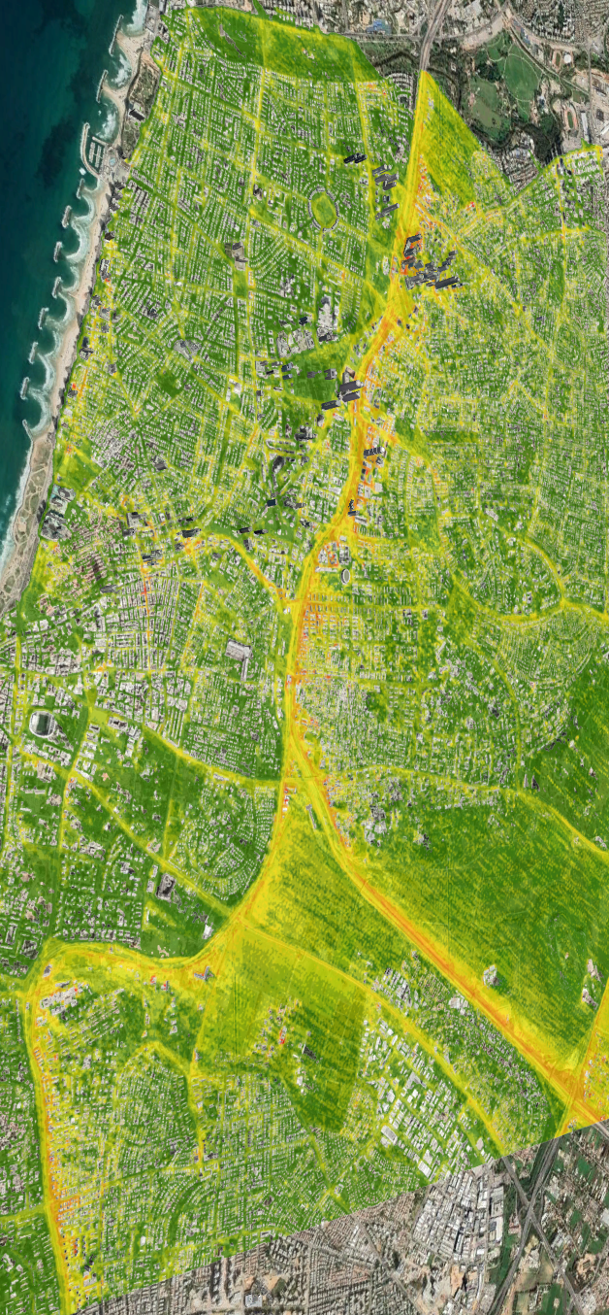
Israel Ministry of the Environment
Operational system for air pollution forecasting in the long term
→ National forecasting system
Client
MoE Israel
Year of the project
2005 - Today
Description of the project
Maintenance, support and continuous upgrades
Operational national scale air quality forecasting chain
High resolution zoom over Tel Aviv for better representation of the population
CHIMERE (3 km)
SIRANE (20 m)
PMSS (3 m)
Progressive improvements as operational needs evolve

Slide 7
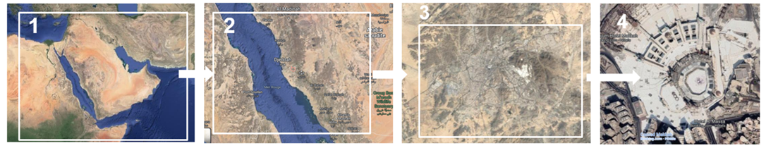
NCEC - Saudi Arabia
Towards a national norm for weather forecasting and air quality
→ National forecasting system
Client
National Center Environmental Compliance
Year of the project
2026 - Today
Description of the project
Support national surveillance, forecasting and decision making
Model outputs transformation into operational services
  Daily forecasts and concentration maps
  Multi-scale visualization through 2D/3D interfaces
  Automated reporting, maintenance, user support and staff training
Provide decision-ready information to environmental authorities

Slide 8

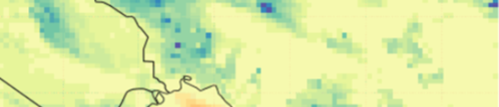






CLEAR-EO
Toward more enhanced forecasts
→ Research-to-operation innovation
Client
Horizon Europe Project
Year of the project
2025 - 2028
SISTEMA
Suez Aria
Satellite data products
Air quality modeling
UPEC/LISA
Description of the project
Focus on Earth Observation-based environmental services
Improve air quality forecasting by combining satellite observations, CHIMERE simulations and ML correction methods.
Transition from research to operation.
EO products and ML are elements of the operational forecasting chain.
Machine learning model
Suez Aria
Improved forecast system

Slide 9
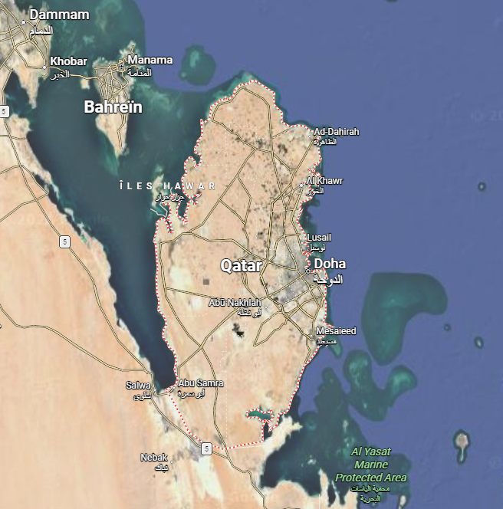
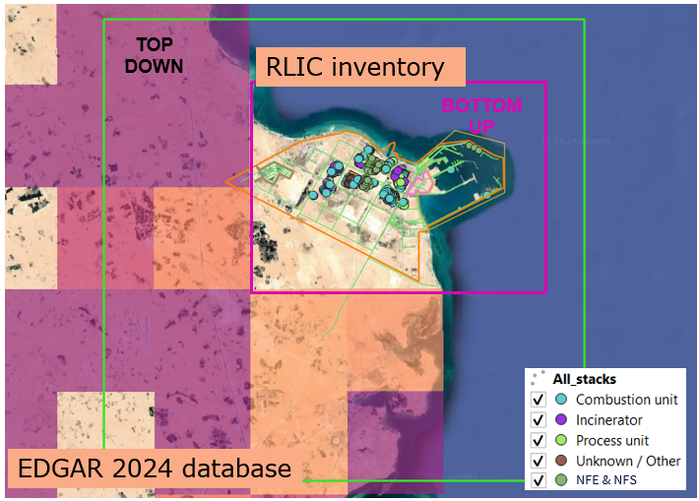
Qatar Ozone Project
Service to the industrial world
→ Industrial scenario assessment
Ras Laffan Industrial City
Client
Qatar Energy / PES
Year of the project
2023 - 2026
Description of the project
Assess the impact of industrial emissions and to compare different emission reduction scenarios
Test of prospective scenarios
Support Qatar Energy in establishing air quality amanagement plan with a particular interest in O₃
Regional air quality context provided by CHIMERE
Higher resolution modelling over Qatar and RLIC made with FARM

Slide 10
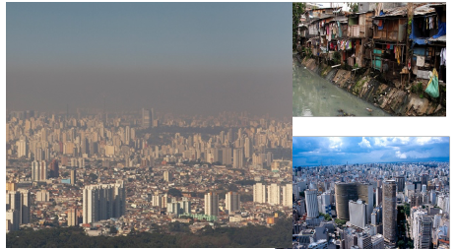
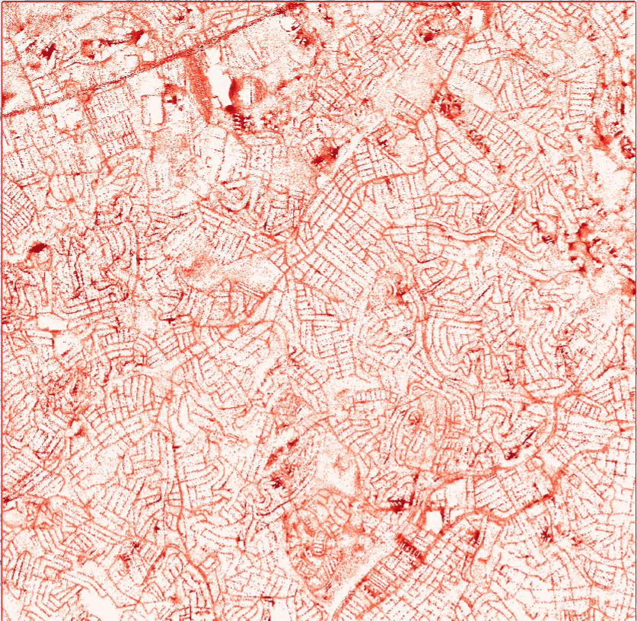
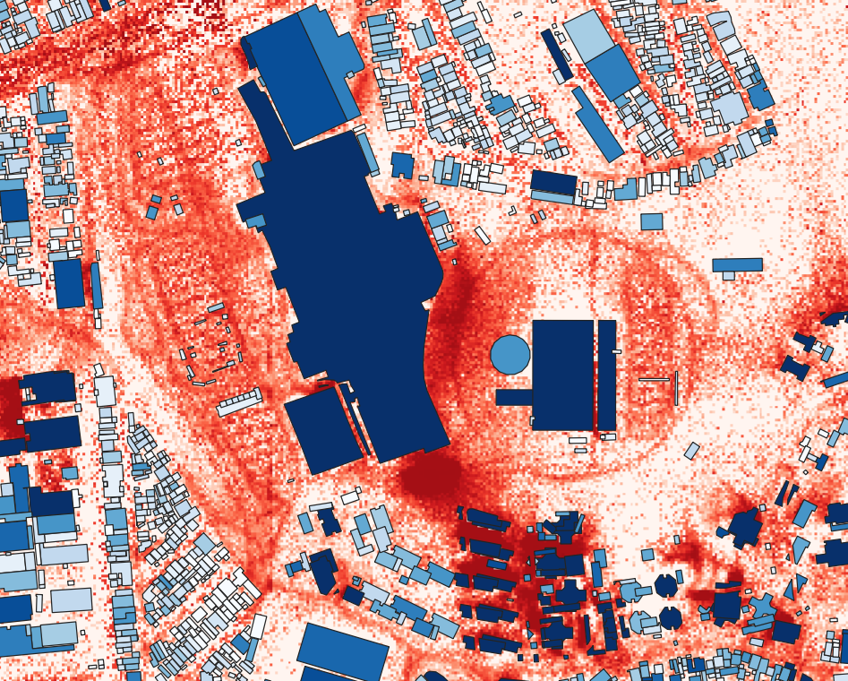
Brazil VERACIS project
Air pollution and health impacts
→ Health-oriented modelling
Client
Einstein Hospital
Year of the project
2025 - 2026
Description of the project
Connection of environmental data and human health protection
Better understand air pollution in Brazilian cities and support health-oriented air quality decision-making
Impact of air pollution on disadvantaged population’s health
Air quality modelling can support public health, urban planning and environmental policy

Slide 11
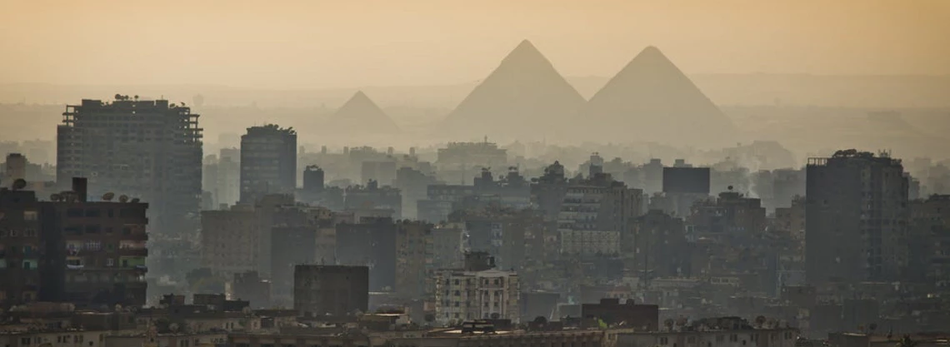



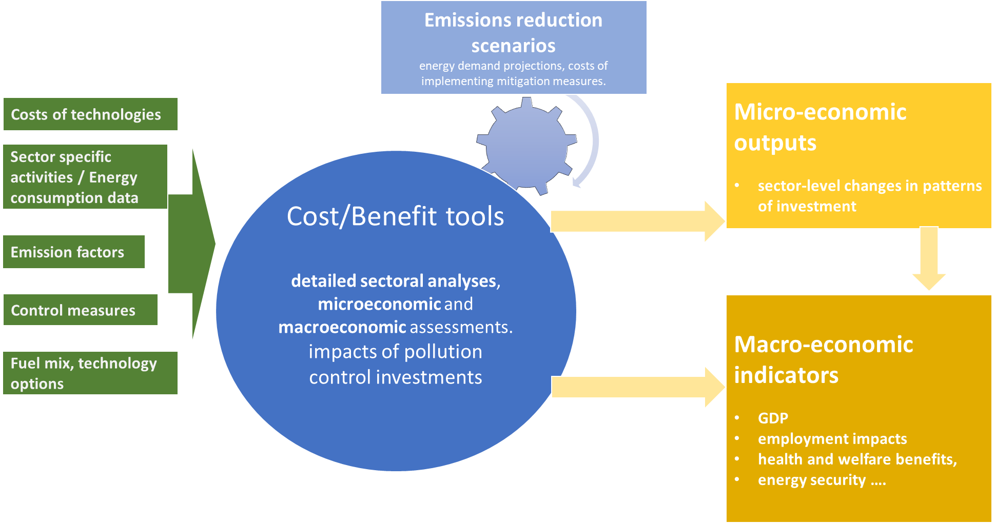


Greater Cairo
Management plan for air quality and climate
→ Policy and investment decision support
Client
EEAA Egypt + World bank
Year of the project
2024 - Today
Partners
Arianet, CHEMONICS (Egypt)
Description of the project
How air quality and climate information can be translated into an integrated management plan
Reduction of atmospheric emissions from critical sectors and to improve resilience to both air pollution and climate change
Policy reviews
Cost benefice assessment
Public awareness and behavior change
Emission inventory analysis
Baseline and future scenarios

Slide 12
Thank you
Any questions?

