Slide 1
Impact of high-resolution emission and meteorological inputs on CHIMERE over Belgium (2022)
Tristan Carion
23 June 2026
tristan.carion@meteo.be
CHIMERE Workshop 2026

Slide 2
Context
TEMPUR project: impact of future climate projections on air quality at high-resolution over Belgium → running historical CHIMERE simulation with high-resolution ALARO-SURFEX data
DEODE project: running CHIMERE with high-resolution emission from uEMEP
↓
Let’s assess the impact of these configurations on the model skills

Slide 3



Simulation configurations
ECMWF OPER - LR (0.1°×0.1°)
ALARO-SURFEX - HR (1.3km×1.3km)
1
Baseline
2
Run 2
Emissions: CAMS-REG
Meteorology: ECMWF OPER 0.1°
Emissions: CAMS-REG
Meteorology: ALARO-SURFEX 1.3km
CAMS-REG - LR (~0.05°×0.1°)
Standard operational setup
Isolates the meteorology effect
3
Run 3
4
Combined HR
Emissions: uEMEP_v6 250m
Meteorology: ECMWF OPER 0.1°
Emissions: uEMEP_v6 250m
Meteorology: ALARO-SURFEX 1.3km
uEMEP_v6 - HR (250m×250m)
Isolates the emission effect
Combined high-resolution setup
Evaluated against NO₂, O₃, PM₁₀, PM₂₅ observations at 4 Belgian monitoring stations

Slide 4
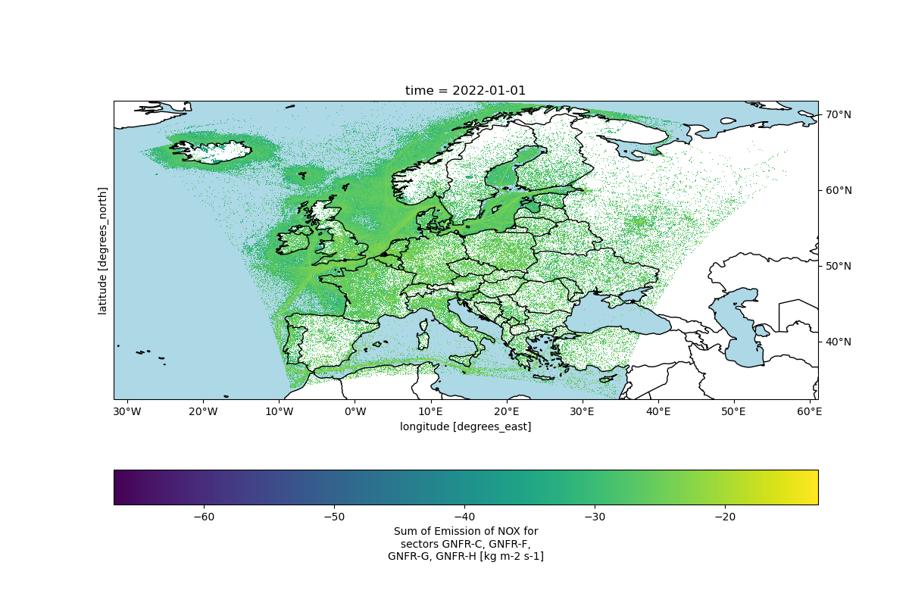
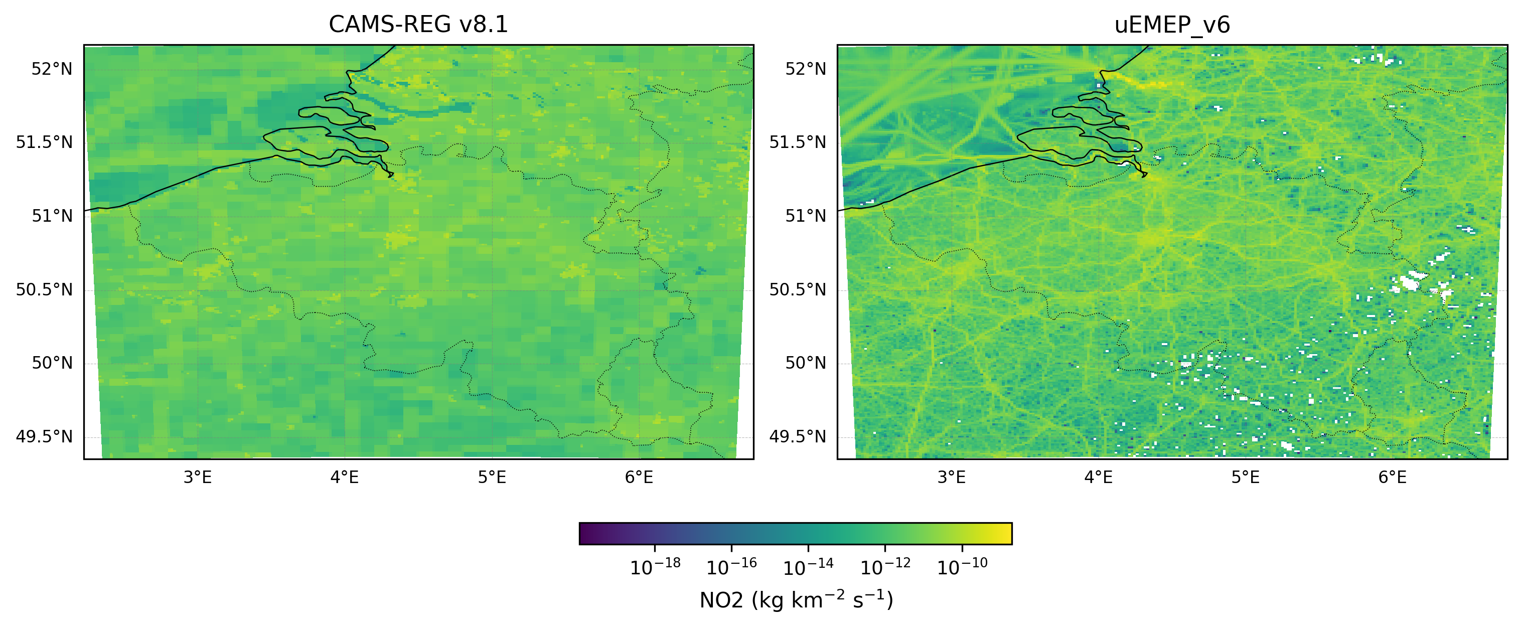
HR emissions
Downscaled emissions in the context of uEMEP_v6 (Mu et al., 2022)
NO₂, PM_{2.5}, and PM₁₀ emission fluxes at 250m ⨯ 250m resolution over Europe
NO₂, PM_{2.5}, and PM₁₀ were reprojected and restructured
to look like CAMS-REG data, making it digestible by emiSURF
Other pollutants are regridded CAMS-REG data
Mu, Q., Denby, B. R., Wærsted, E. G., and Fagerli, H.: Downscaling of air pollutants in Europe using uEMEP_v6, Geosci. Model Dev., 15, 449–465, https://doi.org/10.5194/gmd-15-449-2022, 2022.

Slide 5
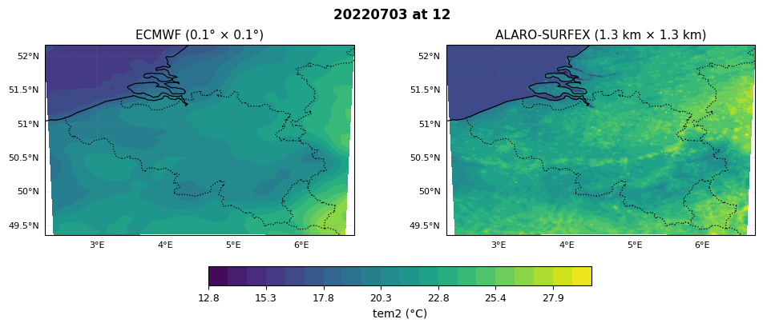
HR meteo
ALARO coupled to the land-surface model SURFEX on a 1.3km × 1.3km grid over Belgium

Slide 6
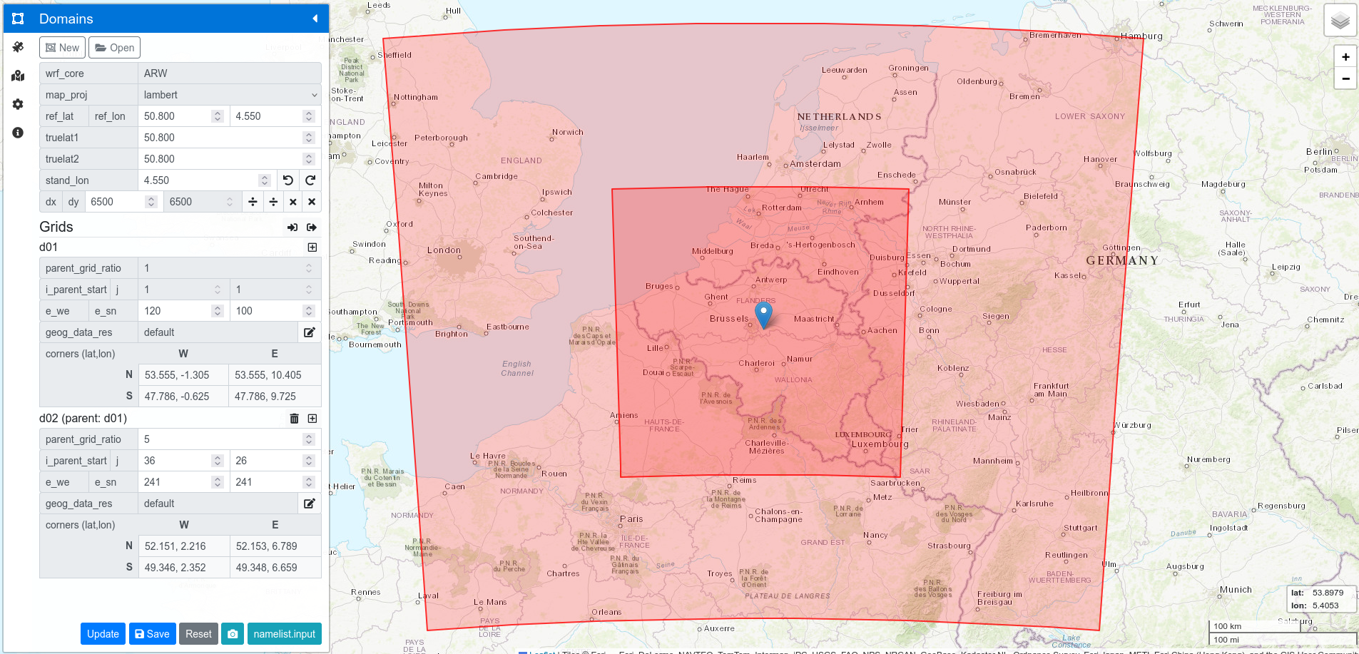
Chimere domain
Coarse domain: 6.5km × 6.5km with ERA5 reanalysis at 0.5° × 0.5°
Nested domain: 1.3km × 1.3km, corresponding to the ALARO-SURFEX grid to avoid interpolation

Slide 7

Results - Animation
https://youtu.be/aOU8ymrcqdc

Slide 8
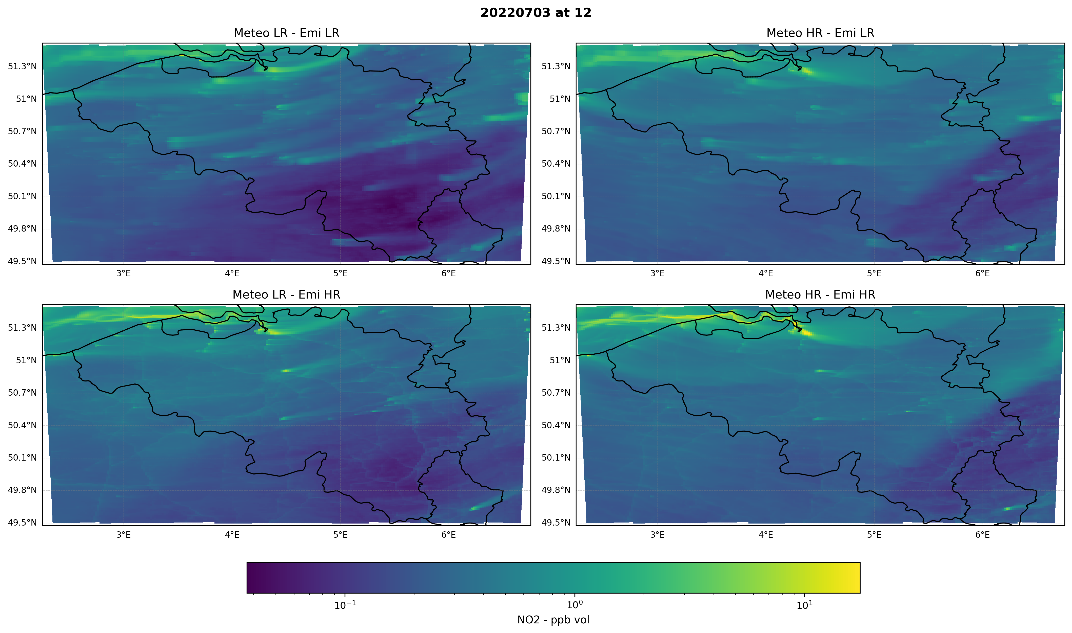
Results - Concentration map

Slide 9
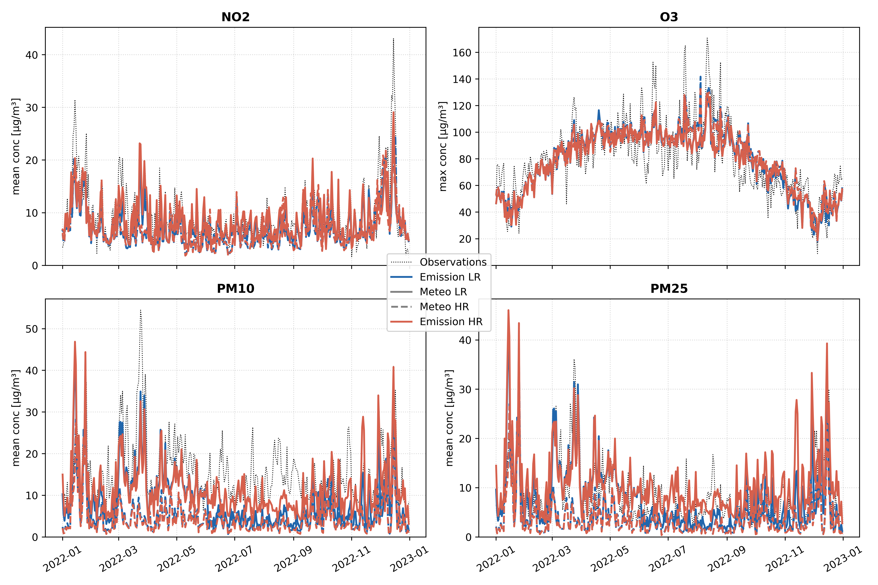
Results - Daily average timeseries
No clear difference for NO₂ and O₃
Concentrations too low for HR meteo for PM₁₀ and PM_{2.5}
Struggle to capture peak concentration events

Slide 10
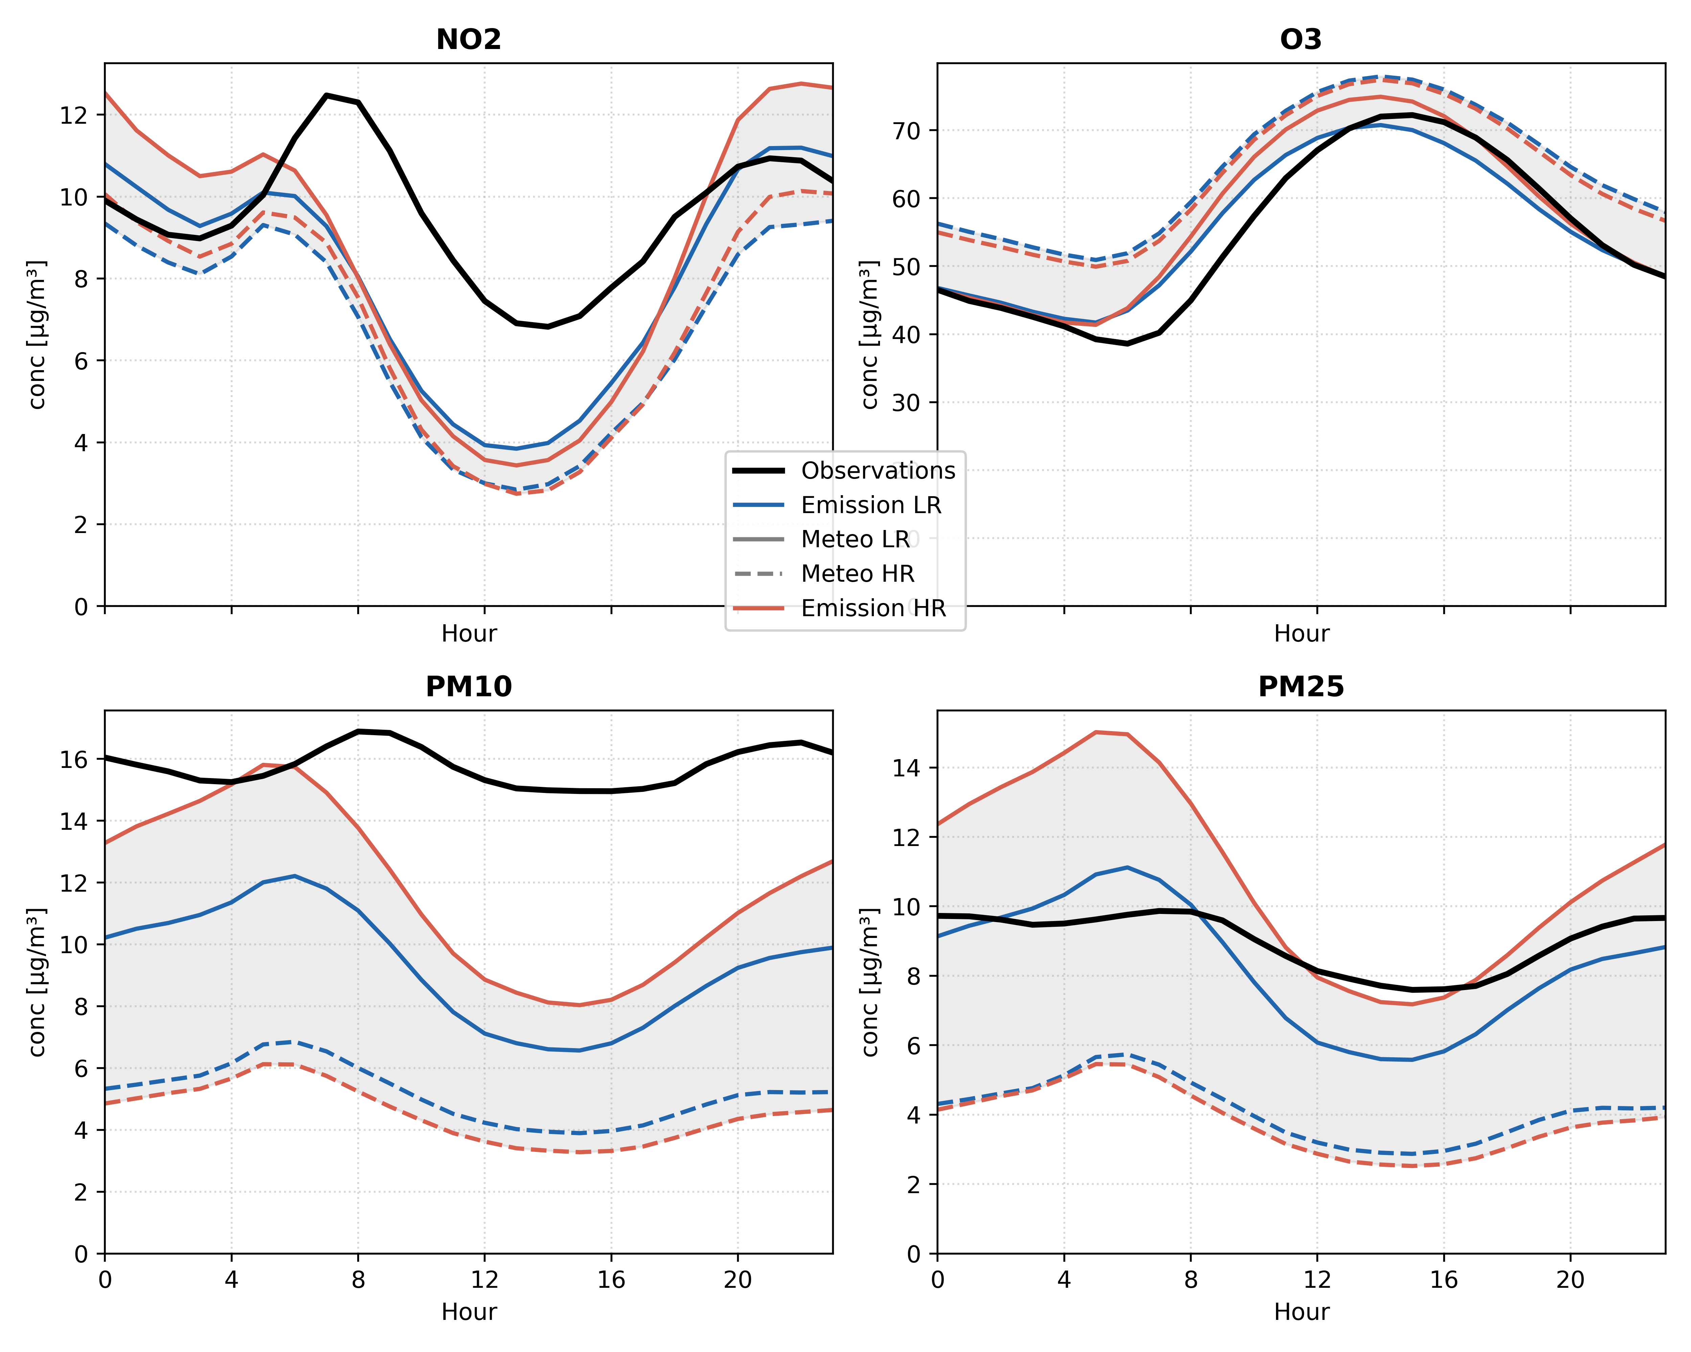
Results - Diurnal cycles
It confirms what the timeseries showed:
  For NO₂ and O₃: no clear difference
  For PM₁₀ and PM_{2.5}: underestimated concentrations for higher resolution meteo
We observe significant biases for NO₂ and PM₁₀

Slide 11
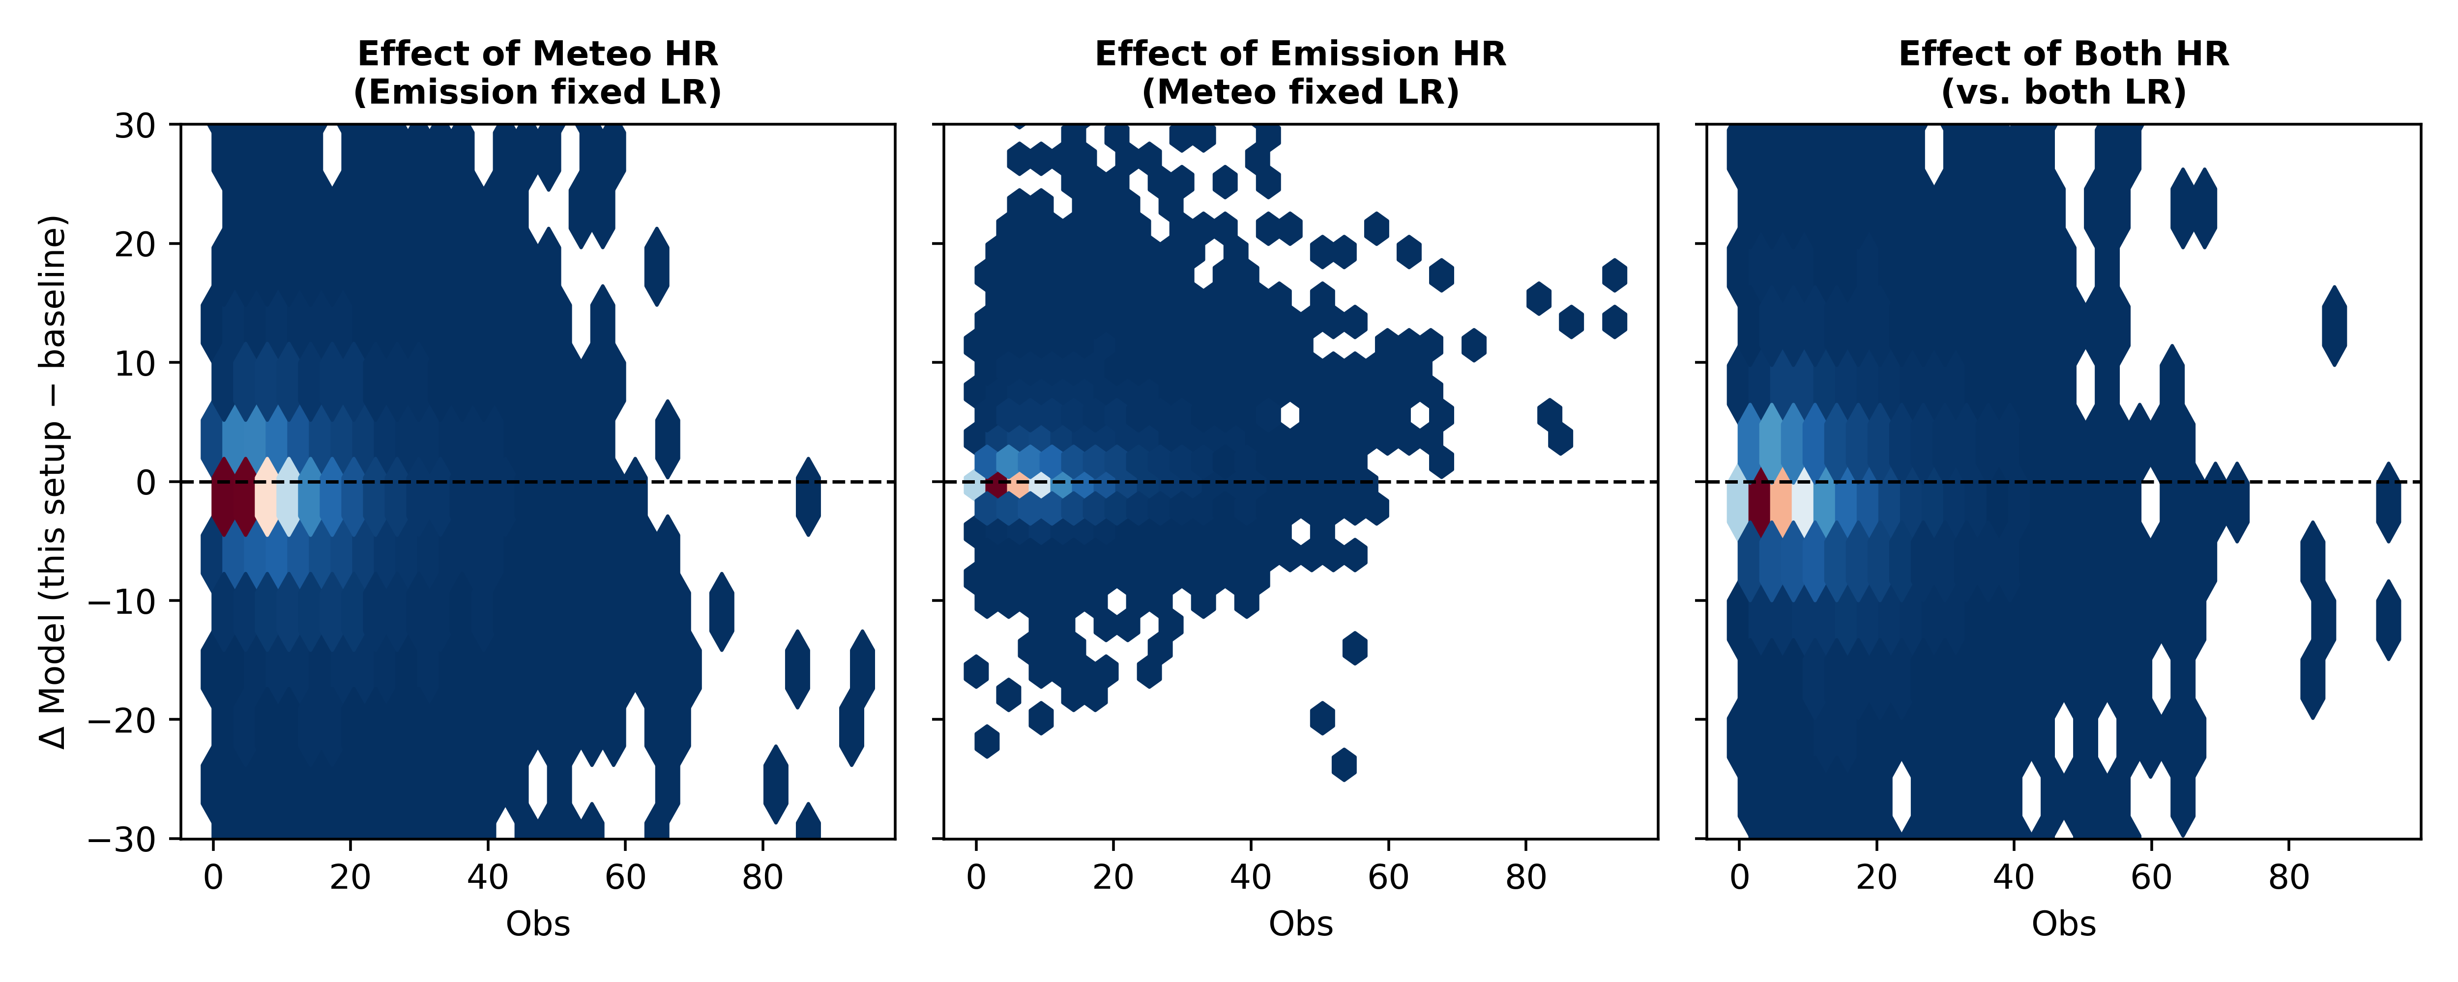
Results - Sensitivity to resolution
Difference in modelled concentrations between the 3 HR configurations and the baseline
Increasing the meteo resolution has significant impact on the variability in modelled concentrations
Conversely, the higher emission resolution has little impact

Slide 12
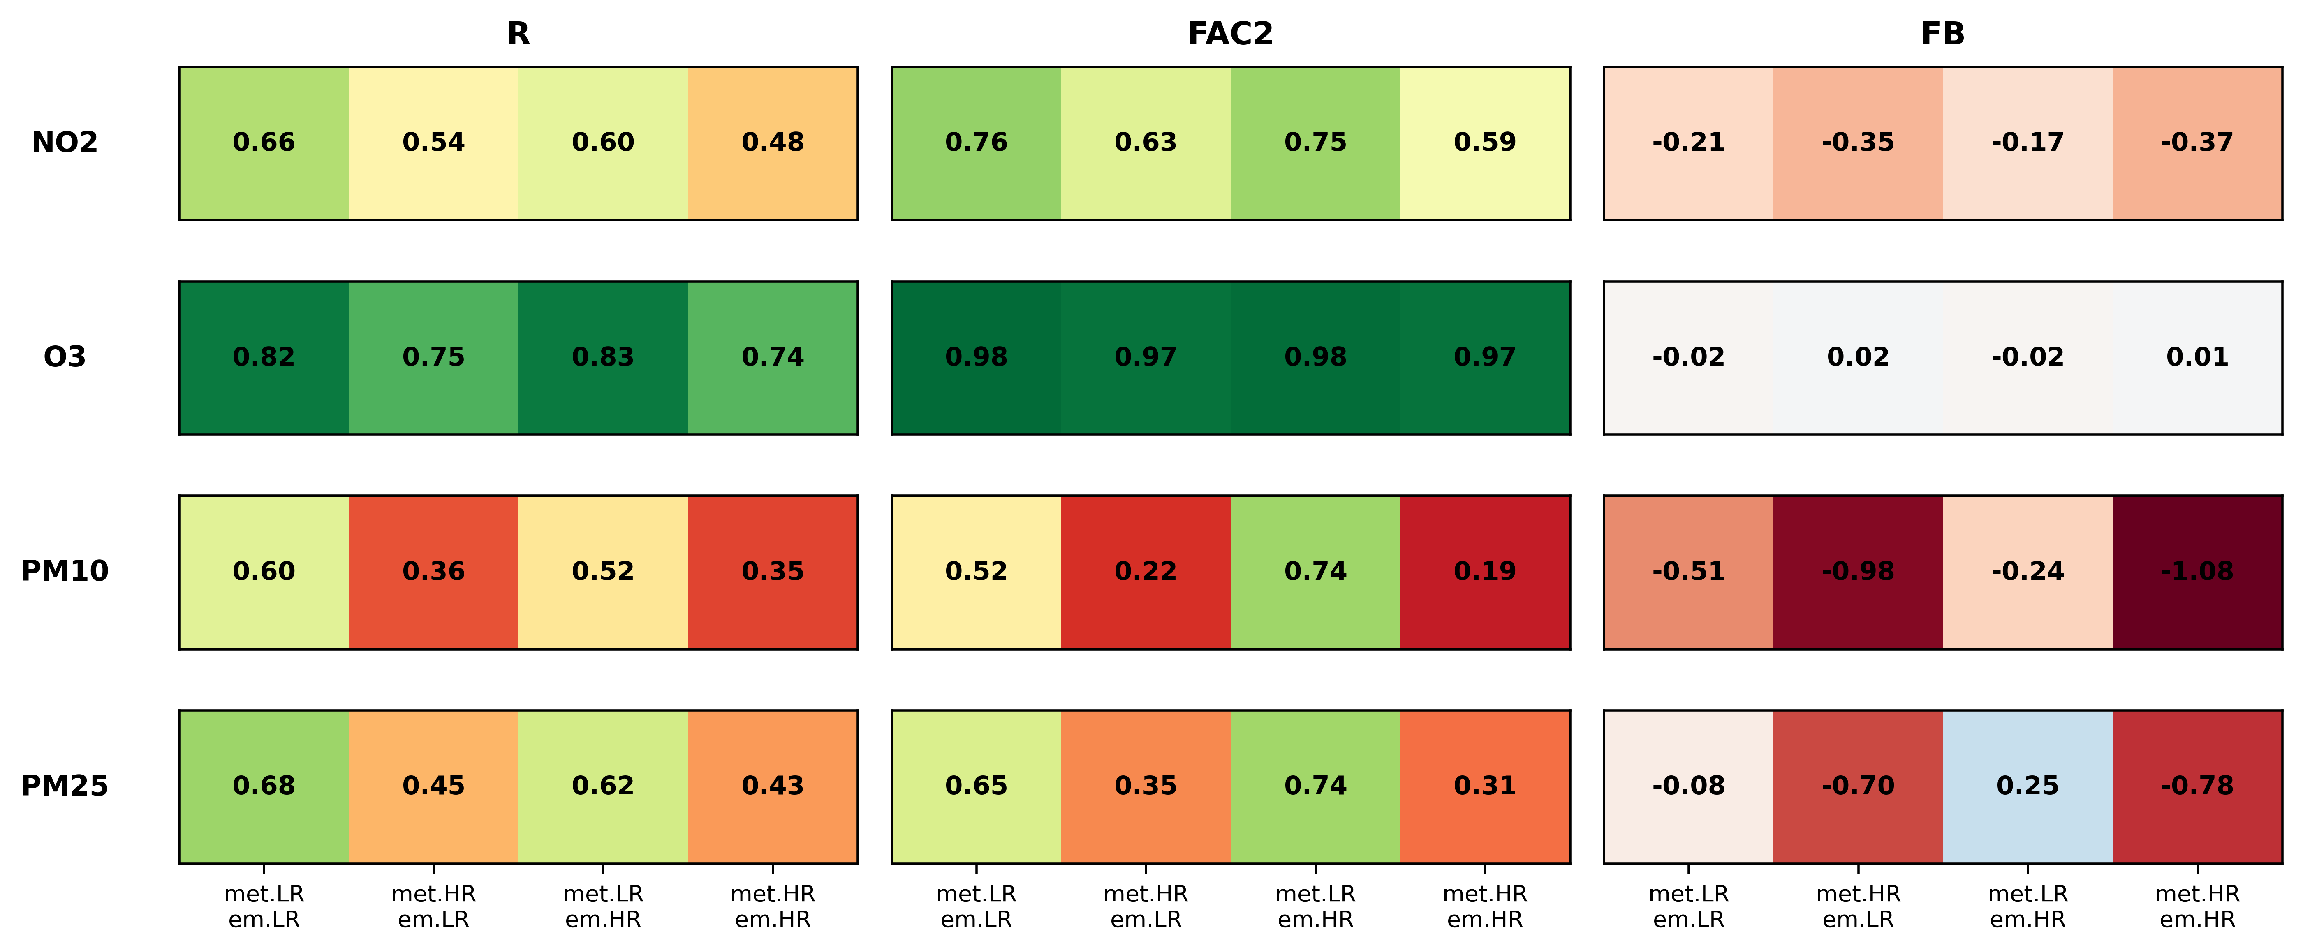
Results - Scores
Correlation coefficient, factor of 2 and fractional bias
As expected from the sensitivity study, the HR emission configuration gives similar scores as the baseline
For the higher resolution meteo configurations, the scores are usually worse!

Slide 13
Results - Discussion (1)
Why increasing resolution does not improve the model performance? Several hypothesis:
The HR emission better resolves the road emissions, but no stations are located close to roads
Like in numerical weather prediction, increasing resolution does not always translate to model performance improvement, because of representativeness errors in point-to-grid comparisons

Slide 14
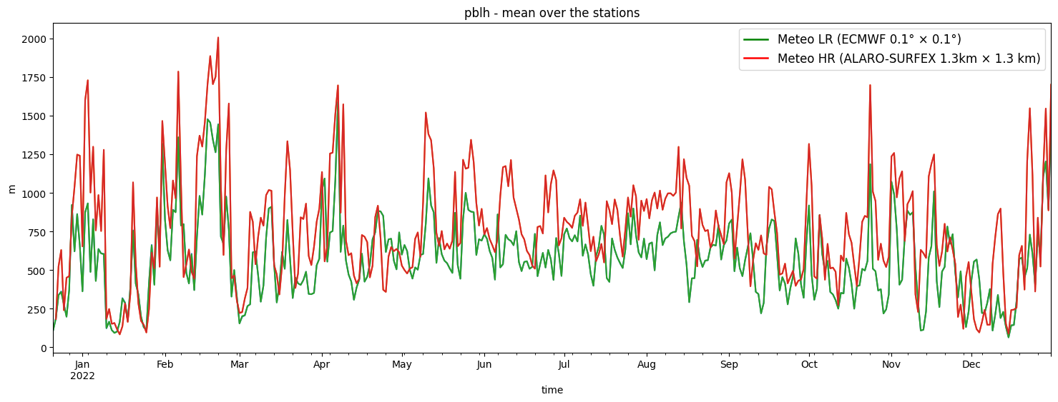
Results - Discussion (2)
Why increasing resolution does not improve the model performance? Several hypothesis:
The ALARO-SURFEX meteo data are experimental, and have not been fully validated yet
For ECMWF 0.1° × 0.1°, the planetary boundary layer height is available, while it is computed by CHIMERE with ALARO-SURFEX data:

Slide 15
tristan.carion@meteo.be

